Slide 1


Taking Lightweight Hand Percussion to the Next Level

Slide 2
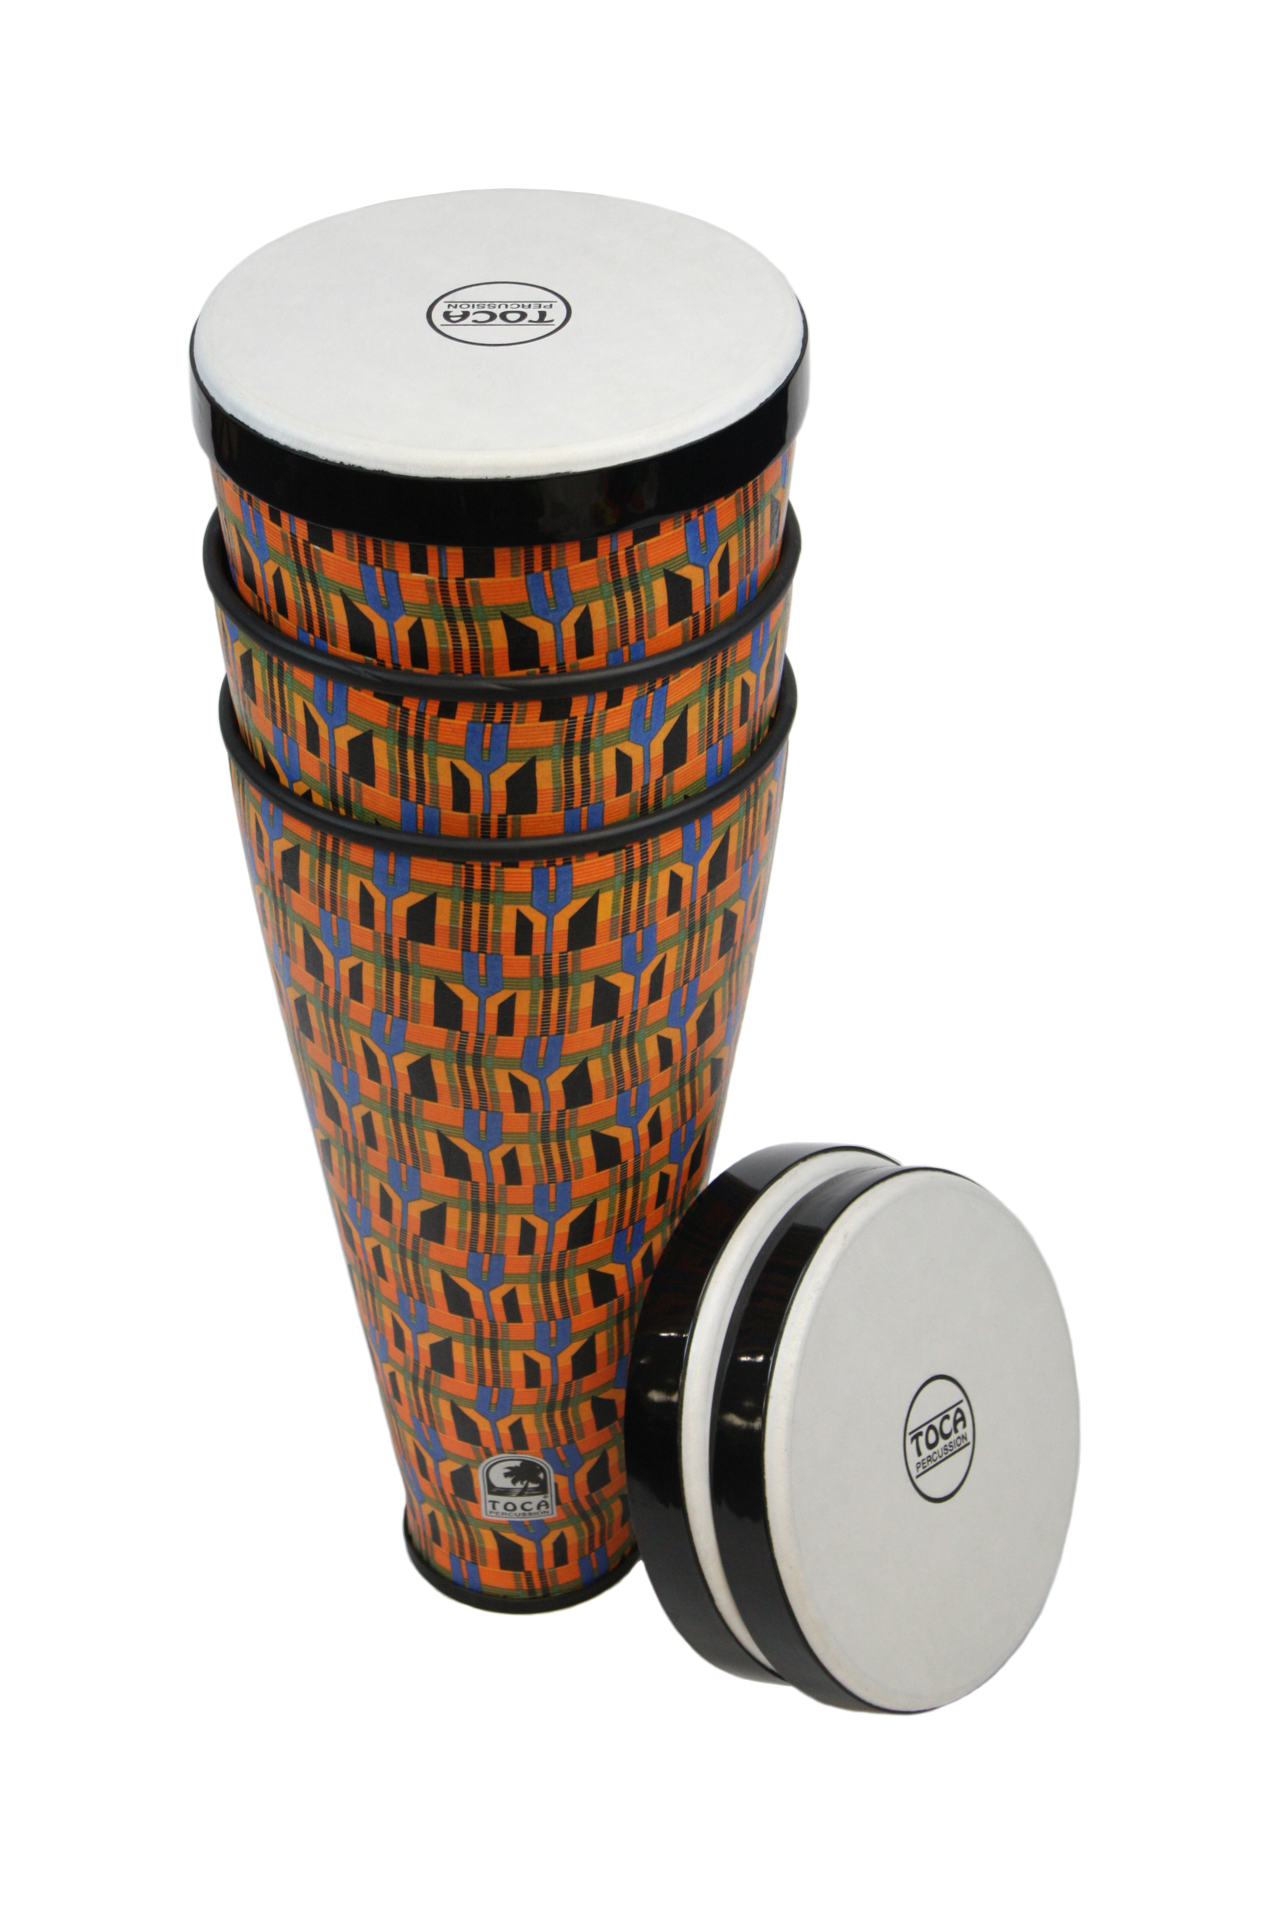
It all started years ago with the Flex Drum

Slide 3
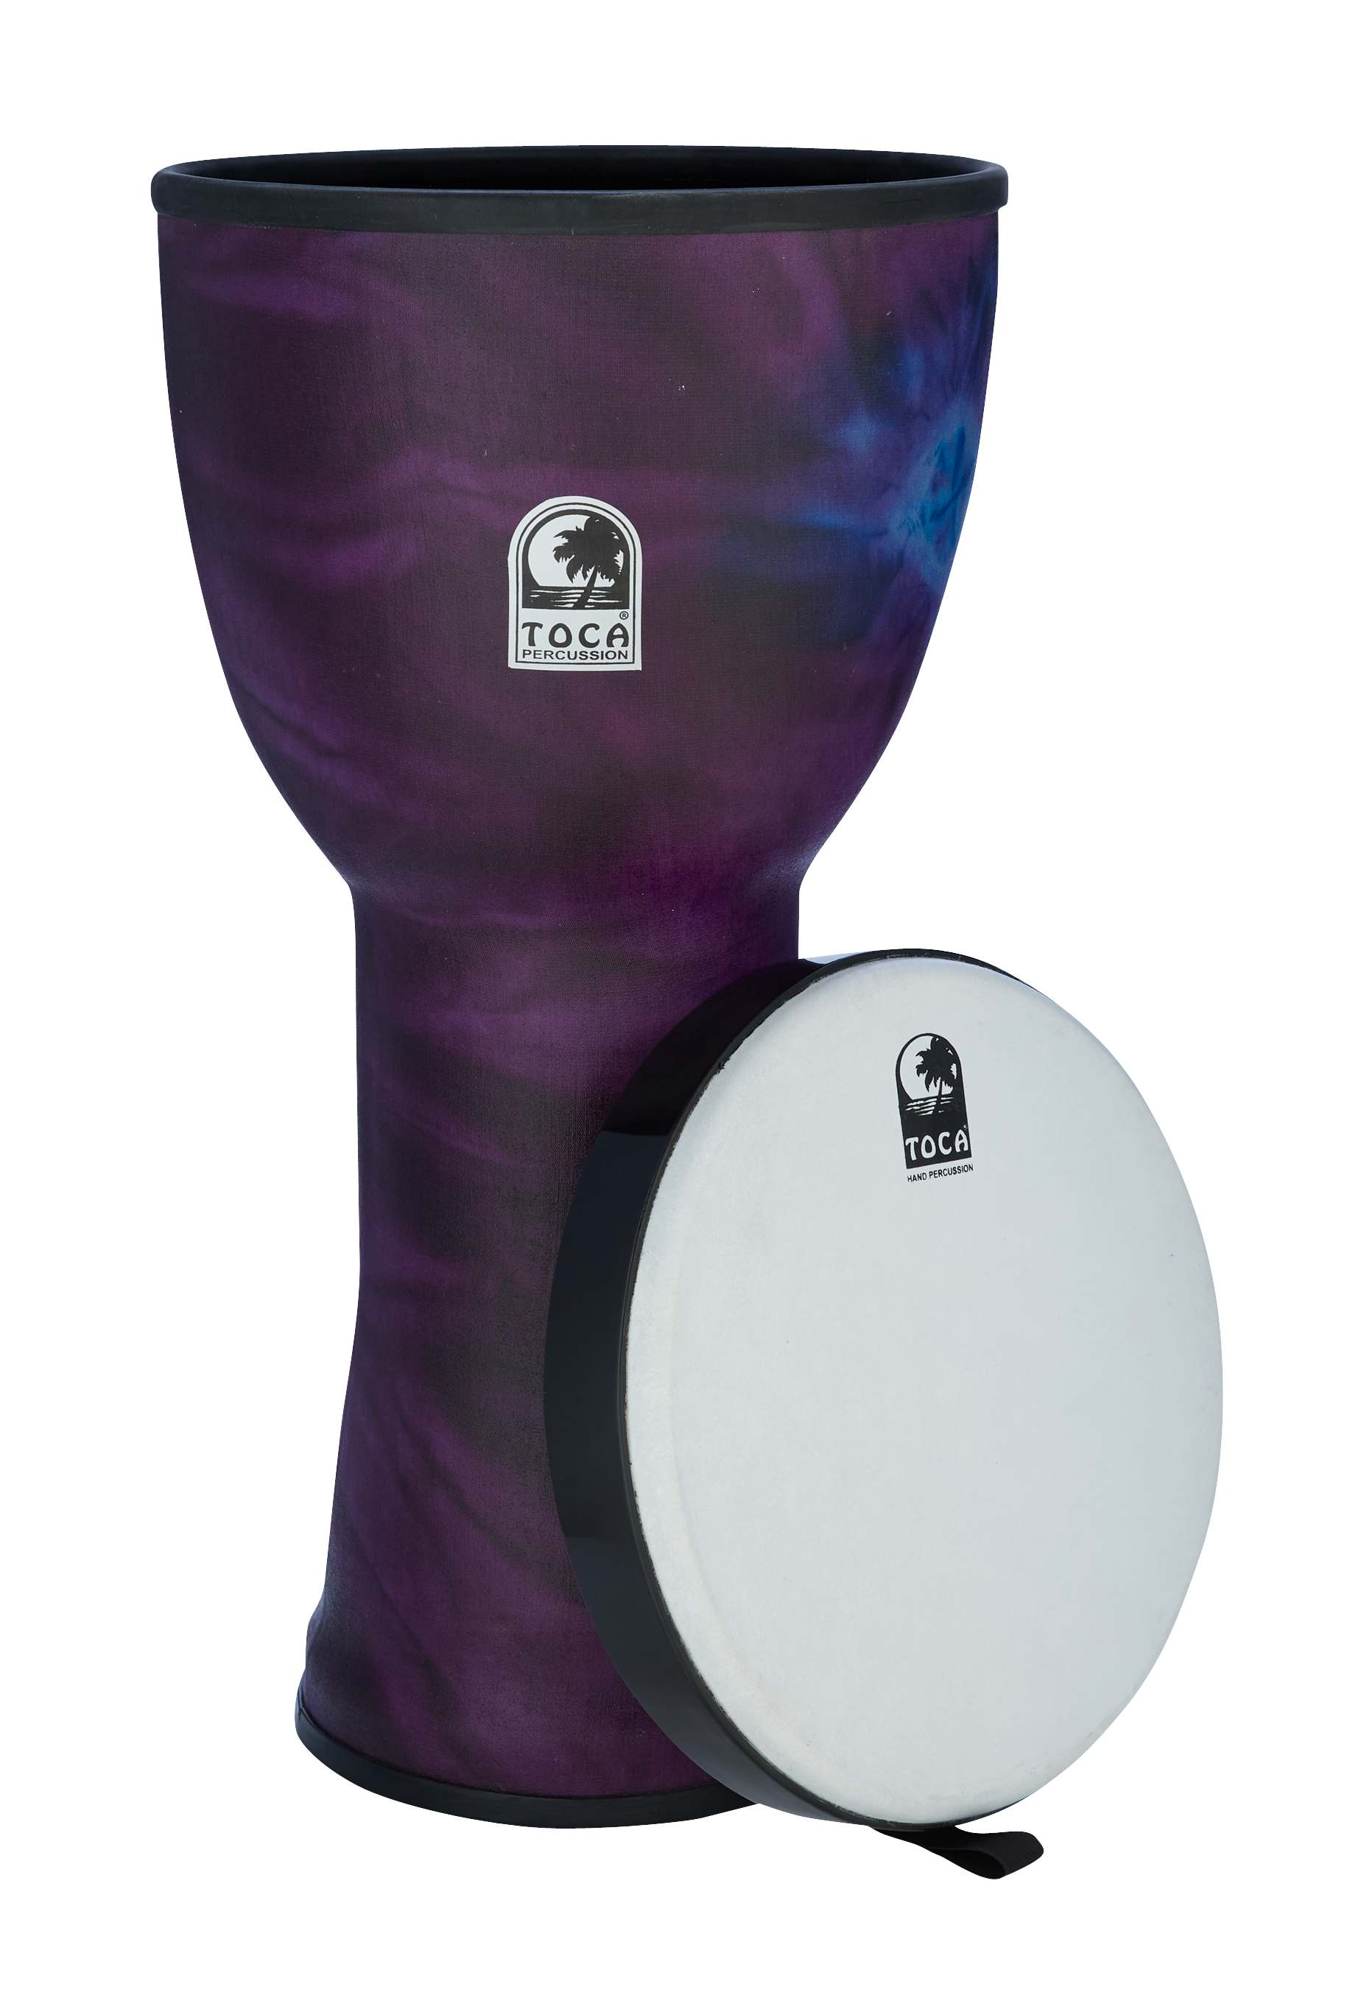
Next Up Was the Line of Nesting Drums

Slide 4
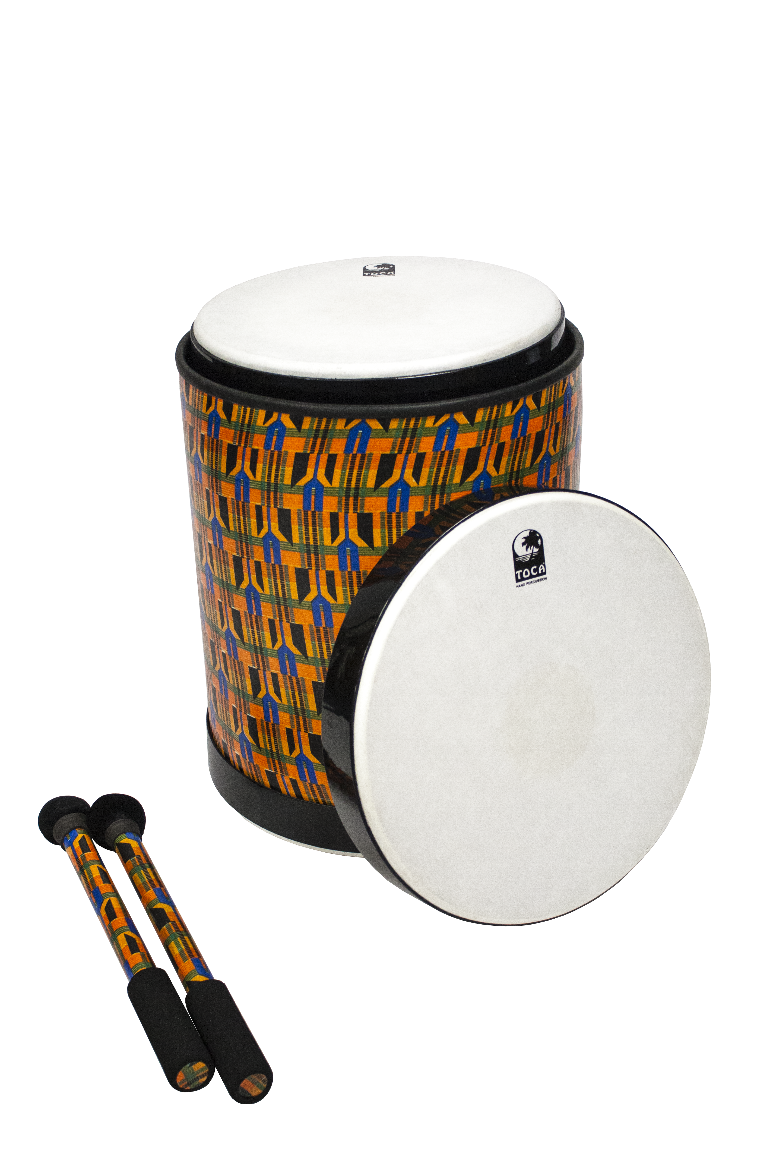
Lightweight
Pretuned
Easily Cleaned
Space Saving
Weather Resistant
Removable Heads
Maintenance Free

Slide 5
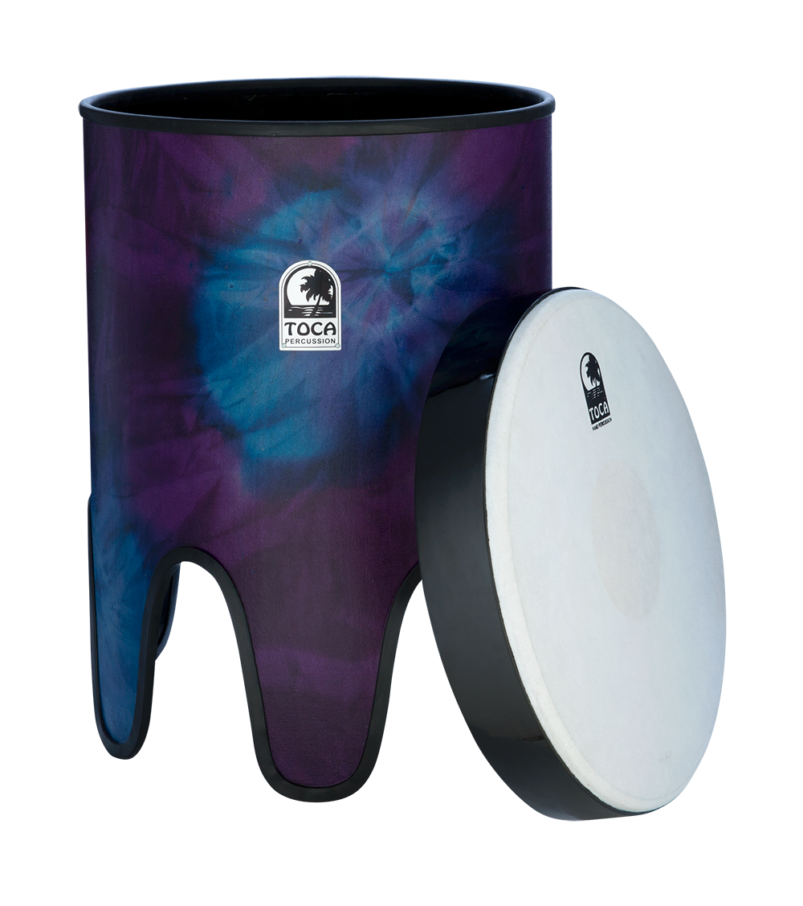
You Can’t Tune Them
Bulky, Heavy Hardware

Slide 6
Lightweight
Pretuned
Easily Cleaned
Space Saving
Weather Resistant
Removable Heads
Maintenance Free

Slide 7
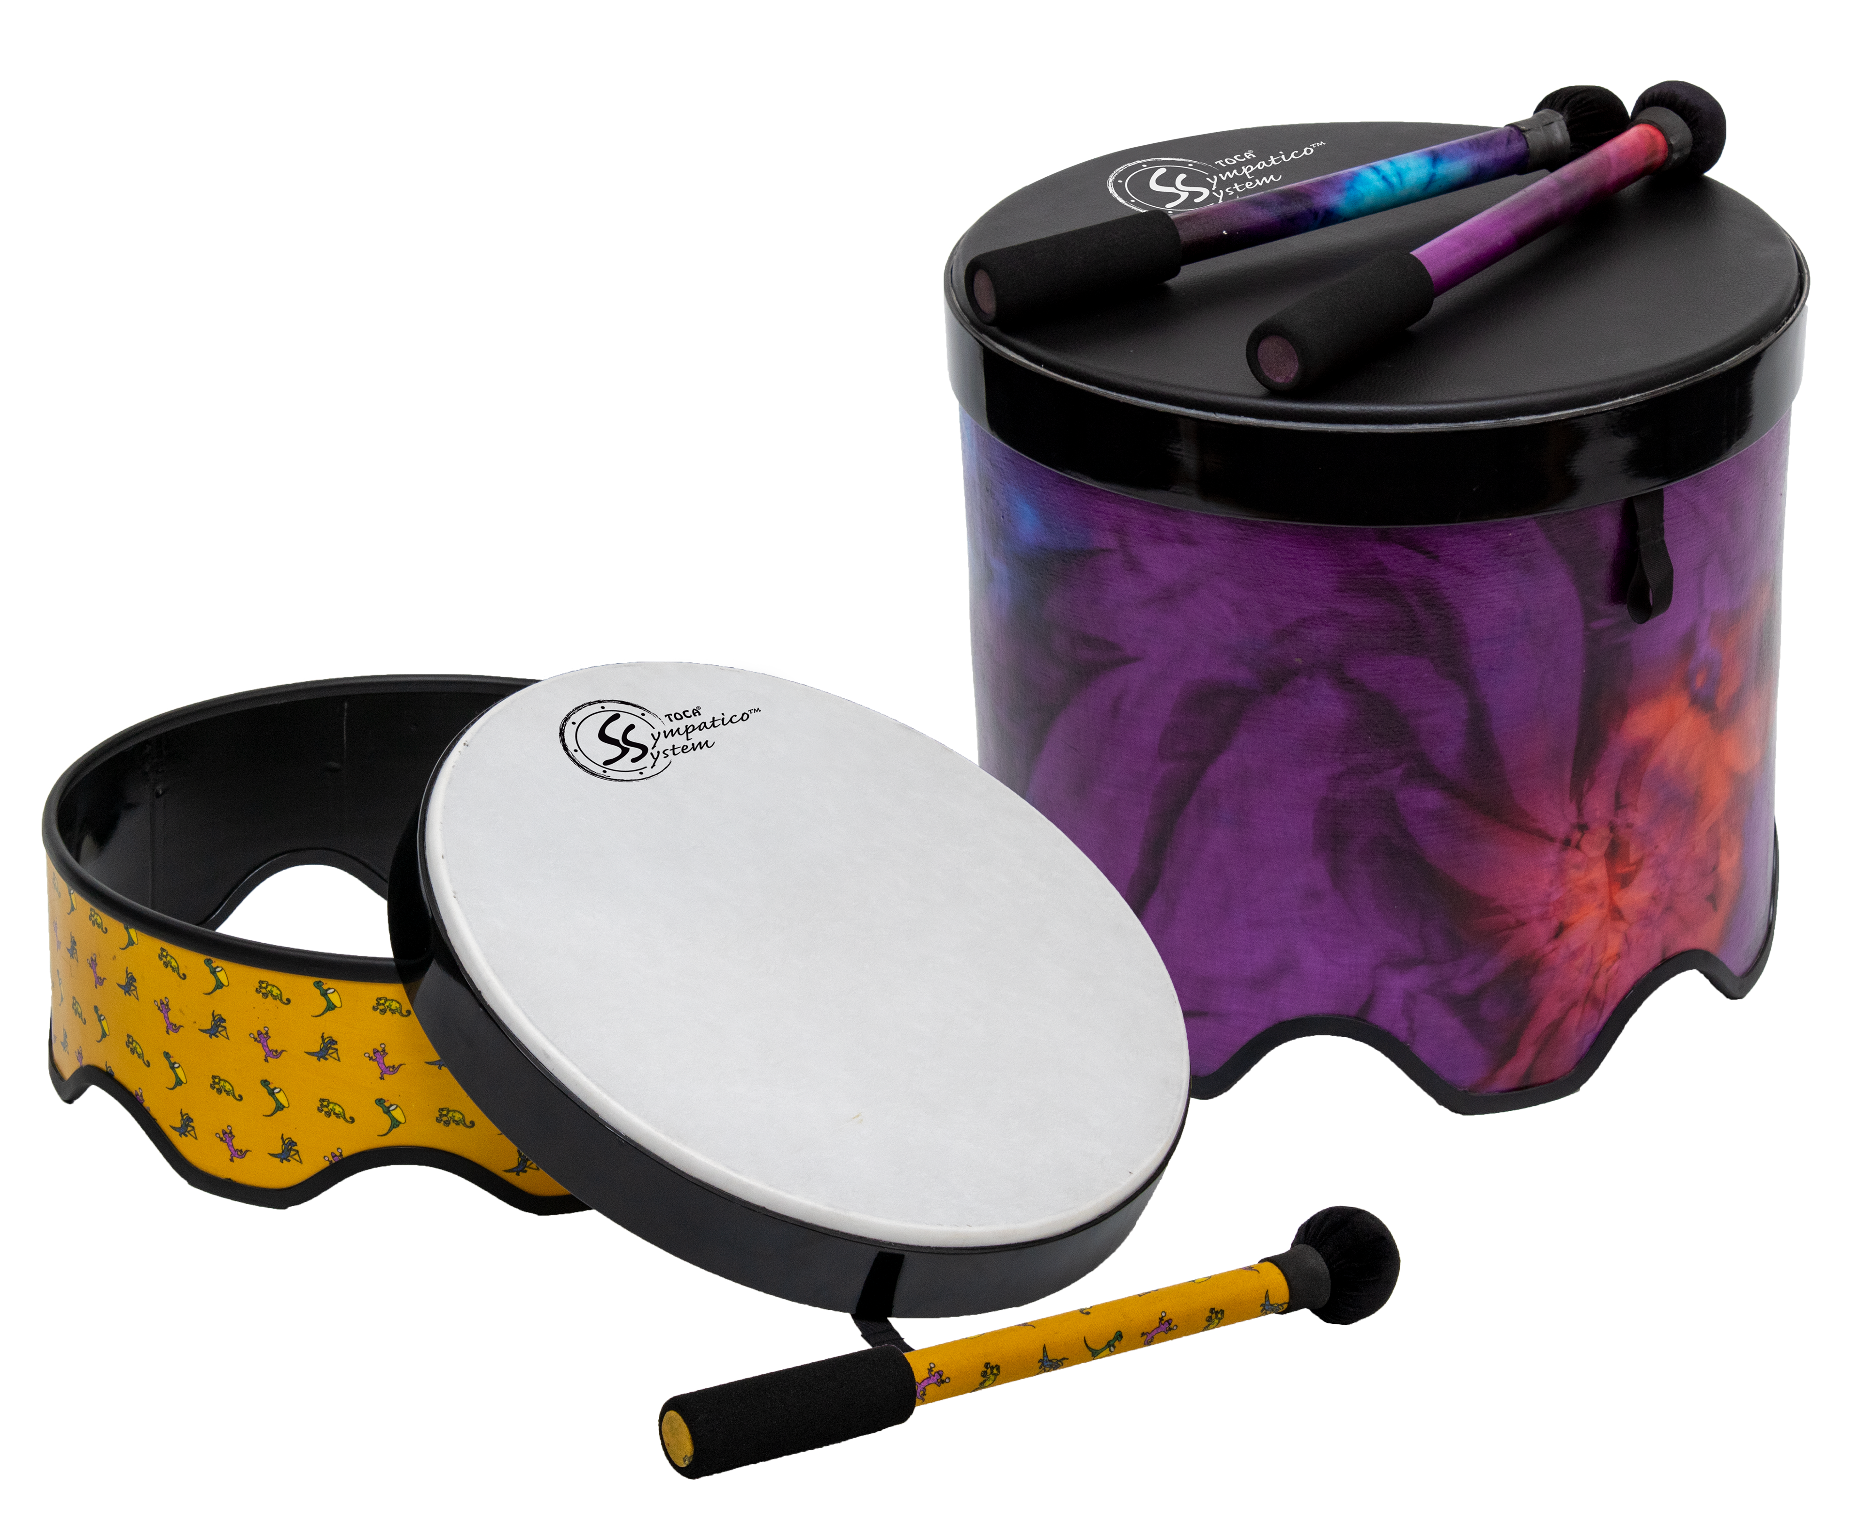
But We Have a Solution!
The Sympatico™
System

Slide 8
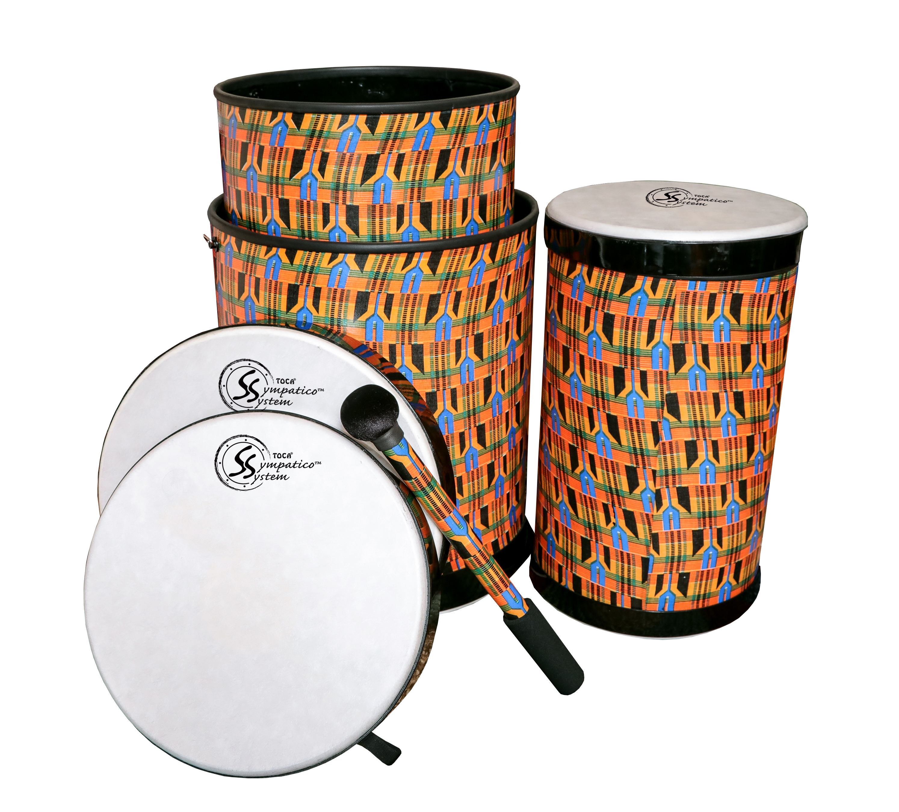
A System of Tuned & Tunable Heads and Drums

Slide 9
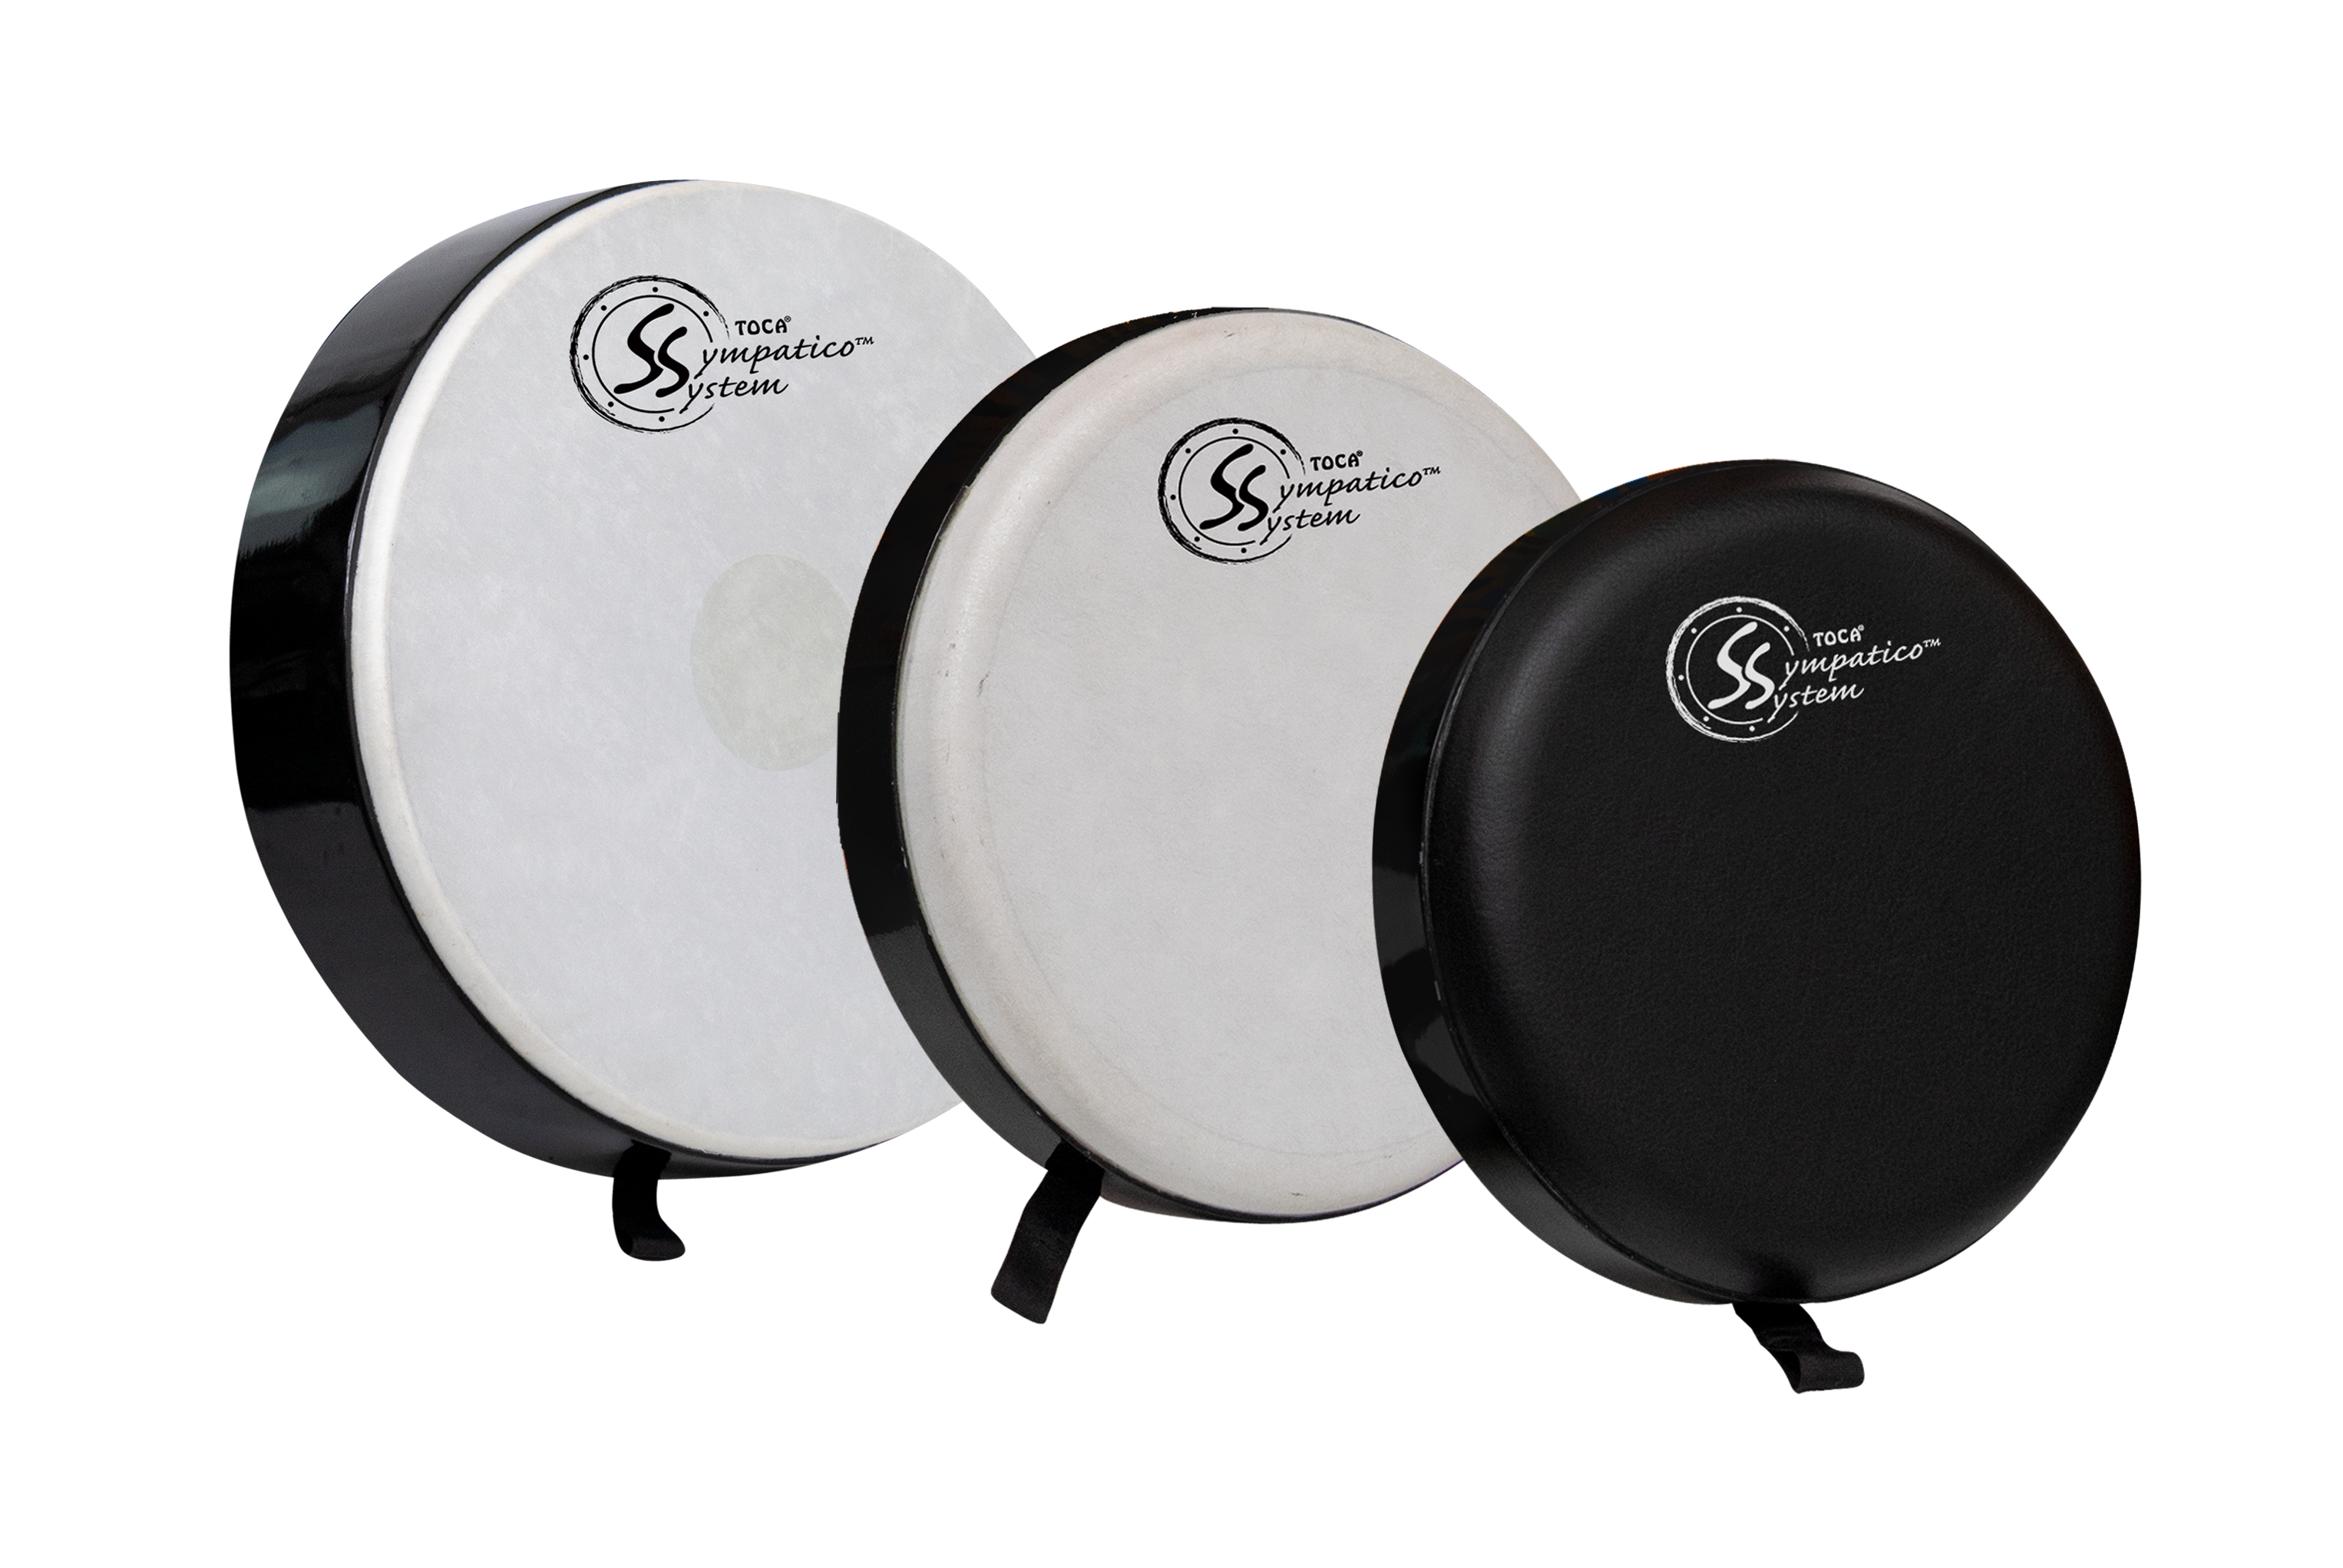
3 Types of Heads

Slide 10
Fiber
Fiber w/Dot
Synthetic Leather

Slide 11
Bright/High
Mellow/Mild
Bass/Low

Slide 12
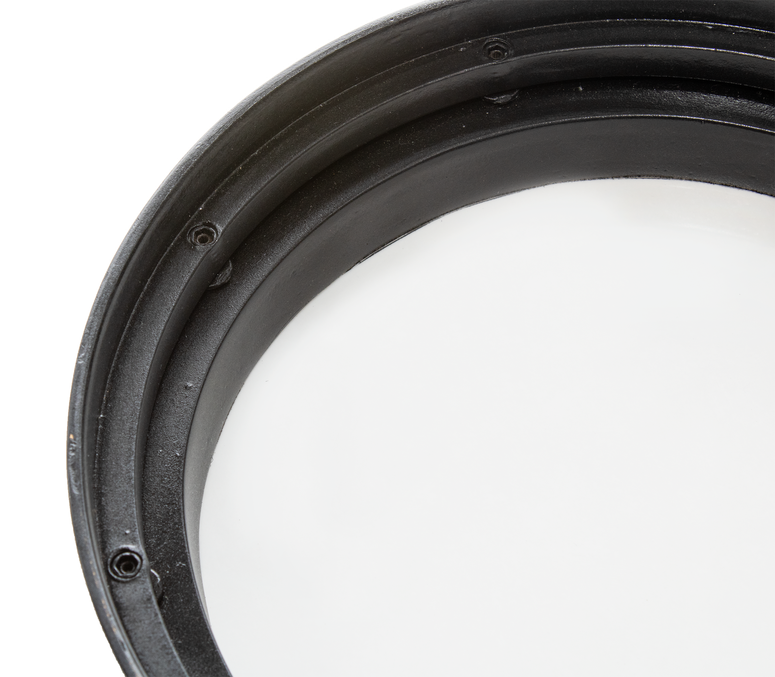
Innovative
Proprietary
Internal
Light
Easy to Tune

Slide 13
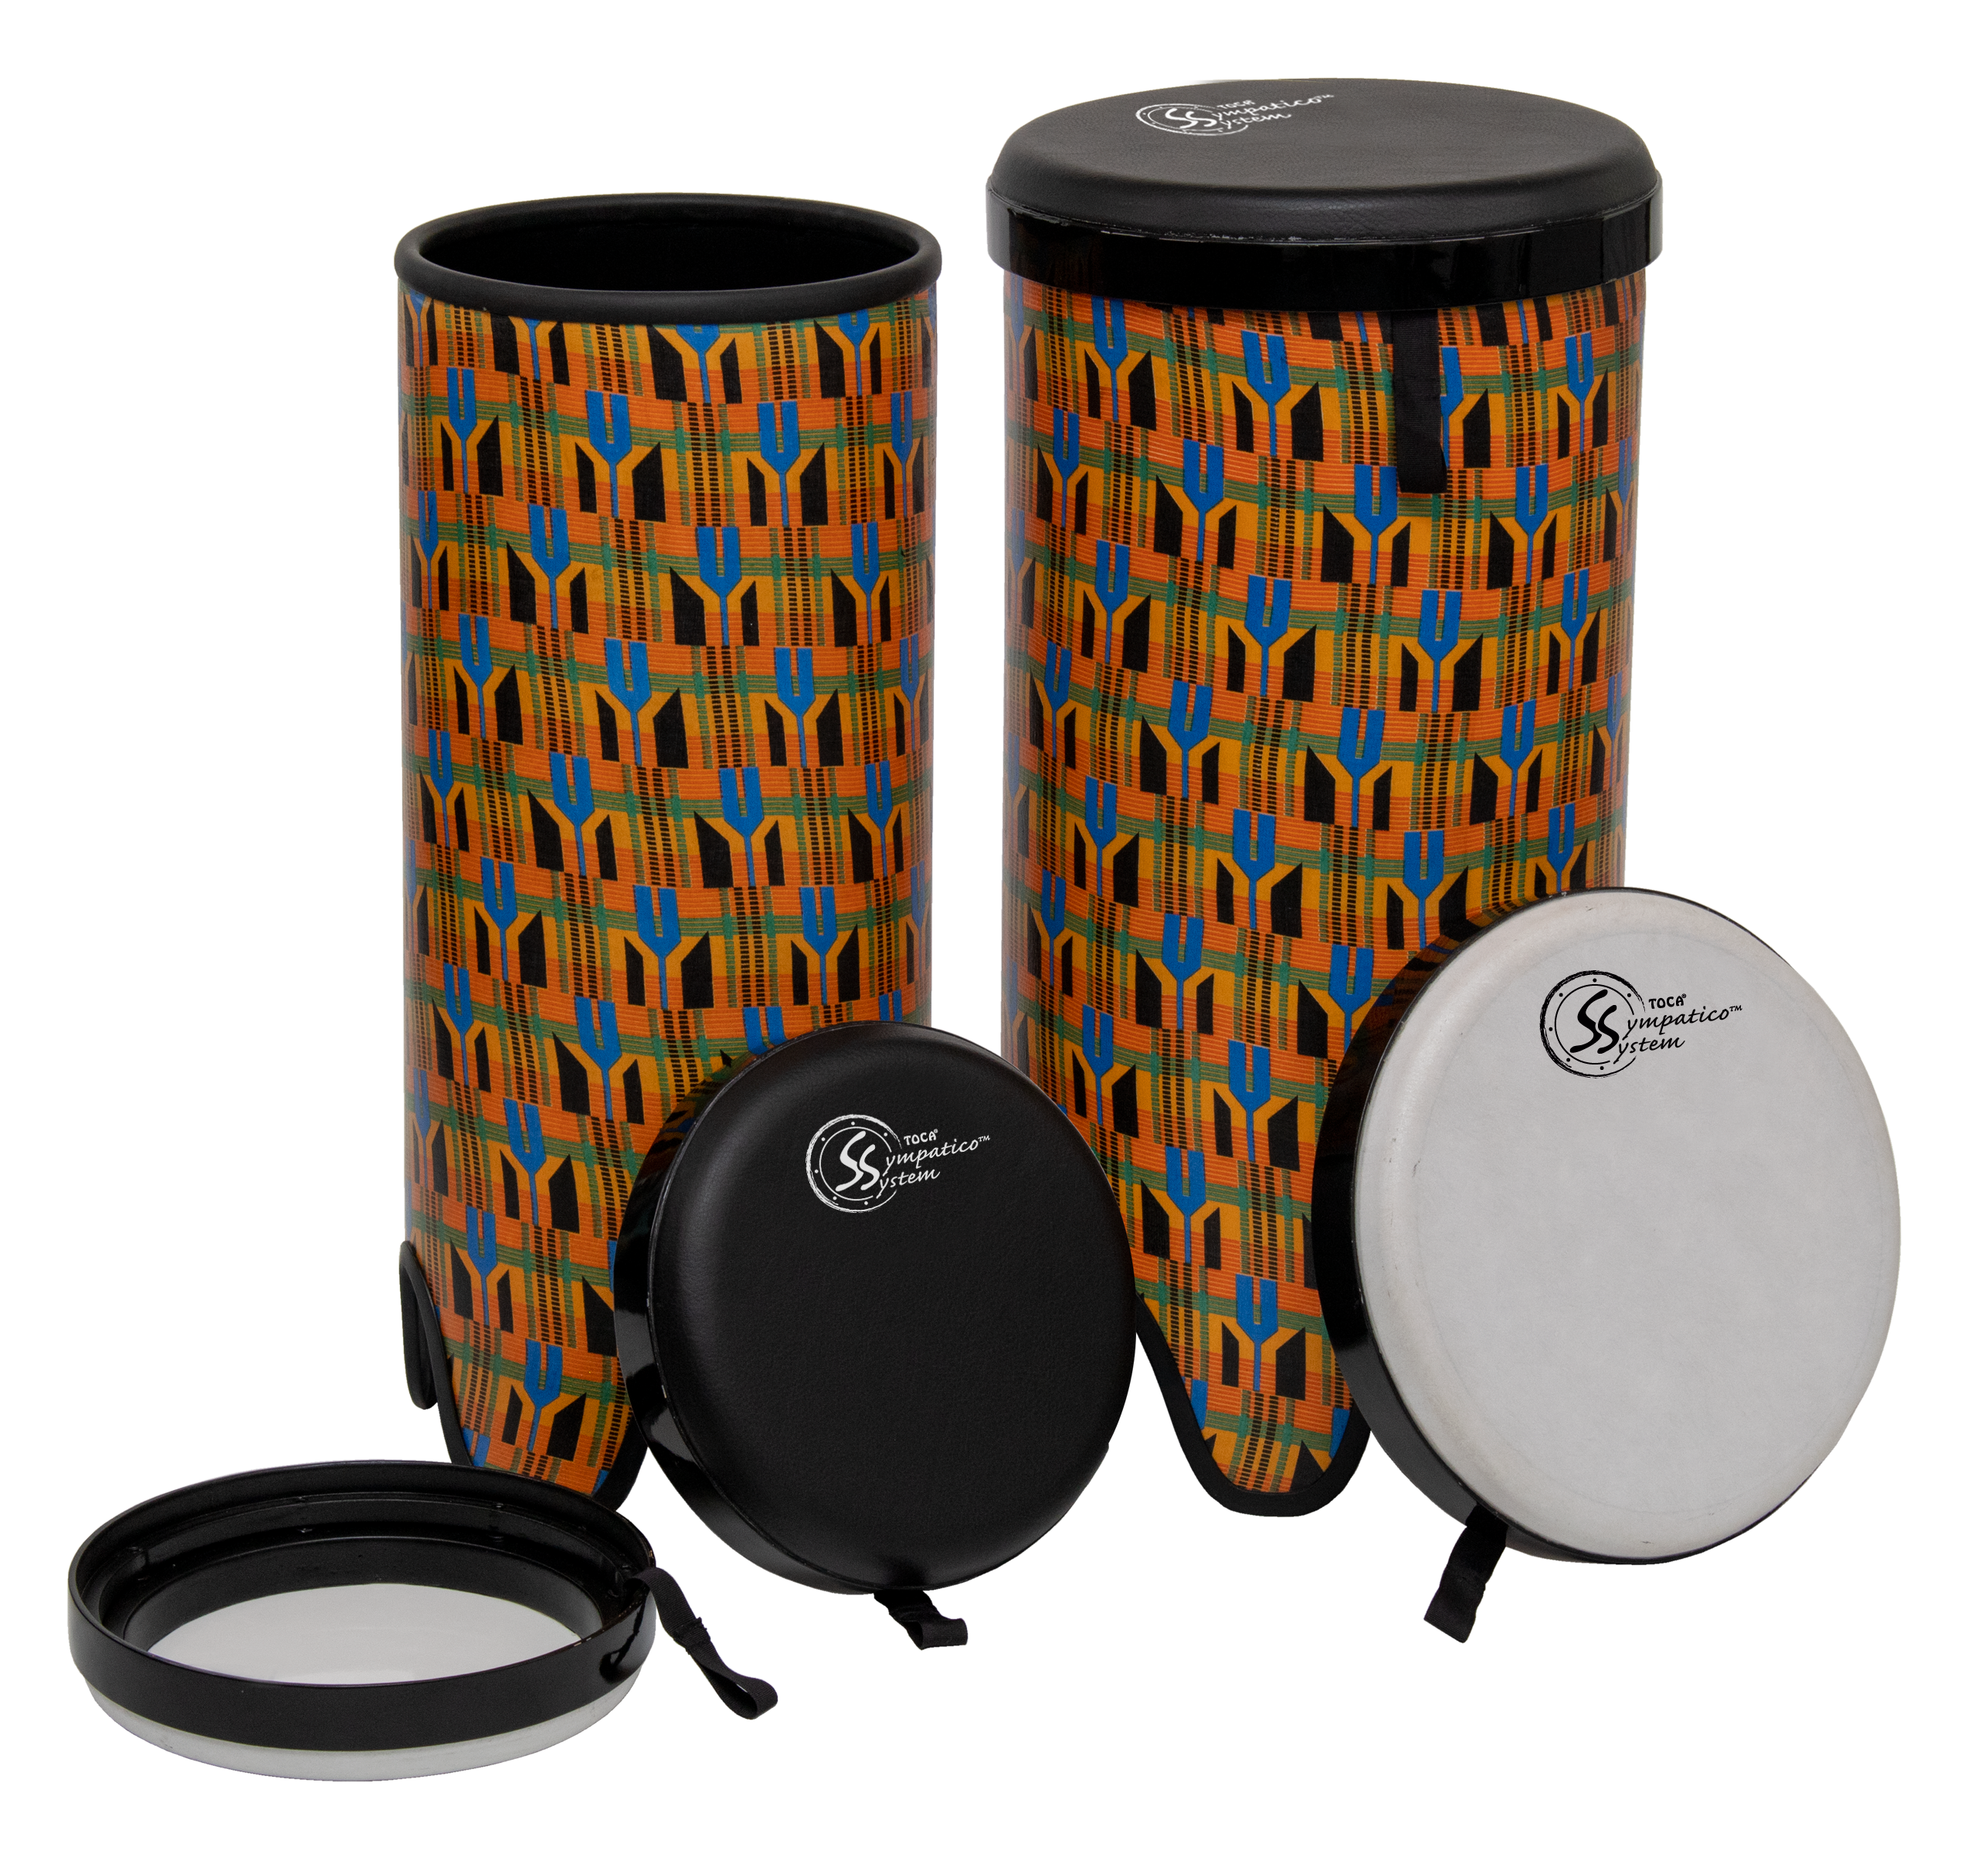
6 Different Drums

Slide 14
Tubadoras

Slide 15
Gathering Drums

Slide 16
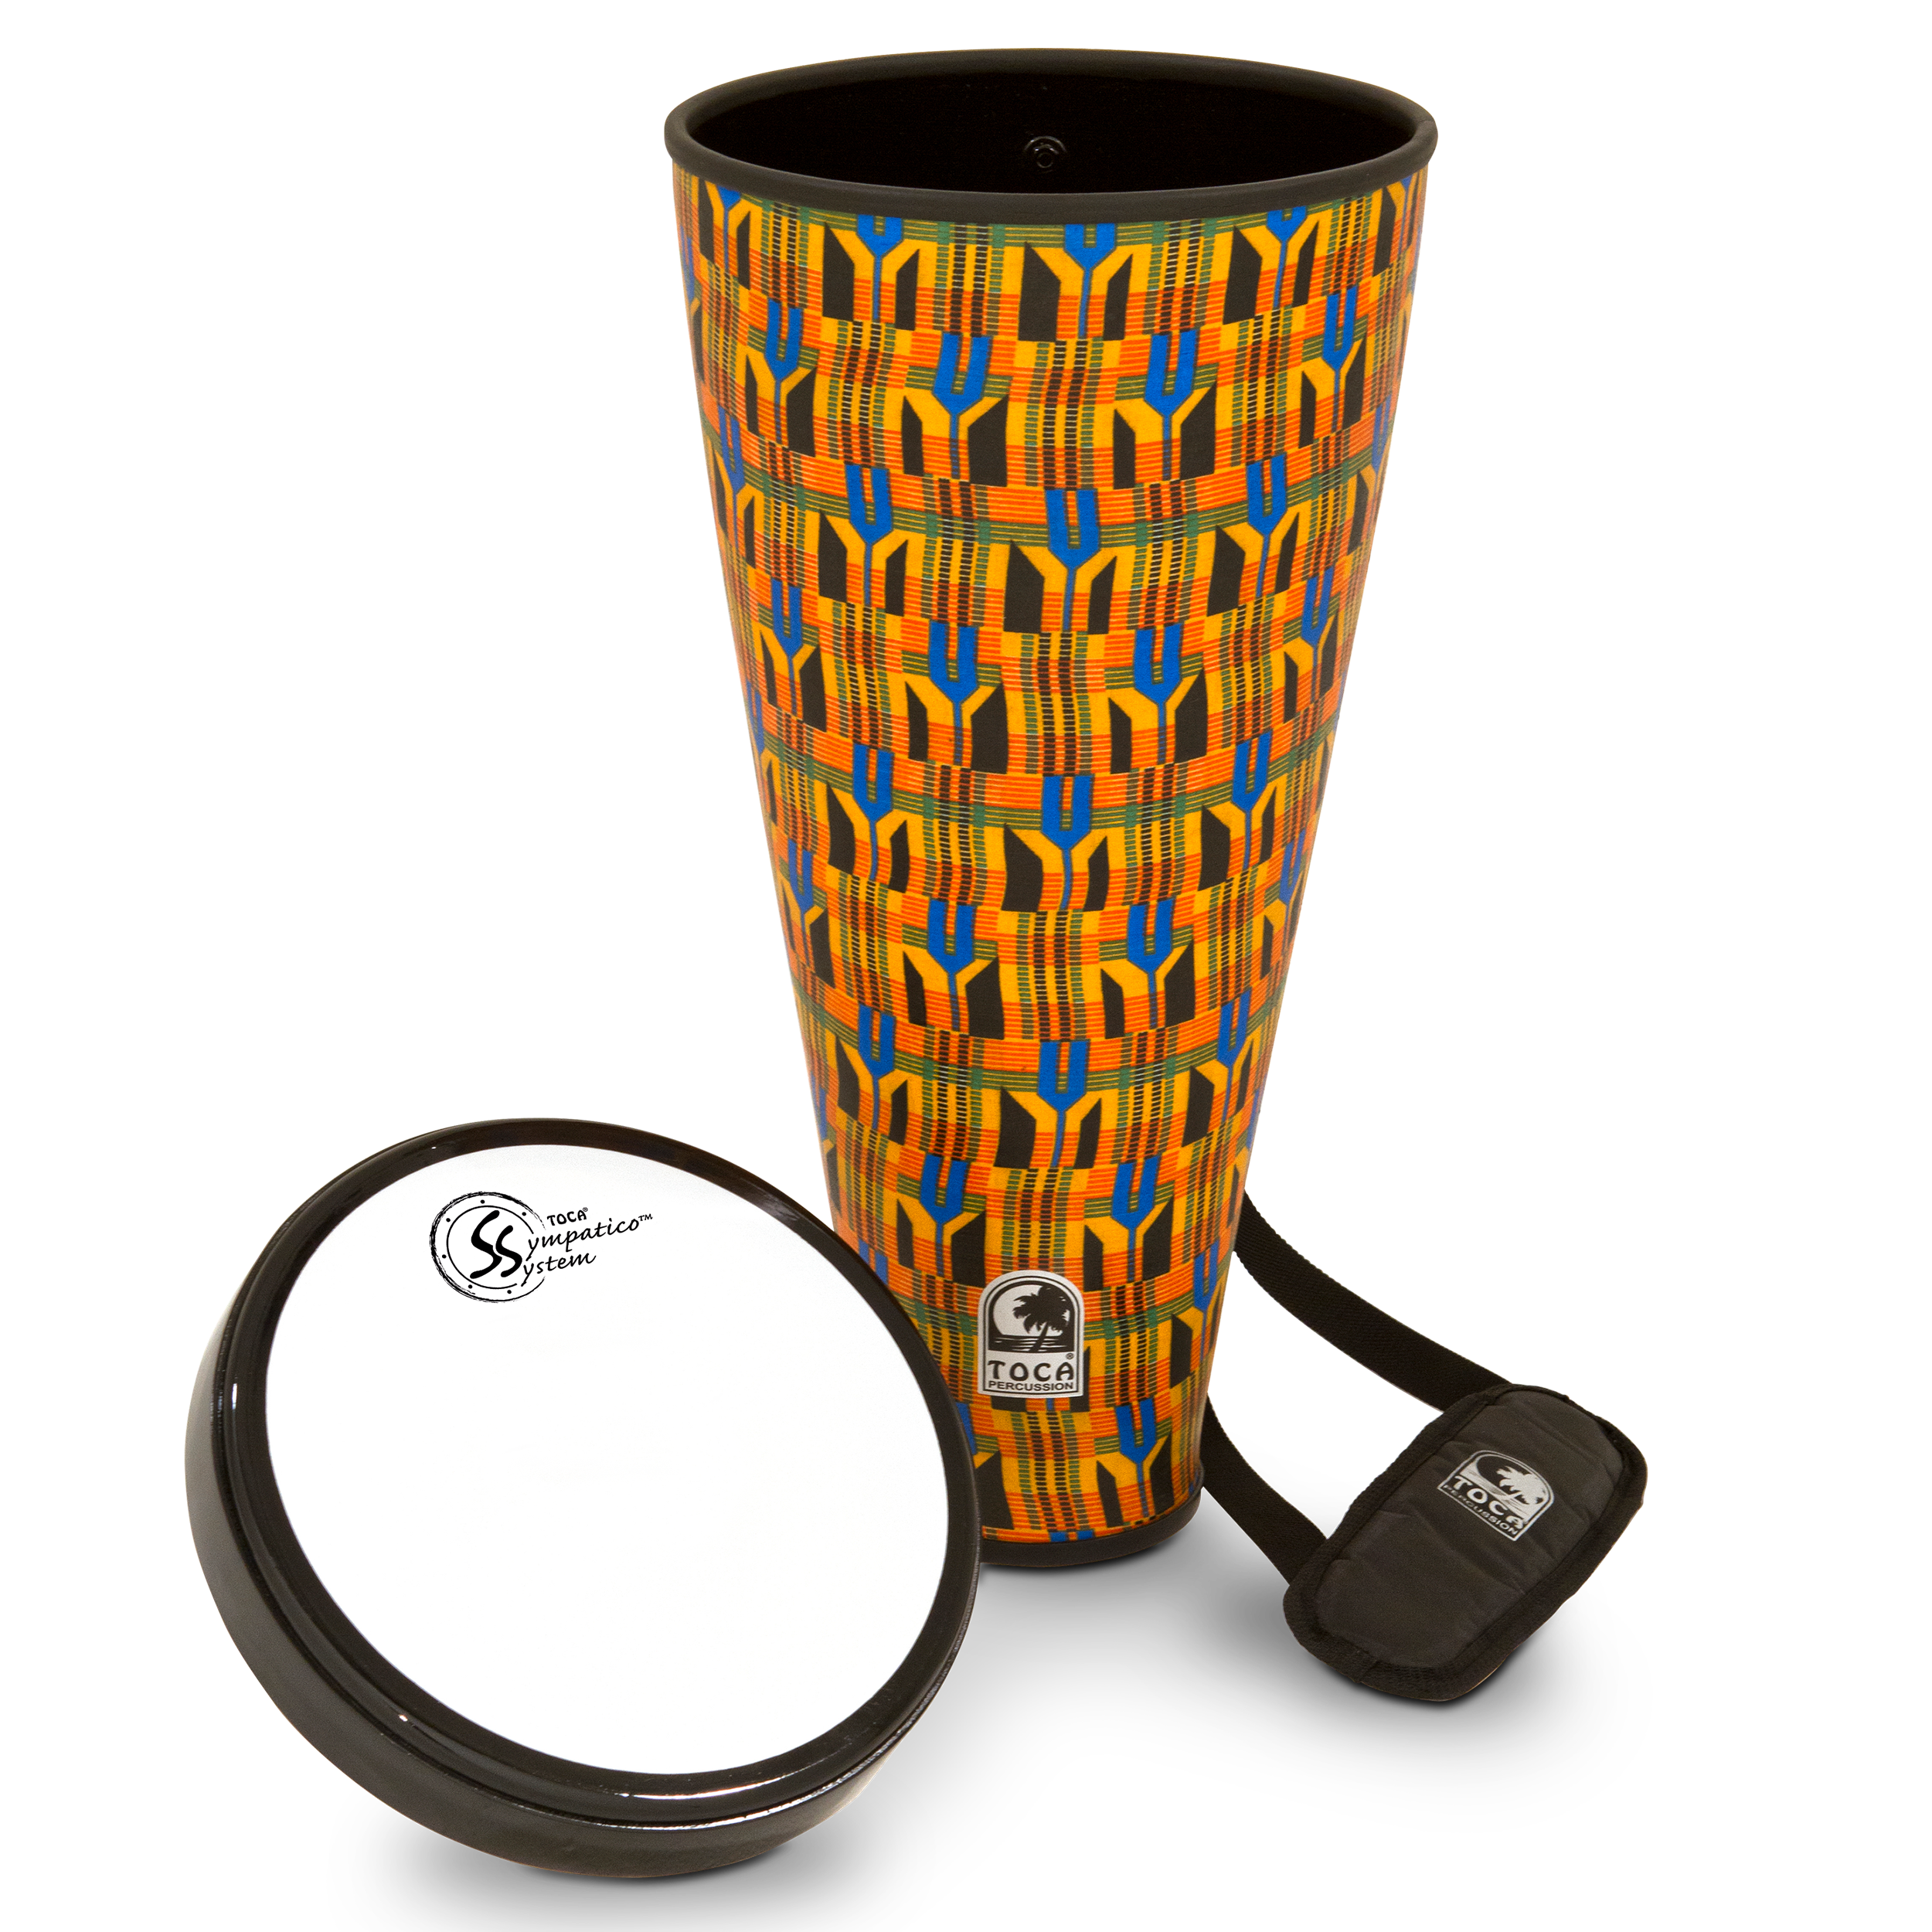
Nesting Ashikos

Slide 17
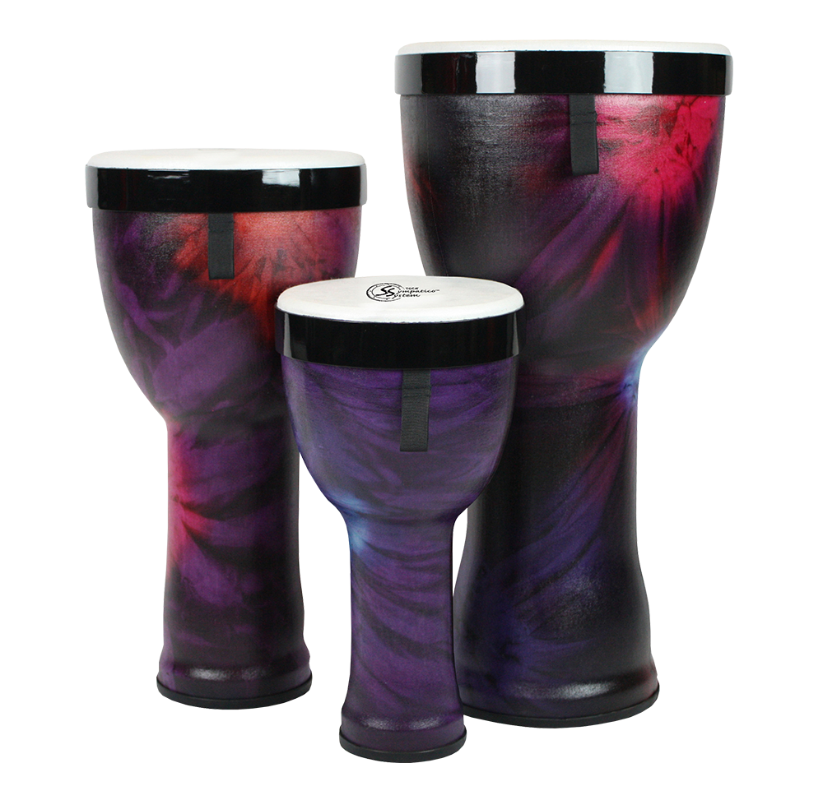
Nesting Djembes

Slide 18
Nesting Dun Duns

Slide 19
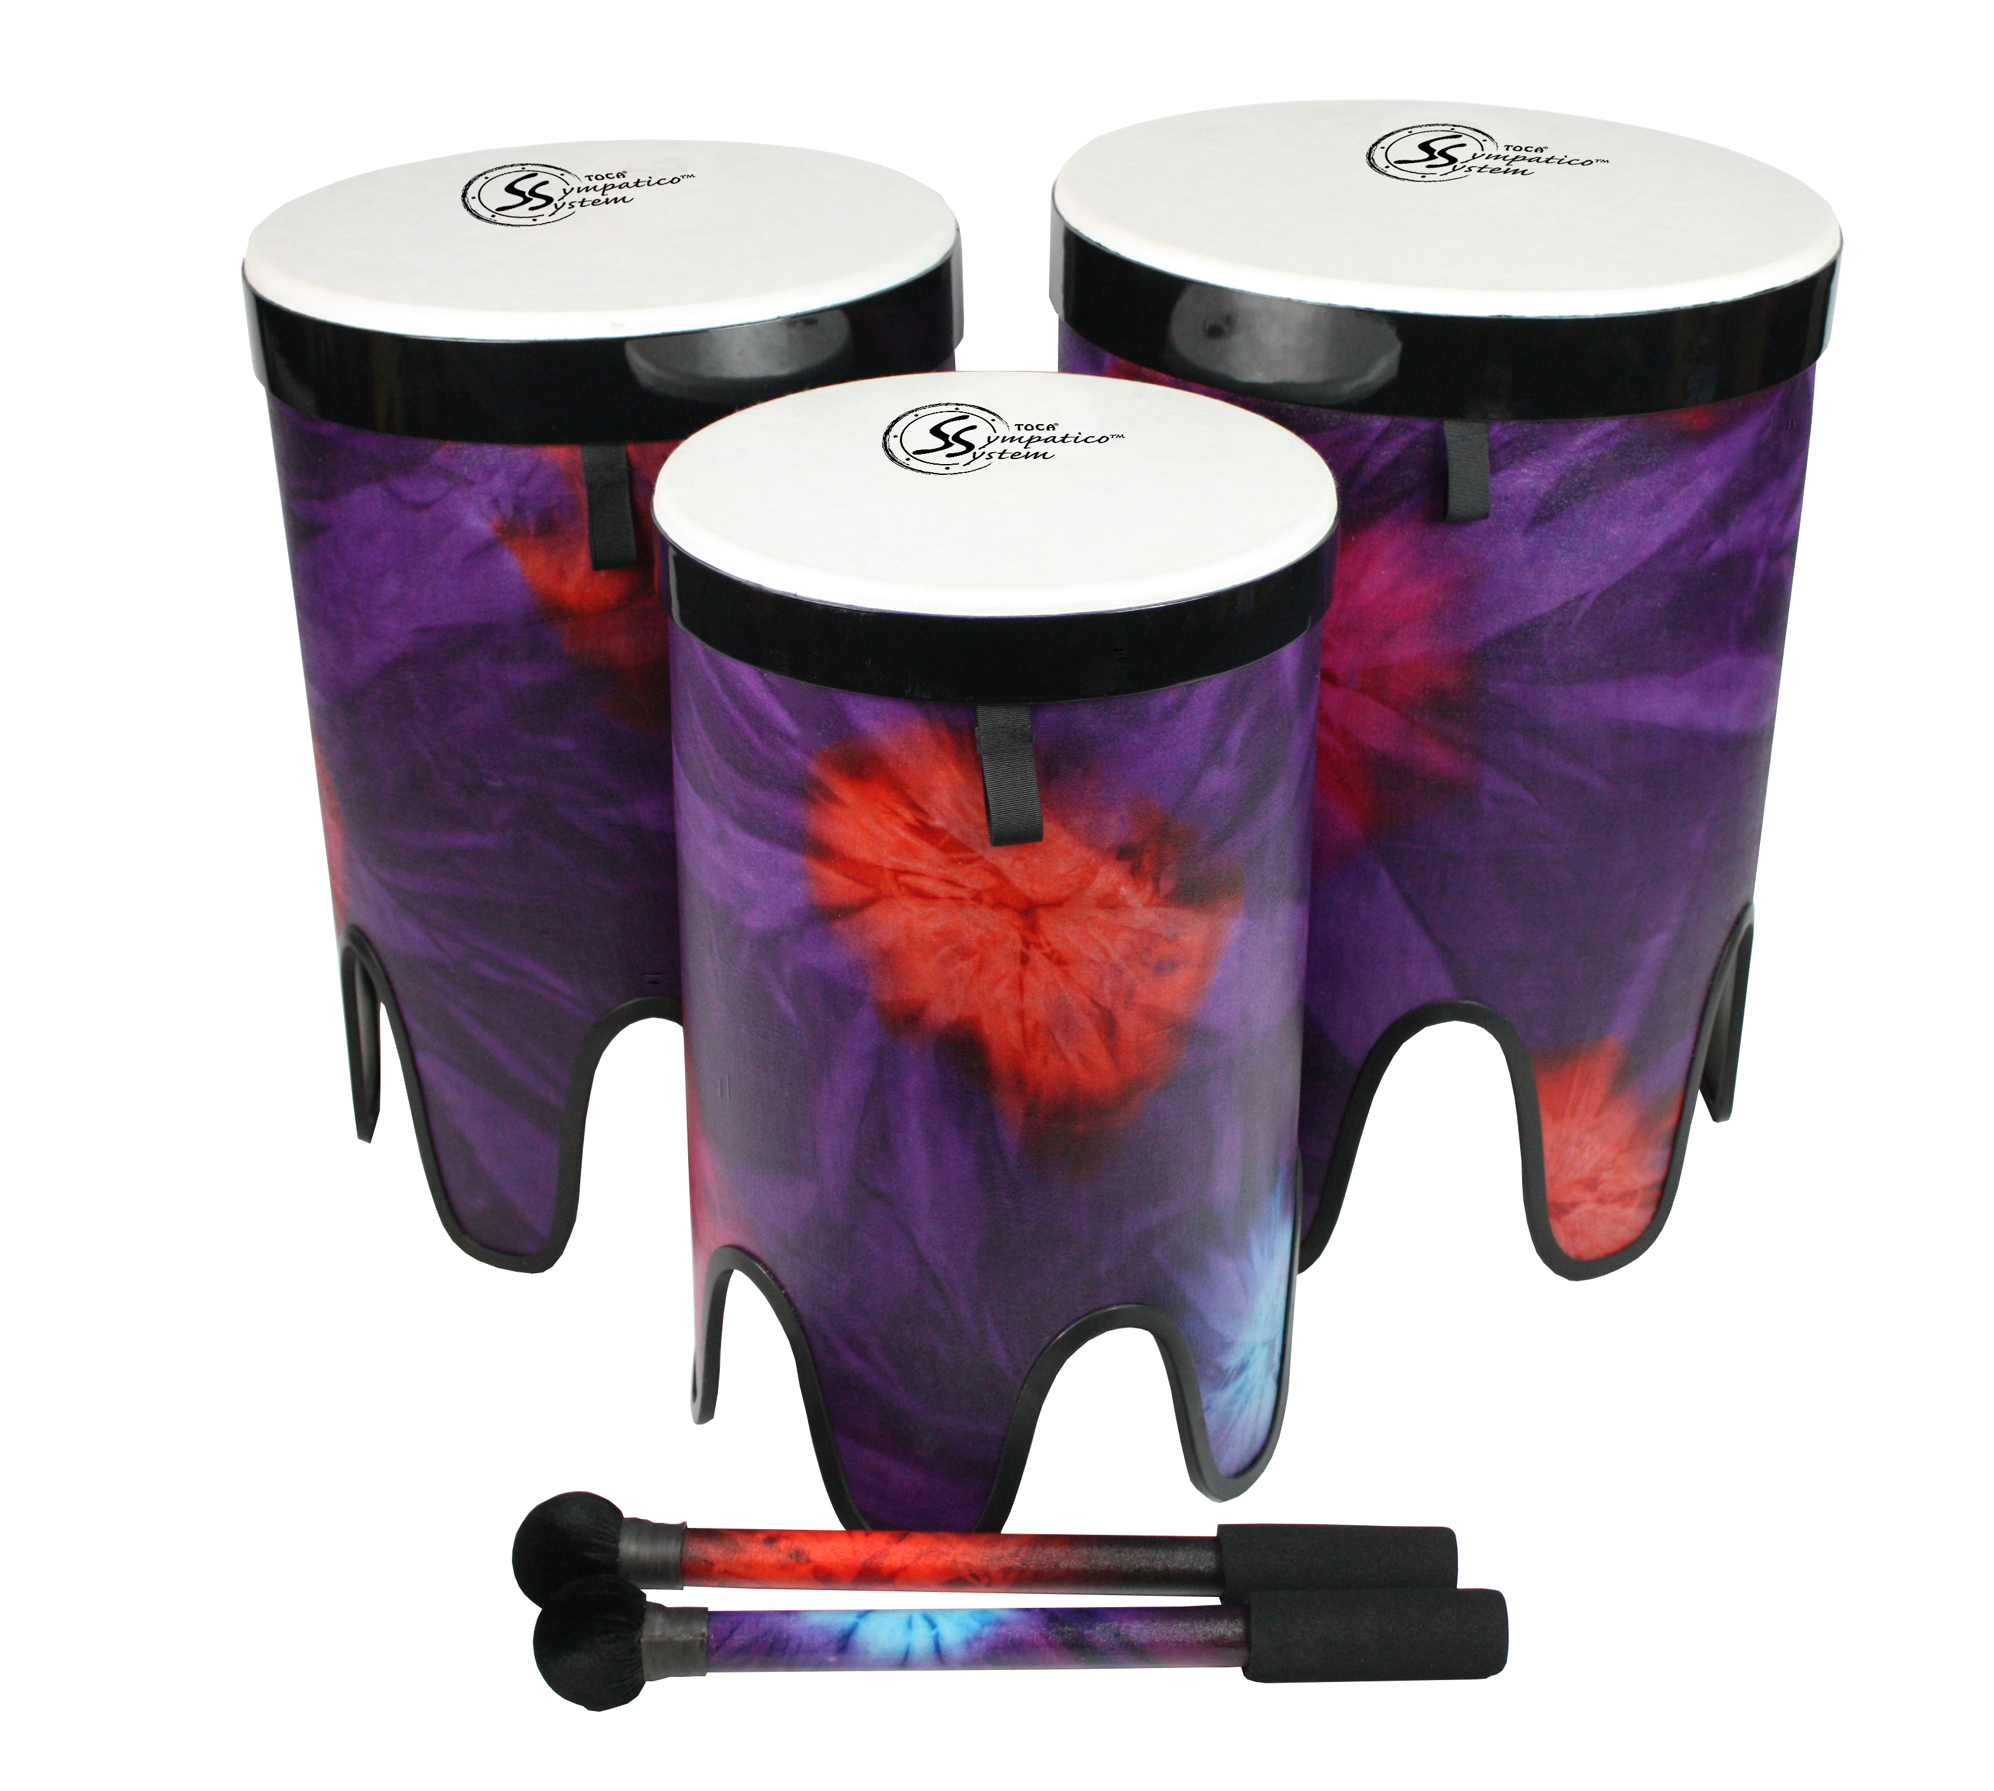
Nesting Tom-Toms

Slide 20
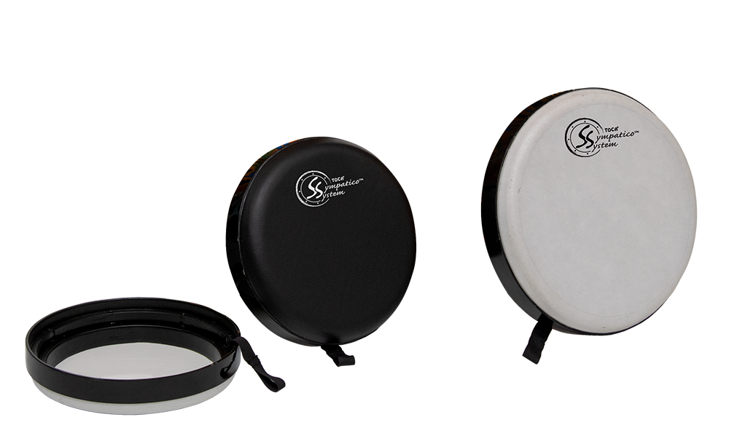
Lightweight
Easily Cleaned
Space Saving
Weather Resistant
Removable Heads
Maintenance Free
Pretuned & Tunable
Compatible with Existing FS2 Drums

Slide 21
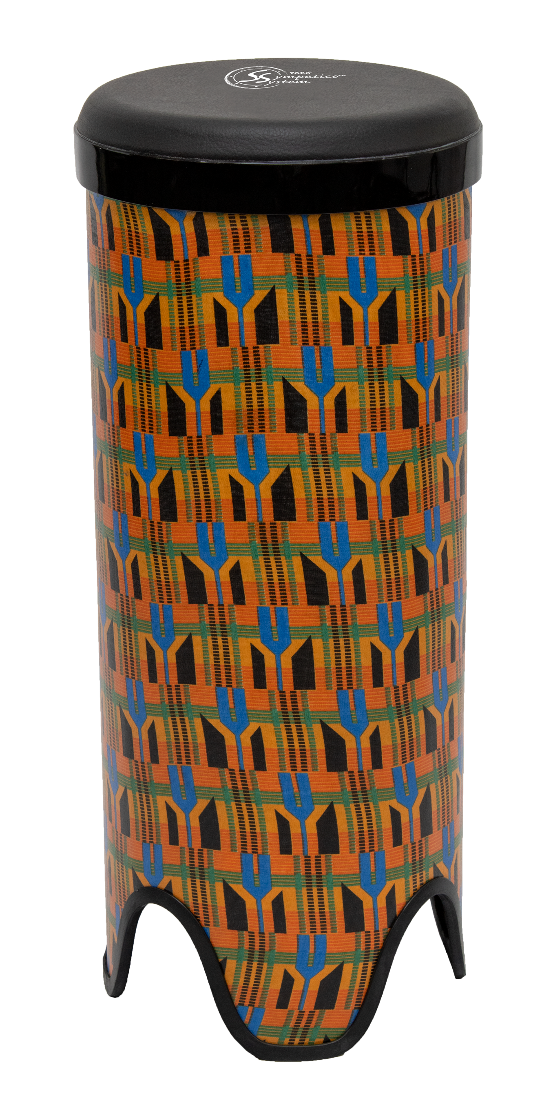
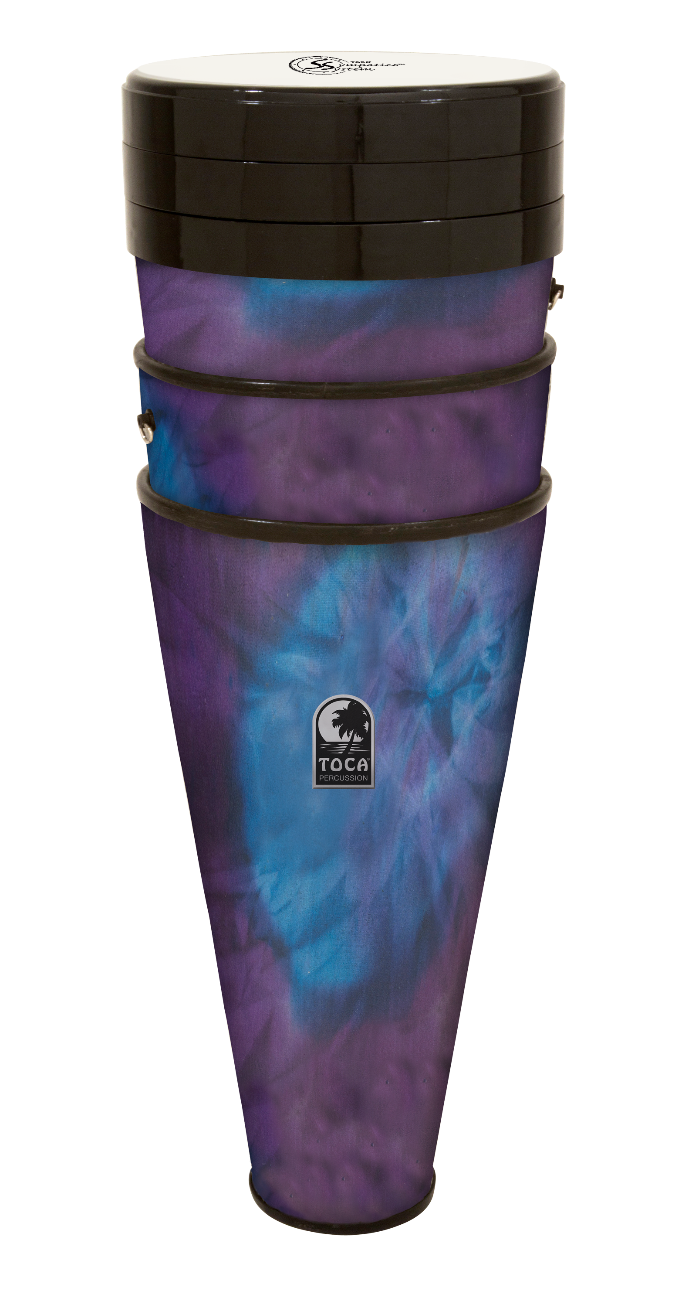
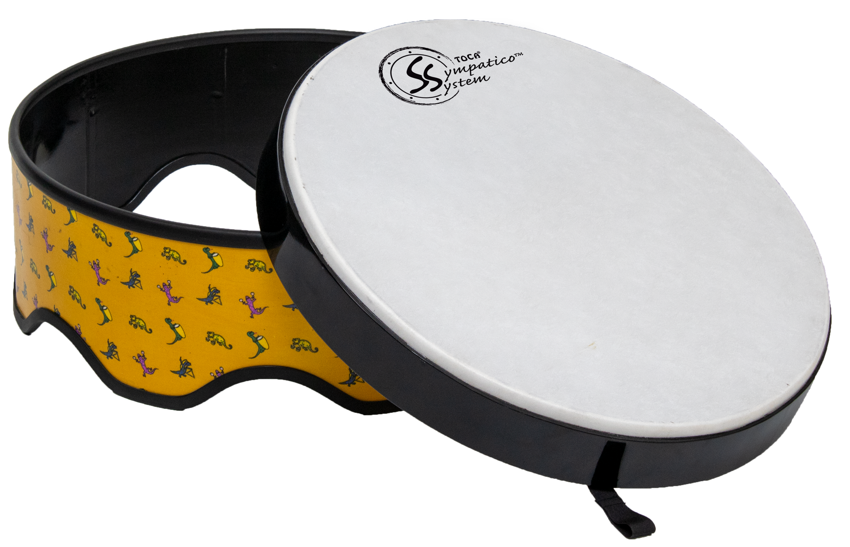
Expanded Range of Sound
Big Potential for Expanded Market

Slide 22
