Slide 1
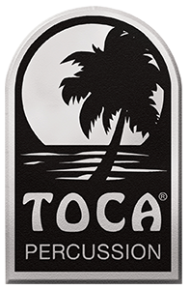
New From
Toca Percussion
2023

Slide 2
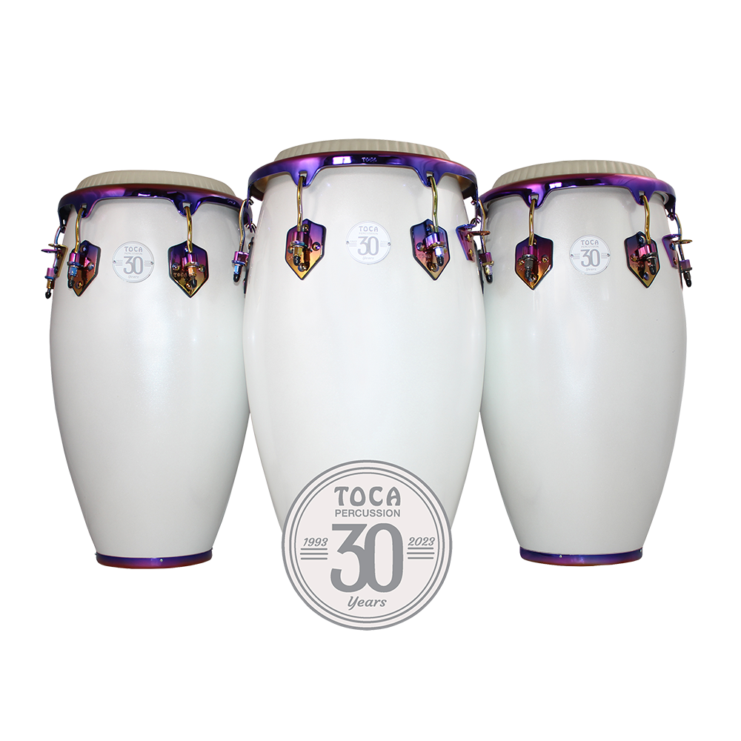
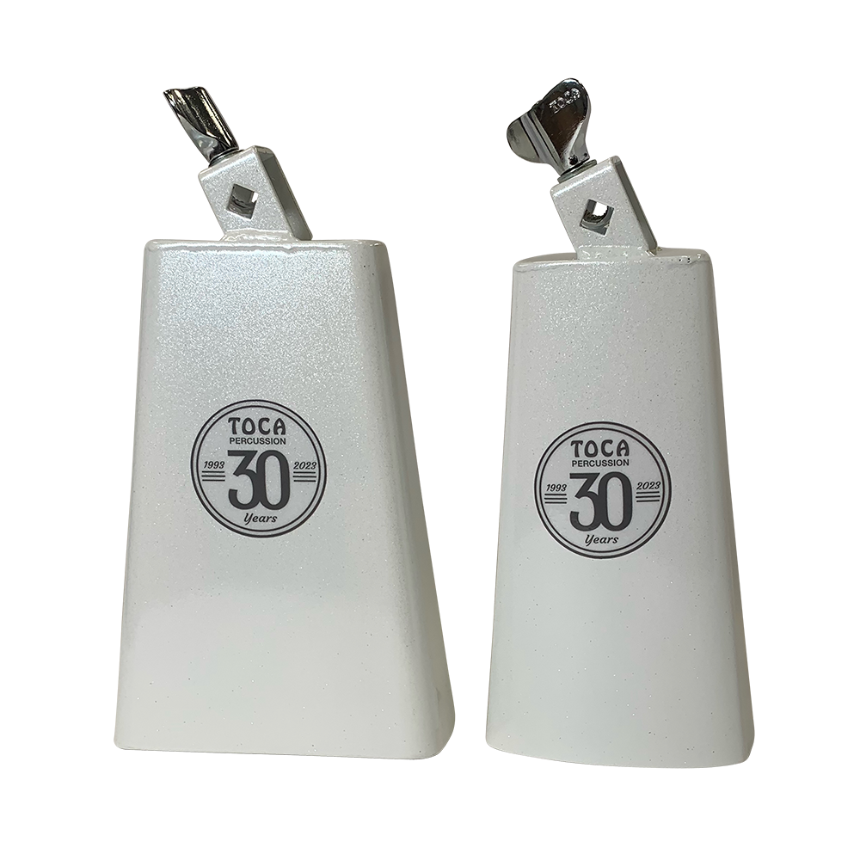
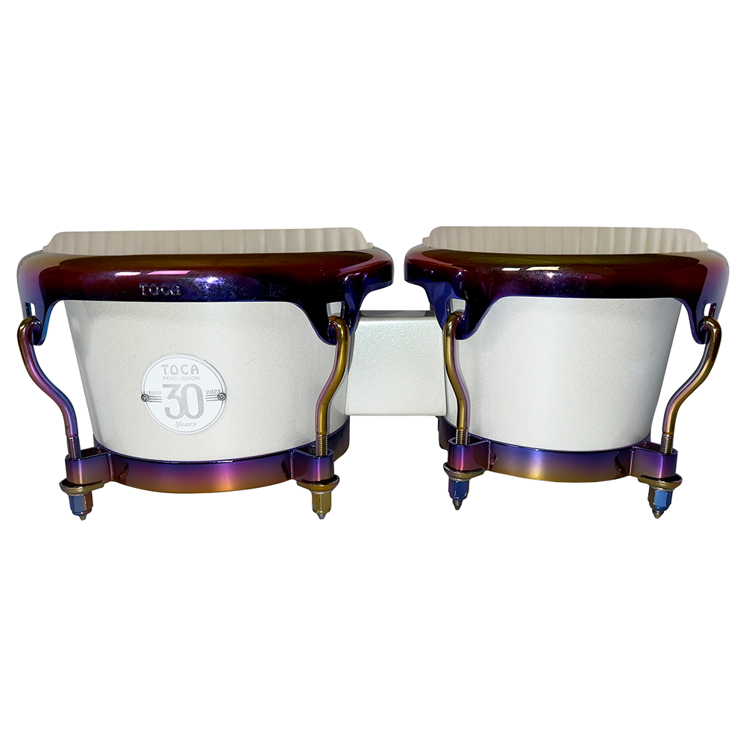
Toca 30th Anniversary

Slide 3
30th Anniversary Congas & Bongos
30tH Anniversary Congas Features:
- Margarita Blanca Finish
- One-of-a-kind Anodized Hardware
- Remo Nuskyn heads
- Seamless Fibreglass shell
- Wider Belly to produce deeper bass tone and crisp highs
5311-MB - Quinto MAP $479.99
5311-3/4MB - Conga MAP $519.99
5312-1/2MB - Tumba MAP $529.99
30tH Anniversary Bongos:
- Margarita Blanca Finish
- One-of-a-kind Anodized hardware
- Remo Nuskyn heads
- Seamless Fiberglass shell
5300-MB - Bongo MAP $379.99

Slide 4
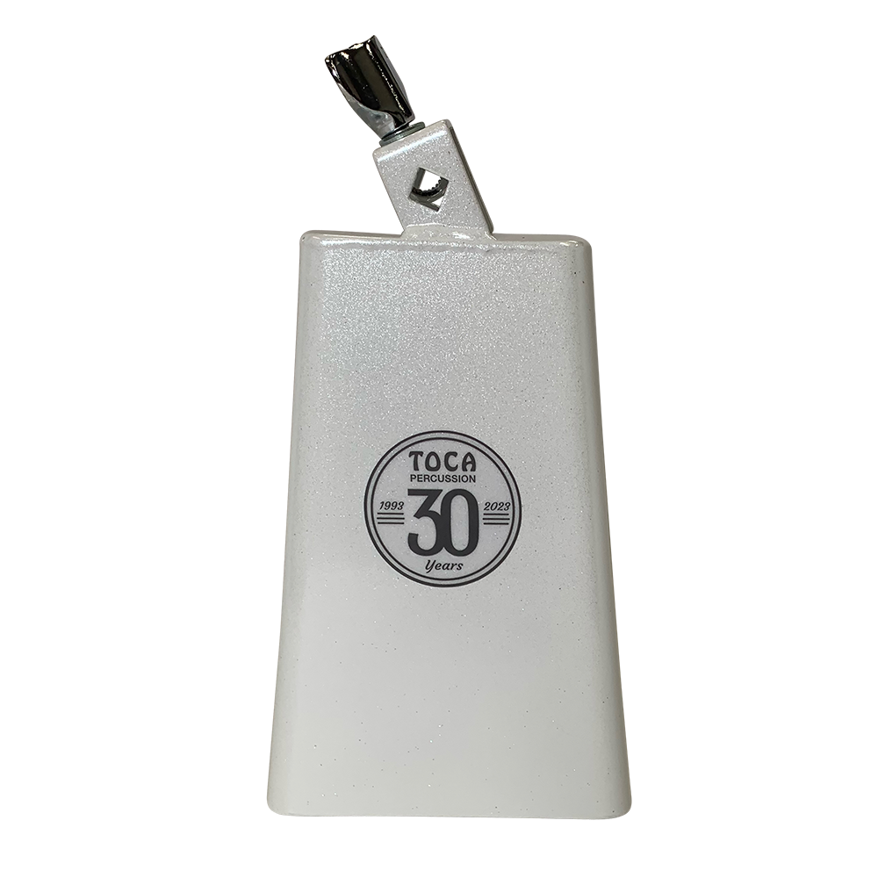
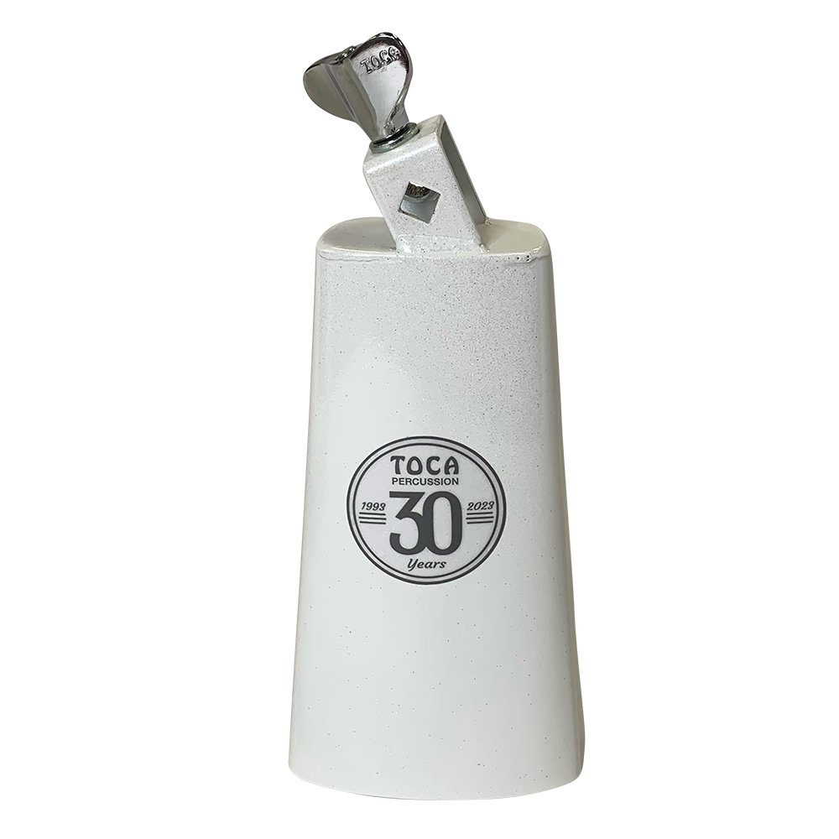
30th Anniversary Timbale & Bongo Bells
Timbale Bell
MAP - $59.99
3026-TMB
Bongo Bell
MAP - $59.99
3028-TMB

Slide 5
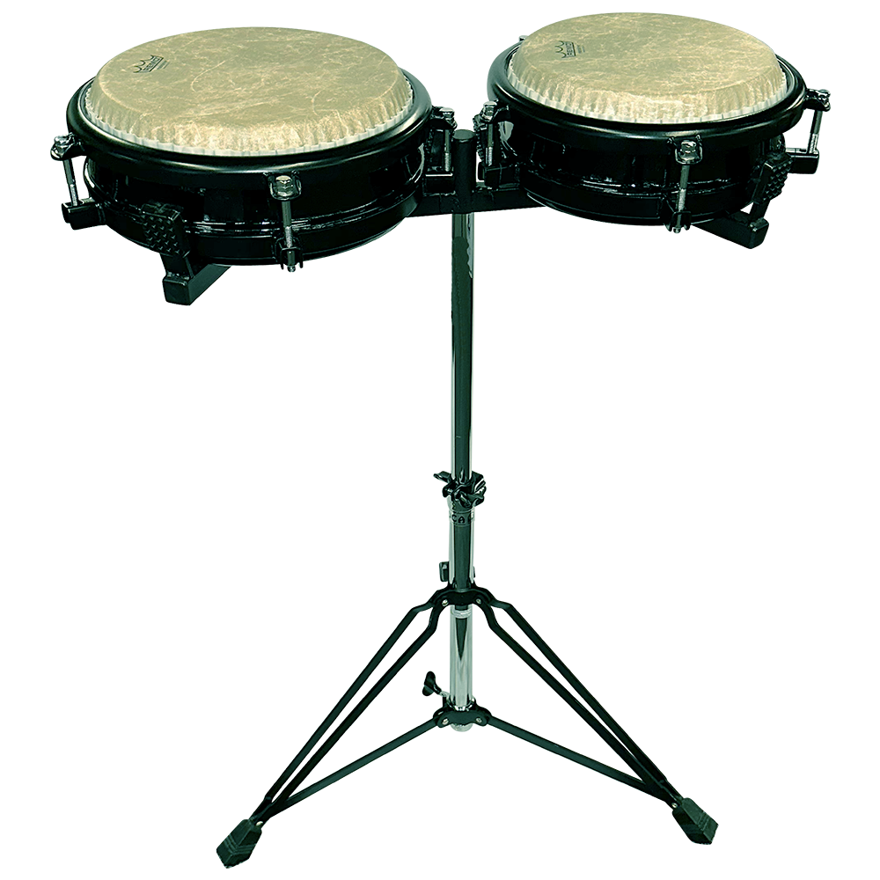
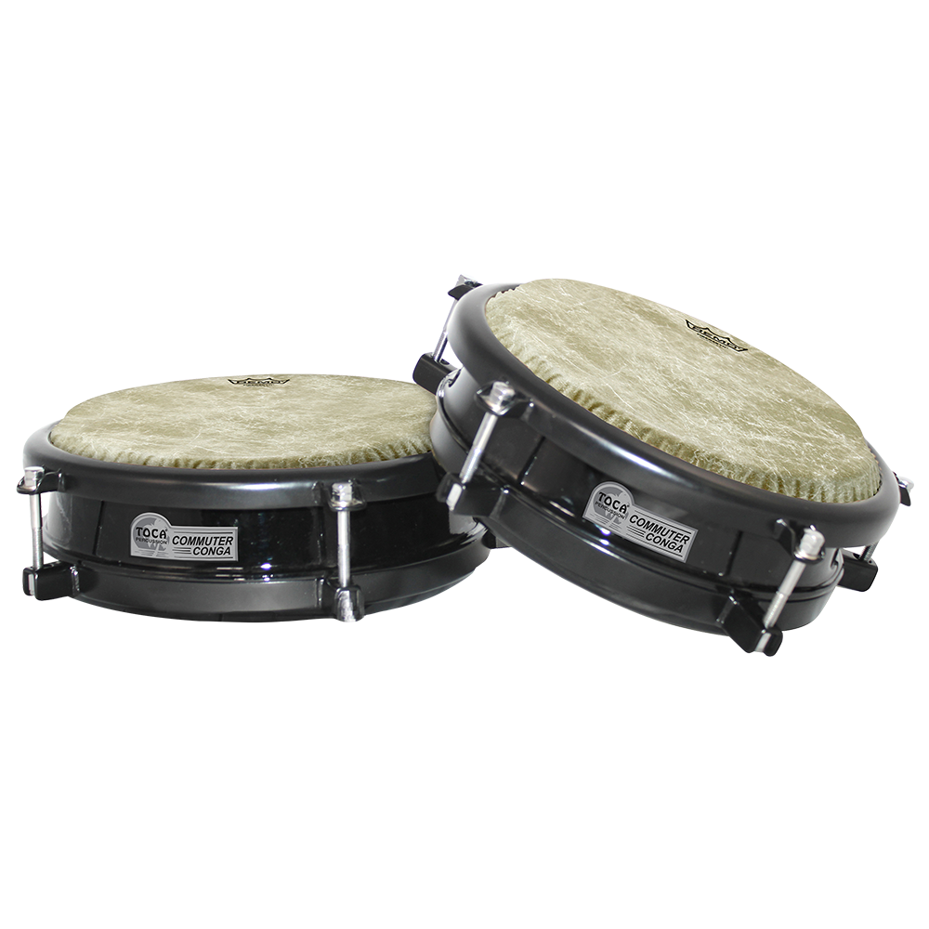
Commuter Congas!!
● Portable drums perfect for musicians on the go. ● 10” & 11” head sizes ● Remo Fiberskyn heads ● Drums sold separately, with or without a stand or as a set of 2 with a double stand ● Lugs accessible at the top for simple & quick tuning ● 10” drum has a 3” diameter port on the bottom ● 11” drum has a 6” diameter port on the bottom ● Heavy-duty steel stand with adjustable arm holds either size Commuter Conga securely

Slide 6
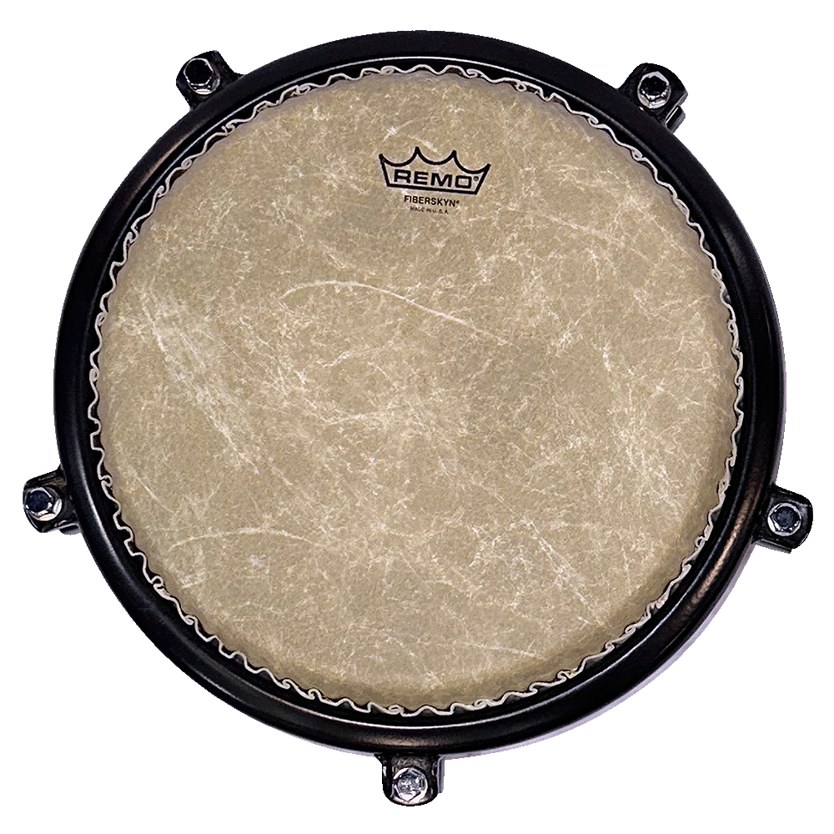
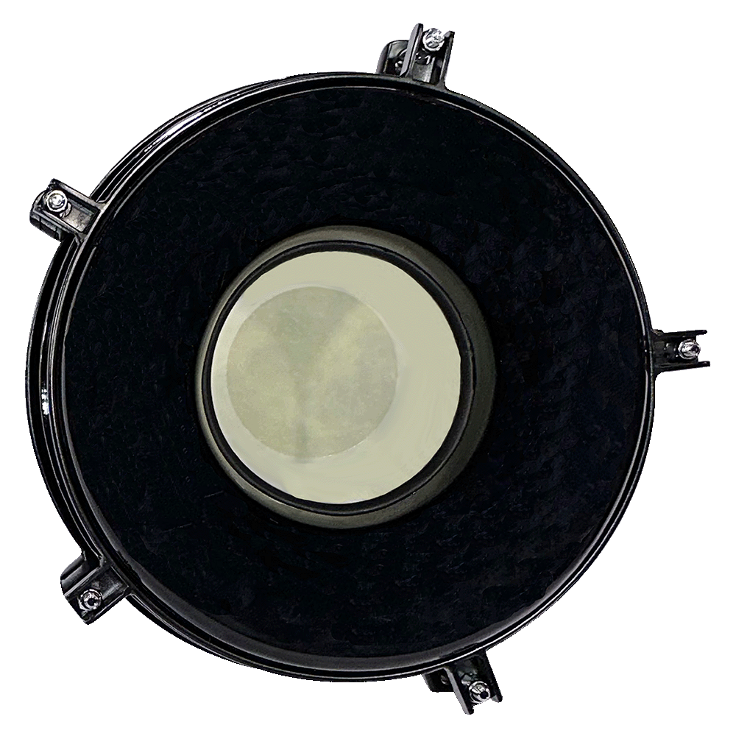
Model# | Description | MAP
TCCD-10-11S | 10” /11" Commuter Congas w/Double Stand | $749.99
TCCD-10 | 10” Commuter Conga | $279.99
TCCD-10S | 10” Commuter Conga w/Sgl Stand | $399.99
TCCD-11 | 11” Commuter Conga | $299.99
TCCD-11S | 11” Commuter Conga w/Sgl Stand | $419.99
Stands Also Sold Separately
TCCD-D | Commuter Conga DBL Stand | $165.99
TCCS-S | Commuter Conga SGL Stand | $111.99

Slide 7
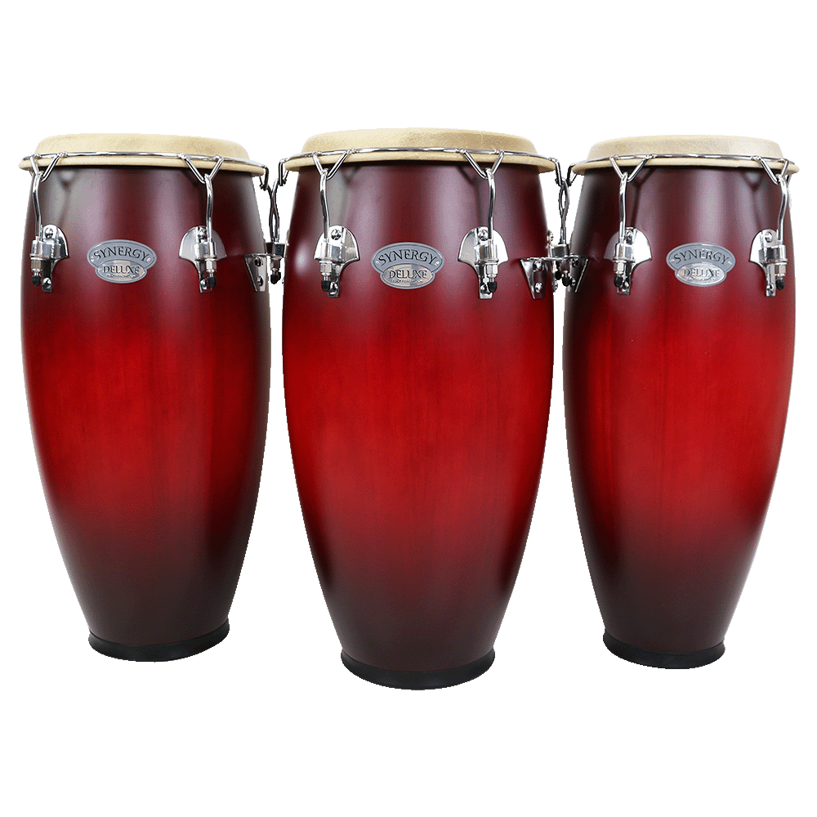
Synergy Deluxe Congas
Wine Burst Matte Finish
28” Tall, Two-ply Asian Oak Wood Shells ● Luxe Matte Wine Burst Finish ● Tucked Natural Heads ● Low Contact Counterhoops for Open Sound ● Adjustable Basket Stands Included ● Matching Bongos Available
Other Finishes Also Available – Coffee Fade, Natural, Purple Fade, Wine Fade

Slide 8
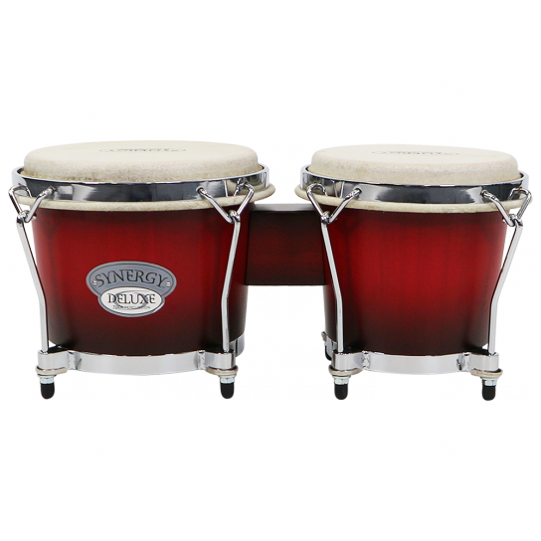
Synergy Deluxe Bongos
Wine Burst Matte Finish
● 6” and 6-3/4” Diameter, Two-ply Asian Oak Wood Shells ● Luxe Matte Wine Burst Finish ● Tucked Natural Heads ● Low Contact Counterhoops for Open Sound ● Coffee Fade, Natural, Purple Fade and Wine Fade Finishes also Available ● Matching Congas Available

Slide 9
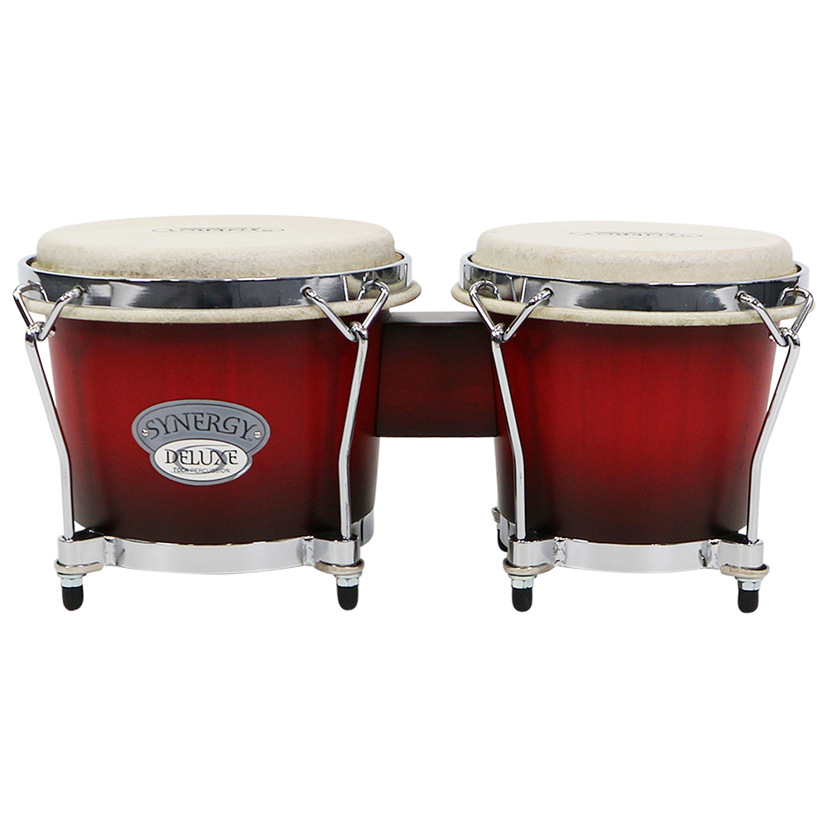
Model# | Description | MAP | DEALER | GP
2150-WB | Synergy Deluxe Bongos- Wine Burst Matte finish | $109.99
2350-WB | Synergy Deluxe 10" / 11" Conga Set w/ Baskeet Stands-Wine Burst Matte finish | $419.99
23512-WB | Synergy Deluxe 12" Tumba w/Basket Stand, Wine Burst Matte finish | $209.99

Slide 10
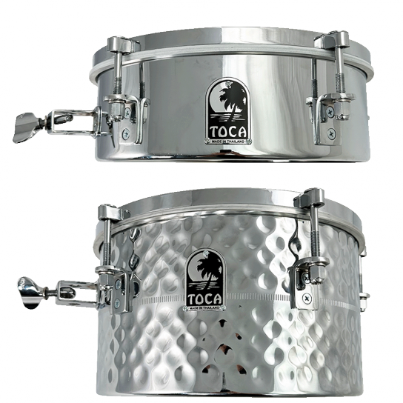
Drum Set Timbales with Snares
● Expand your range of sound options ● Perfect for drummers looking to add new elements to their music ● 12” x 4” model - stunning stainless steel finish provides maximum sustain, brightness, & clarity ● 12” x 7” model - dazzling hand-hammered stainless-steel finish provides a deeper ring ● Smaller head size makes it easy to place in tighter spaces, ● Steel shells provide maximum sustain, brightness, & clarity. ● Equipped with a snare, with heavy duty throw off, enabling drummers to easily transition from a unique timbale sound to a snappy snare sound. ● Heavy-duty mount that accommodates a variety of rods & tom holders, for easy placement on any kit

Slide 11
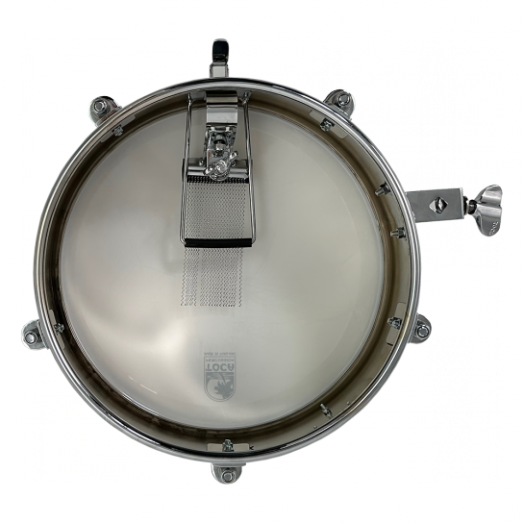
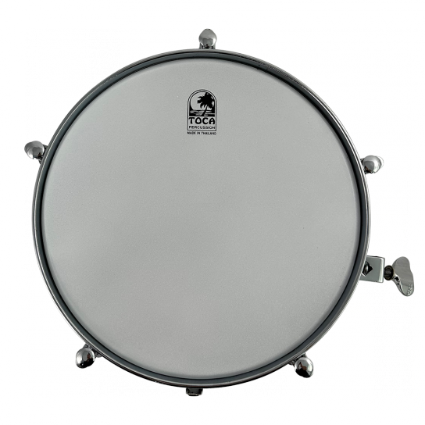
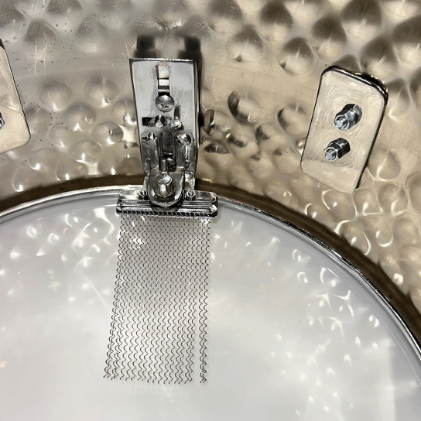
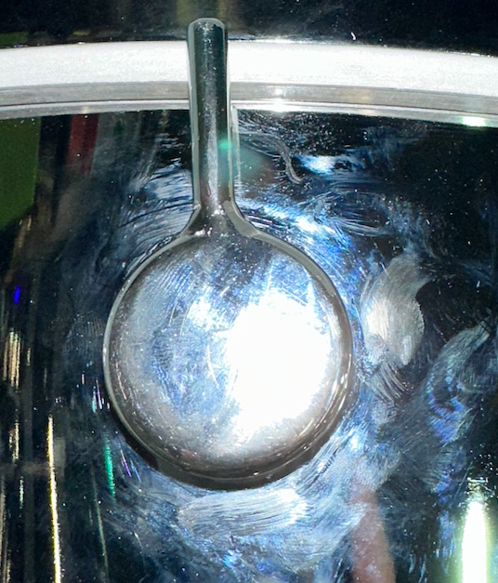
Drum Set Timbales with Snares
Model# | Description | MAP
T-412-SS | Drumset Timbale w/Snares, 4"x 12", Stainlesss Steel Shell | $219.99
T-712-HH | Drumset Timbale w/Snares, 7"x 12", Hand Hammered Shell | $249.99

Slide 12
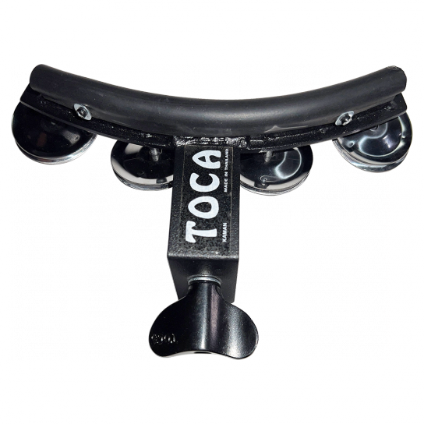
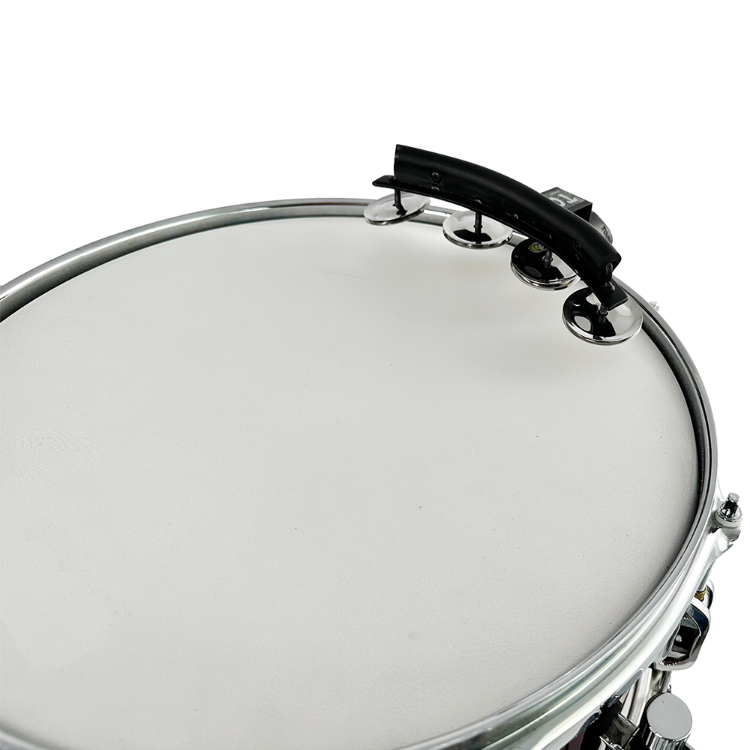
Jingle Snap – (T-JS)
● Innovative accessory that adds a jingle sound with precision & control. ● Keep that jingle sound close & hit it whenever it’s needed. ● Provides sound only when needed, as it’s mounted directly to snare instead of constantly moving hi-hat ● Fits on any acoustic kit drum ● Features four nickel-plated steel jingles ● Black powder-coated metal frame ensures durability & long-lasting use

Slide 13
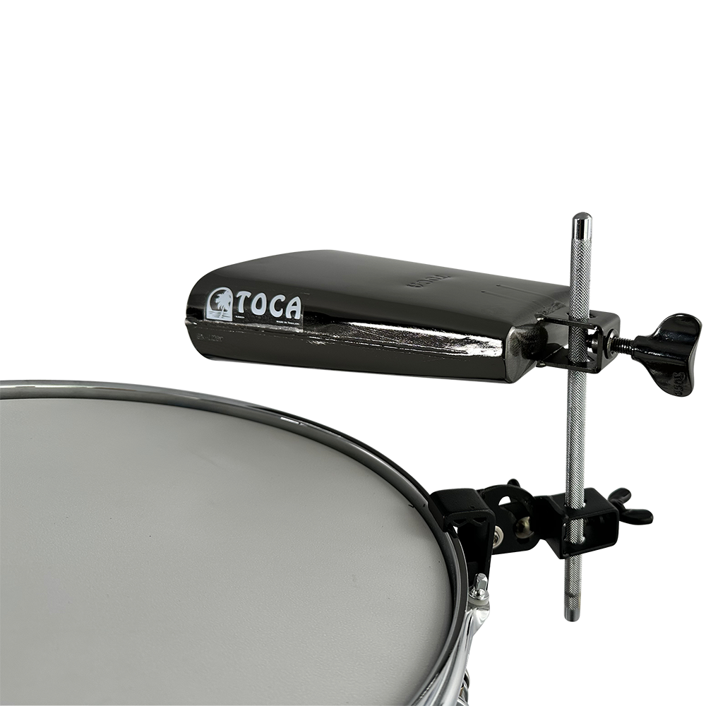
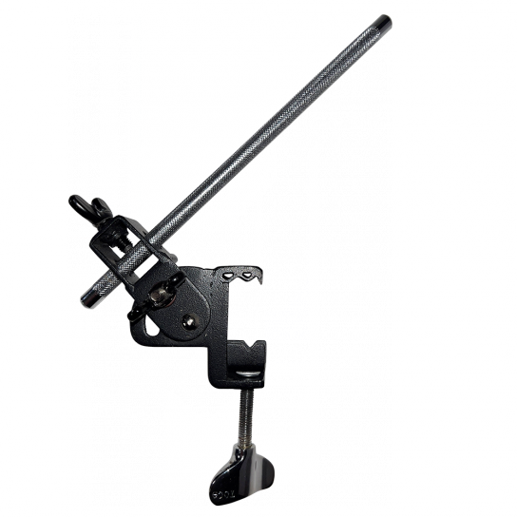
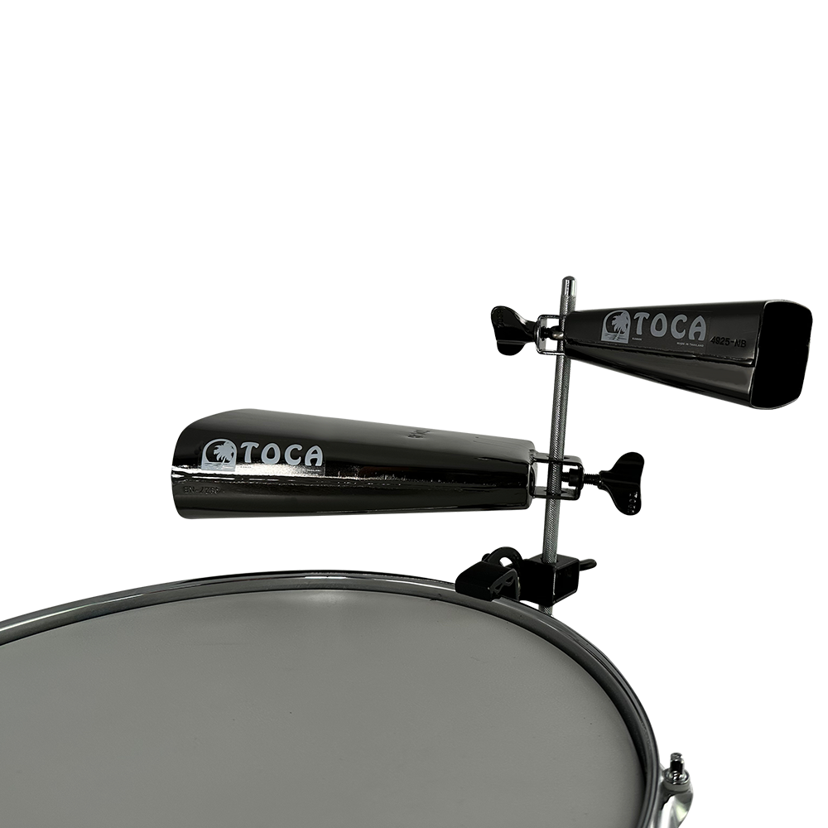
The Grabber - TPGM
● Easily add percussion/small cymbals & microphones to nearly every standard drum rim exactly where needed ● Ideal for drum kit set-ups, percussion rigs, and marching drums ● Angle and height adjustable ● Comes standard with a percussion mounting rod ● Versatile addition to any drummer or percussionist’s tool kit

Slide 14
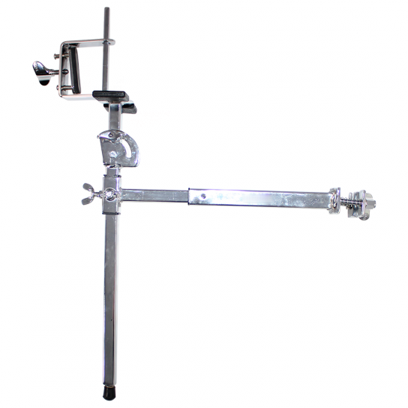
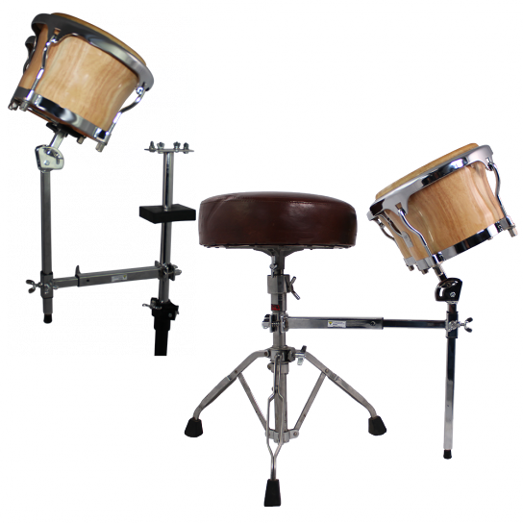
Multi-Use Bongo
Stand – TMBS
● Versatile & durable stand ● Combines the functionality of seated bongo stands & bongo arms into one ● Play bongos while seated on a throne or attach them to a double conga stand ● Fully customizable to meet any playing style ● C-Clamp bongo mount & adjustable height & angle ● Designed to fit any double conga stand ● Add bongos to your set, without taking up floor space ● Ideal add-on for any drummer or percussionist

Slide 15
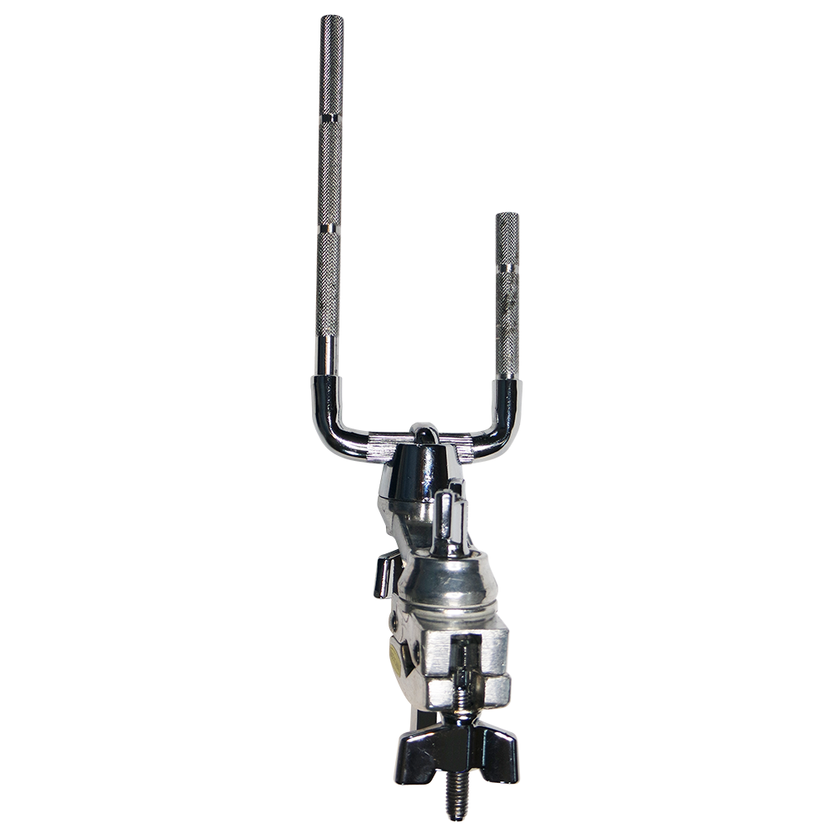
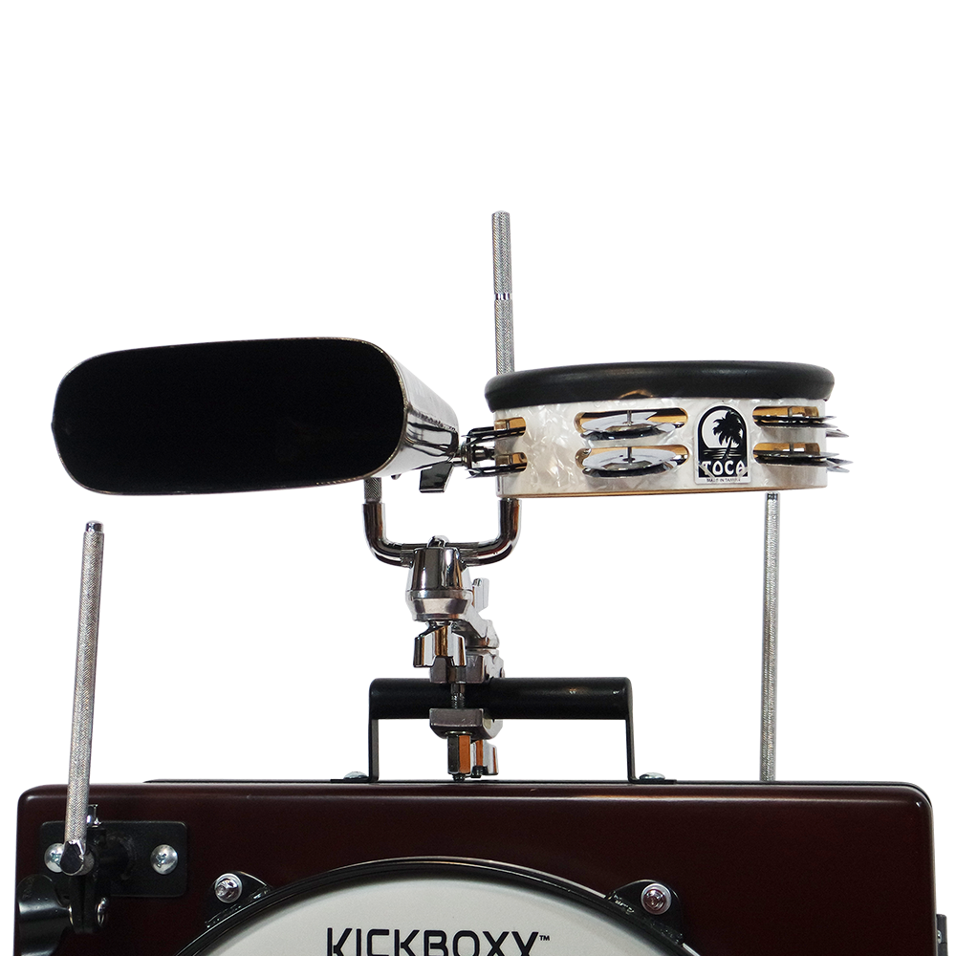
Dual Post U-Rod Accessory Clamp - TDPAC
● Two 3/8” diameter posts, in two lengths on one end ● An adjustable stand clamp on the other end ● Great for mounting multiple accessories together at different heights ● Perfect for use with the Toca KickBoxx

Slide 16
Part Number | Description | MAP- 2023 | Dealer | GP
T-JS | Jingle Snap | $25.99
TPGM | The Grabber' Percussion Clamp | $35.99
TMBS | Multi-Use Bongo Stand | $99.99
TDPAC | Dual Post U-Rod Accessory Clamp | $30.00

Slide 17
Thank you!

