Slide 2
Welcome!

Slide 3
Welcome!
The origin and history of Soundbellows
The most important features
The Philosophy
Tips on playing technique
Inside the Bellows
Structure of the Soundbellows Jumbos
Soundbellows in use
The product range

Slide 4
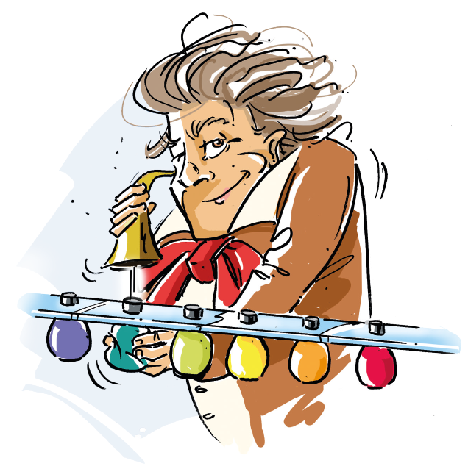
The Origin and the History
#1
THE ORIGIN
AND
THE HISTORY

Slide 5
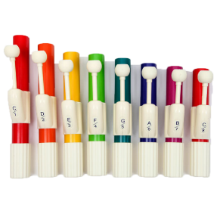
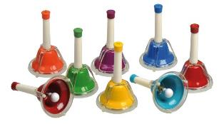
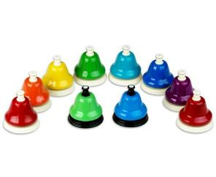
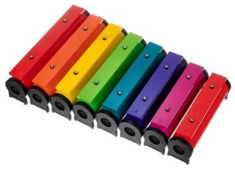
The Origin and the History
The inventor, Gert Balzer, as a teacher, trainer and now managing director of the Music Institute of the University of Education in Freiburg (Germany), has always been impressed by the enormous music education potential of color coding and single-note instruments.
Precisely because the colorful approach of the colorful instrumentarium is becoming more and more popular in musicology and music didactics, he felt the need to develop a color-coded single-tone instrument that, above all, perfects intuitive and barrier-free playing and the greatest possible sound design possibilities!

Slide 6
The most important features
THE
MOST IMPORTANT FEATURES
#2

Slide 7
The most important features
THE
MOST IMPORTANT FEATURES
You literally have the sound in your hand and therefore have a unique, intuitive and direct influence on the
Tone lenght variation
Volume variation
Artuclarity variation
USP

Slide 8
Further important features
Further
IMPORTANT FEATURES
Intuitive, easy to play and accessible
Everyday and toy-like appearance
Teamwork, playing together and listening to each other
Easy to combine with other instruments
No tuning necessary
Robust material
easy to transport
quick and easy to clean and disinfect.

Slide 9
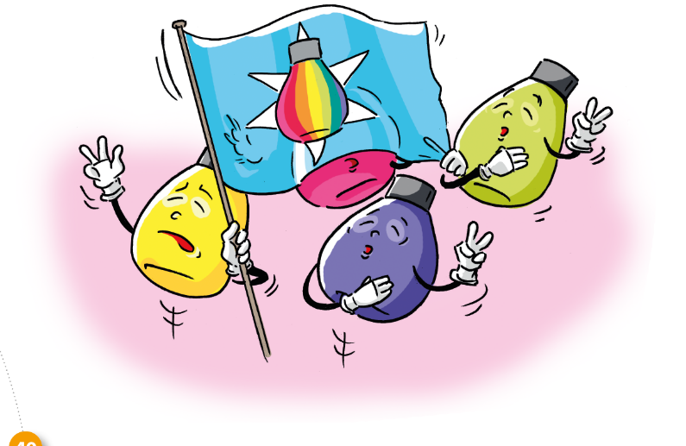
The Philosophy
THE PHILOSOPHY
#3

Slide 10
The Philosophy
THE PHILOSOPHY 1. Tools instead of rules
Complex, “large” instruments
Classical notation
Narrow and tightly managed curricula
Applicable regardless of skills & educational background
“No” rules
Can be used according to needs

Slide 11
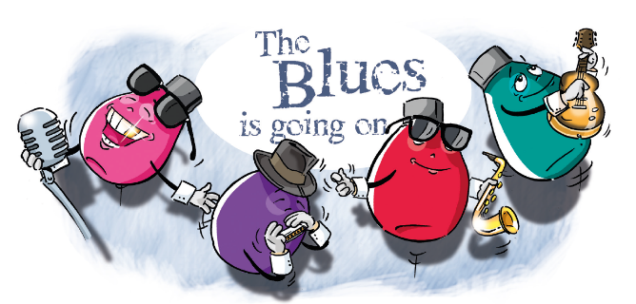
The Philosophy
THE PHILOSOPHY 2. Simplicity and joy
Making music should first and foremost be fun and create added value
Many of the best things in life are kept simpleSound before Sight

Slide 12
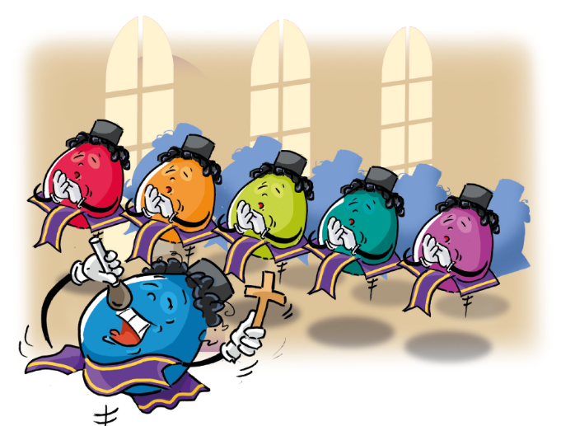
The Philosophy
THE PHILOSOPHY 3. Development of music pedagogical possibilities
The Soundbellows were born out of a commitment to music education
Ultimately, making music is not about playing a classical “real” instrument
To make music, you simply have to .... make music!

Slide 13
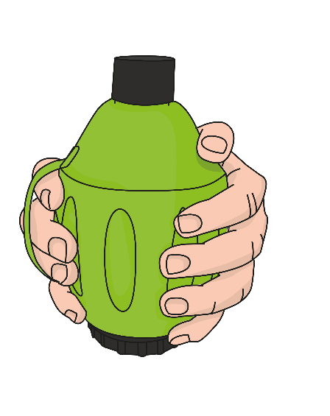
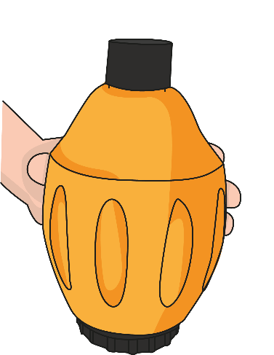
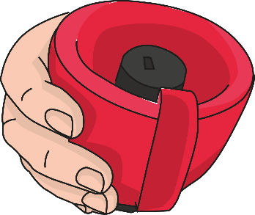
Tips on Playing Technique
TIPS ON
PLAYING TECHNIQUE
#4

Slide 14
Tips on Playing Technique
TIPS ON
PLAYING TECHNIQUE
“Everything” is allowed - there is no right or wrong
The more air you have under control, the better the sound!
Attention: Soundbellows are instruments ;-)
Practice makes perfect!
Most important principle: A lot of feeling and little force!

Slide 15
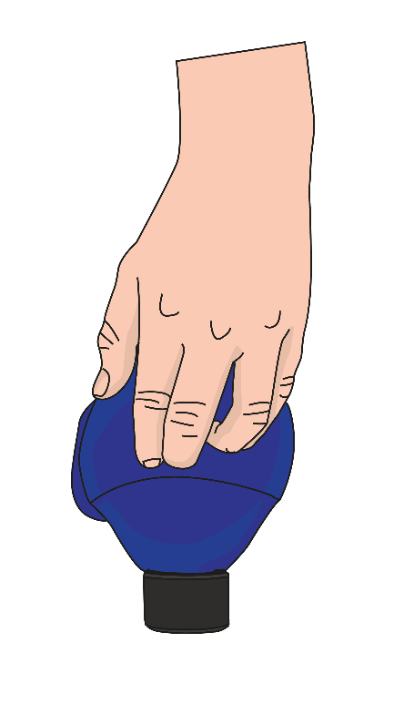
Tips on Playing Technique
TIPS ON PLAYING TECHNIQUE
Lying on the table, the Soundbellows Jumbos are super easy to play! They have a good grip because the hand strap works wonderfully as a “roll-away stopper”.
Especially for players whose fine motor skills are not yet so well developed, playing the jumbos in transport mode helps. Here, the sound head acts as an air blocker so that not too much air can be sent to the reed at once.

Slide 16
Inside the Bellows
INSIDE THE BELLOWS
#5
Pressure too high
Pressure too low
Pressure just right

Slide 17
Structure of the SB-Jumbos
#6
STRUCTURE
OF THE SOUNDBELLOWS JUMBOS

Slide 18
Structure of the SB-Jumbos
The color of the caps inicates the tones in the respective pitch:
^{black: high range}
^{white: lower range}
^{Even in the low} register (white band), the larger air volume of the design option. jumbo allows an optimal sound
STRUCTURE
OF THE
JUMBOS
Specially developed high-quality reeds ensure a pleasant sound. The bellows are designed in such a way that they can also be played by small children‘s hands.
Attention: Repeated tovigorous pressing can cause abortion of the reed!
The color coding is the same as that of the Boomwhackers® (Chroma Notes®).

Slide 19
In Use
#7
IN USE

Slide 20
In Use
IN USE
You can find countless impressive video impressions and further information about this extraordinary instrument on the Soundbellows social media platforms!
For reasons of storage space, links are provided here via QR code!
Just pull out your cell phone and off you go! :-)
LINK
LINK
LINK

Slide 21
Note
NOTE
In addition to the Soundbellows Jumbos (2nd generation), there are still the smaller 1st generation Soundbellows.
You can read here how these differ from the Soundbellows Jumbos:
Evolution
LINK

Slide 22
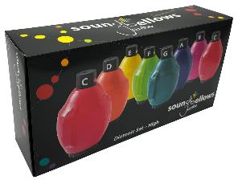
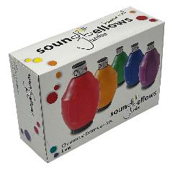
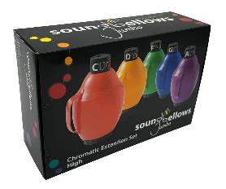
Assortment 1/2
Soundbellows® 8-Note Jumbo Diatonic Set Low C'-C'' (SBS-JDL)
8 Soundbellows®
Tones: C‘/ D‘/ E‘/ F‘/ G‘/ A‘/ B‘/ C‘‘
Soundbellows® 8-Note Jumbo Diatonic Set High C'-C'' (SBS-JDH)
8 Soundbellows®
Tones: C‘‘/ D‘‘/ E‘ ‘/ F‘ ‘/ G‘‘/ A‘‘/ B‘ ‘/ C‘‘‘
Soundbellows® 5-Note Jumbo Chromatic Extension Set Low C#'-A#' (SBS-JCL) 5 Soundbellows® Tones: C#‘/Db‘, D#‘/Eb‘, F#‘/Gb‘, G#‘/Ab‘, A#‘/Bb‘
Soundbellows® 5-Note Jumbo Chromatic Extension Set High C#'-A#' (SBS-JCH) 5 Soundbellows® Tones: C#‘‘/Db‘‘, D#‘‘/Eb‘‘, F#‘‘/Gb‘‘, G#‘‘/Ab‘‘, A#‘‘/Bb‘‘

Slide 23
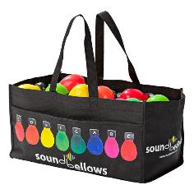
Assortment 2/2
Soundbellows® 8-Note Jumbo Diatonic Set Low C'-C'' (SBS-JDL)
8 Soundbellows®
Tones: C‘/ D‘/ E‘/ F‘/ G‘/ A‘/ B‘/ C‘‘
Soundbellows® Bag (SB-BAG)
Soundbellows® 5-Note Jumbo Chromatic Extension Set Low C#'-A#' (SBS-JCL) 5 Soundbellows® Tones: C#‘/Db‘, D#‘/Eb‘, F#‘/Gb‘, G#‘/Ab‘, A#‘/Bb‘
Soundbellows ® Bar

