Slide 1
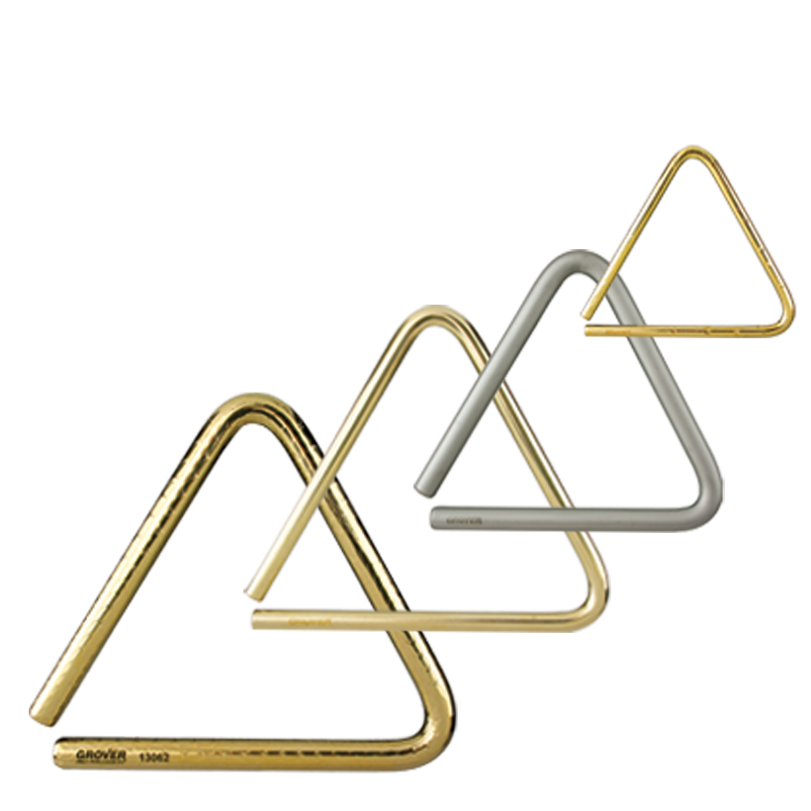
Triangles
Since setting a new standard for professional triangles in 1980, Grover Pro triangles have become THE choice for percussionists around the globe. These are the very first triangles specifically engineered to produce a wide and varied array of overtones, critical for creating a musically pleasing sonority. Simply put, our triangles are considered the “Stradivarius” of triangles!

Slide 2
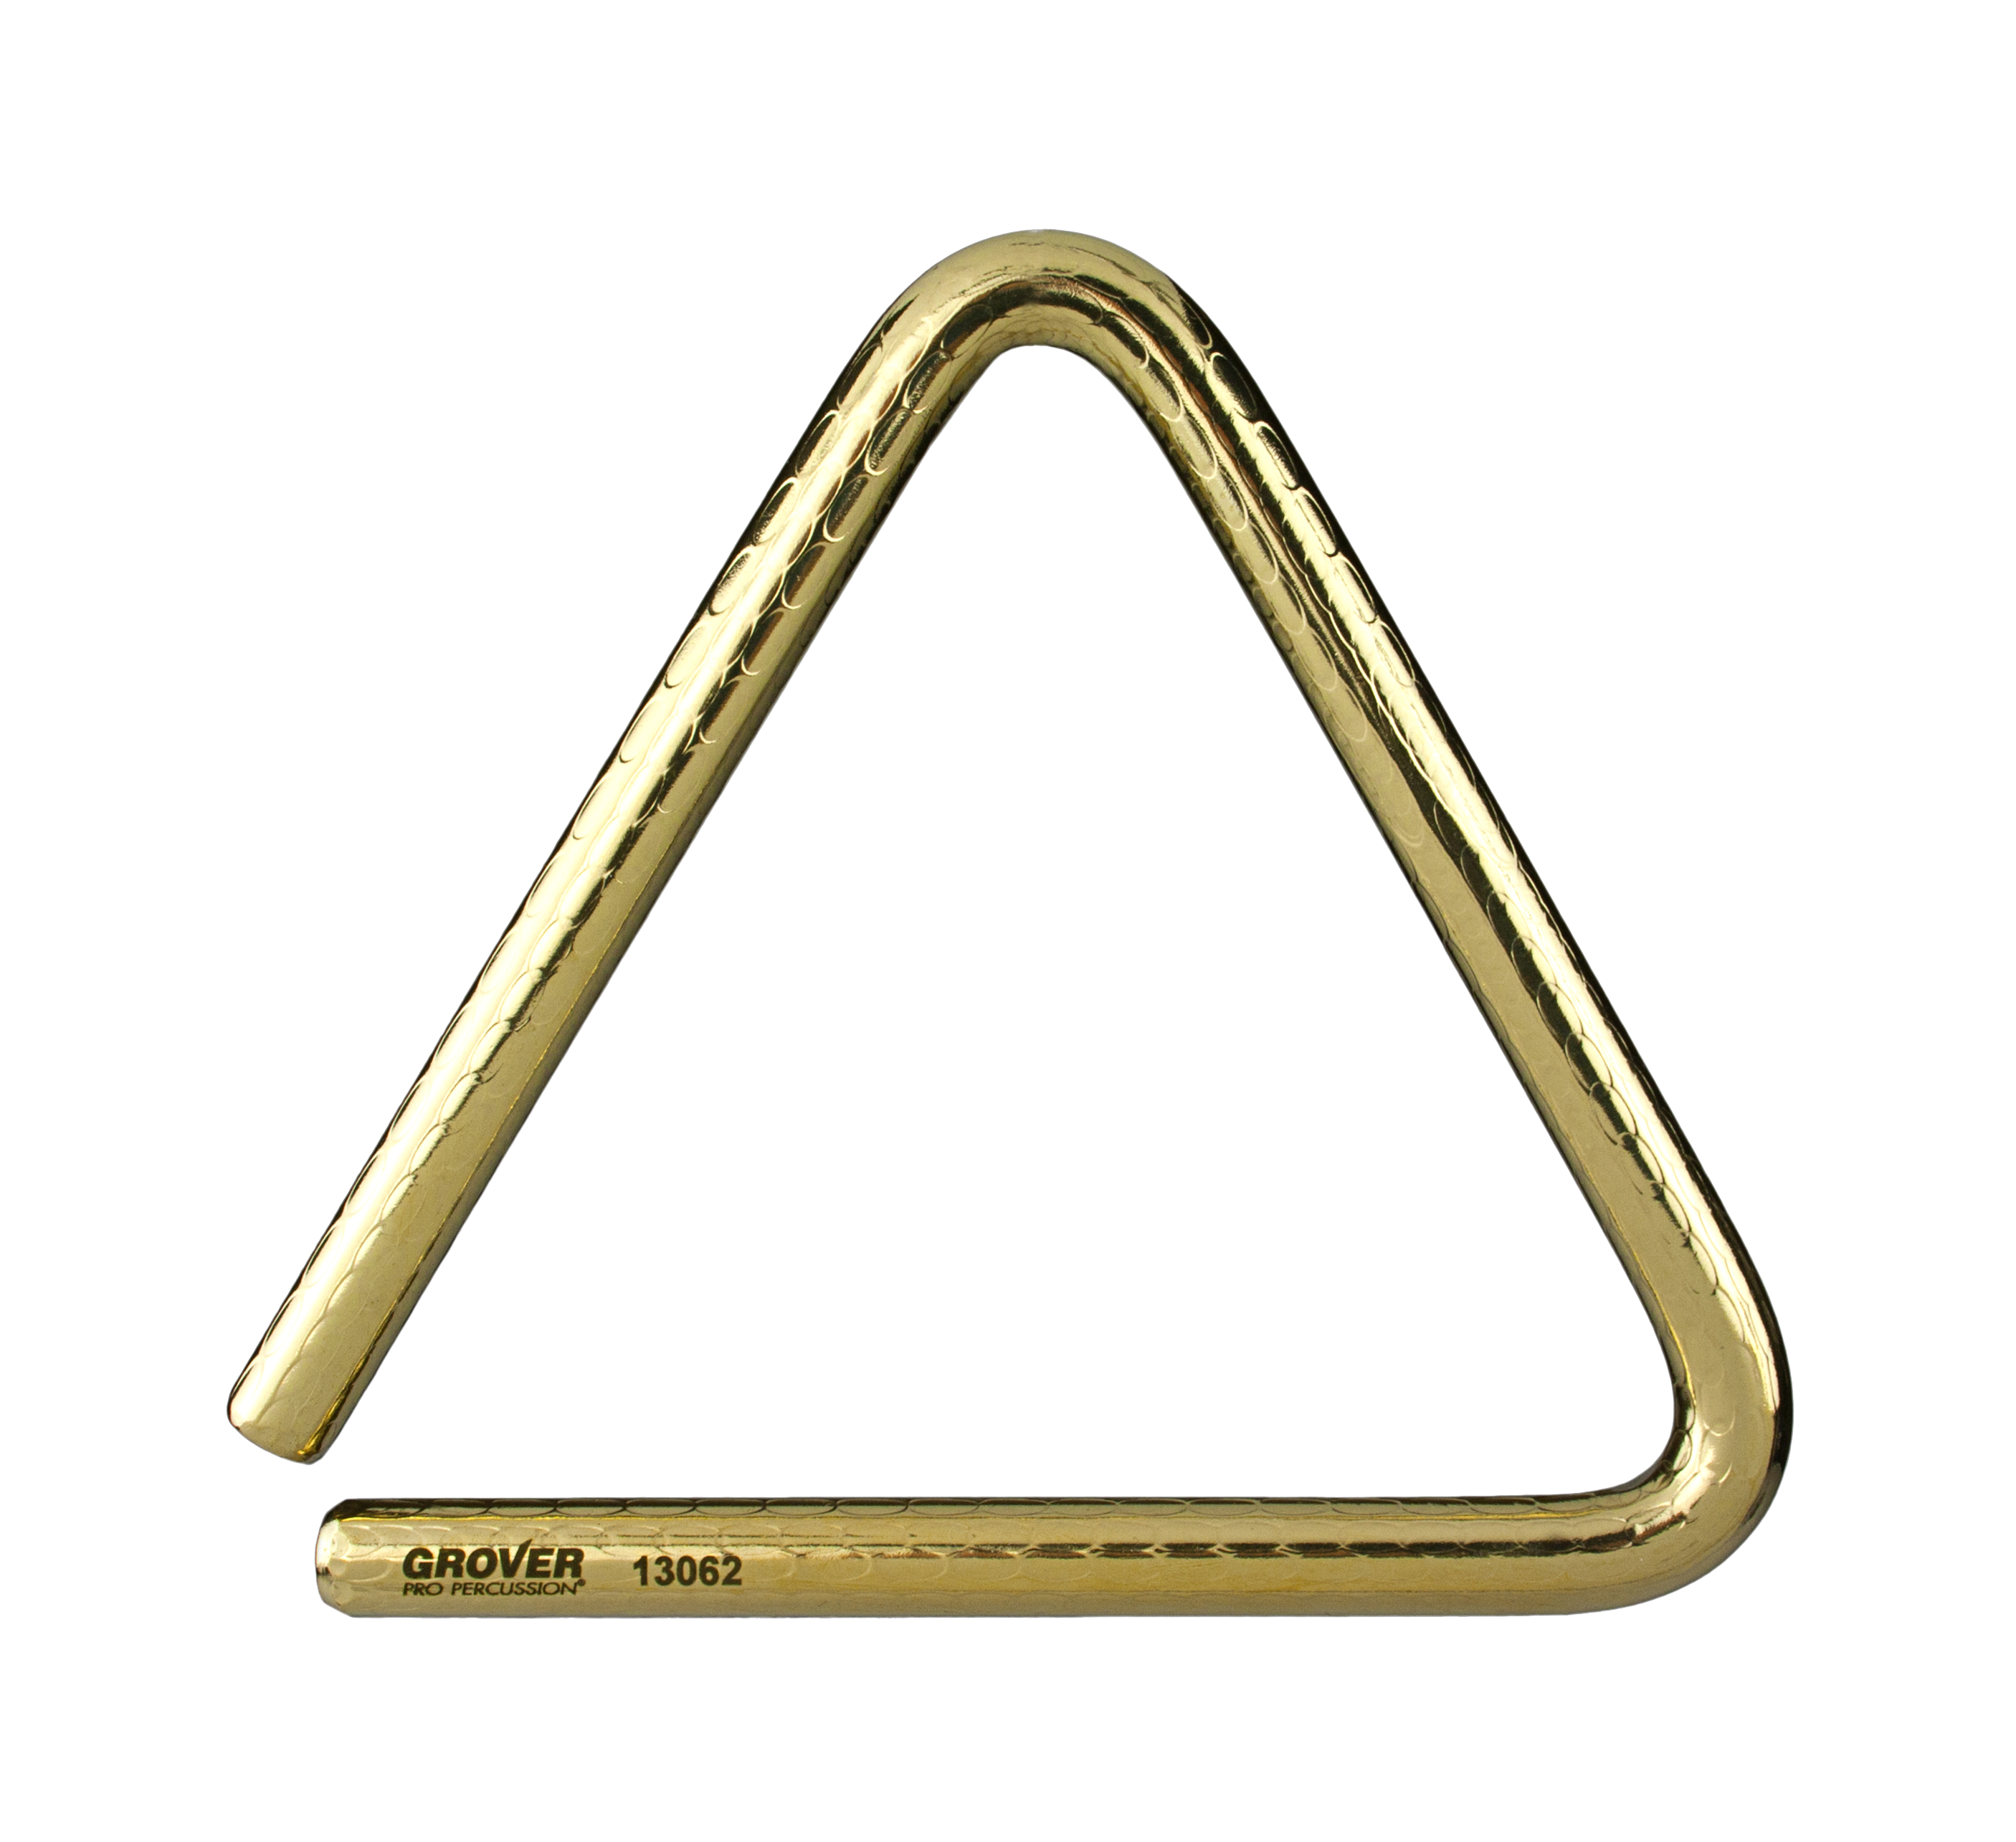
Bronze Pro
Hammered™
Triangles
Ideal for professionals and percussionists who demand an instrument capable of full expression and ultimate musicality.
The flagship of the Grover Pro triangle line, our Bronze Pro™ Hammered Triangles are painstakingly hammered to produce a reverberating richness that’s unparalleled. Well suited for discriminating professionals who demand a world-class instrument capable of full expression and finessed musicality.

Slide 3
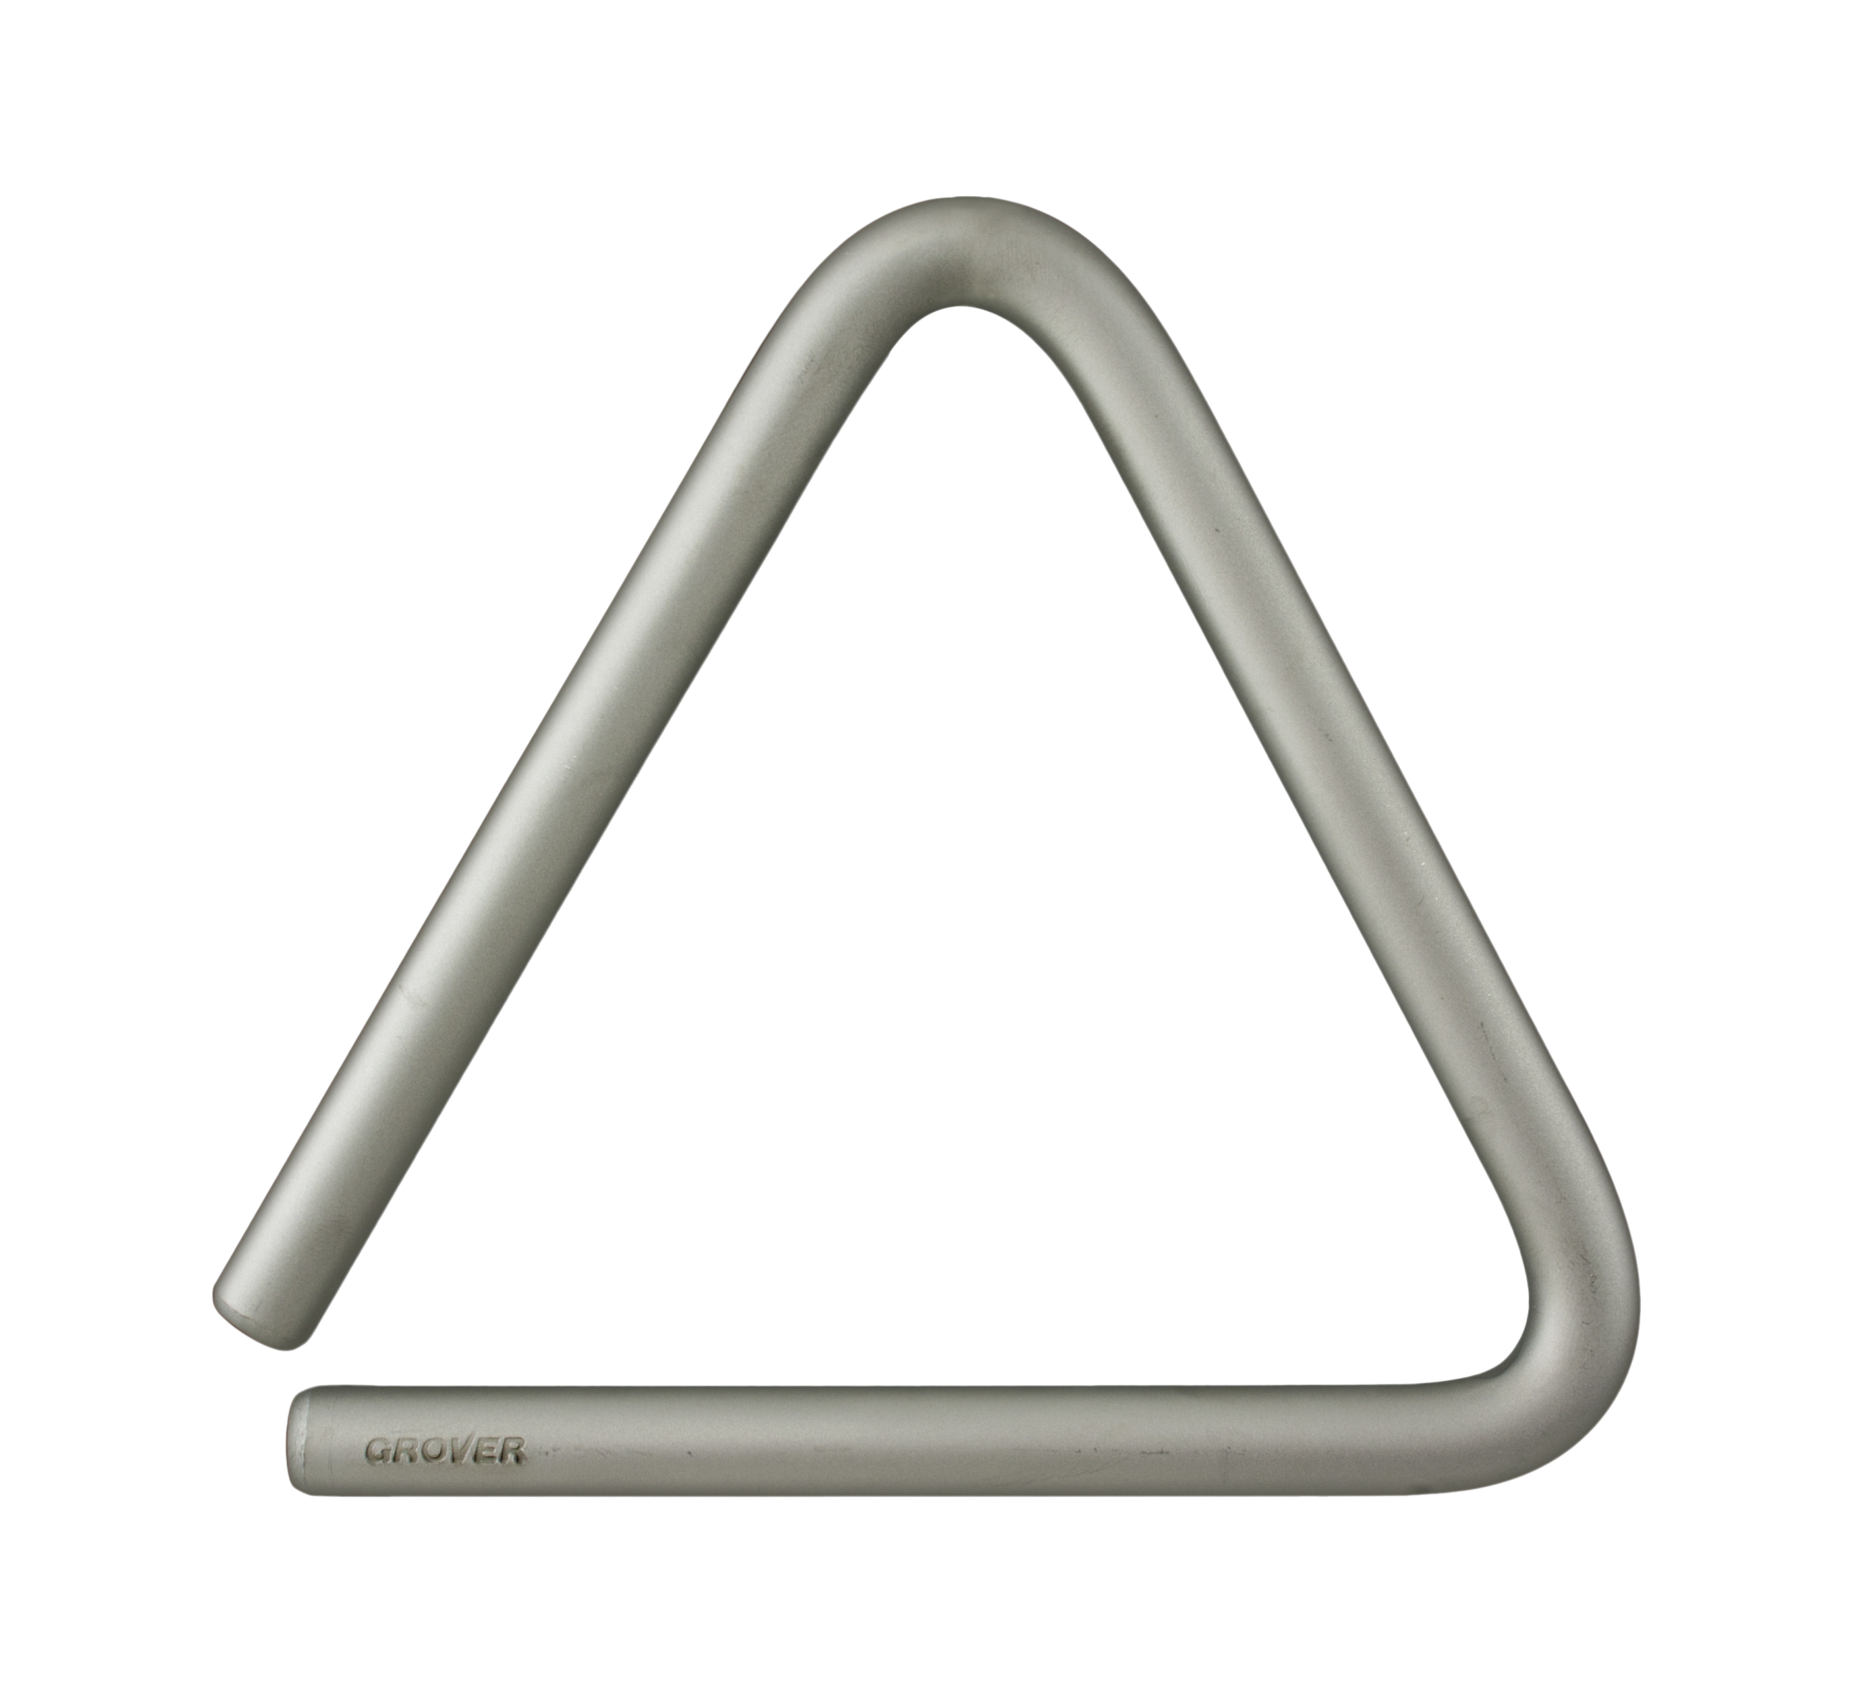
Super-Overtone™
Triangles
Creates wide spectrum overtone resonance throughout an expanded dynamic range.
Our original product, Super-Overtone™ triangles sport a wide spectrum of overtones with a large dynamic range. Abundant acoustic energy is produced by these triangles, eliminating the need to overplay.

Slide 4
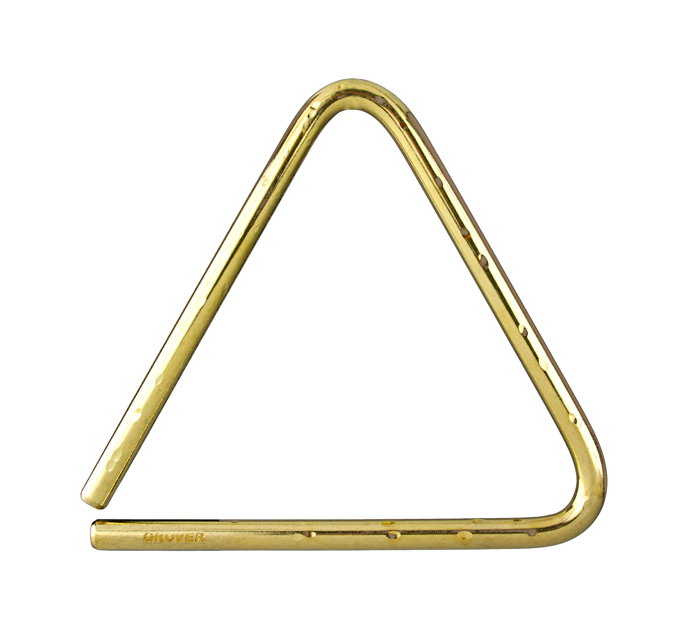
Bronze
Hammered Lite™
Triangles
Enhanced production of primary and secondary harmonics.
The Bronze Hammered Lite Triangles to produce a lighter spectrum of audible overtones. The tonal properties can best be described as resonant with a wide array of audible harmonics.

Slide 5
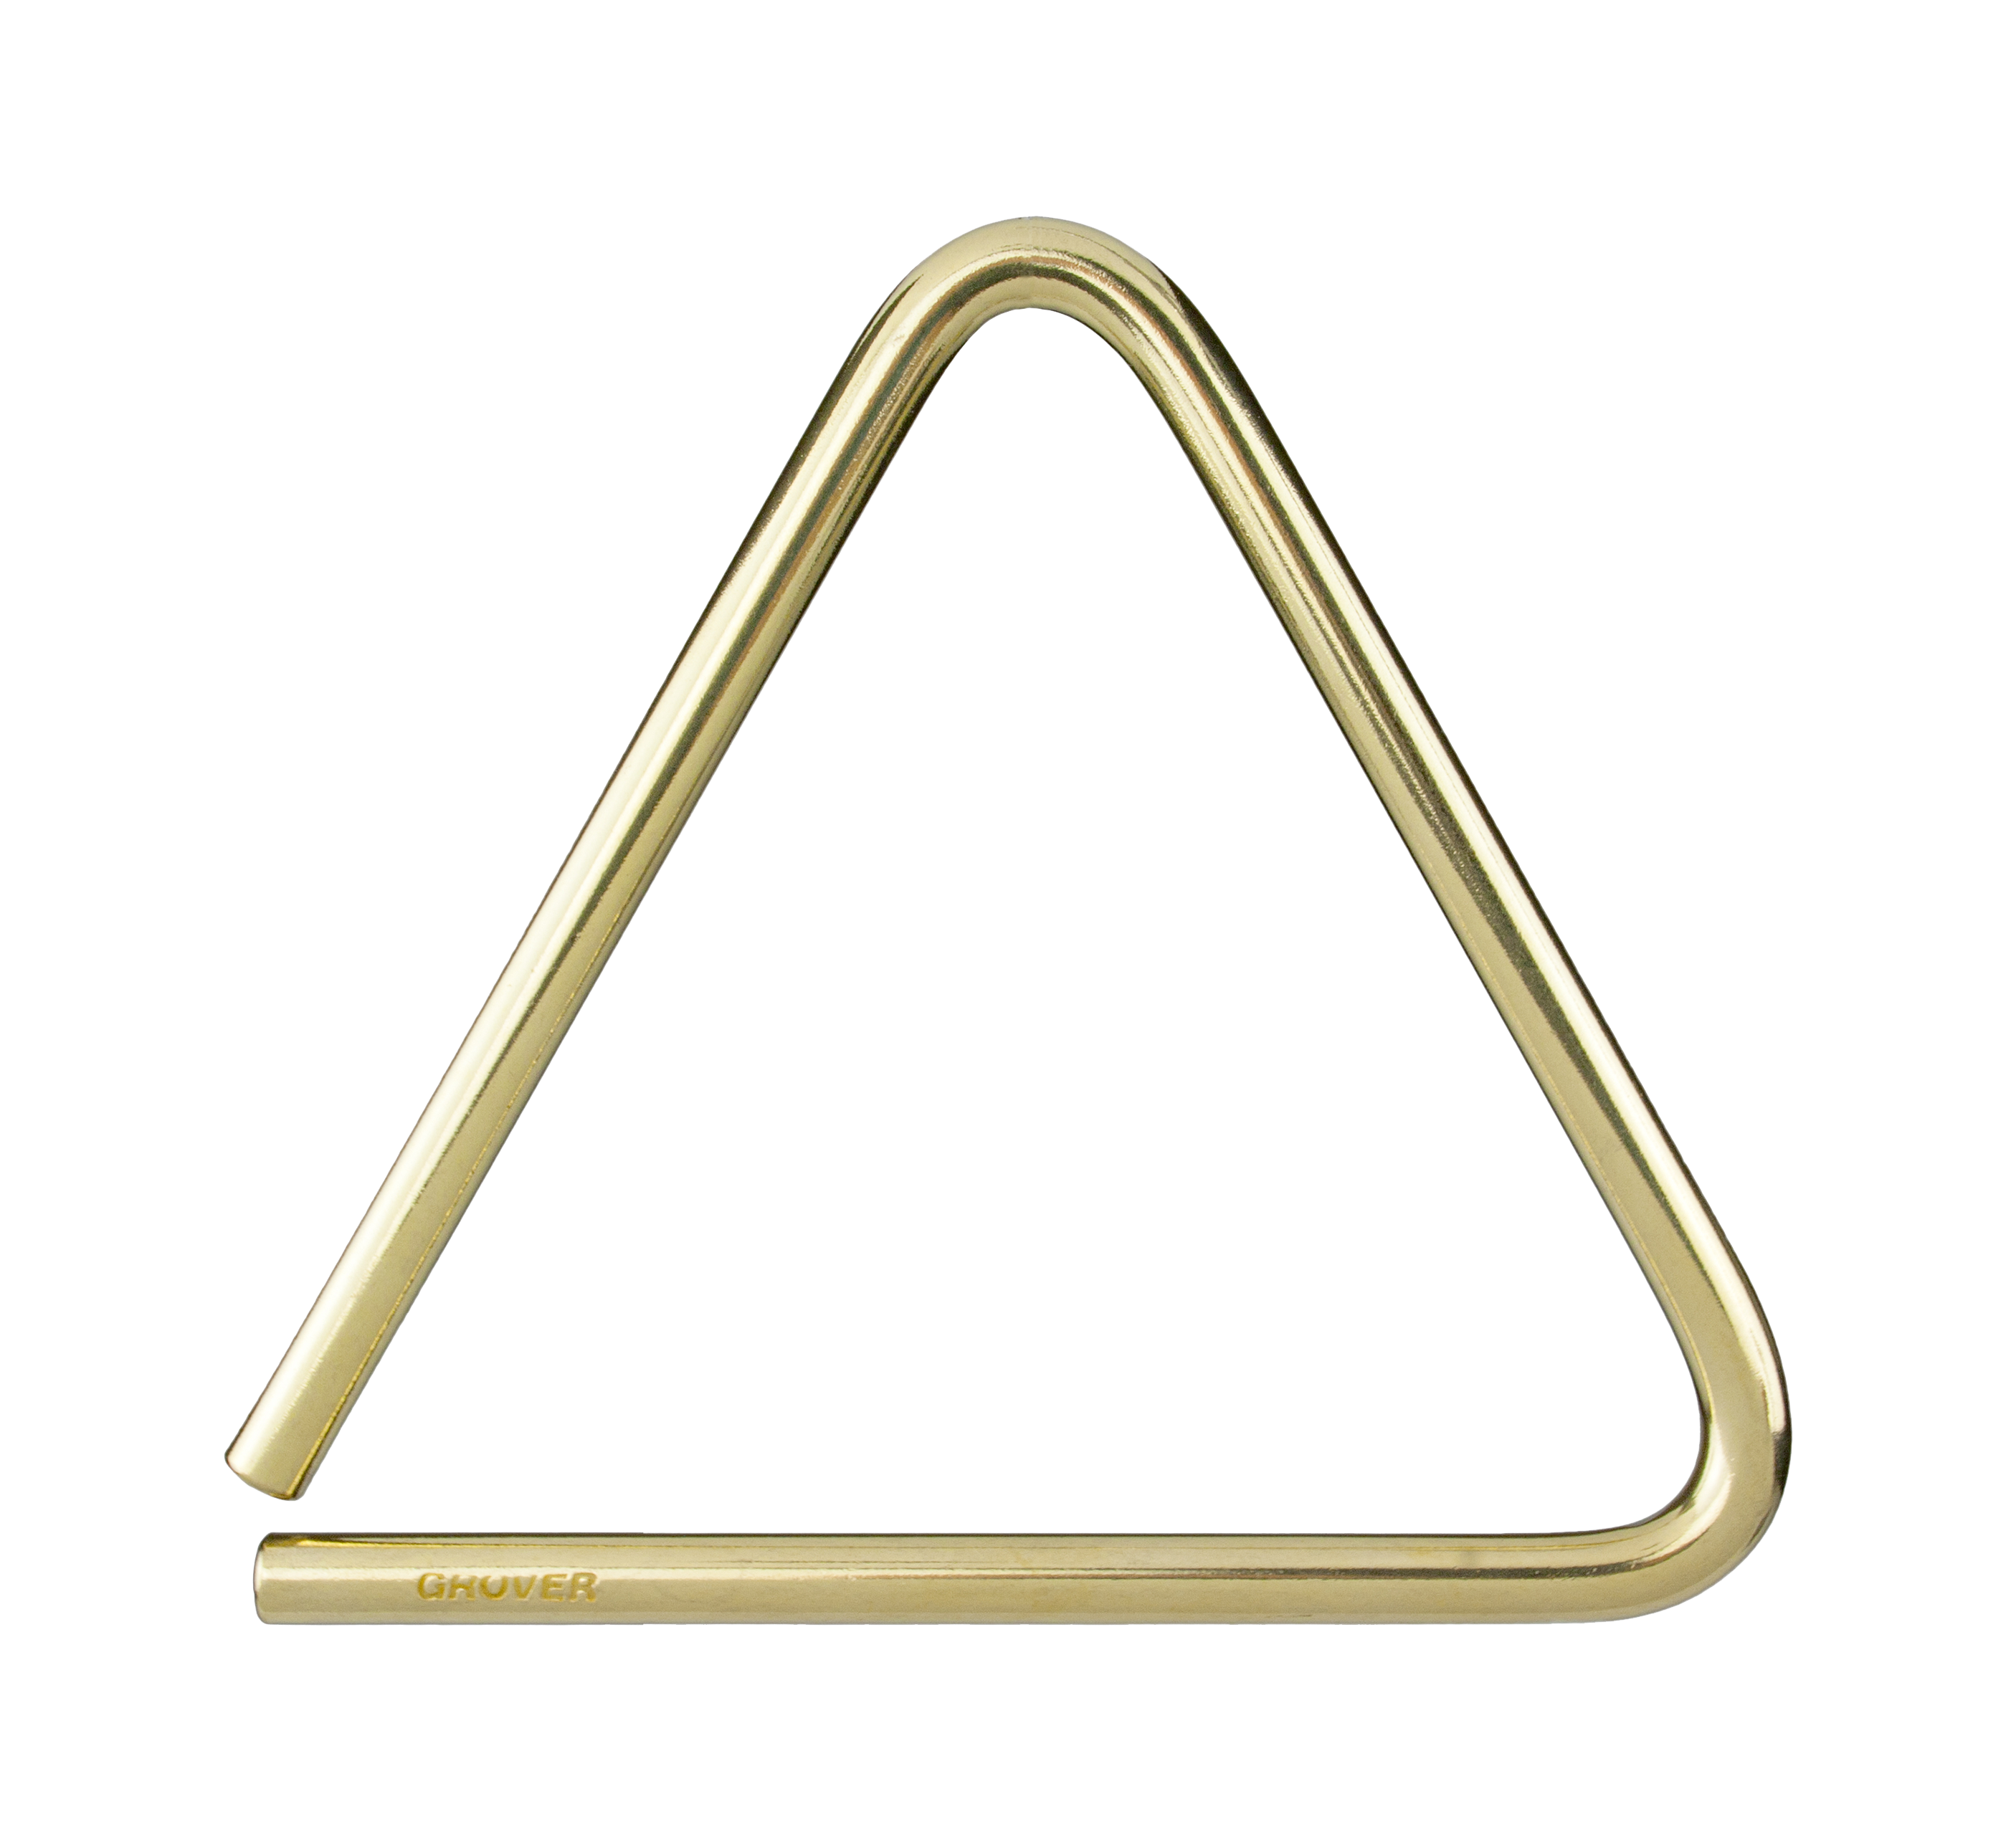
Bronze
Series
Triangles
Perfect for lighter applications and small ensembles.
These triangles fill a need for lighter sounding triangles with a focused sound. Perfect for players searching for a resonant, clear tone.

Slide 6
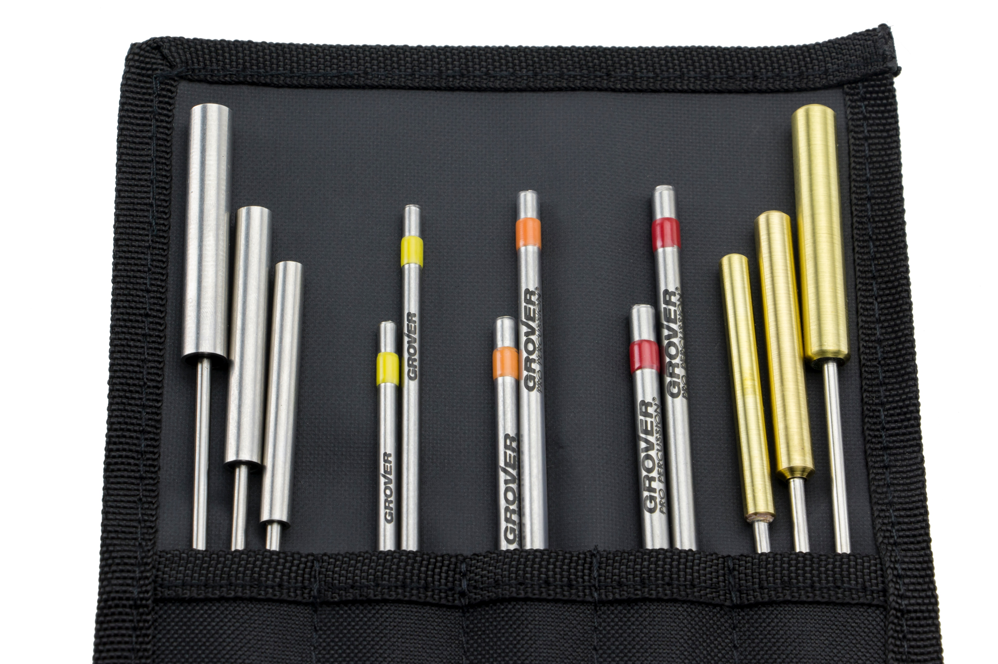
Super Deluxe
Beater Set
Our most popular sizes and styles in one set!
This special set of twelve beaters contains three different models of beater, including our popular Alloy 303™ straight rod beaters, our Stainless-Steel Tubular beaters, and our heavy-wall Brass Tubular beaters.

Slide 7
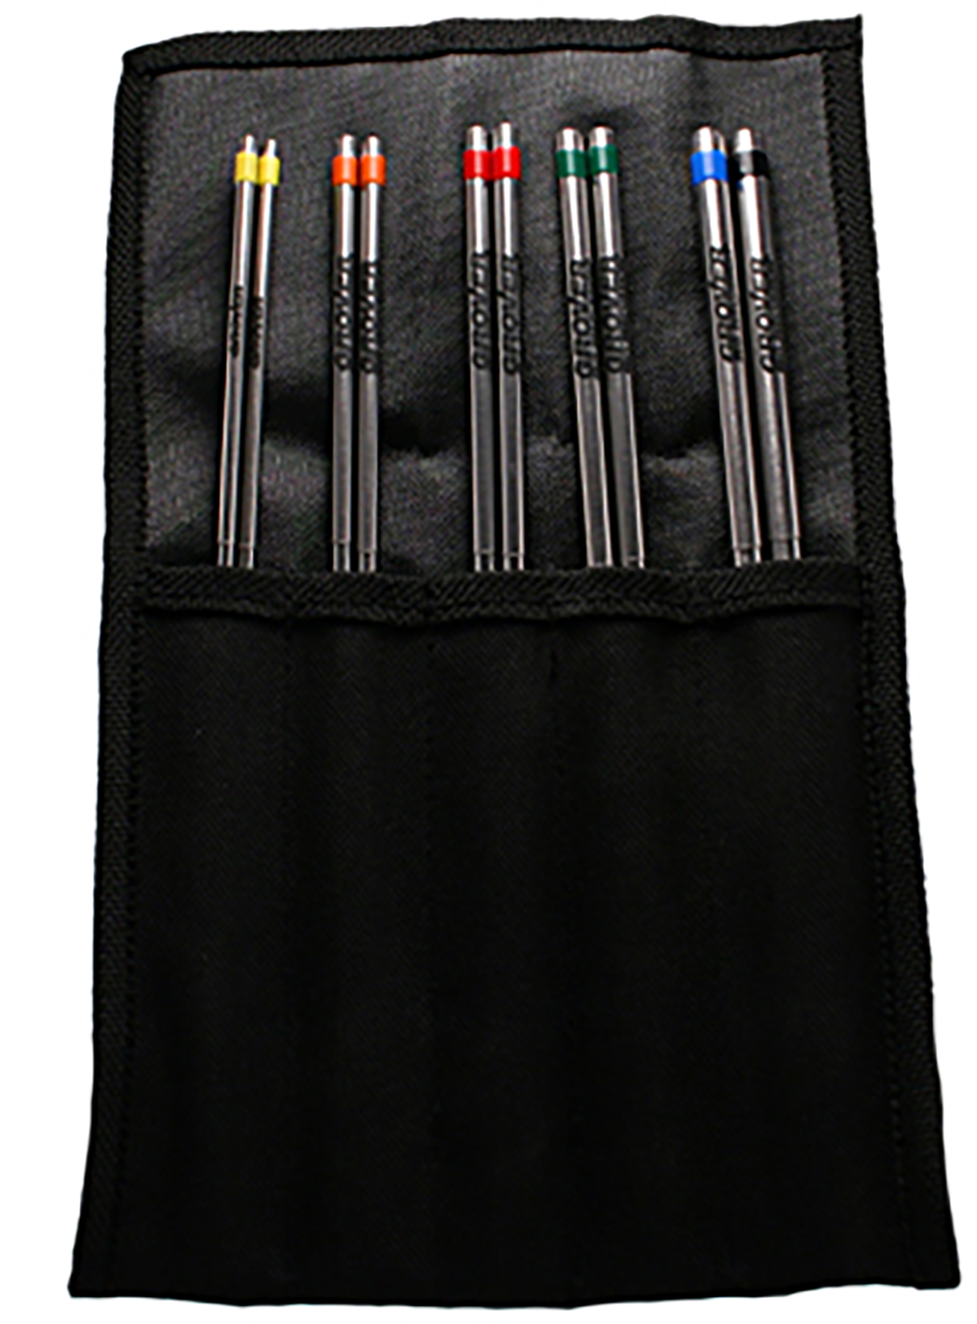
Alloy 303™
Beaters
Traditional style triangle beaters.
Traditional in design, Alloy 303 Beaters are made from a stainless steel alloy. Their extra length makes it easy to play rolls and intricate rhythms.

Slide 8
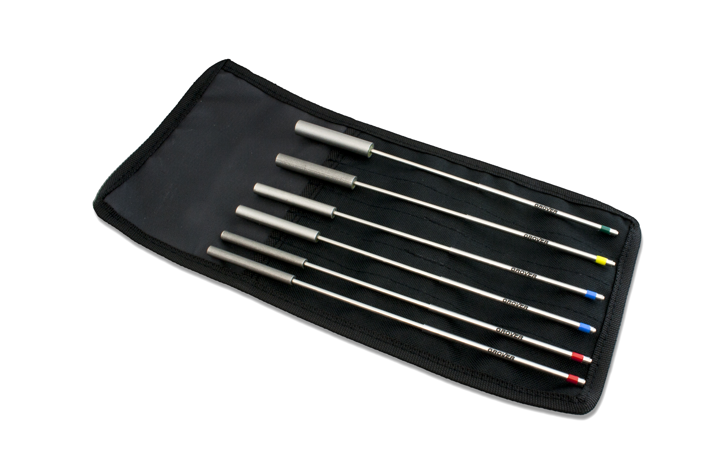
Stainless Steel Tubular
Beaters
Contemporary style triangle beaters.
These contemporary style beaters feature a stainless steel tubular beater face isolated from a core shaft using a special rubber compound. These beaters produce a great array of spectral overtones from triangles thanks to the heavier and larger beater face.

Slide 9
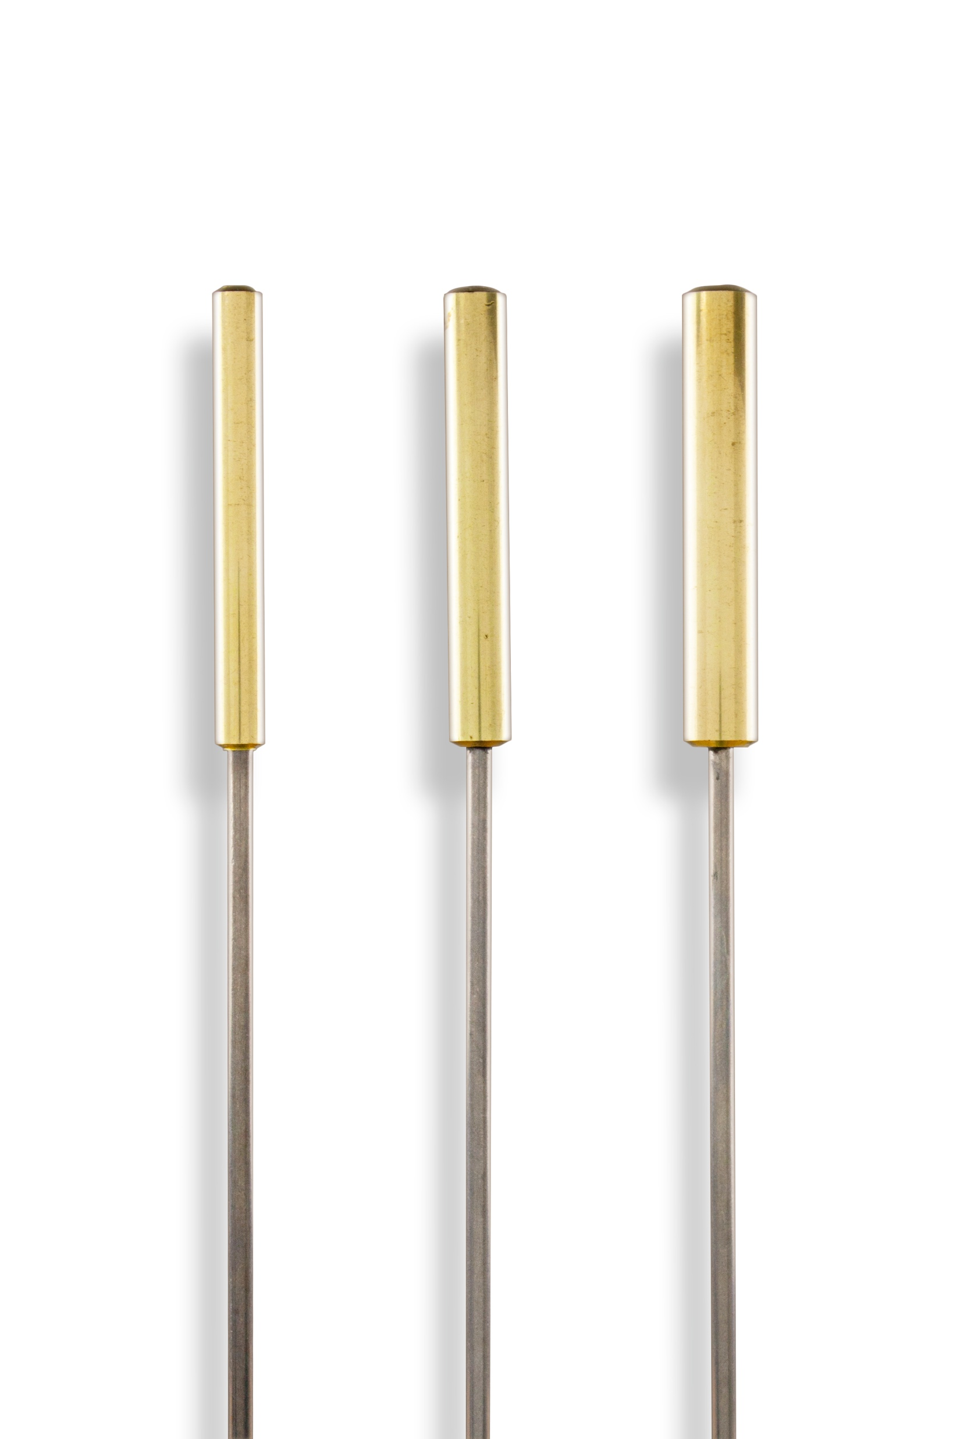
Brass Tubular
Beaters
Designed for pronounced overtone production.
Contemporary in design, our brass tubular triangle beaters will bring out the overtones more than a traditional style beater. They produce a sonorous shimmer immediately upon impact with minimal contact sound.

Slide 10
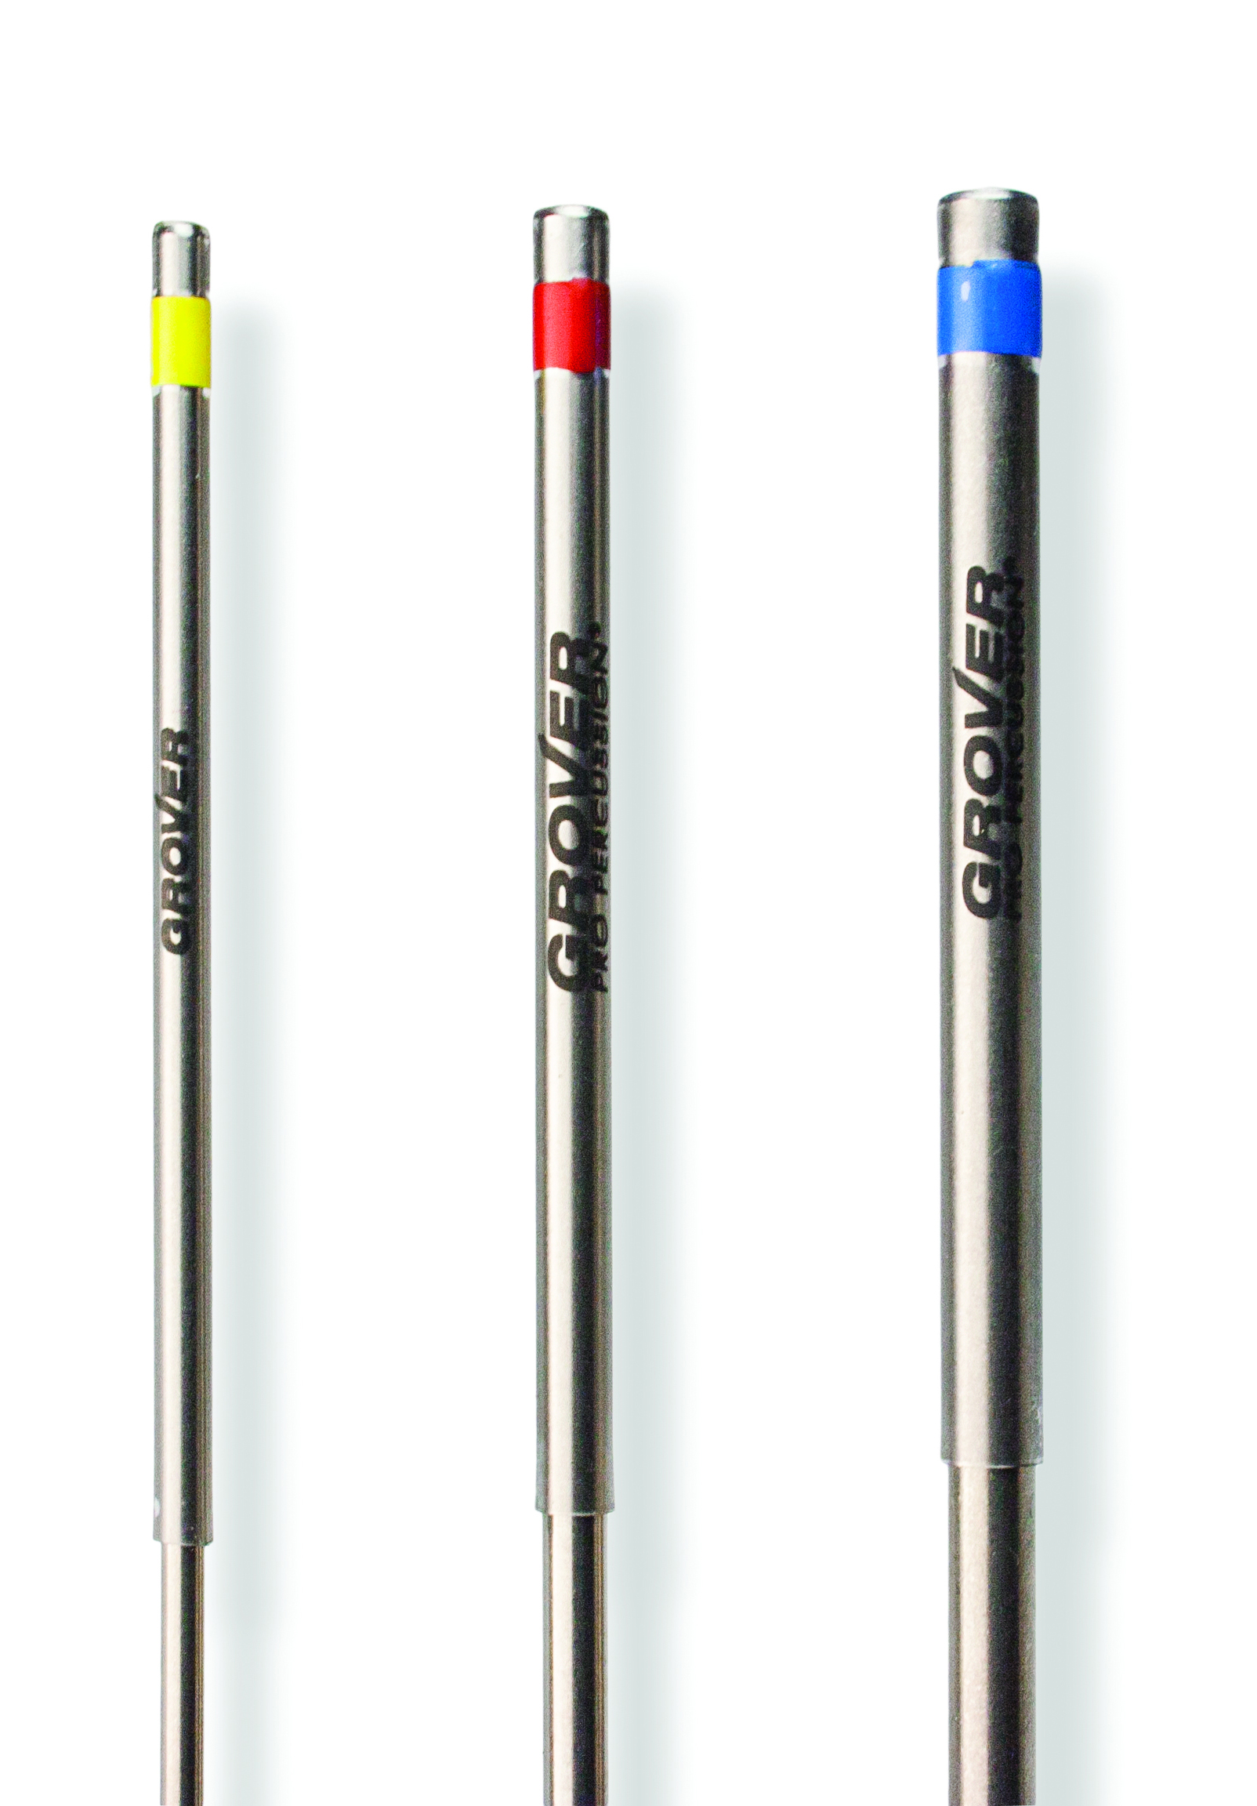
Sound Values™
Beaters
A basic set of quality triangle beaters.
Recognizing that not everyone needs a complete set of six beaters, the three most popular sizes of our Alloy 303™ models make up the Sound Values line.

