Slide 1
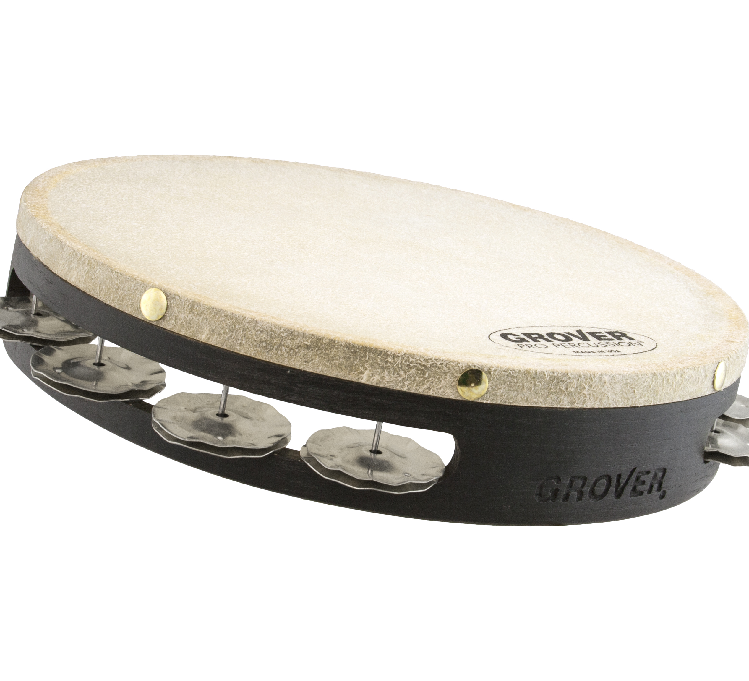
Tambourines
Considered the world’s finest, Grover Pro tambourines set the standard by which all others are judged. Renowned for vastly superior sound, innovative design, and unparalleled construction, Grover Pro tambourines have been resounding with crystal-clear clarity and full, rich resonance since 1980!

Slide 2
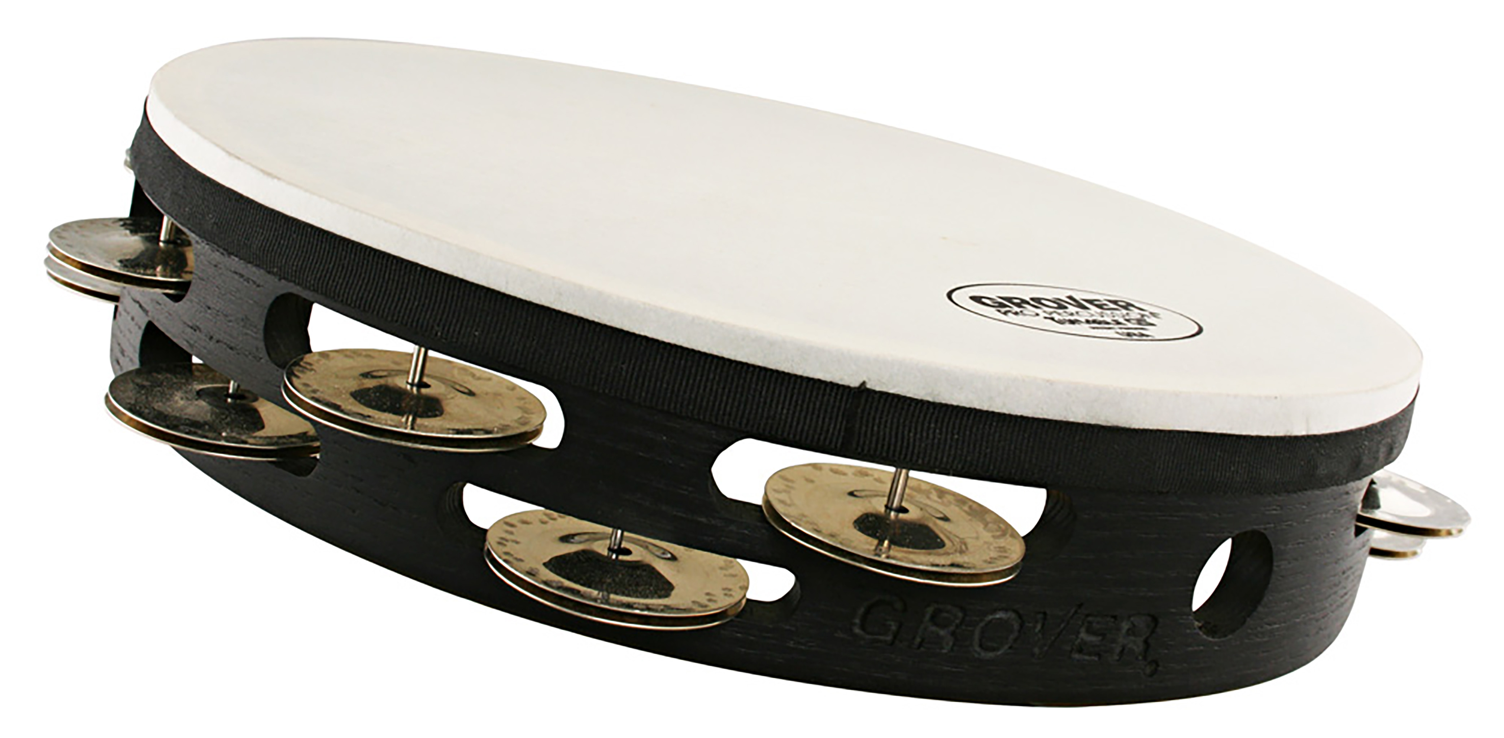
Tunable
Tambourine
Tunable, customizable tambourine; natural skin head
The Grover Pro Tunable Tambourine affords players who prefer a natural skin head the ability to maintain a consistent head tension regardless of the temperature and humidity.

Slide 3
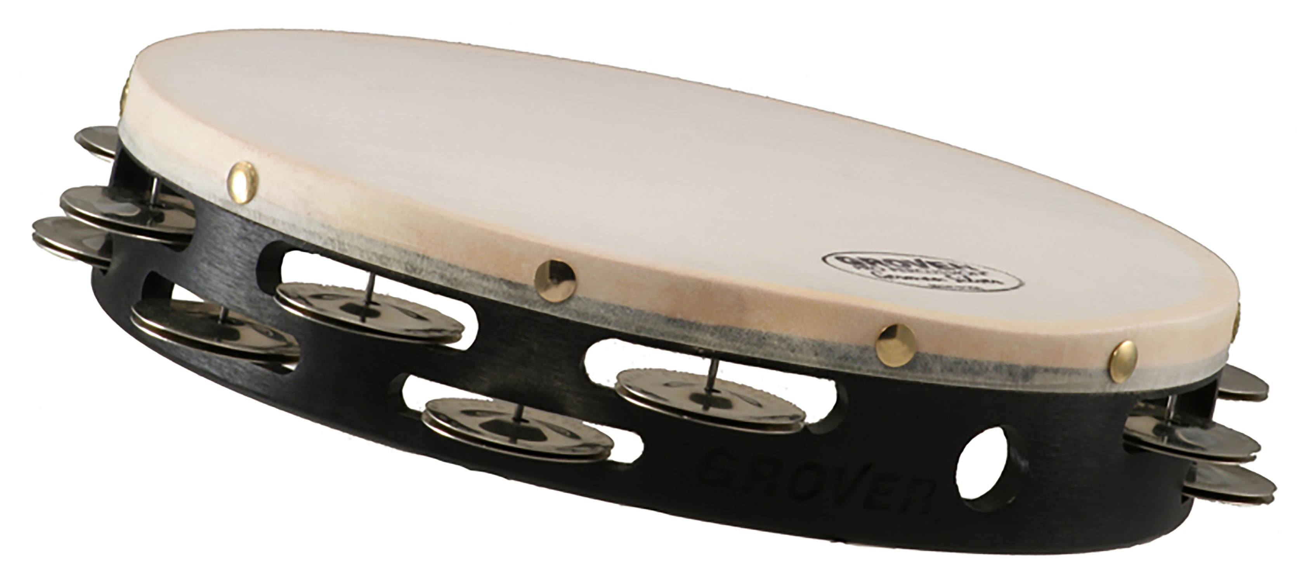
German Silver
Tambourine
Hand-hammered silver jingles, natural skin head
Our most popular alloy, German Silver resounds with a clear articulation that is bright, sensitive, and powerful.

Slide 4
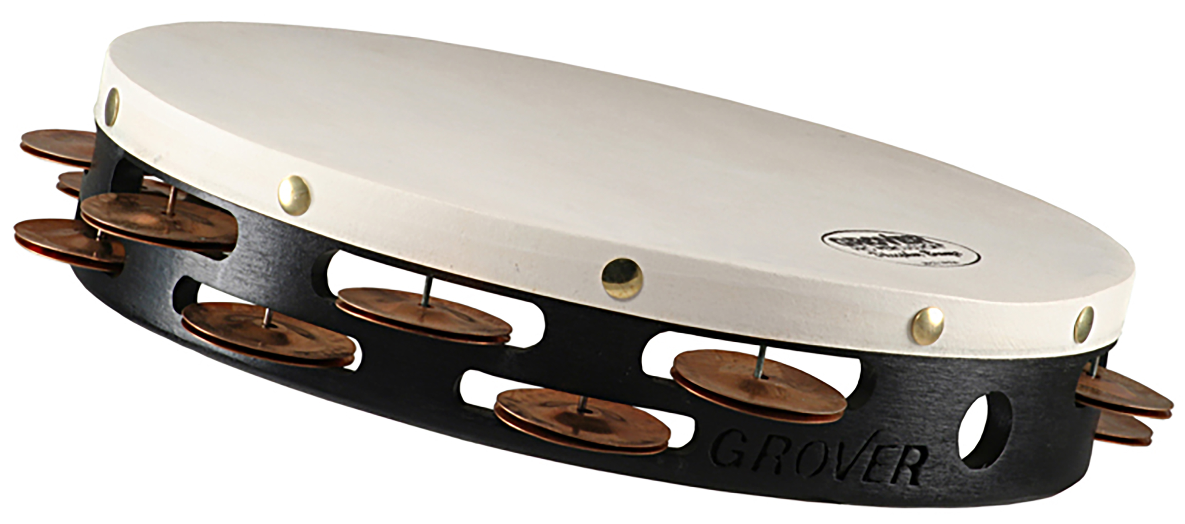
Phosphor Bronze
Tambourine
Hand-hammered bronze jingles, natural skin head
Our Phosphor Bronze model is a favorite of percussionists who desire a deep, darker sound color.

Slide 5
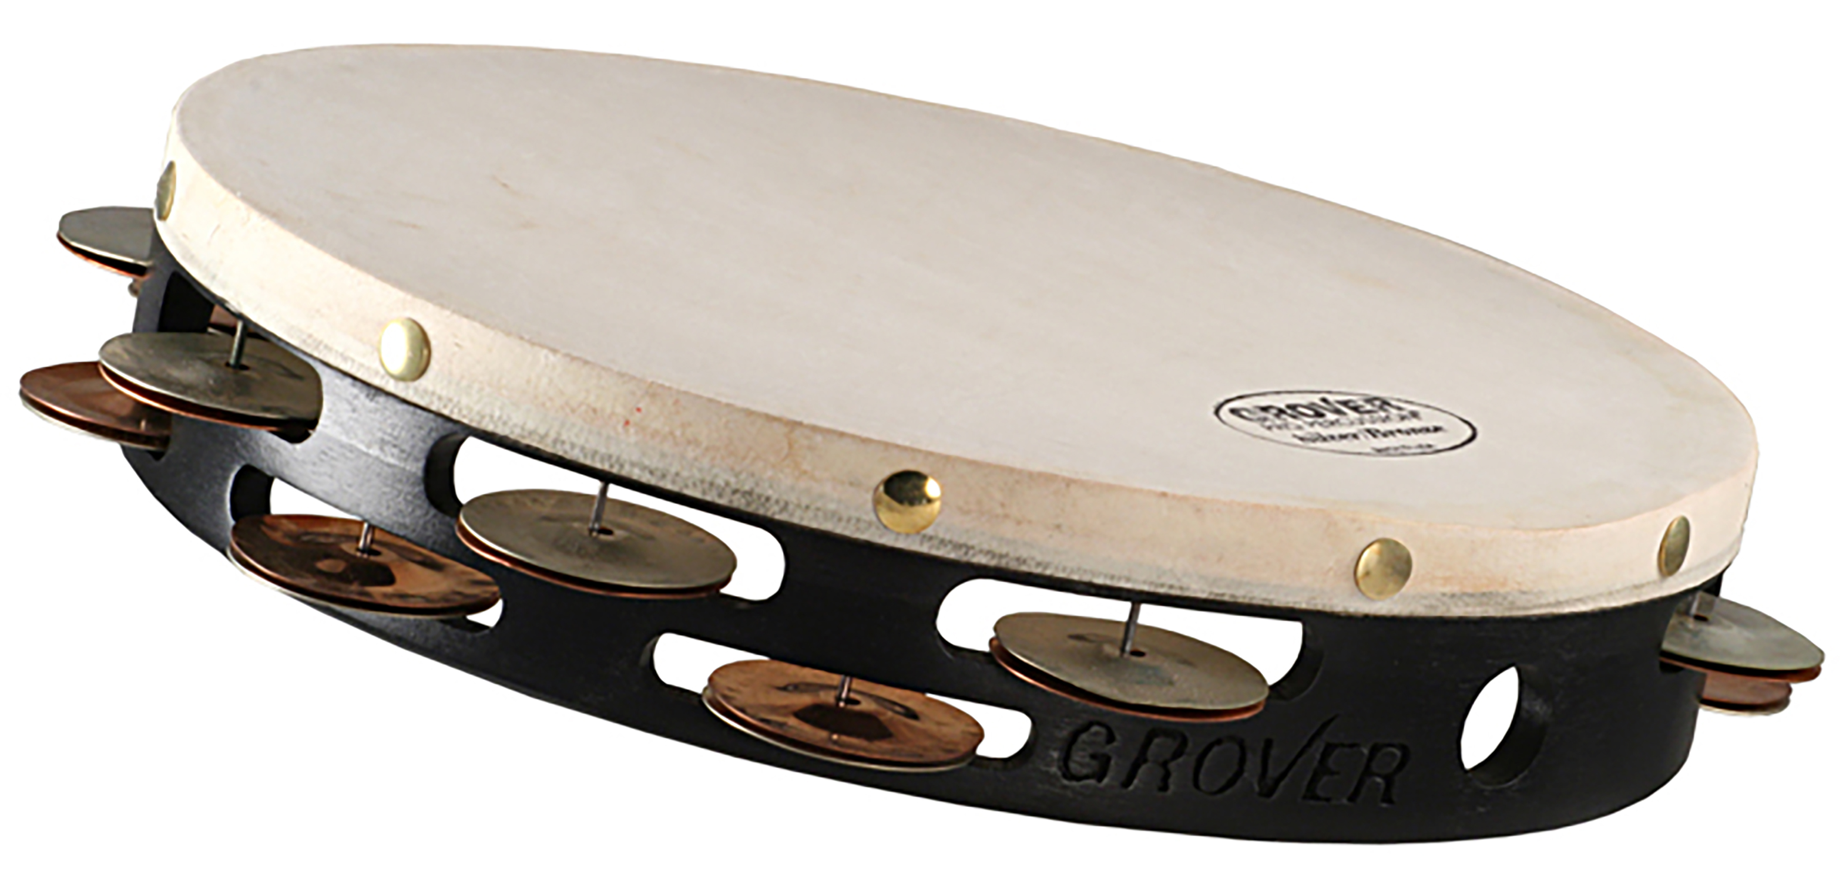
Silver/Bronze Combo
Tambourine
Hand-hammered silver & bronze jingles, natural skin head
Grover Pro’s innovative “combo” model was the first tambourine to use fully integrated German Silver and Phosphor Bronze alloys on one tambourine.

Slide 6
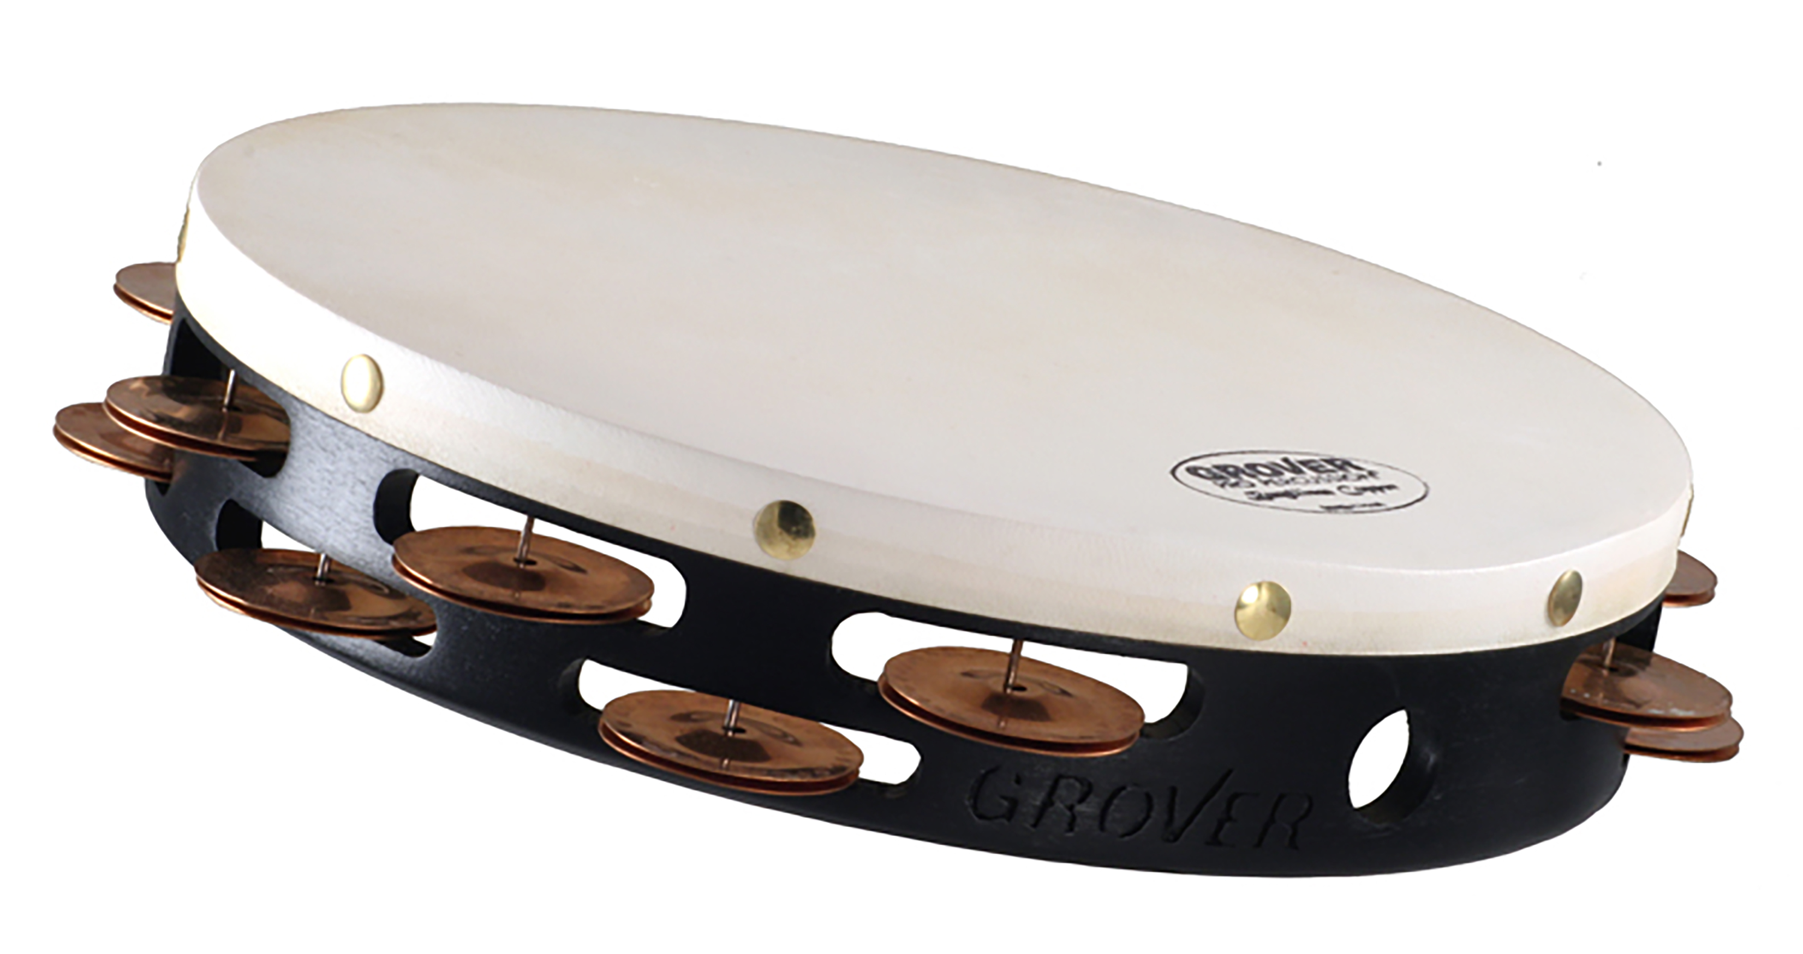
Beryllium Copper
Tambourine
Hand-hammered copper jingles, natural skin head
Beryllium Copper jingles were pioneered by Grover Pro in the 1980s. This rare alloy is chosen by players who want a rich texture with a balanced blend of both bright and dark overtones.

Slide 7
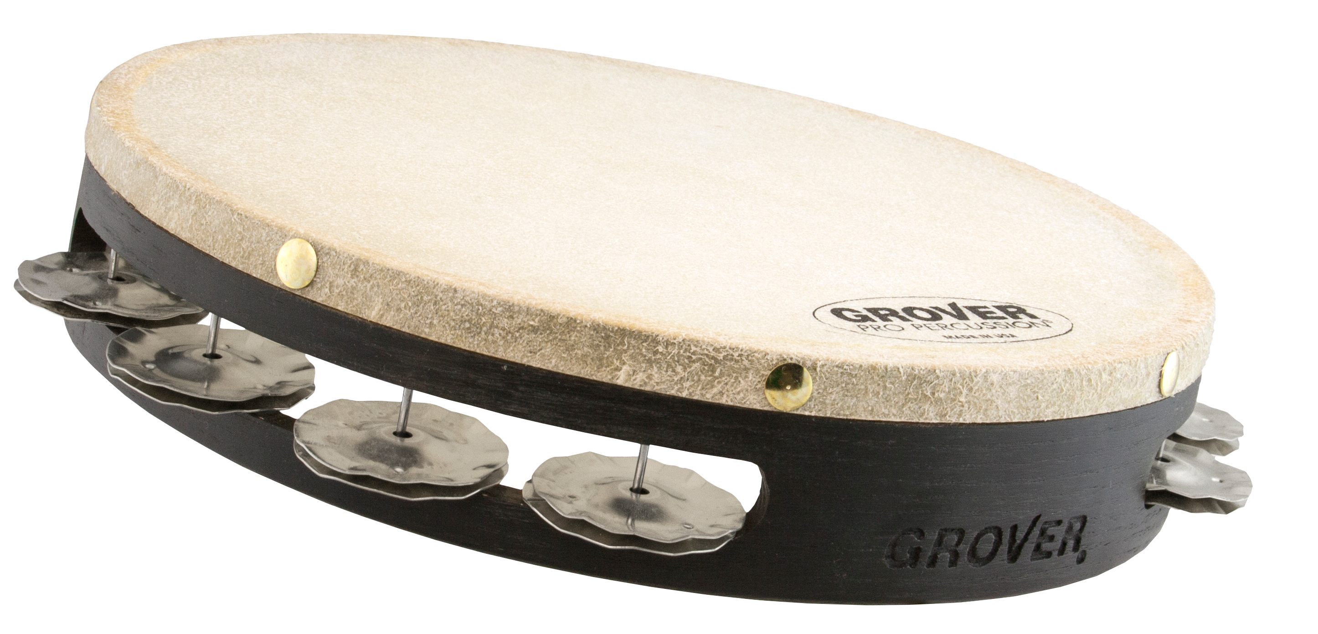
Spanish Silver
Tambourine
Fluted silver jingles, natural skin head
One of the distinguishing features of the traditional Spanish tambourine are jingles that are fluted (or crinkled). This effectively controls the resonance of the instrument while at the same time adding a focused richness to the sound.

Slide 8
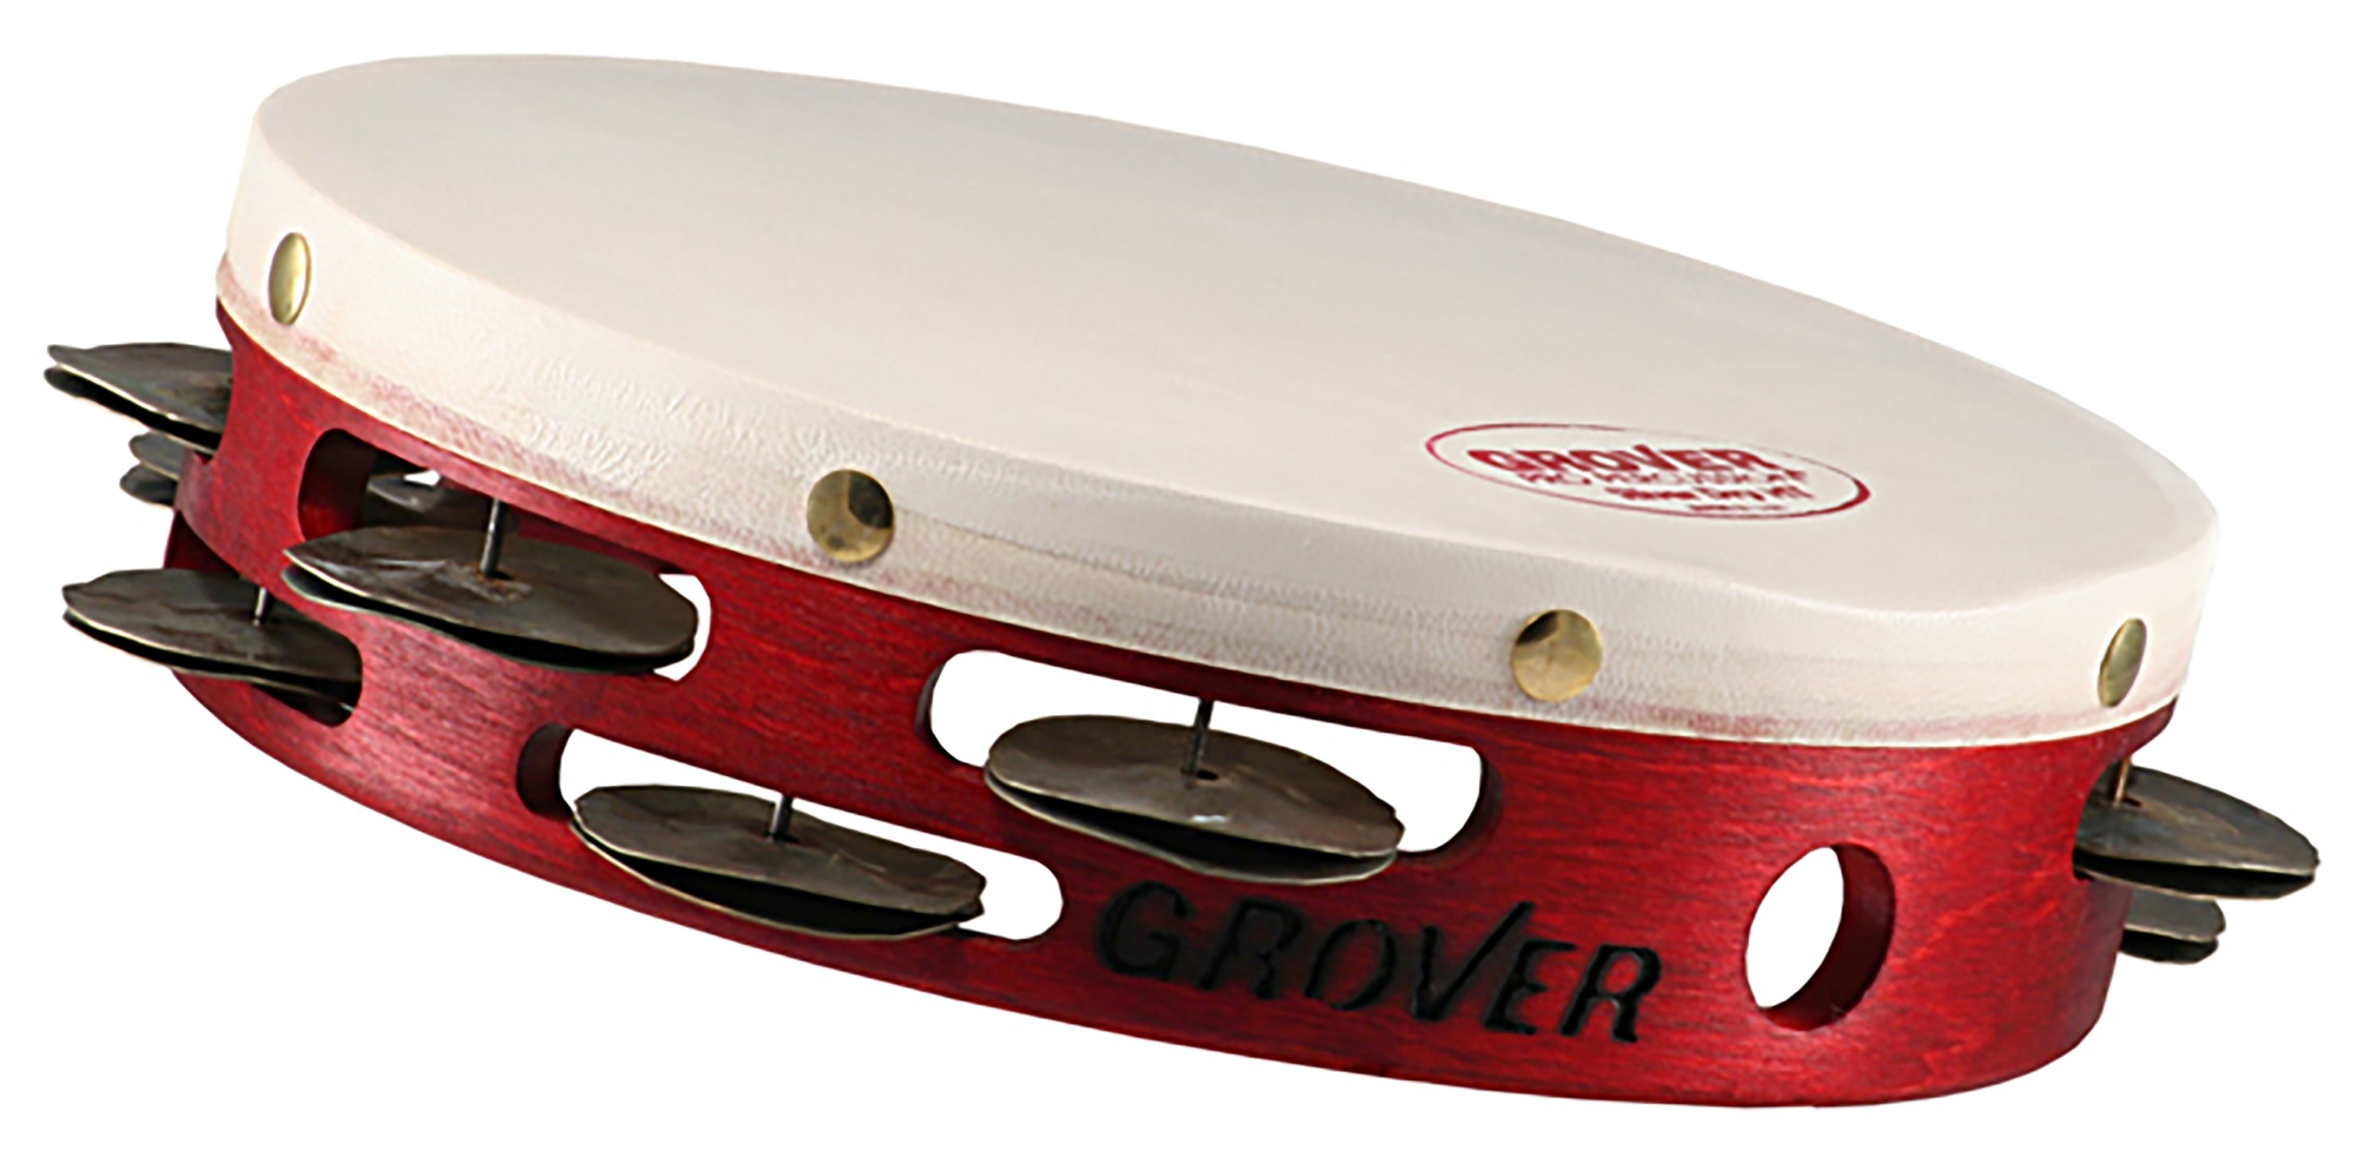
Custom Dry™
Tambourine
Heat-treated silver jingles, natural skin head
Producing an articulate, “crunchy” spread of overtones, this tambourine is perfect for passages that require exaggerated articulation.

Slide 9
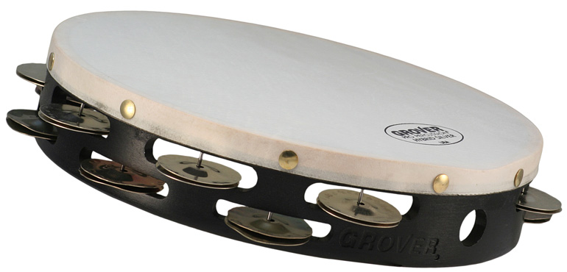
Hybrid
Tambourine
Hand-hammered & heat-treated silver jingles, natural skin head
Our innovative Hybrid Silver tambourine blends German Silver with Custom Dry jingles. Perhaps our most versatile model, this tambourine is an excellent choice for those who need one tambourine to do it all.

Slide 10
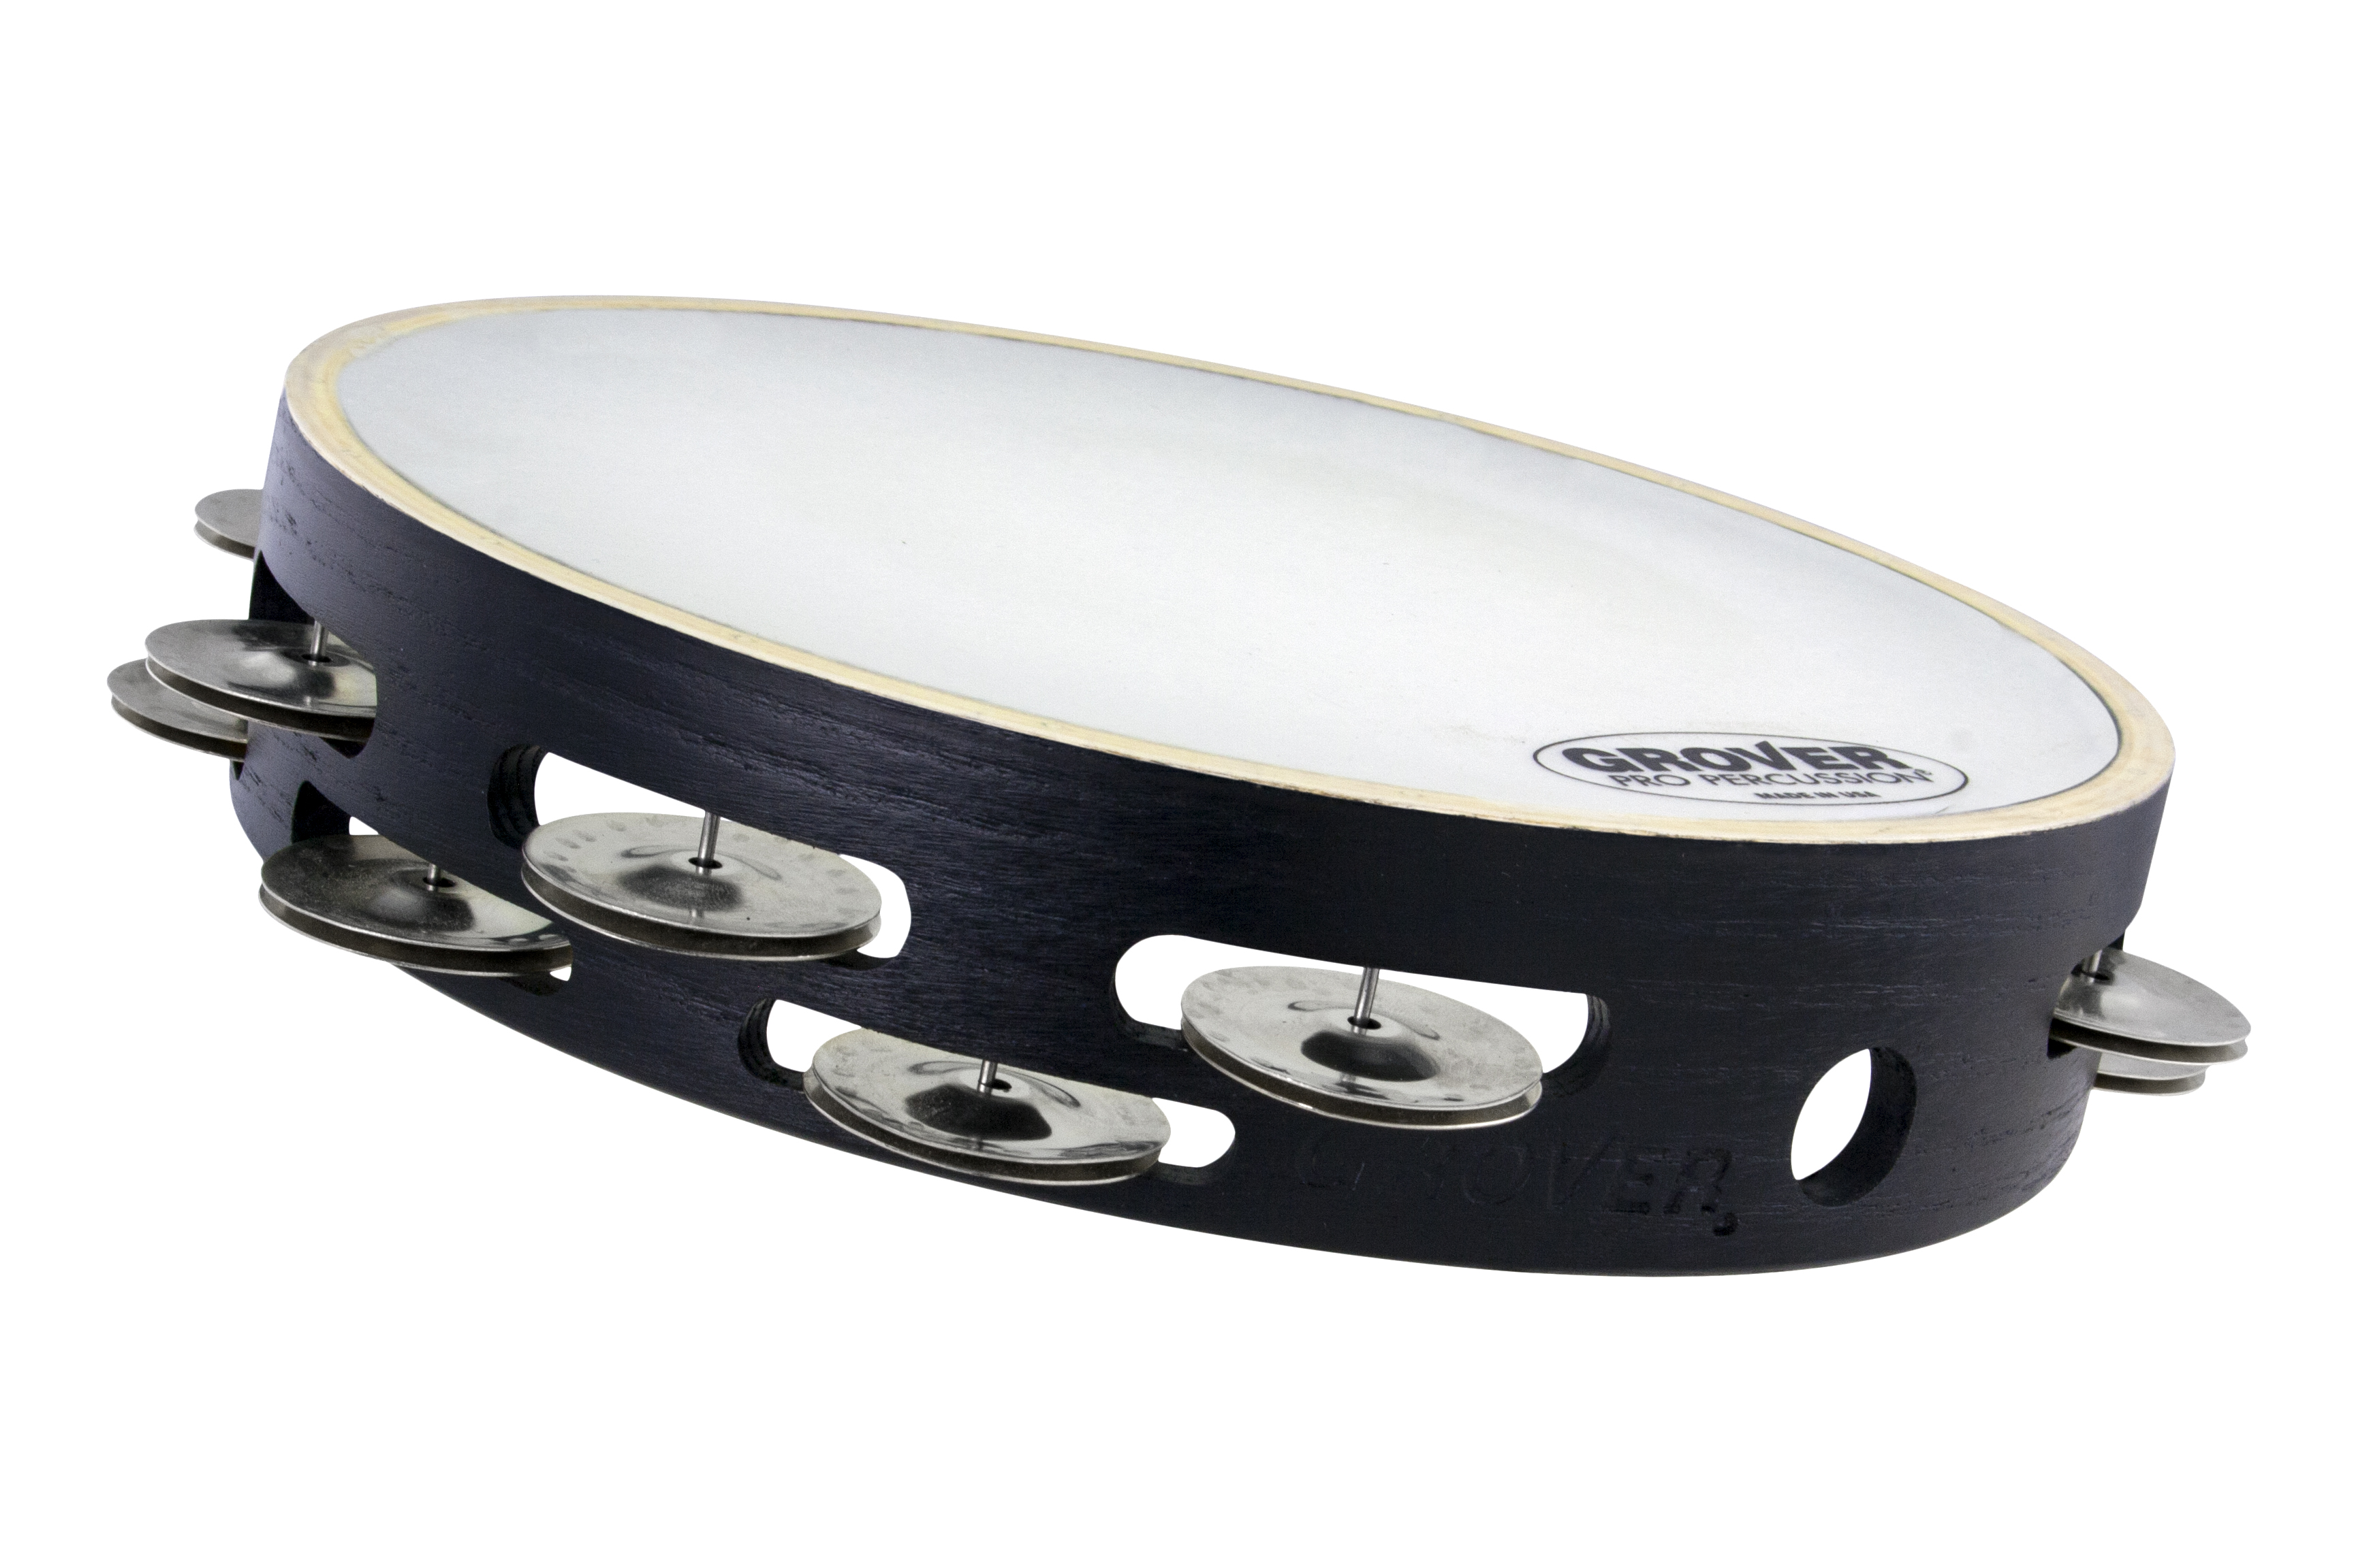
X-Series™ German Silver
Tambourine
Hand-hammered silver jingles, synthetic head
X-Series models are synthetic-headed versions of three popular Projection-Plus models. Natural skin is replaced by Remo Renaissance® synthetic material, which is unaffected by changes in humidity or temperature.

Slide 11
X-Series™ Silver/Bronze Combo
Tambourine
Hand-hammered silver & bronze jingles, synthetic head
X-Series models are synthetic-headed versions of three popular Projection-Plus models. Natural skin is replaced by Remo Renaissance® synthetic material, which is unaffected by changes in humidity or temperature.

Slide 12
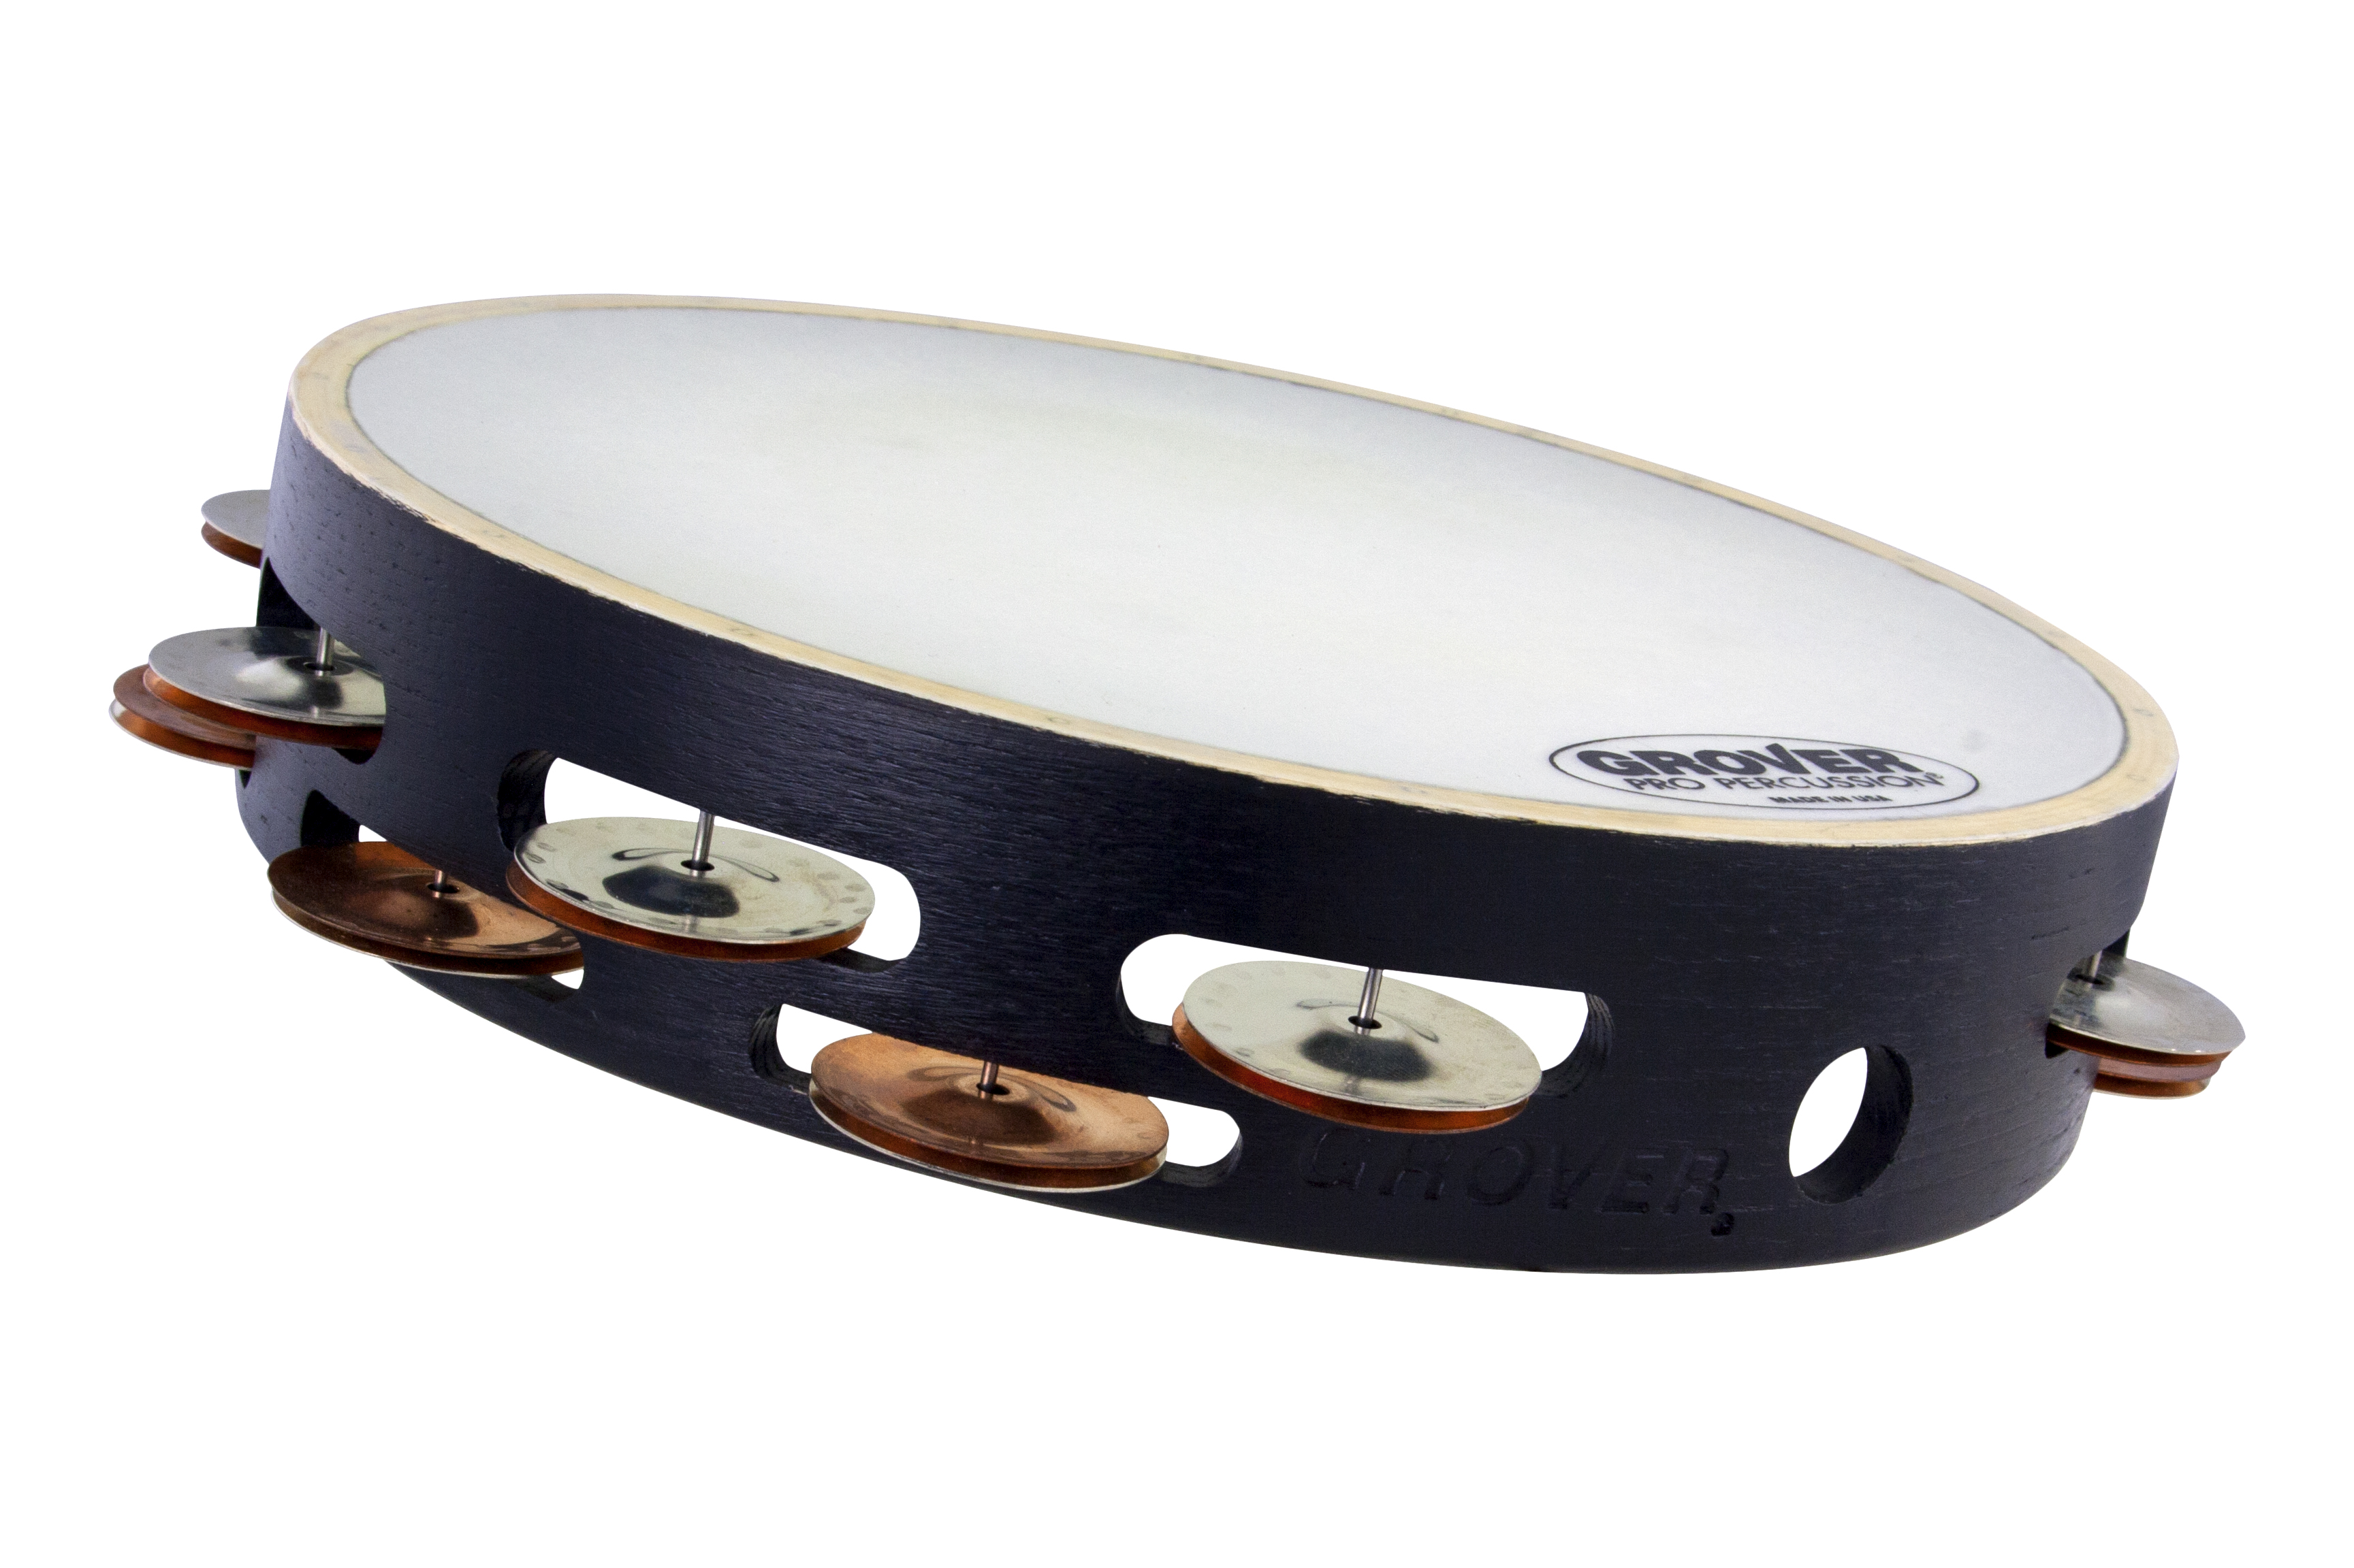
X-Series™ Silver/Bronze Combo
Tambourine
Hand-hammered silver & bronze jingles, synthetic head
X-Series models are synthetic-headed versions of three popular Projection-Plus models. Natural skin is replaced by Remo Renaissance® synthetic material, which is unaffected by changes in humidity or temperature.

Slide 13
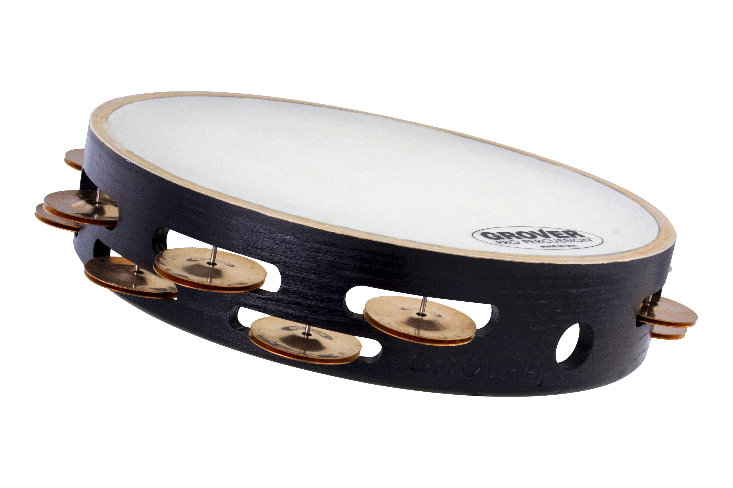
X-Series™ Beryllium Copper
Tambourine
Hand-hammered copper jingles, synthetic head
X-Series models are synthetic-headed versions of three popular Projection-Plus models. Natural skin is replaced by Remo Renaissance® synthetic material, which is unaffected by changes in humidity or temperature.

Slide 14
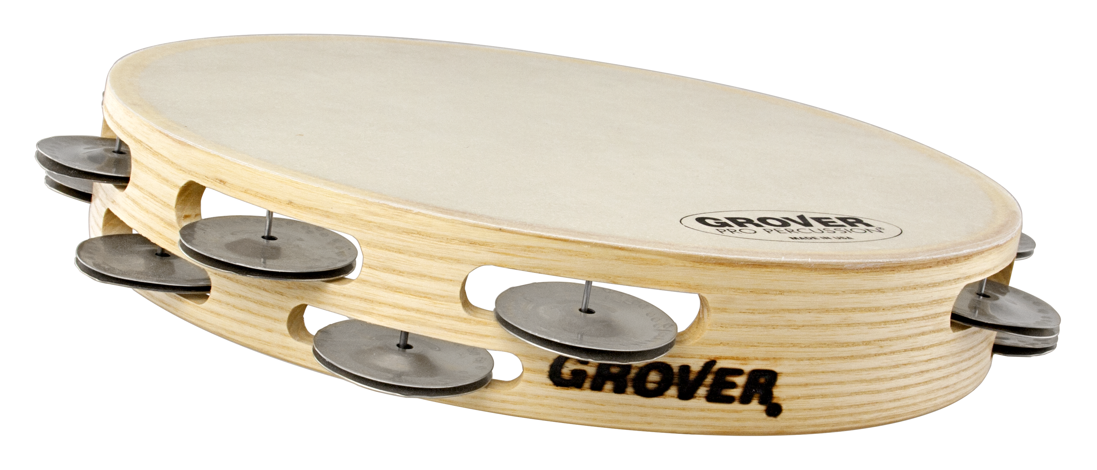
Bantamweight™ German Silver
Tambourine
Hand-hammered silver jingles, synthetic head
Weighing 15% less than our other pro-level tambourines, Grover Pro Bantamweight™ Series tambourines are easier to grip, control, and play! The Bantamweight’s shell is narrower in depth, resulting in a professional-quality instrument which can be played with ease and dexterity, especially by younger percussionists and those with smaller hands.

Slide 15
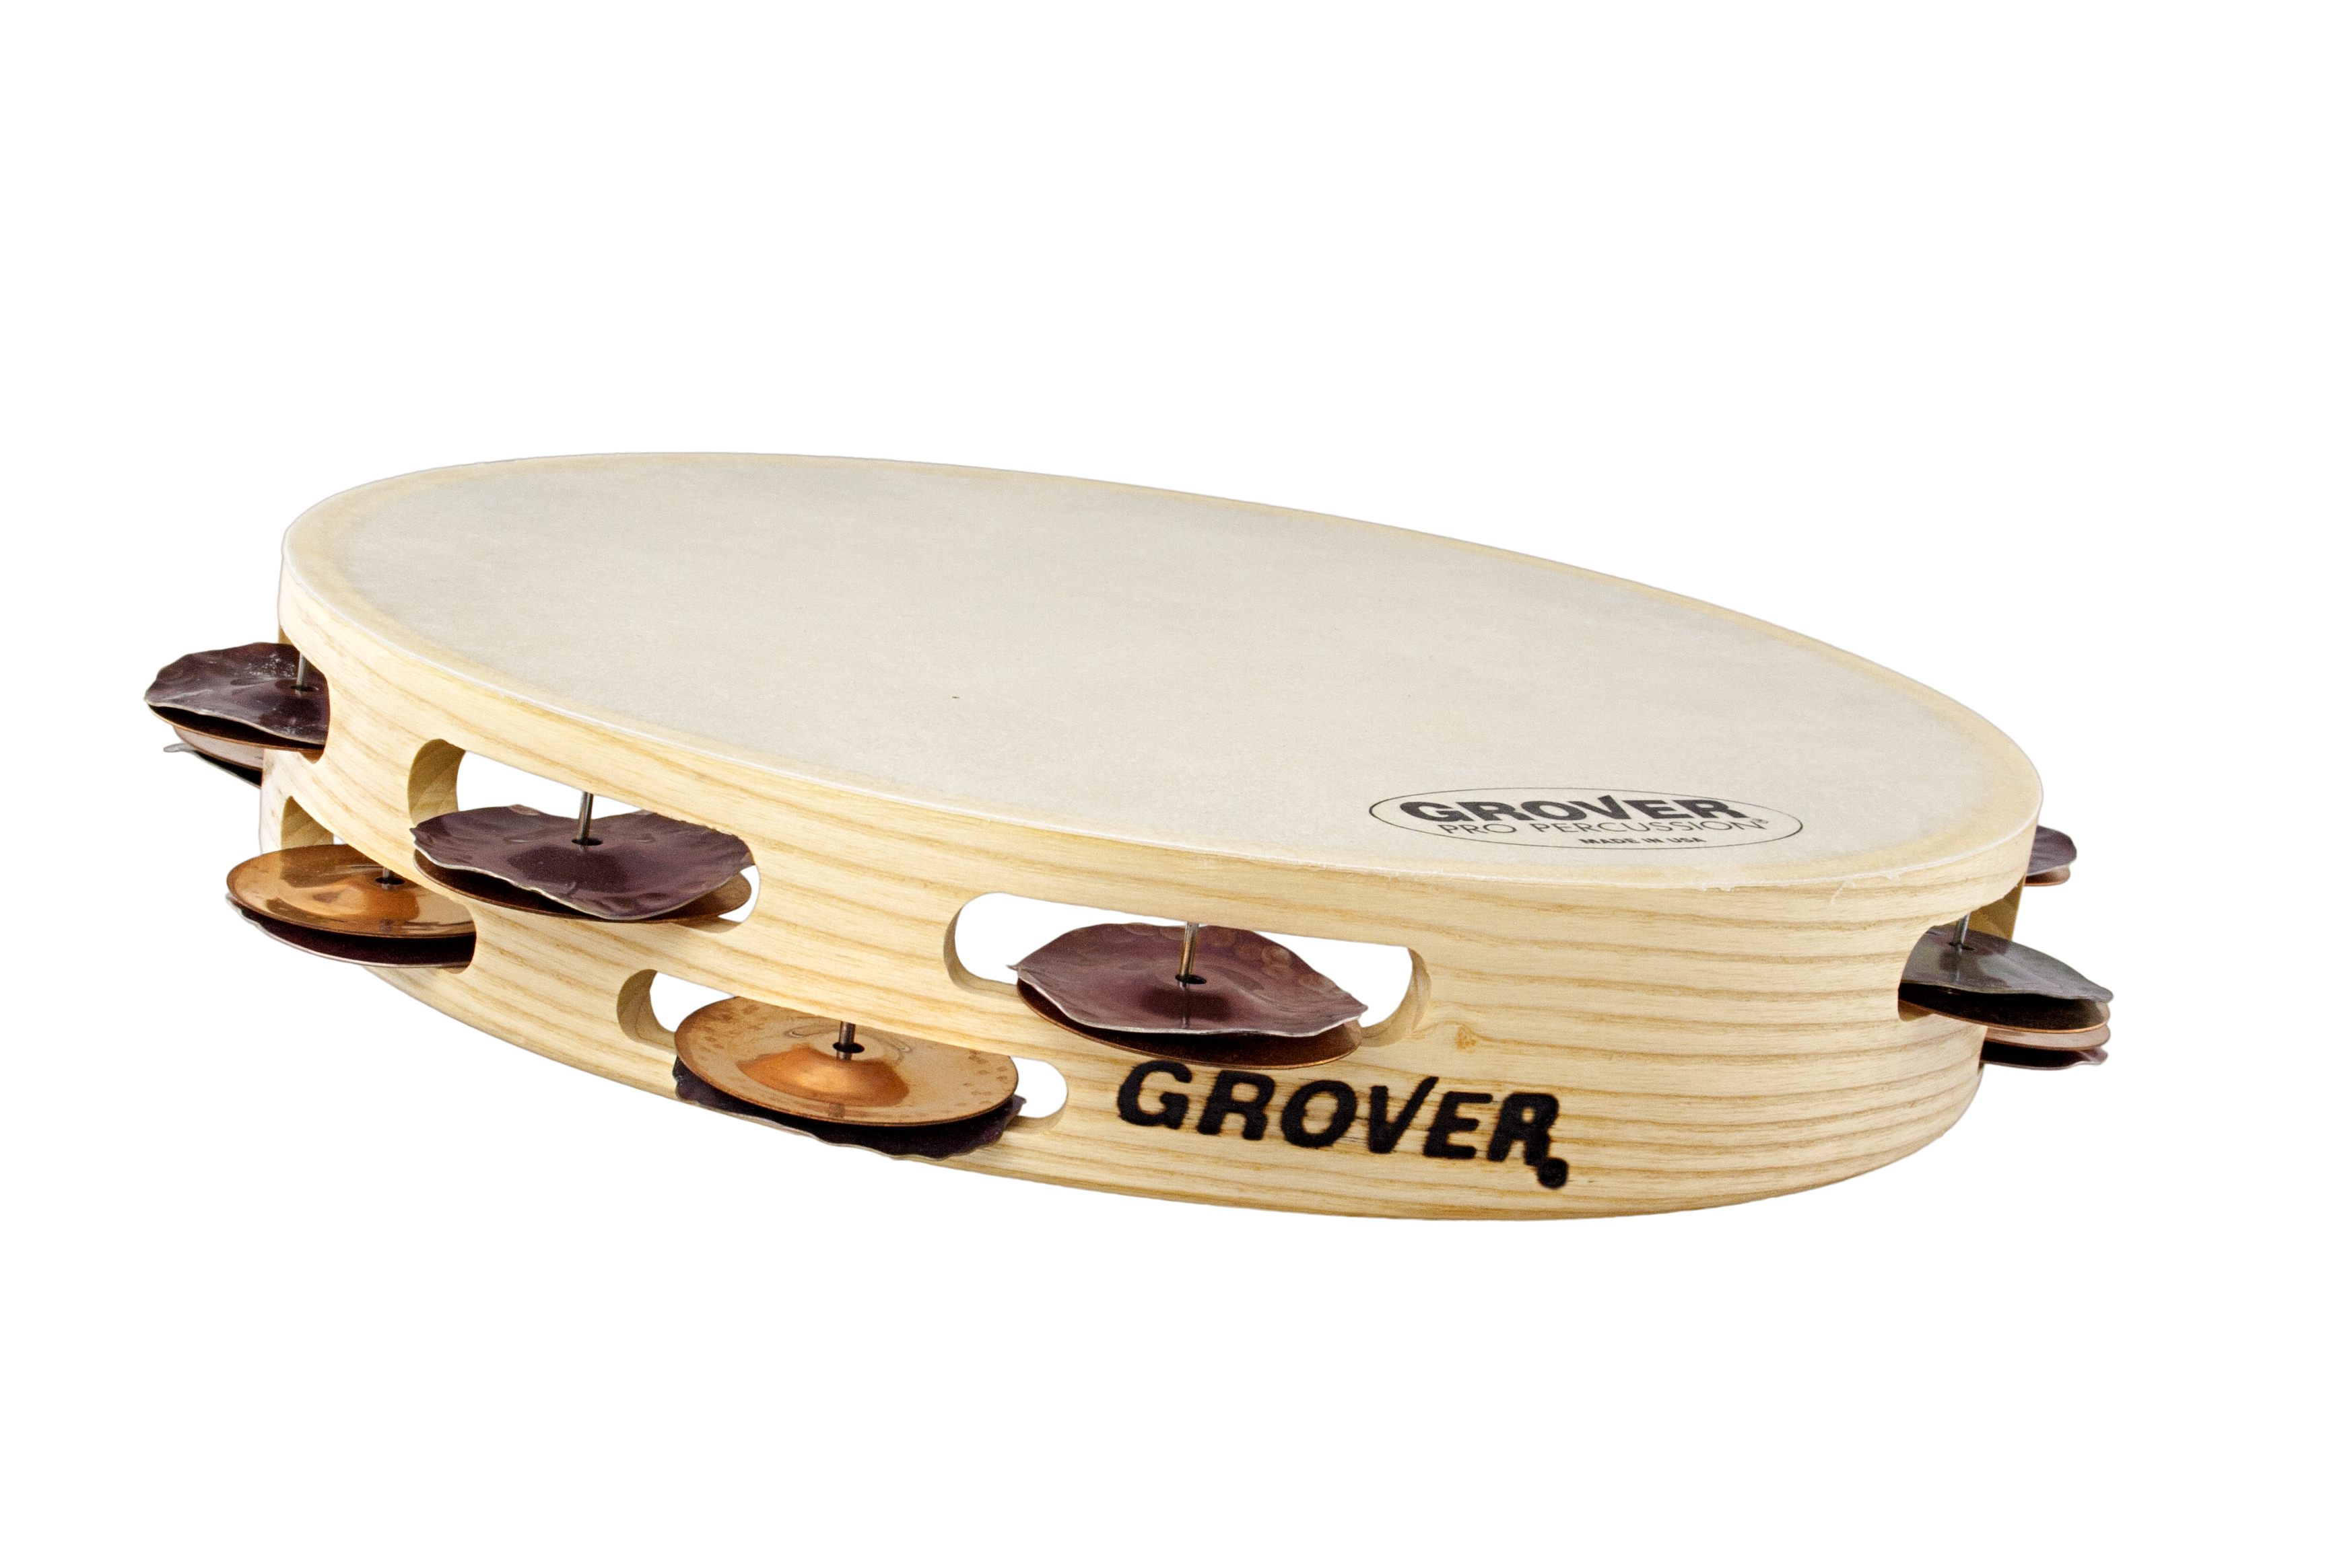
Bantamweight™ Heat-Treated Silver/Phospor Bronze
Heat-treated silver & hand-hammered bronze jingles, synthetic head
Weighing 15% less than our other pro-level tambourines, Grover Pro Bantamweight™ Series tambourines are easier to grip, control, and play! The Bantamweight’s shell is narrower in depth, resulting in a professional-quality instrument which can be played with ease and dexterity, especially by younger percussionists and those with smaller hands.

Slide 16
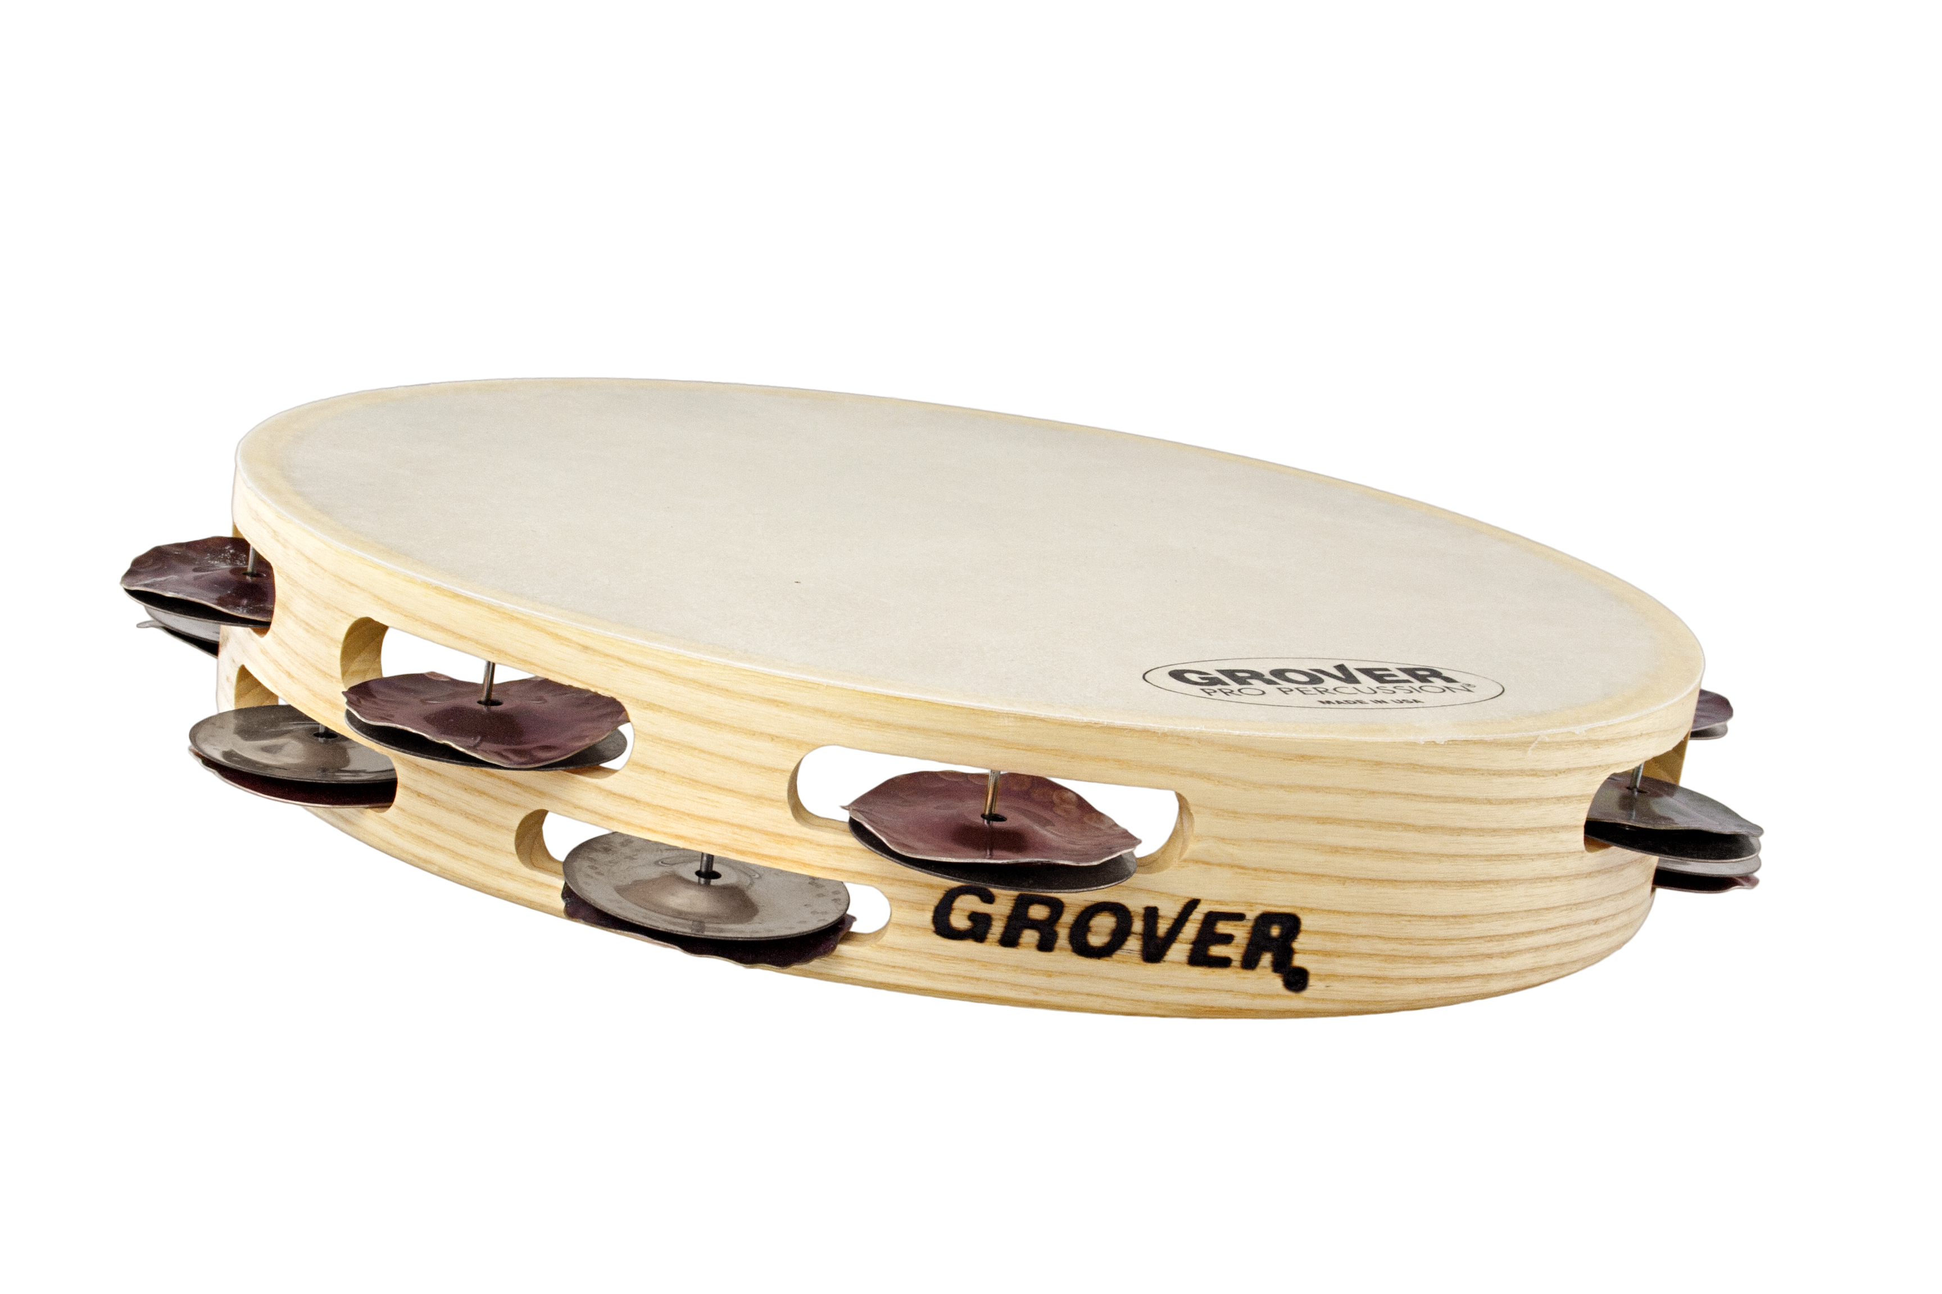
Bantamweight™ Hybrid Silver Tambourine
Heat-treated & hand-hammered silver jingles, synthetic head
Weighing 15% less than our other pro-level tambourines, Grover Pro Bantamweight™ Series tambourines are easier to grip, control, and play! The Bantamweight’s shell is narrower in depth, resulting in a professional-quality instrument which can be played with ease and dexterity, especially by younger percussionists and those with smaller hands.

Slide 17
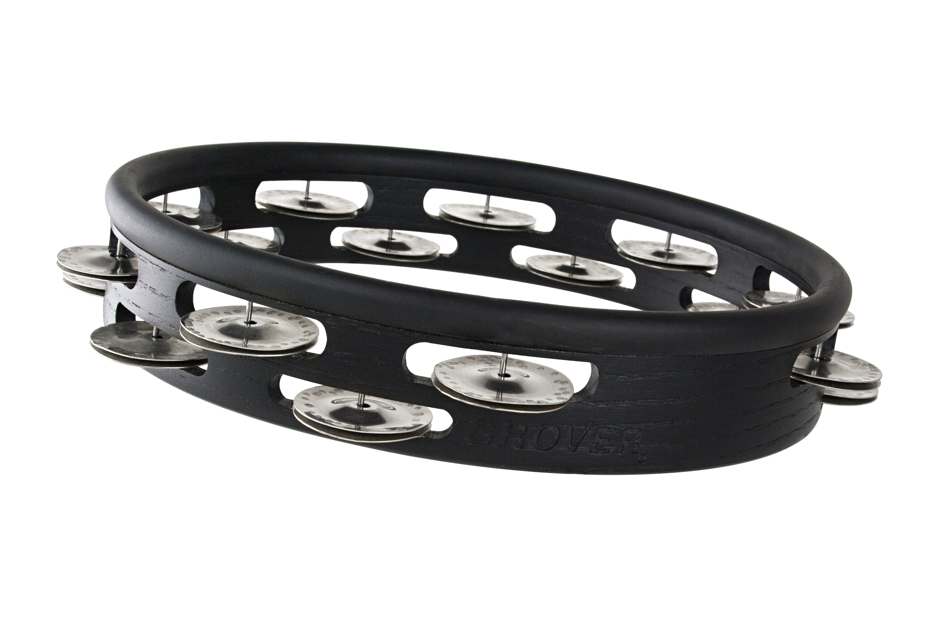
Studio Pro™ Tambourine – German Silver
Hand-hammered silver jingles, headless
The same solid hardwood shell and high-quality jingles that we use for our world-renowned concert tambourines is every bit as suitable for a headless model. Not only is this instrument ideal for studio recording, but it has the cut, articulation, and distinctive full-bodied sound for live performances as well.

Slide 18
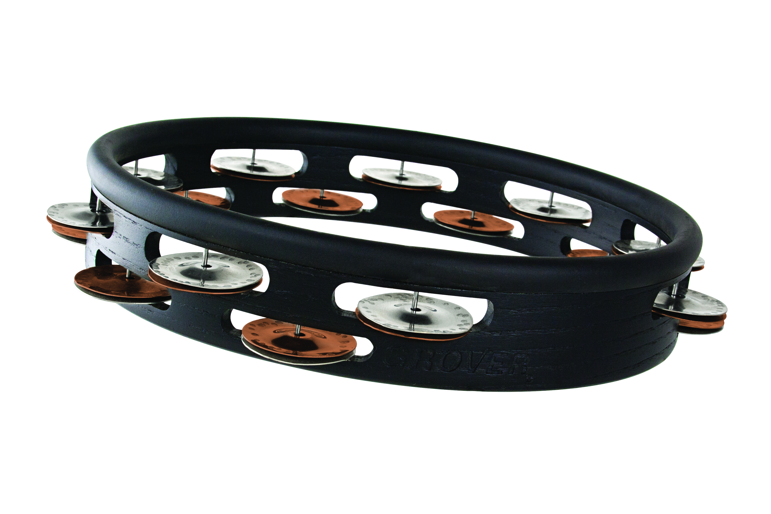
Studio Pro™ Tambourine – Silver Bronze
Hand-hammered silver & bronze jingles, headless
The same solid hardwood shell and high-quality jingles that we use for our world-renowned concert tambourines is every bit as suitable for a headless model. Not only is this instrument ideal for studio recording, but it has the cut, articulation, and distinctive full-bodied sound for live performances as well.

Slide 19
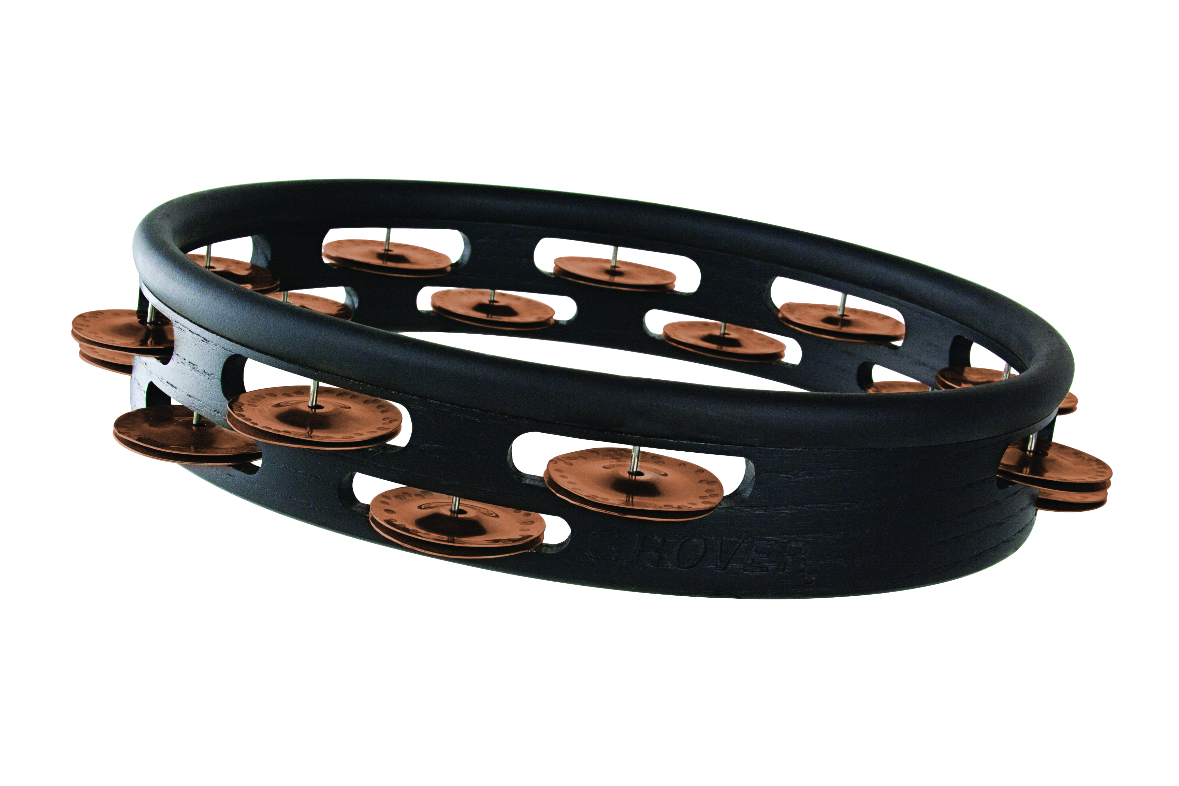
Studio Pro™ Tambourine – Phosphor Bronze
Hand-hammered bronze jingles, headless
The same solid hardwood shell and high-quality jingles that we use for our world-renowned concert tambourines is every bit as suitable for a headless model. Not only is this instrument ideal for studio recording, but it has the cut, articulation, and distinctive full-bodied sound for live performances as well.

Slide 20
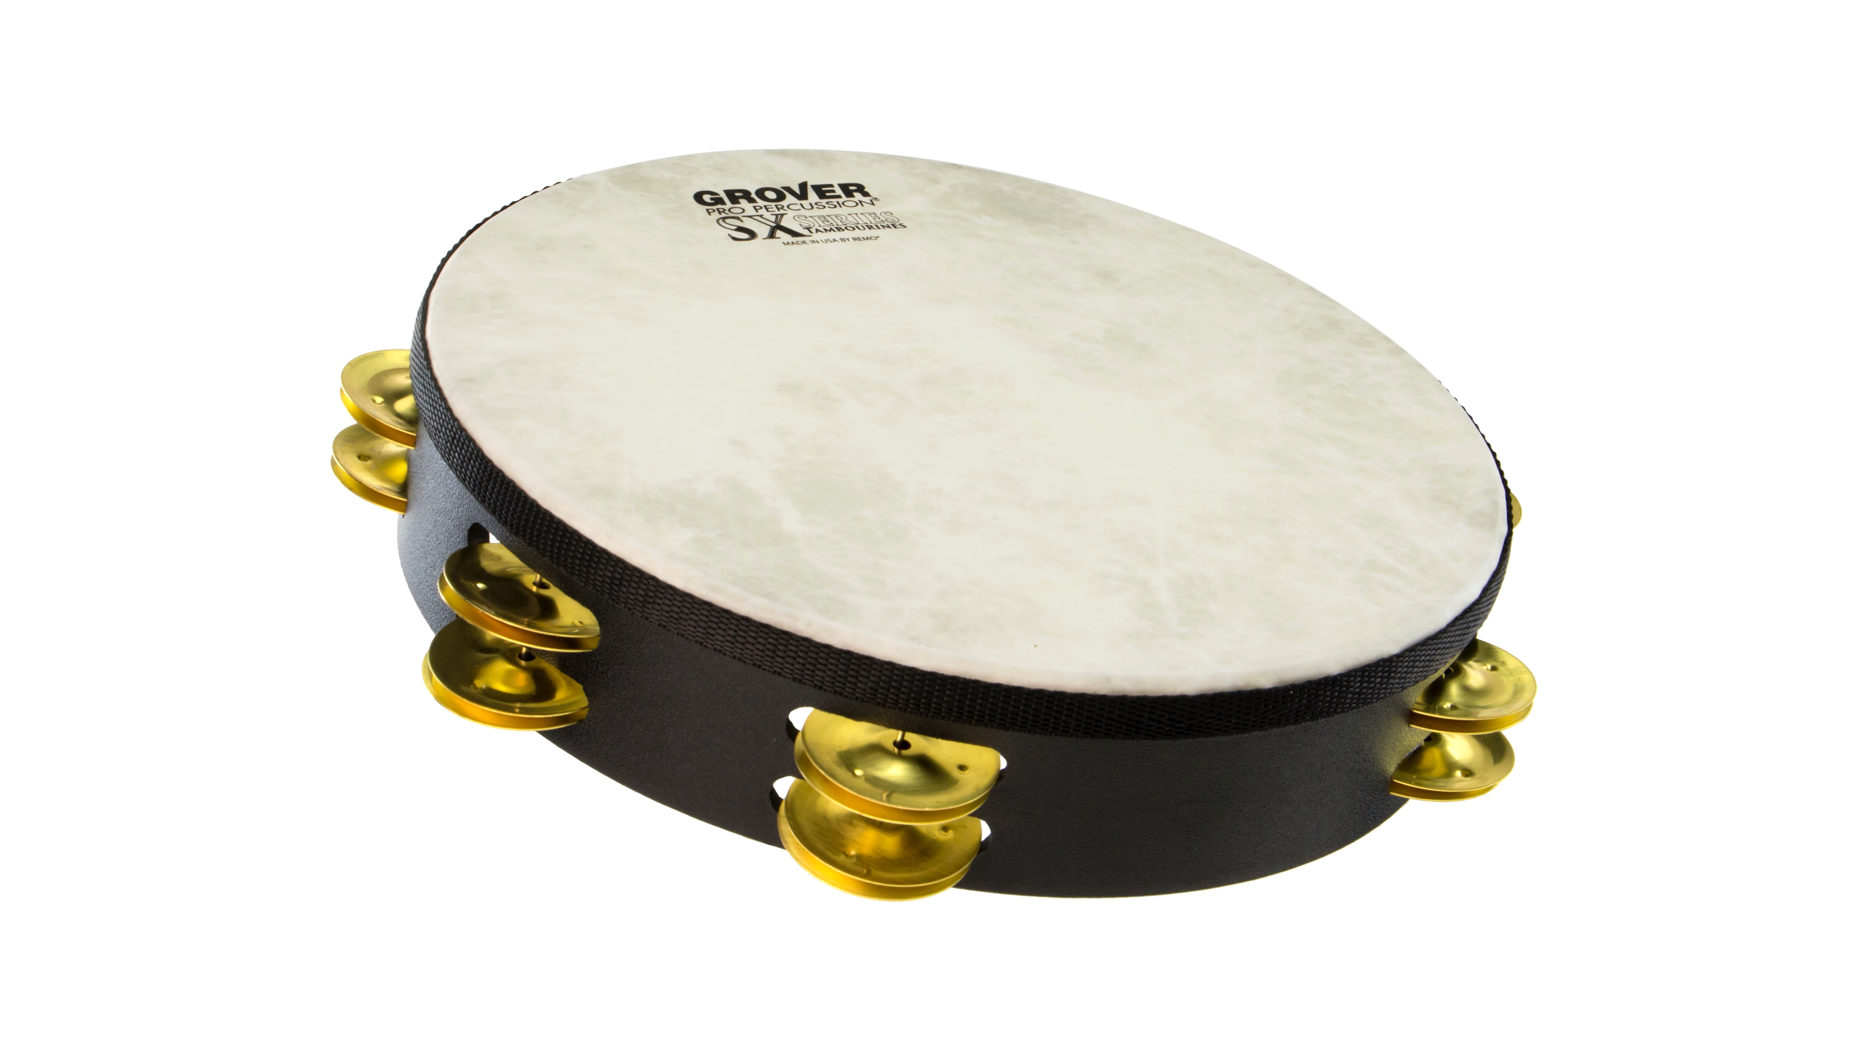
SX™ Tambourine – Brass
Stamped brass jingles, synthetic head
Our SX™ Tambourines are general-purpose concert instruments specifically designed for those looking for a value-priced, quality concert tambourine. Fabricated from wood fiber, the Acousticon™ shell is formed under heat and pressure creating a strong, durable frame. Pre-tensioned heads made from durable Fiberskyn™ material are chosen for their strength and tension stability.

Slide 21
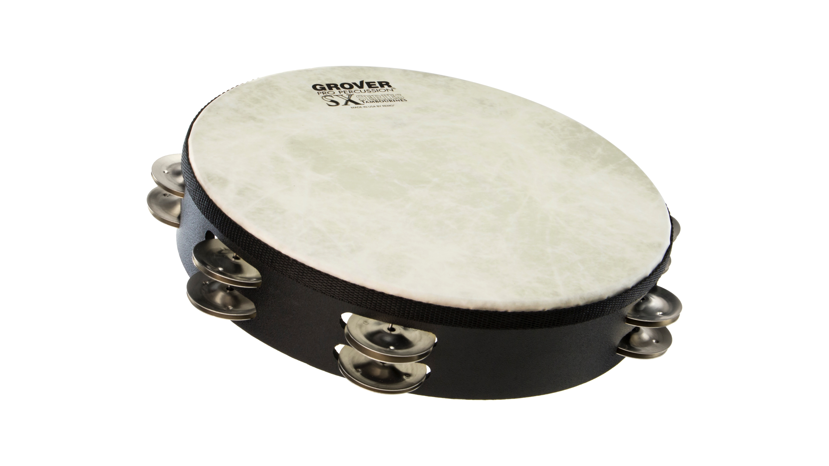
SX™ Tambourine – German Silver
Stamped silver jingles, synthetic head
Our SX™ Tambourines are general-purpose concert instruments specifically designed for those looking for a value-priced, quality concert tambourine. Fabricated from wood fiber, the Acousticon™ shell is formed under heat and pressure creating a strong, durable frame. Pre-tensioned heads made from durable Fiberskyn™ material are chosen for their strength and tension stability.

Slide 22
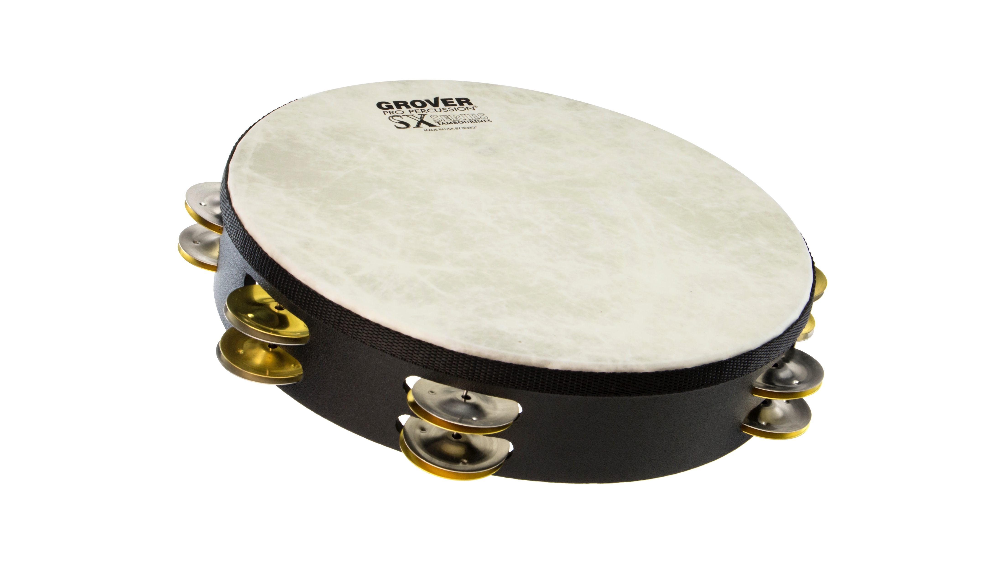
SX™ Tambourine – Silver/Brass
Stamped silver & brass jingles, synthetic head
Our SX™ Tambourines are general-purpose concert instruments specifically designed for those looking for a value-priced, quality concert tambourine. Fabricated from wood fiber, the Acousticon™ shell is formed under heat and pressure creating a strong, durable frame. Pre-tensioned heads made from durable Fiberskyn™ material are chosen for their strength and tension stability.

Slide 23
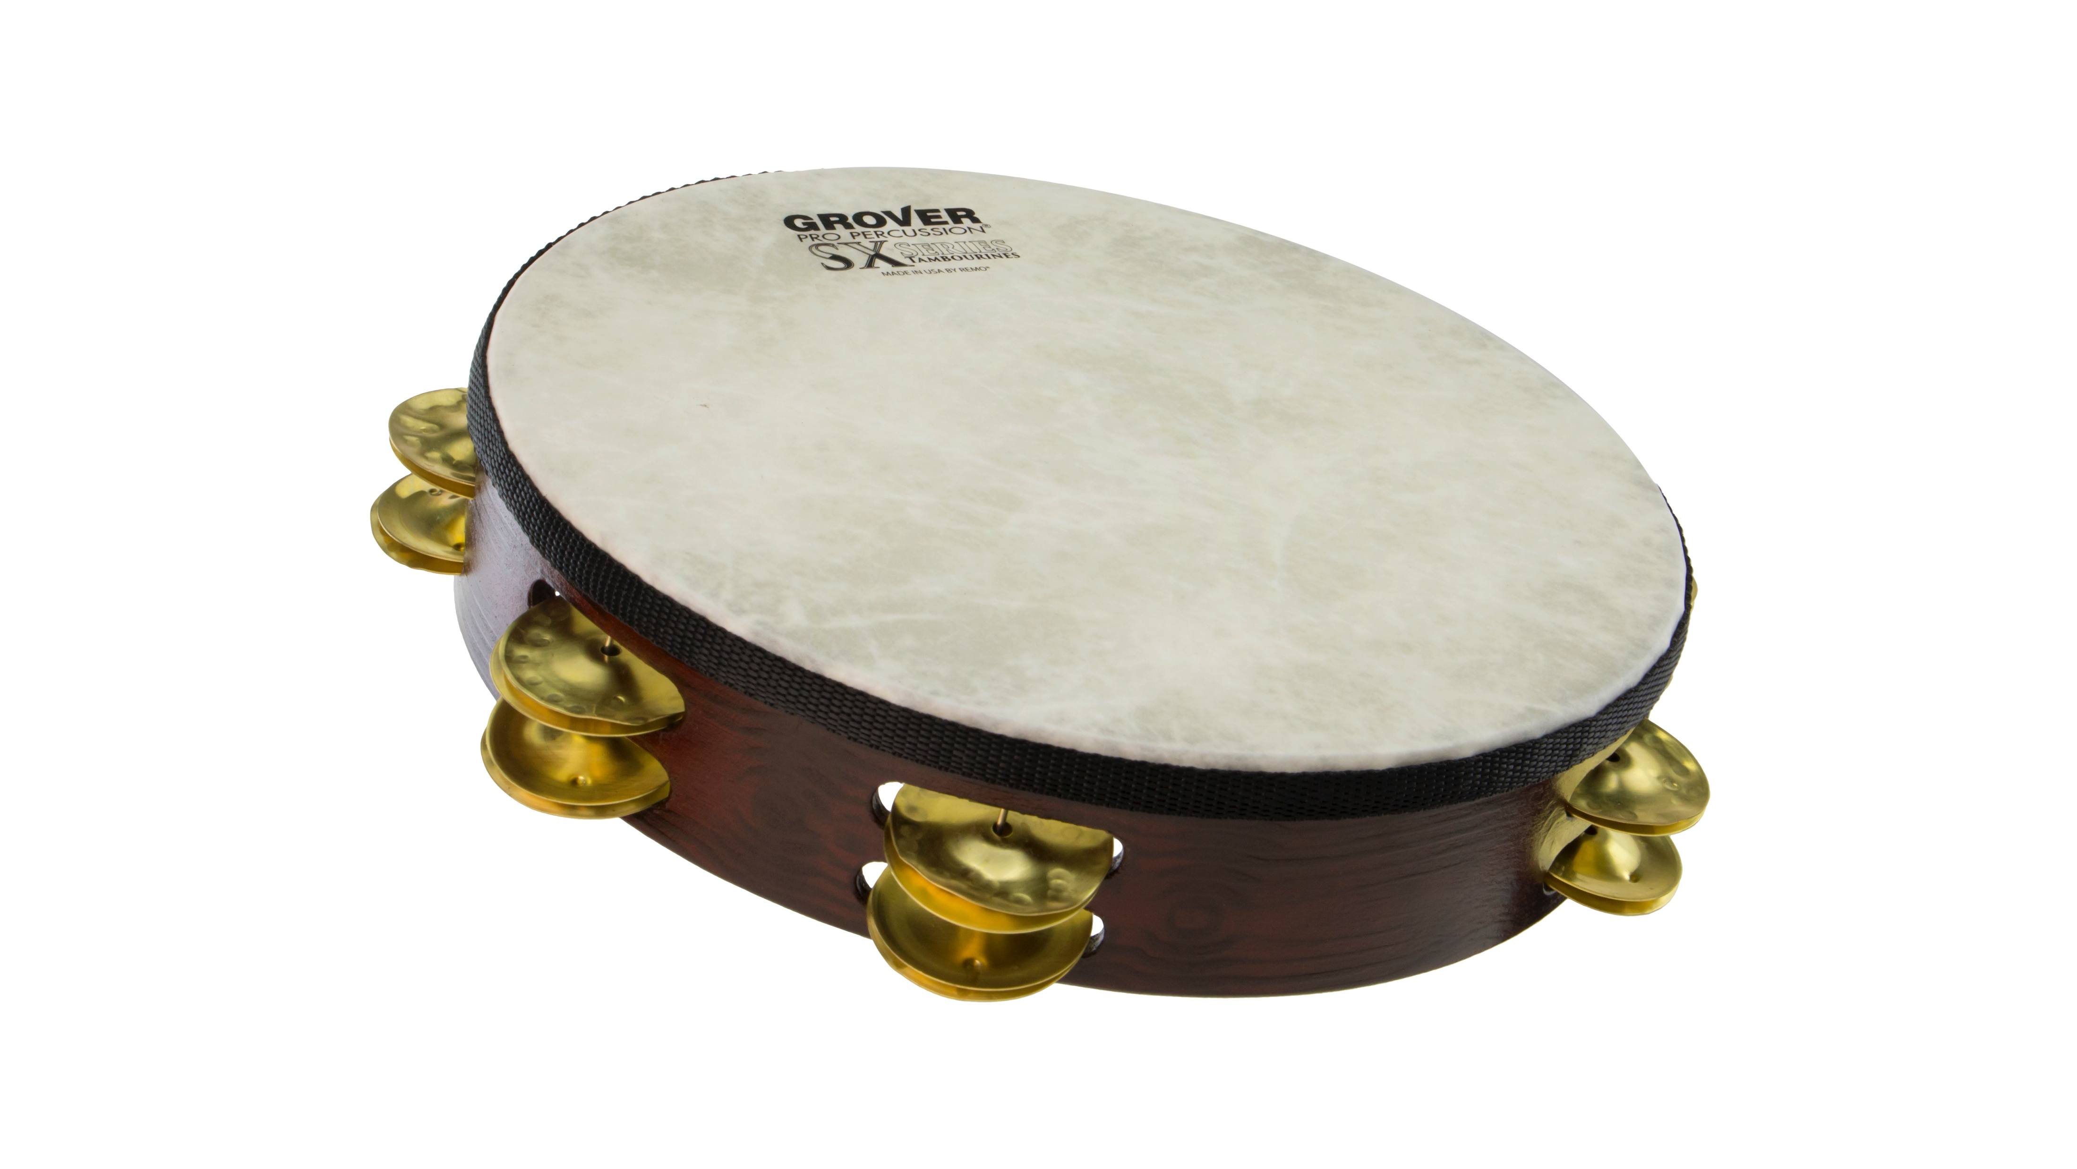
SX Plus™ Tambourine – Brass
Hand-hammered & stamped brass jingles, synthetic head
Our SX™ Tambourines are general-purpose concert instruments specifically designed for those looking for a value-priced, quality concert tambourine. Fabricated from wood fiber, the Acousticon™ shell is formed under heat and pressure creating a strong, durable frame. Pre-tensioned heads made from durable Fiberskyn™ material are chosen for their strength and tension stability.

