Slide 1
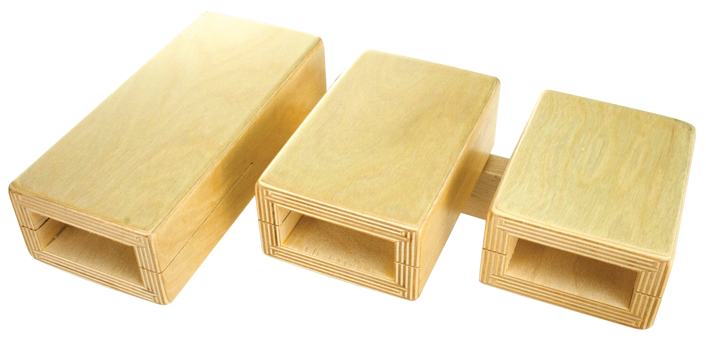
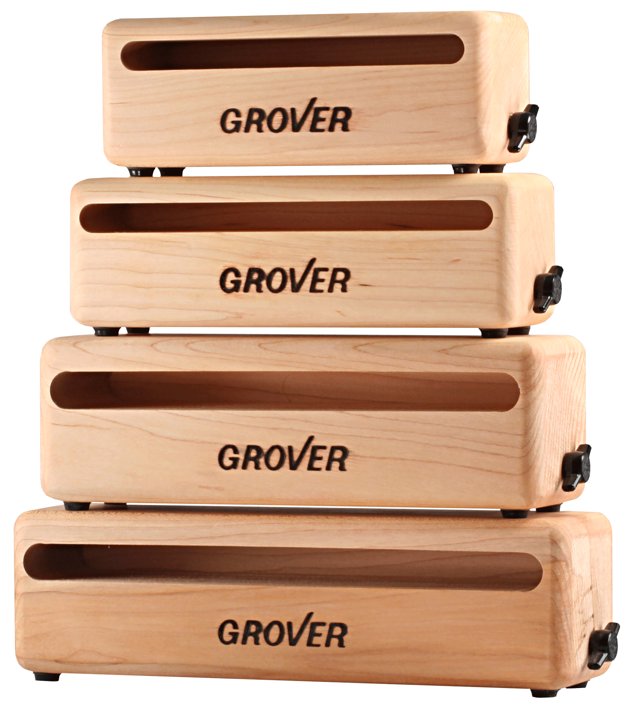
Blocks
Grover Pro woodblocks and temple blocks are made from renewable hardwoods that provide the “woody” full bodied sound that professionals demand. Made in the USA, these products have features superior in design and functionality to the competition.

Slide 2
Wood Blocks
New England rock maple blocks.
Our blocks are full and naturally “woody” sounding. They have the ability to speak with a whisper or attack with a loud cutting “bark”. Internal mounting hardware is provided on both sides of every Grover Pro wood block, making placement options virtually unlimited!

Slide 3
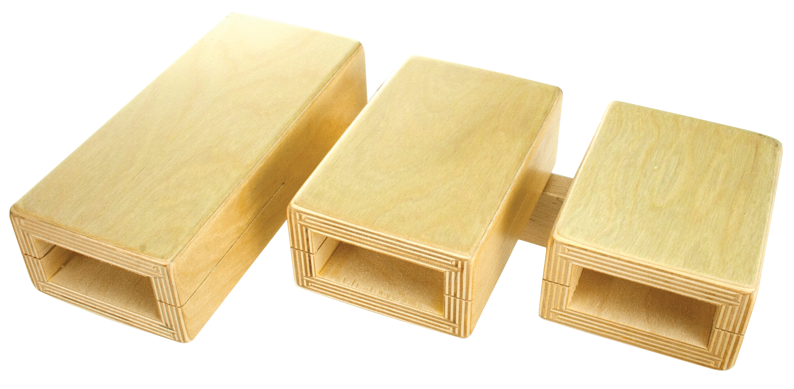
Temple Blocks - Standard
5-pc standard set.
Made from high quality Baltic birch for strength, durability, and resonant sound characteristics. Each block is graduated in size and tuned so that each set is tonally matched for consistent intervals between blocks. Our temple blocks have a full, focused sound and exemplify the benchmark of quality.

