Slide 1
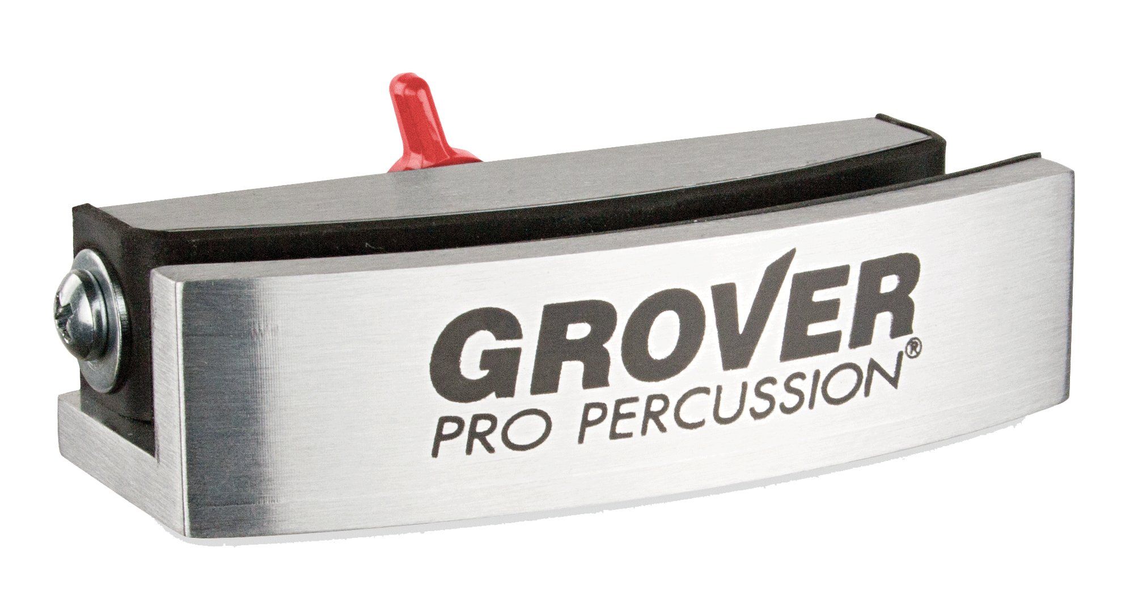
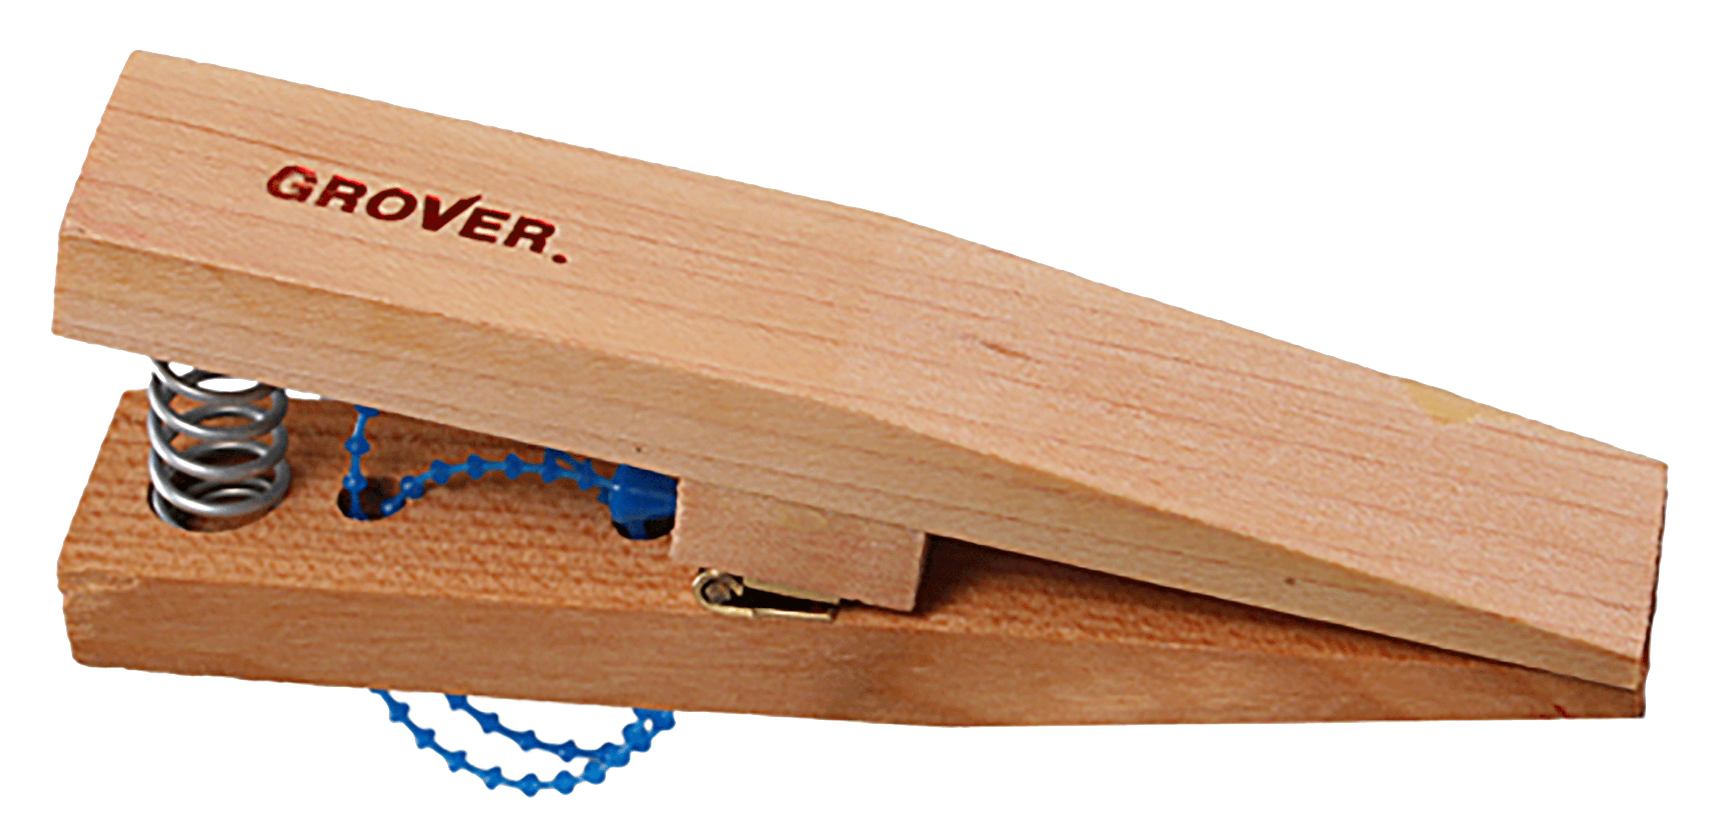
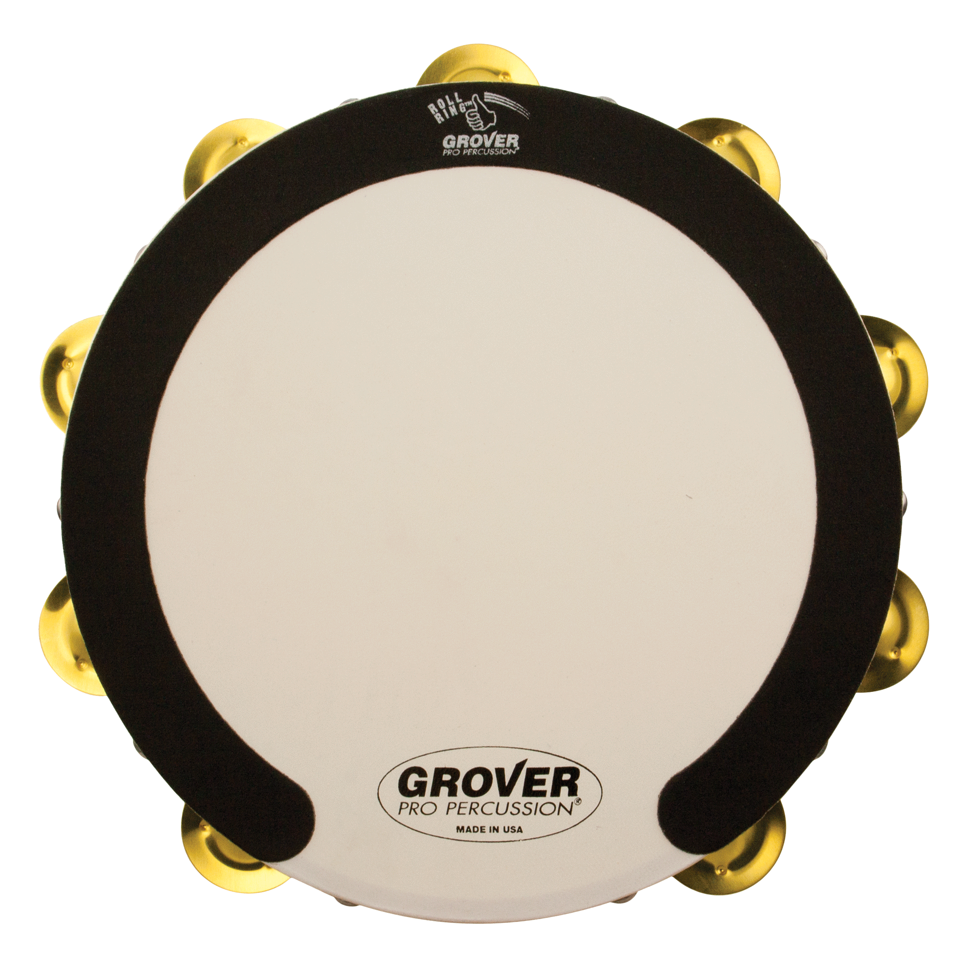
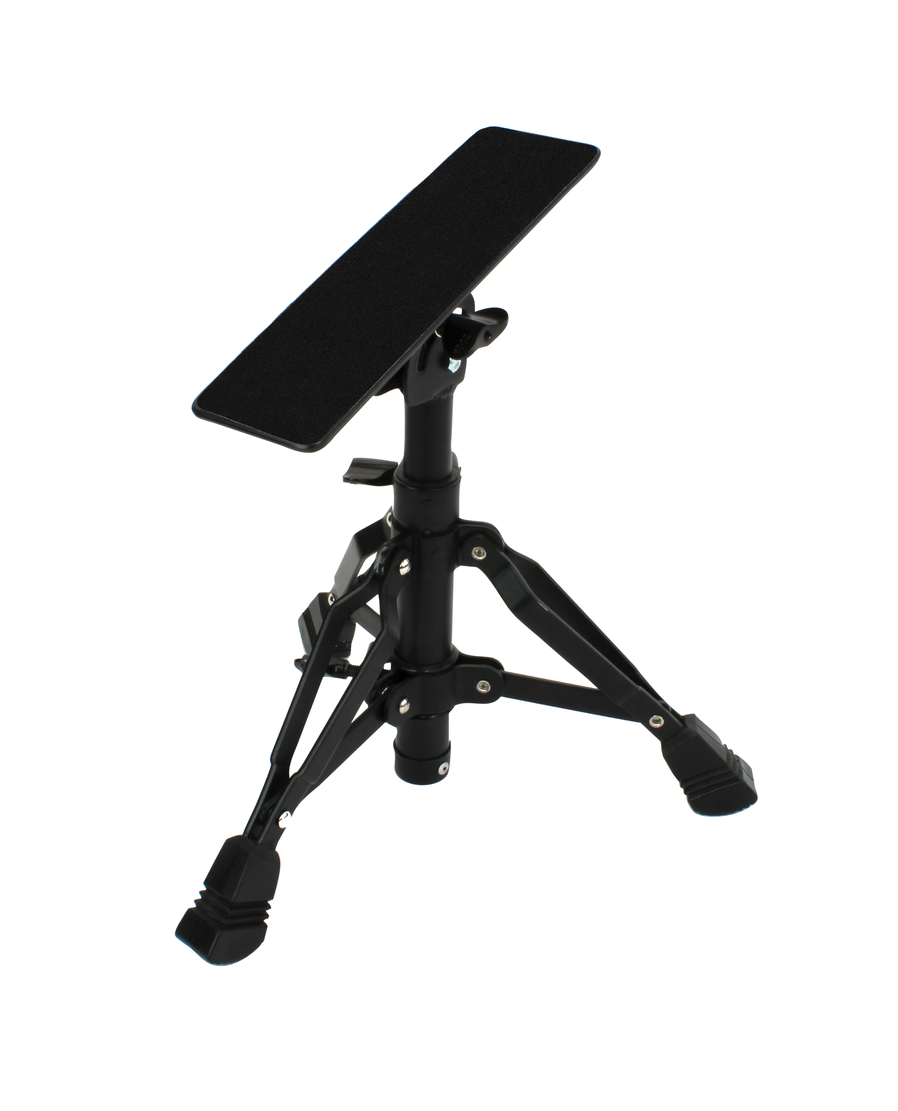
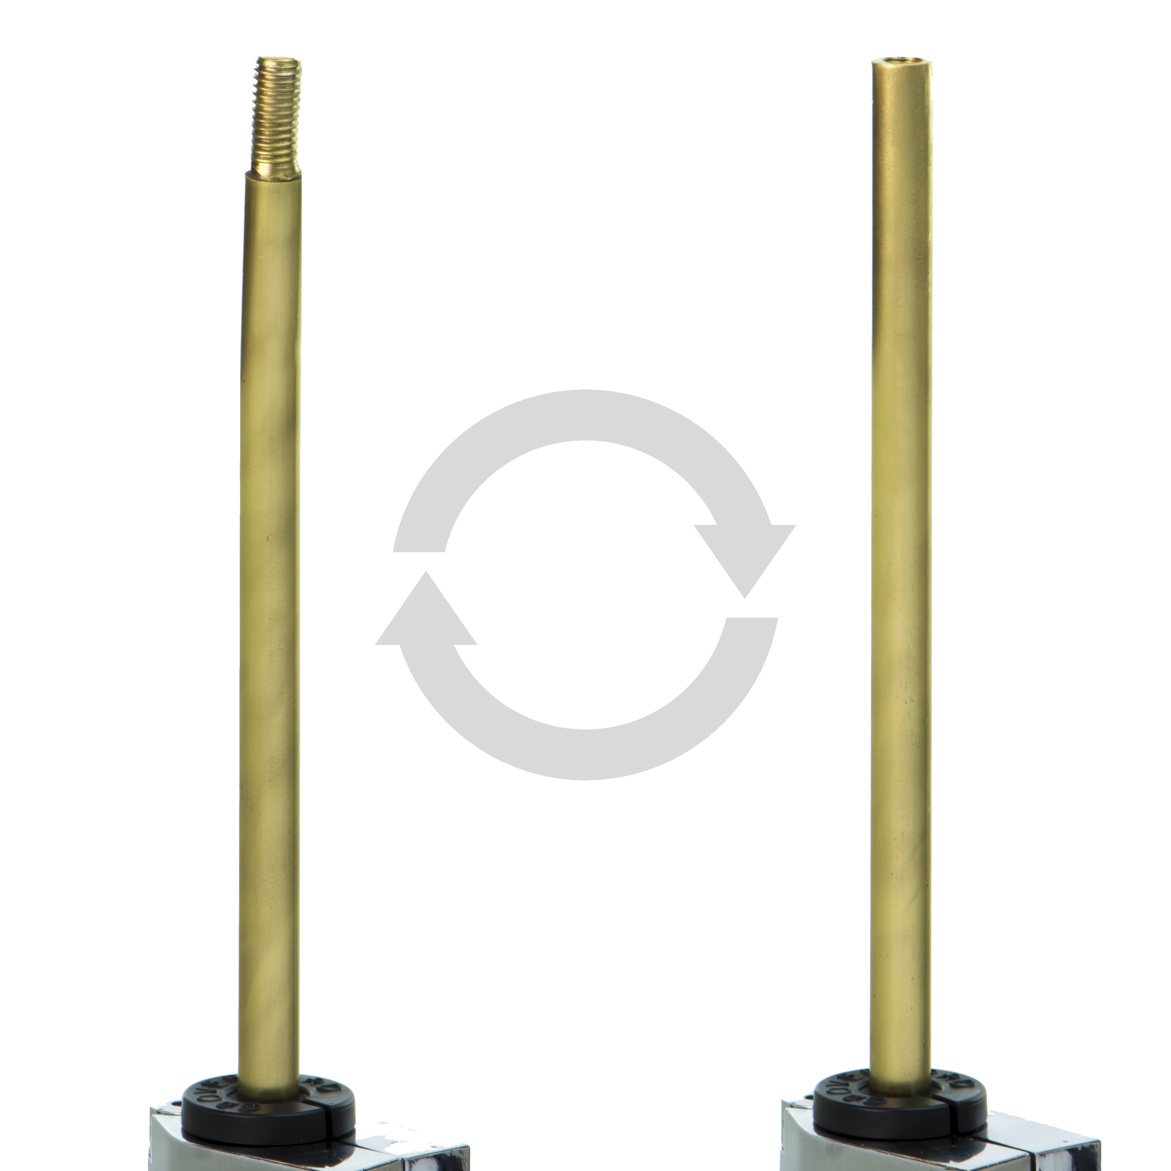
Accessories
Designed with input from the world’s top percussive artists, our wide range of percussion accessories provide percussionists with the tools that enable them to sound their best! Ergonomic in design and functionality, these products offer players solutions that help them achieve their optimum technical skill level.

Slide 2
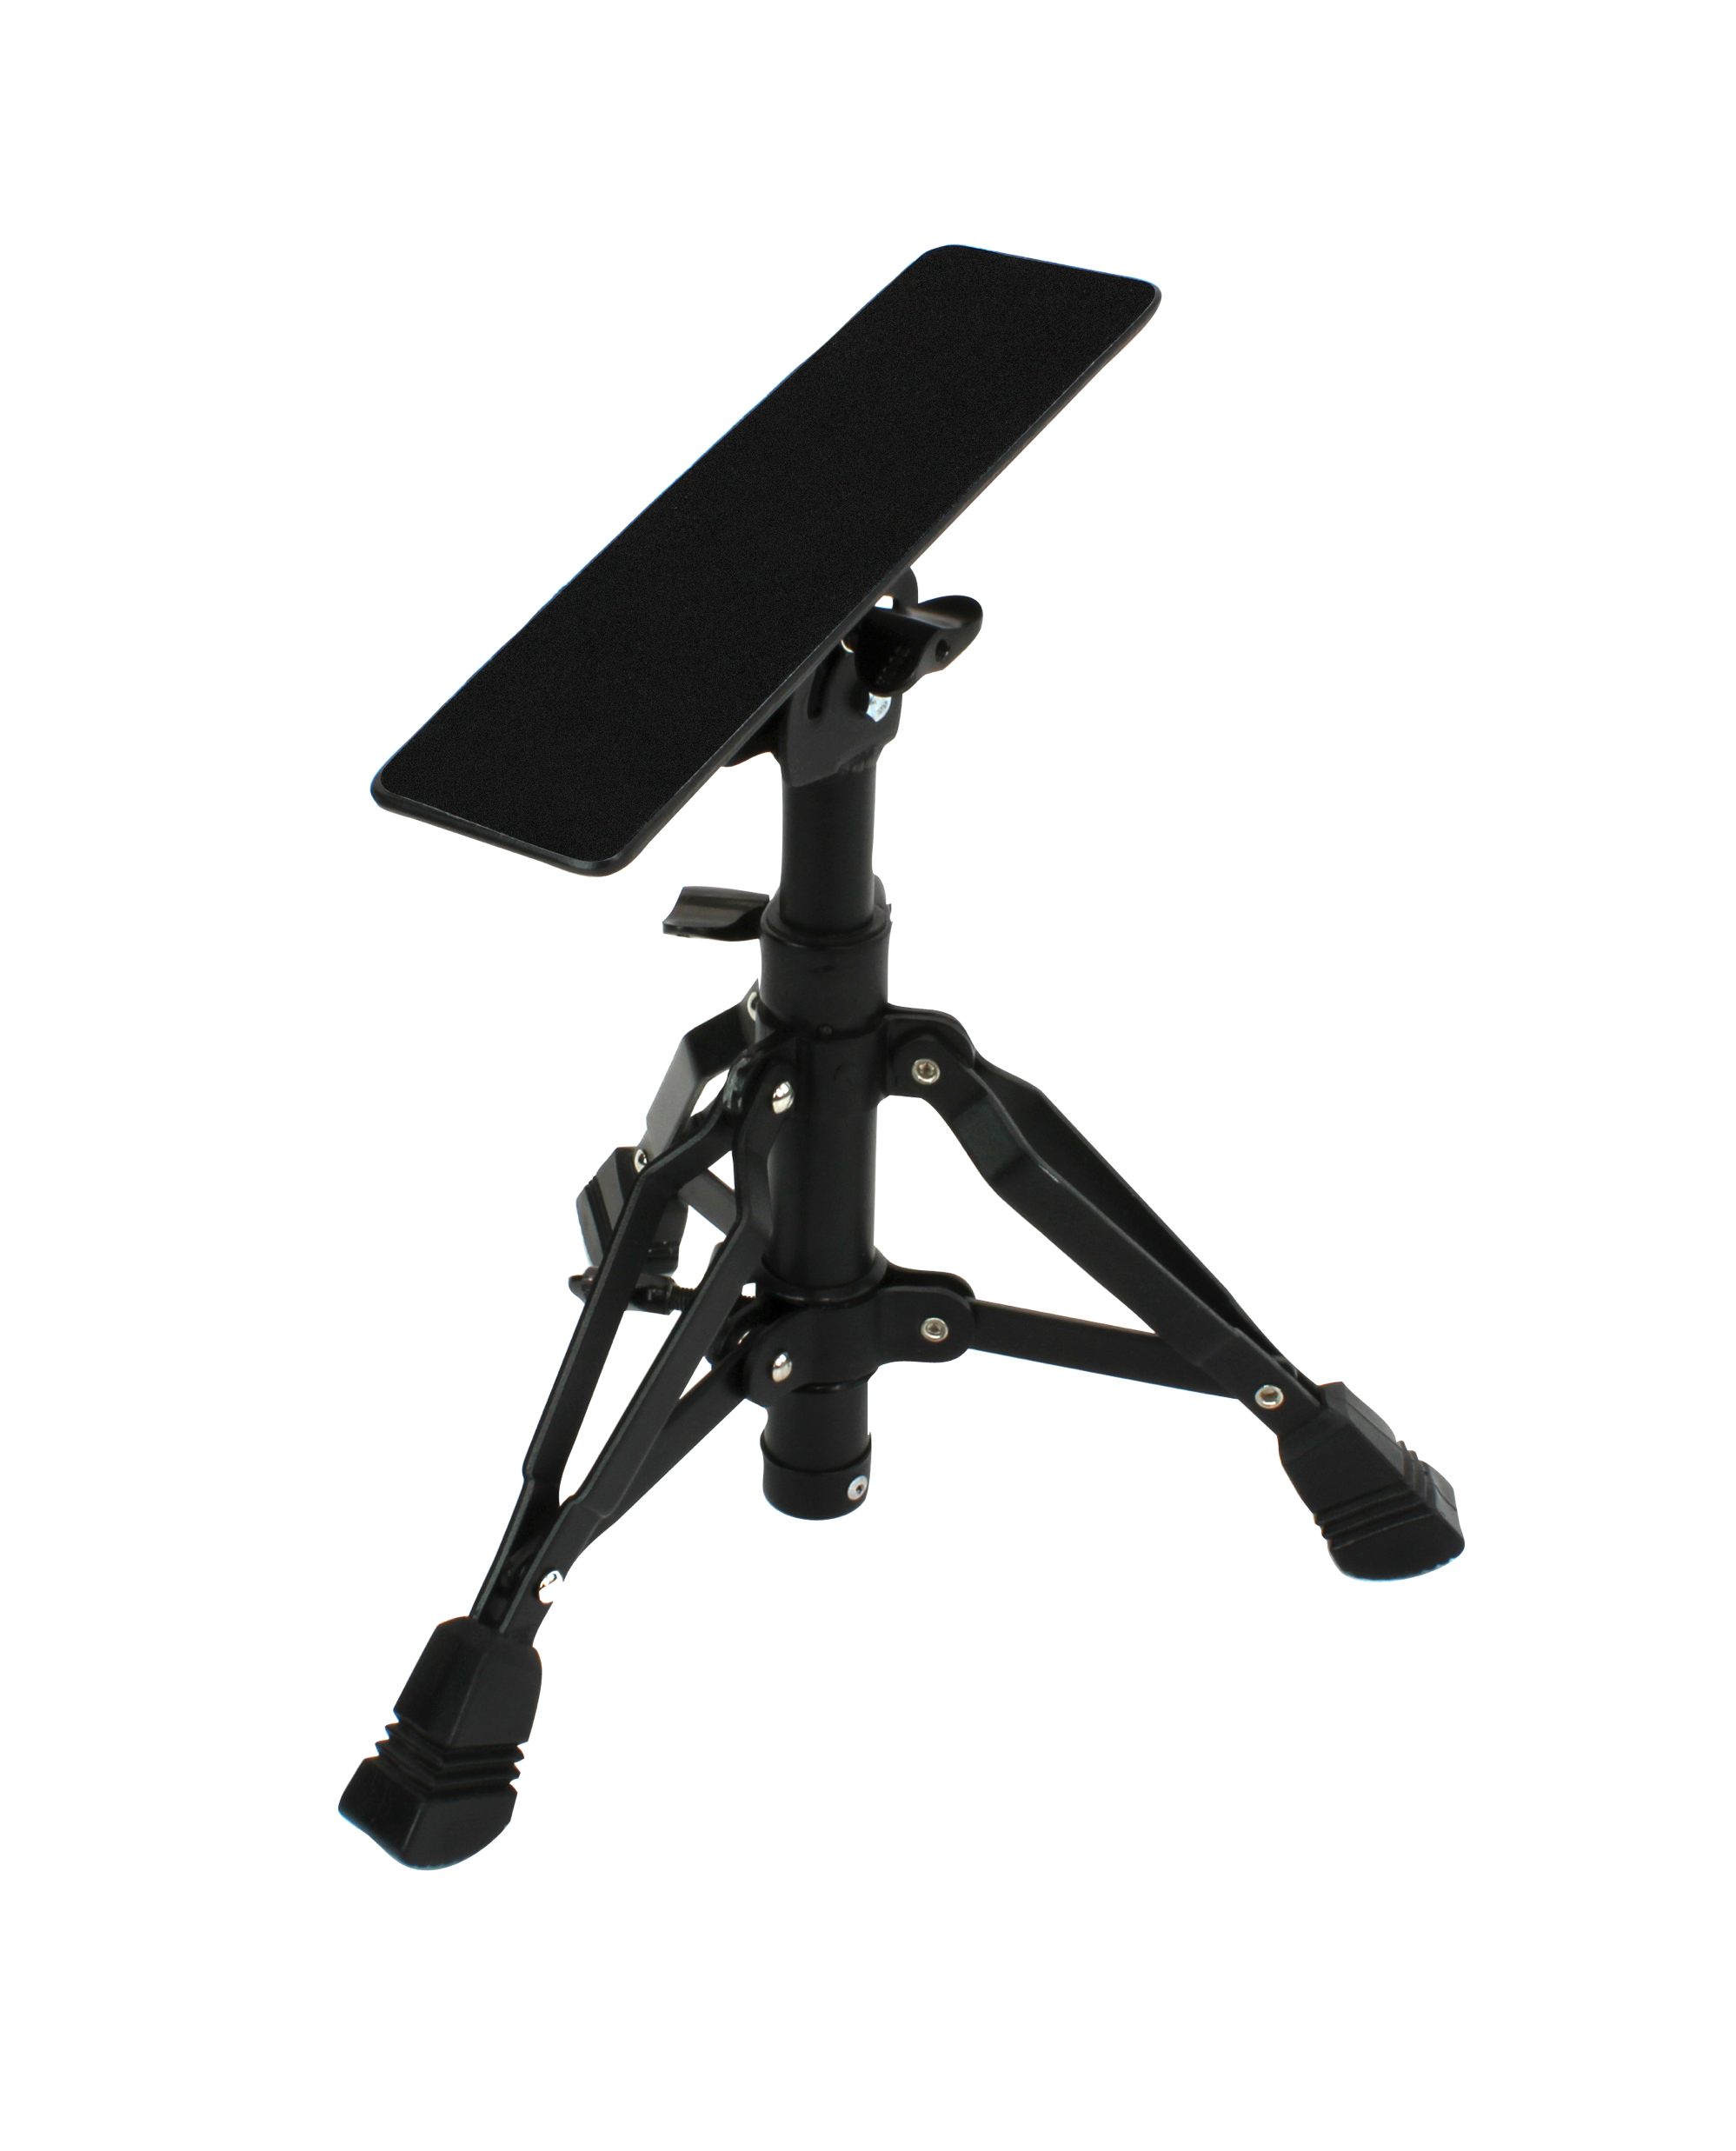
Percussion Footrest
An innovative solution for percussionists of all levels!
A versatile performance aid for concert bass drum, tambourine and castanets
Height adjustment
Footboard angle adjustment
Non-slip surface
Folds for transport/storage

Slide 3
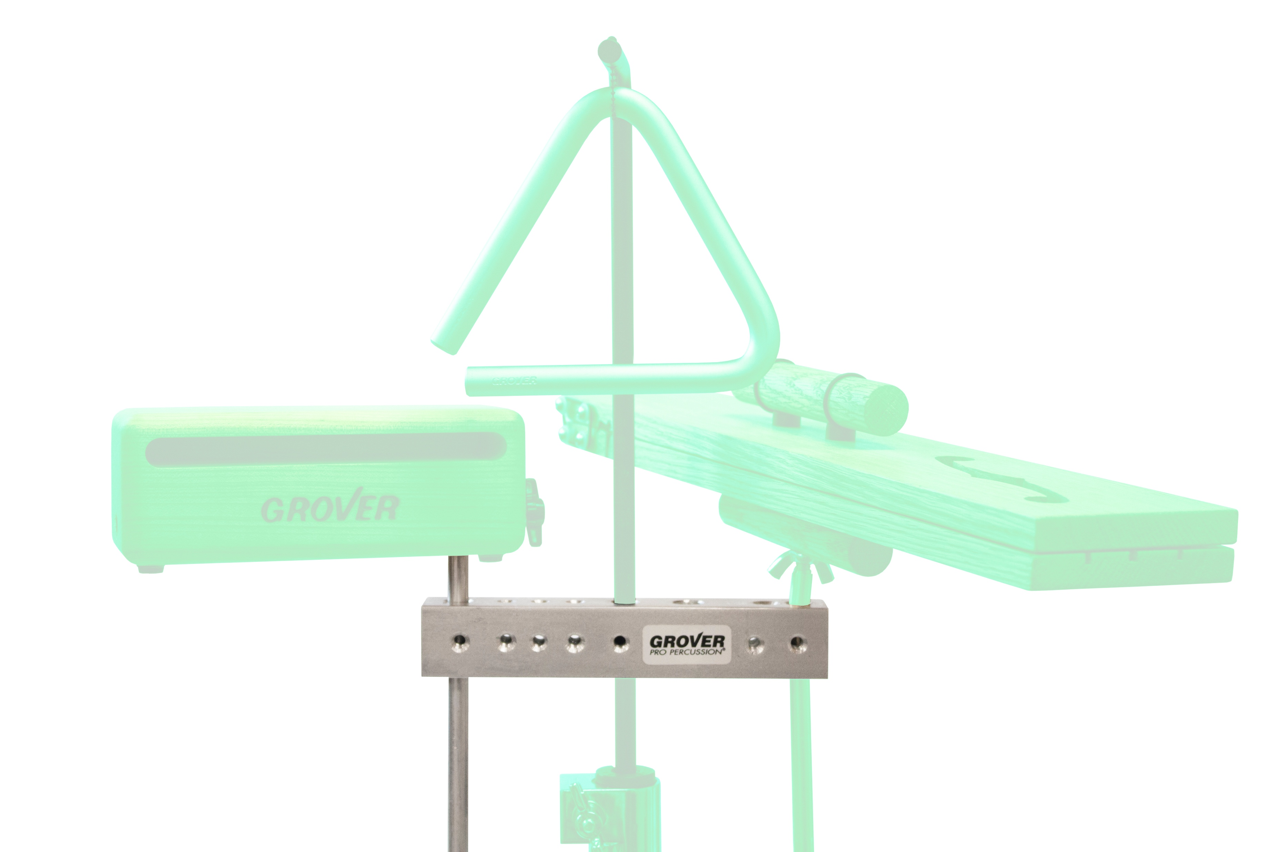
Multi-Instrument Mount
Versatile device that provides an unlimited number of options.
Mounts woodblocks, triangles, castanets, slapstick, cowbells, and much more!
base bar
straight arms
3 “T” screws
multi-stand adapter
storage pouch

Slide 4
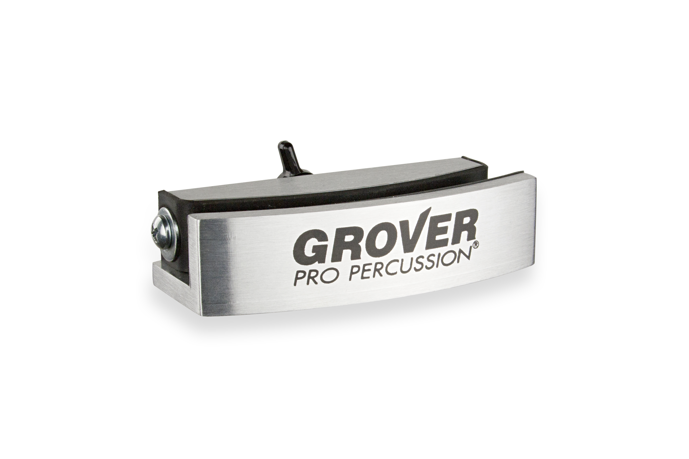
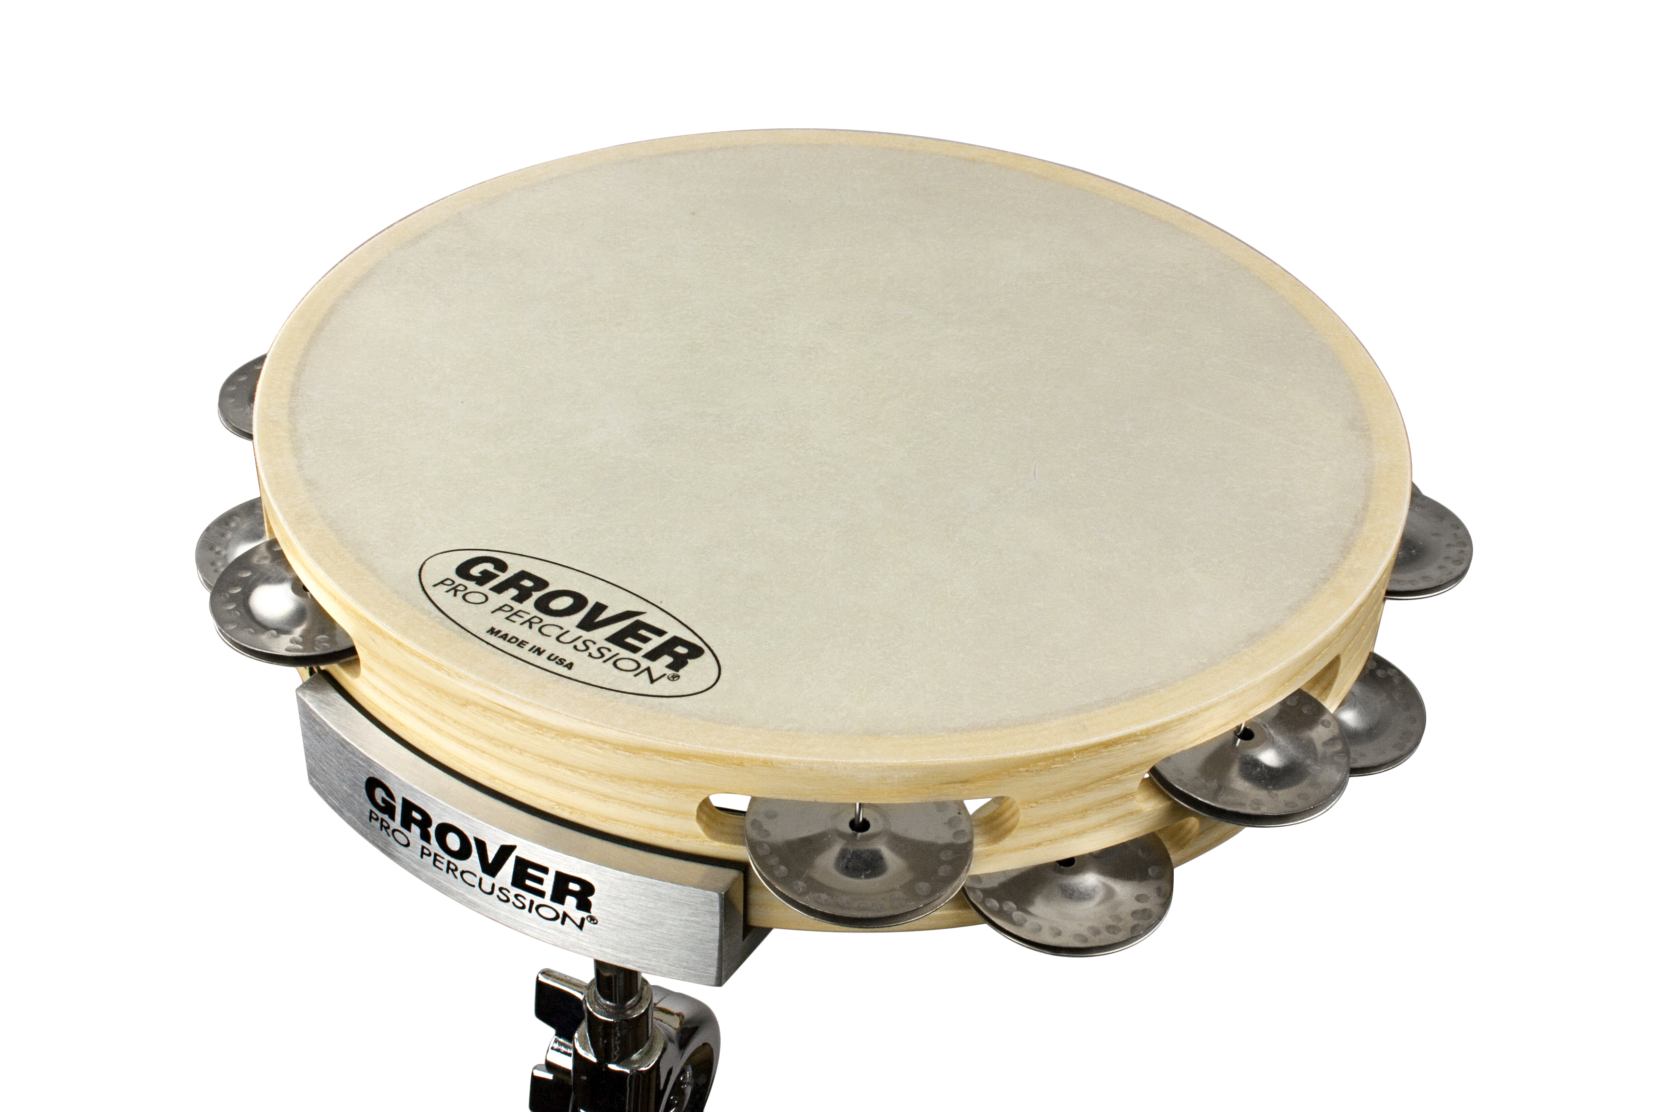
Tambourine Mounting Clamp
For 8-, 10-, or 12-inch tambourines and frame drums
A sturdy universal tambourine clamp that will grip your tambourine securely but allows frame and jingles to resonate fully!

Slide 5
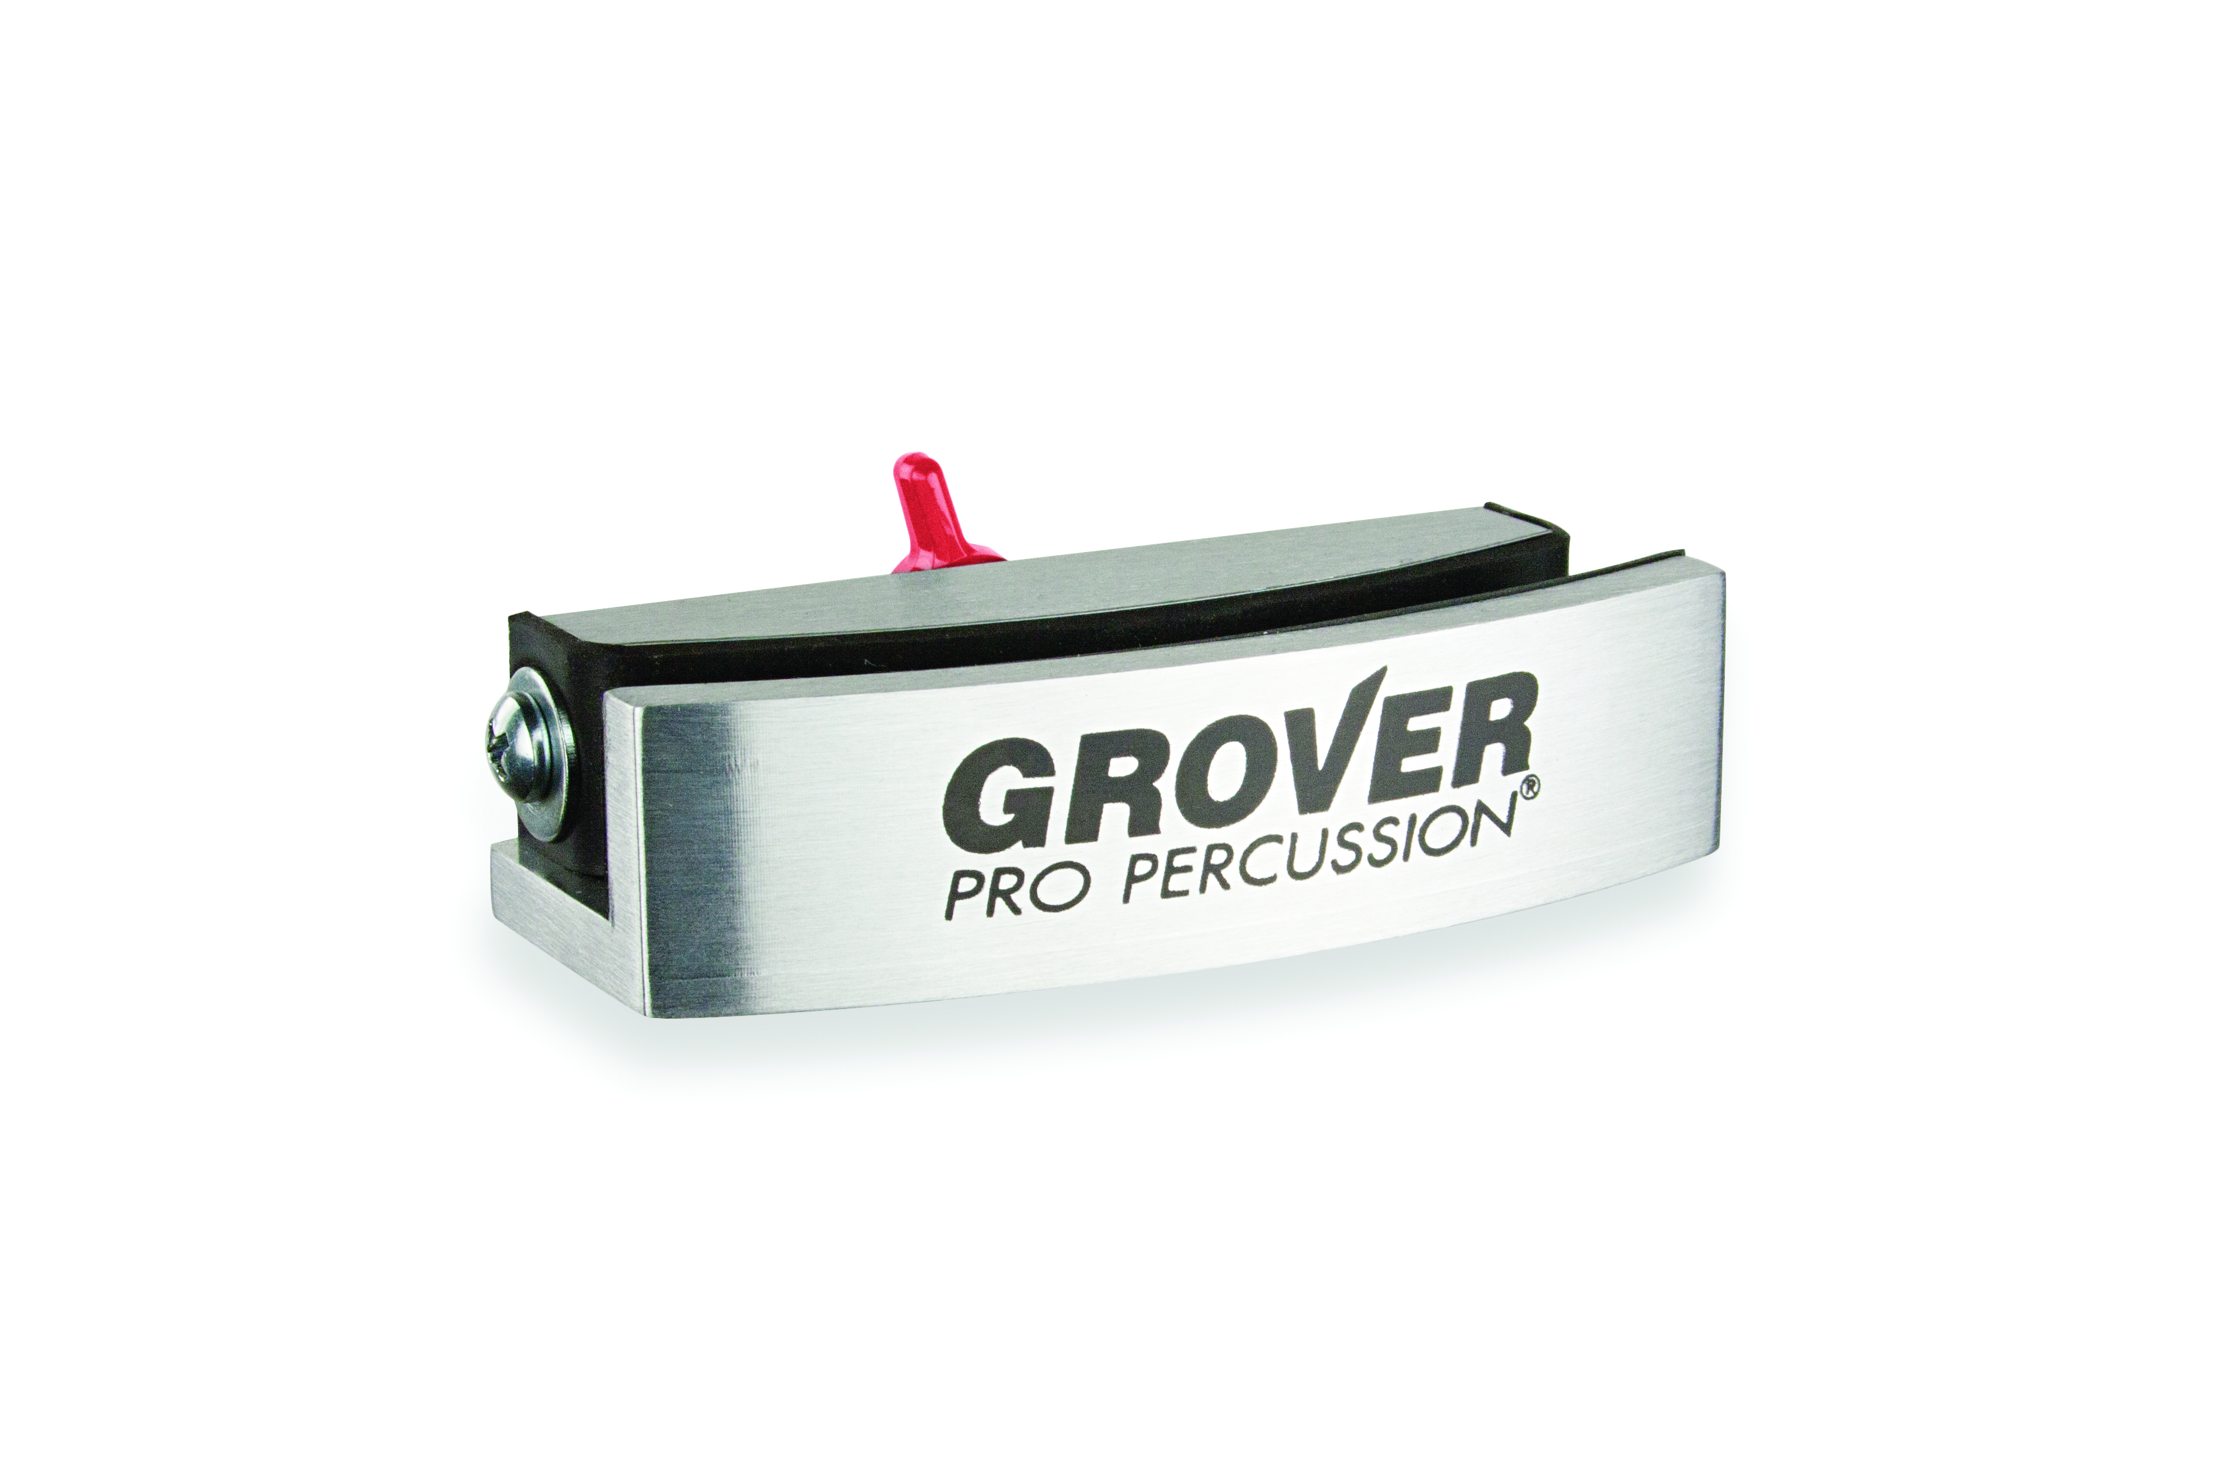
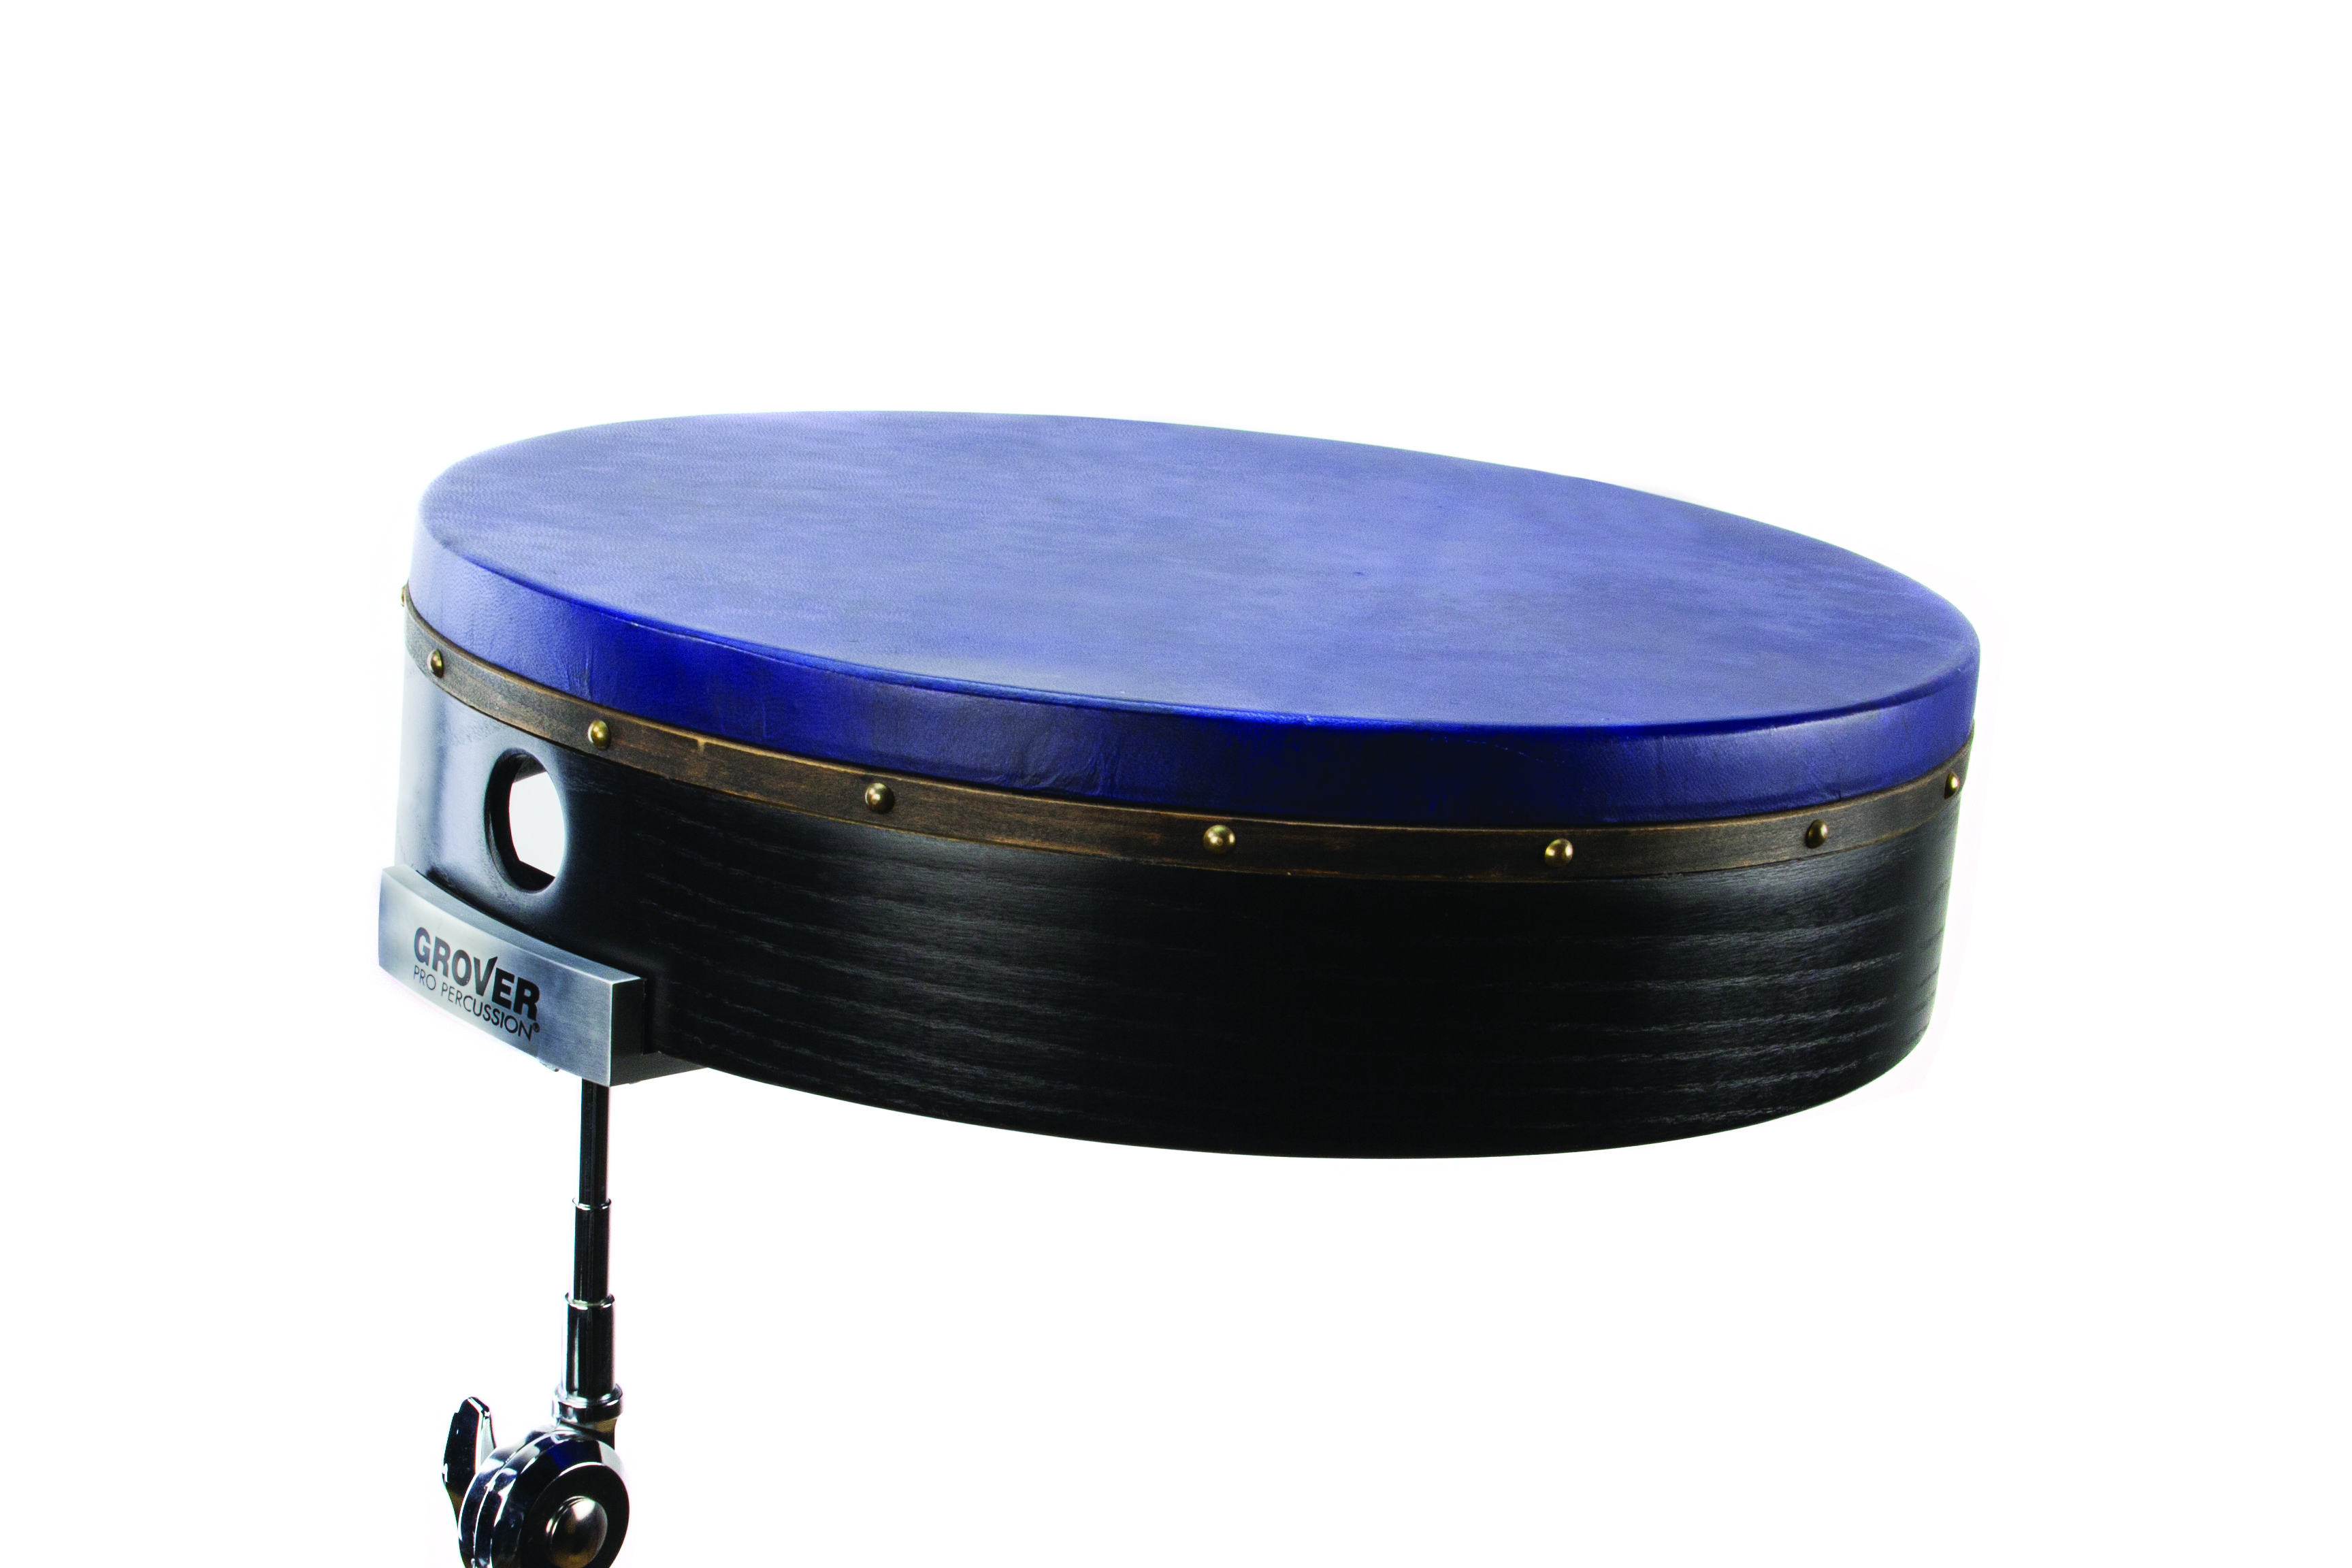
Frame Drum Mounting Clamp
For 14- to 22-inch frame drums
A sturdy universal frame drum clamp that will grip your securely but allow the frame to resonate fully!

Slide 6
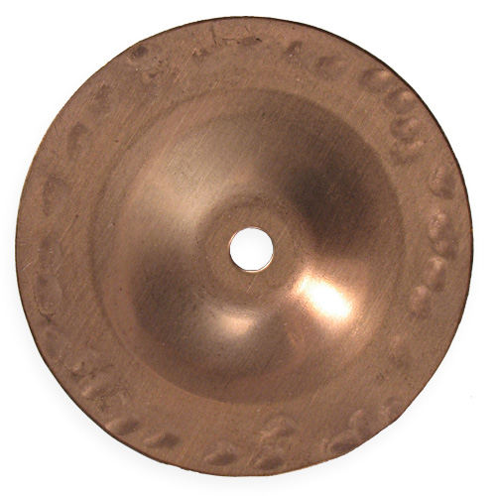
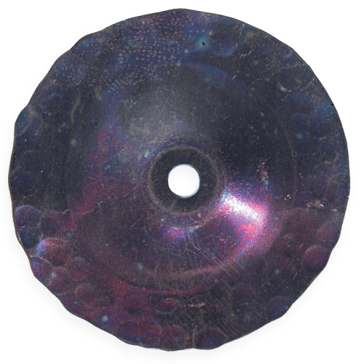
Jingle Packs
For 14- to 22-inch frame drums
18-piece jingle packs for the Grover Pro Tunable Tambourine
JP-BC – Beryllium Copper Jingle Pack
JP-HTS – Heat-Treated Silver Jingle Pack
JP-PHBR – Phosphor Bronze Jingle Pack

Slide 7
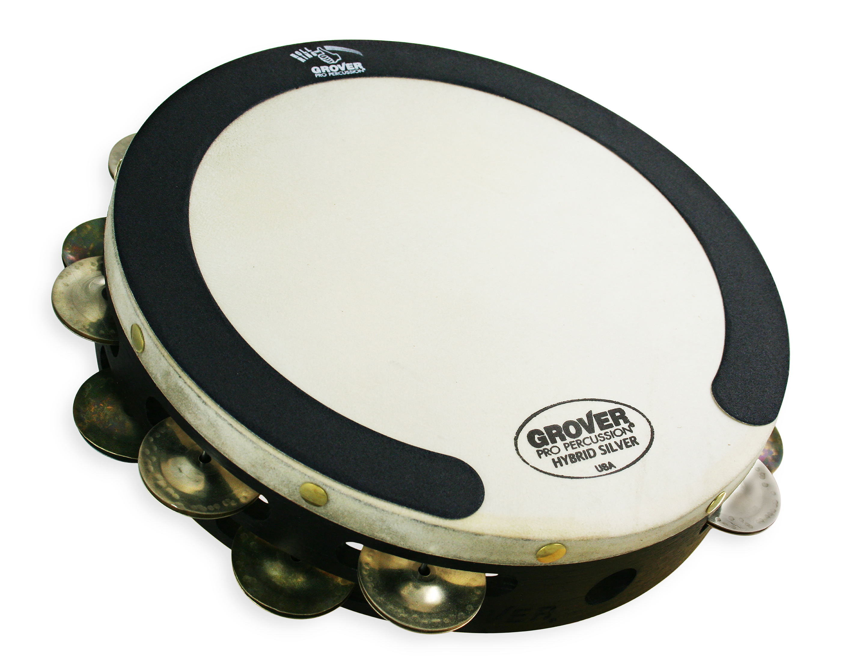
Roll Ring™
Tambourine Thumb Rolls Have Never Been Easier!
Our Roll Ring is designed to aid concert percussionists with the execution of thumb/finger tambourine rolls.
This circular ring helps players easily create the friction needed to produce a smooth, even sounding roll.

Slide 8
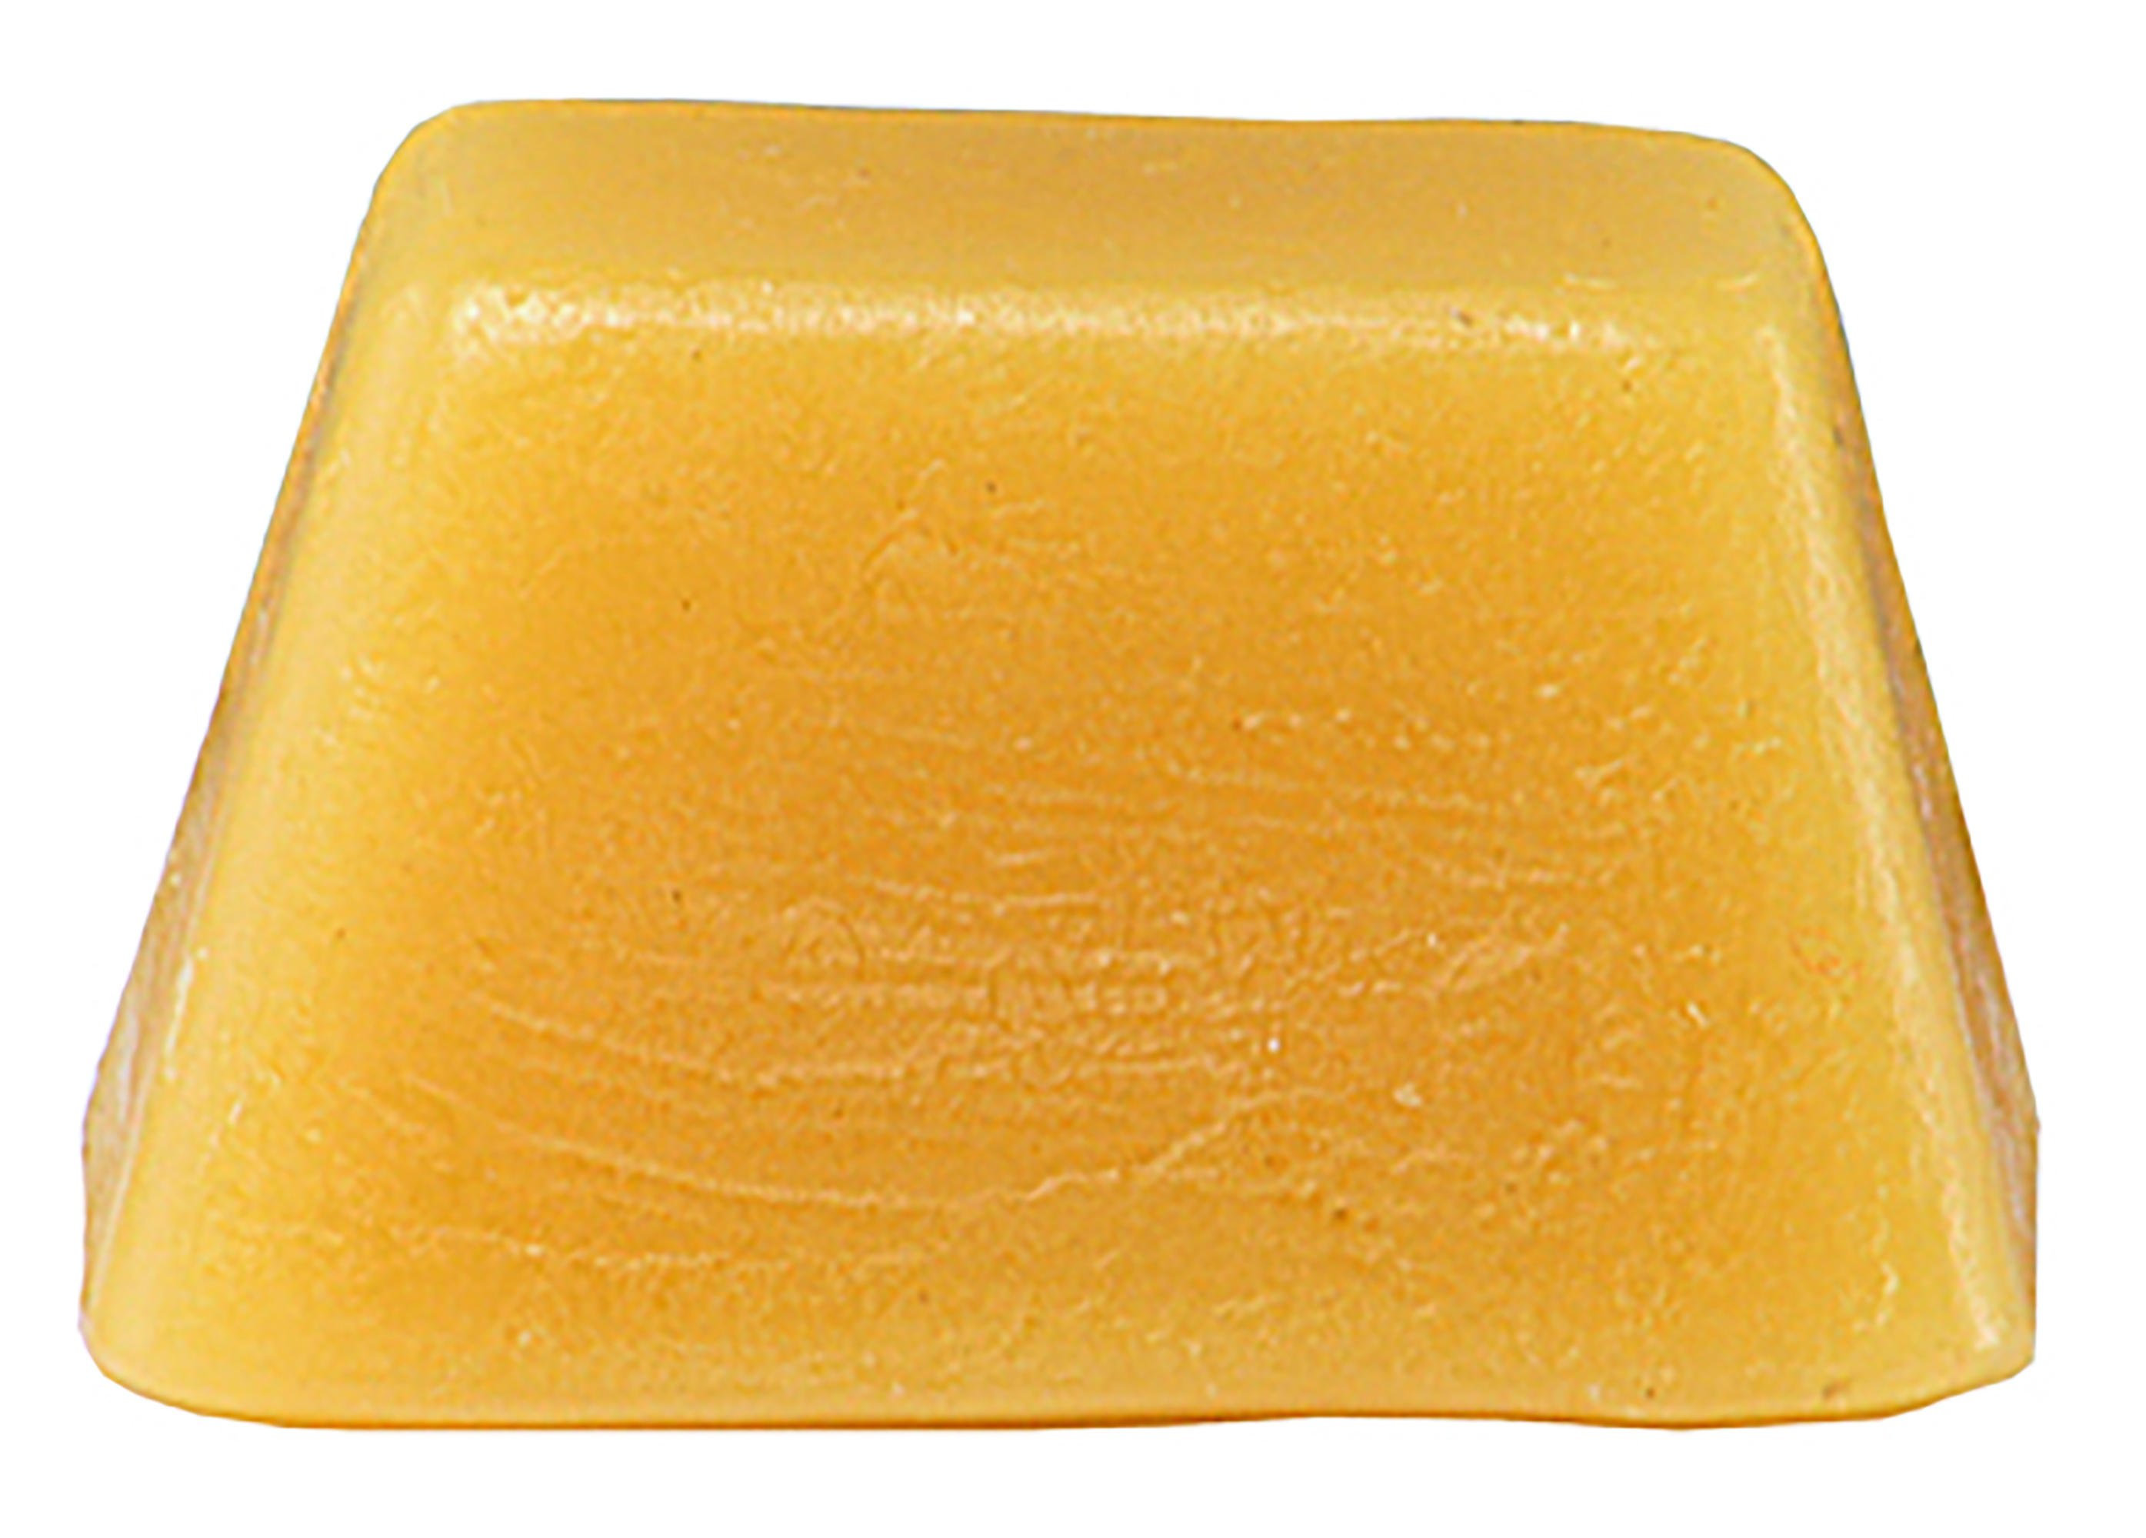
Tambourine Wax
A special family secret since 1979!
Wax gathered from selected bees combined with Mother Grover’s secret recipe makes this an exclusive mix. Just rub on a little of our wax and executing finger rolls becomes a breeze!

Slide 9
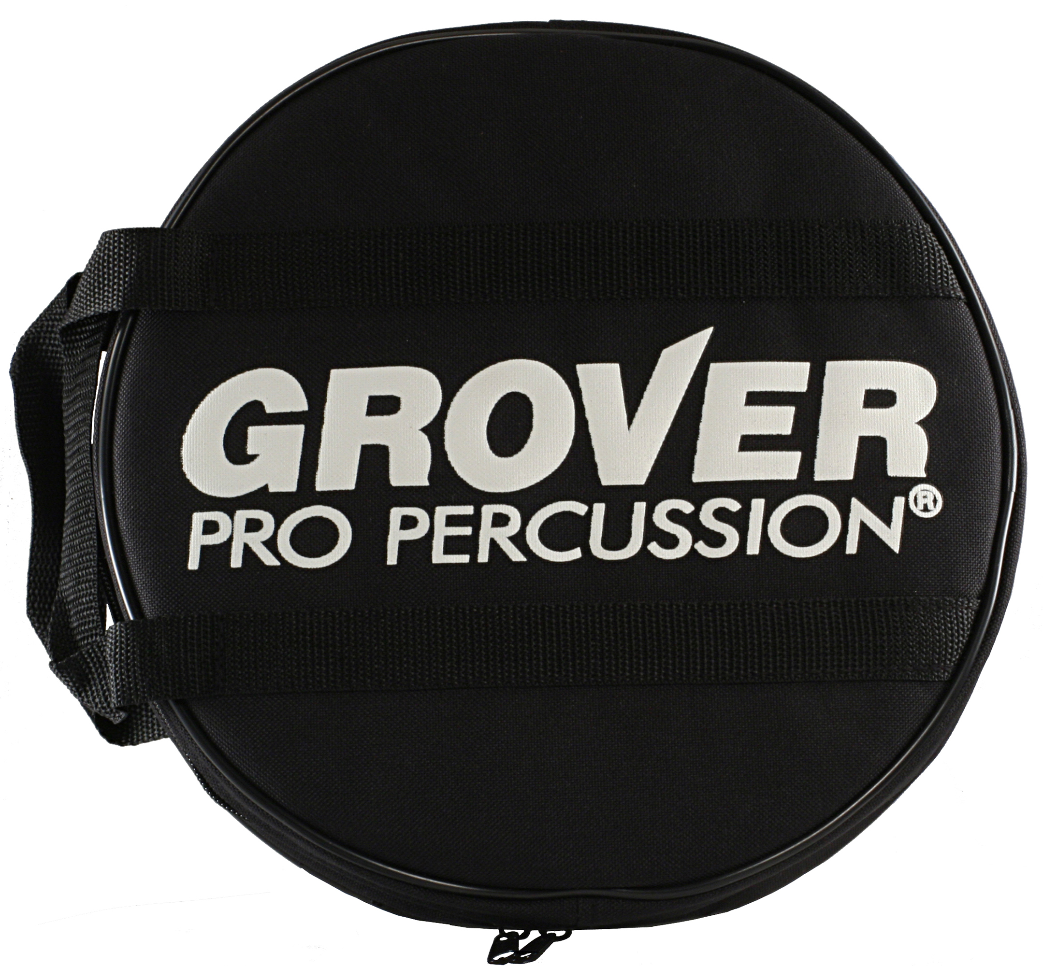
Tambourine Bag
Tambourine bags come standard with all tambourines, but are also available separately.
Our zippered Cordura® tambourine bags come standard with all tambourines, but are also available separately.

Slide 10
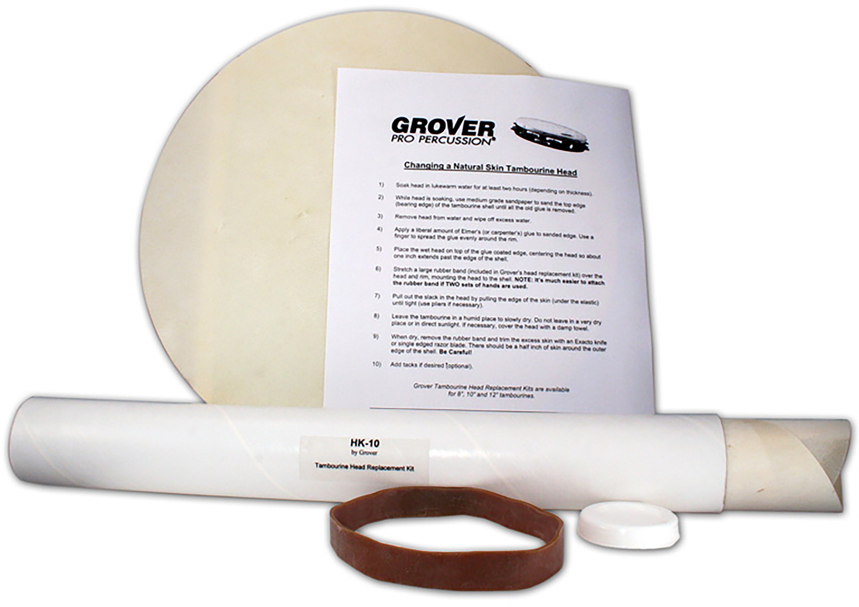
Tambourine Head Kits
DIY head replacement
Includes premium skin head, special mounting band, and instructions.

Slide 11
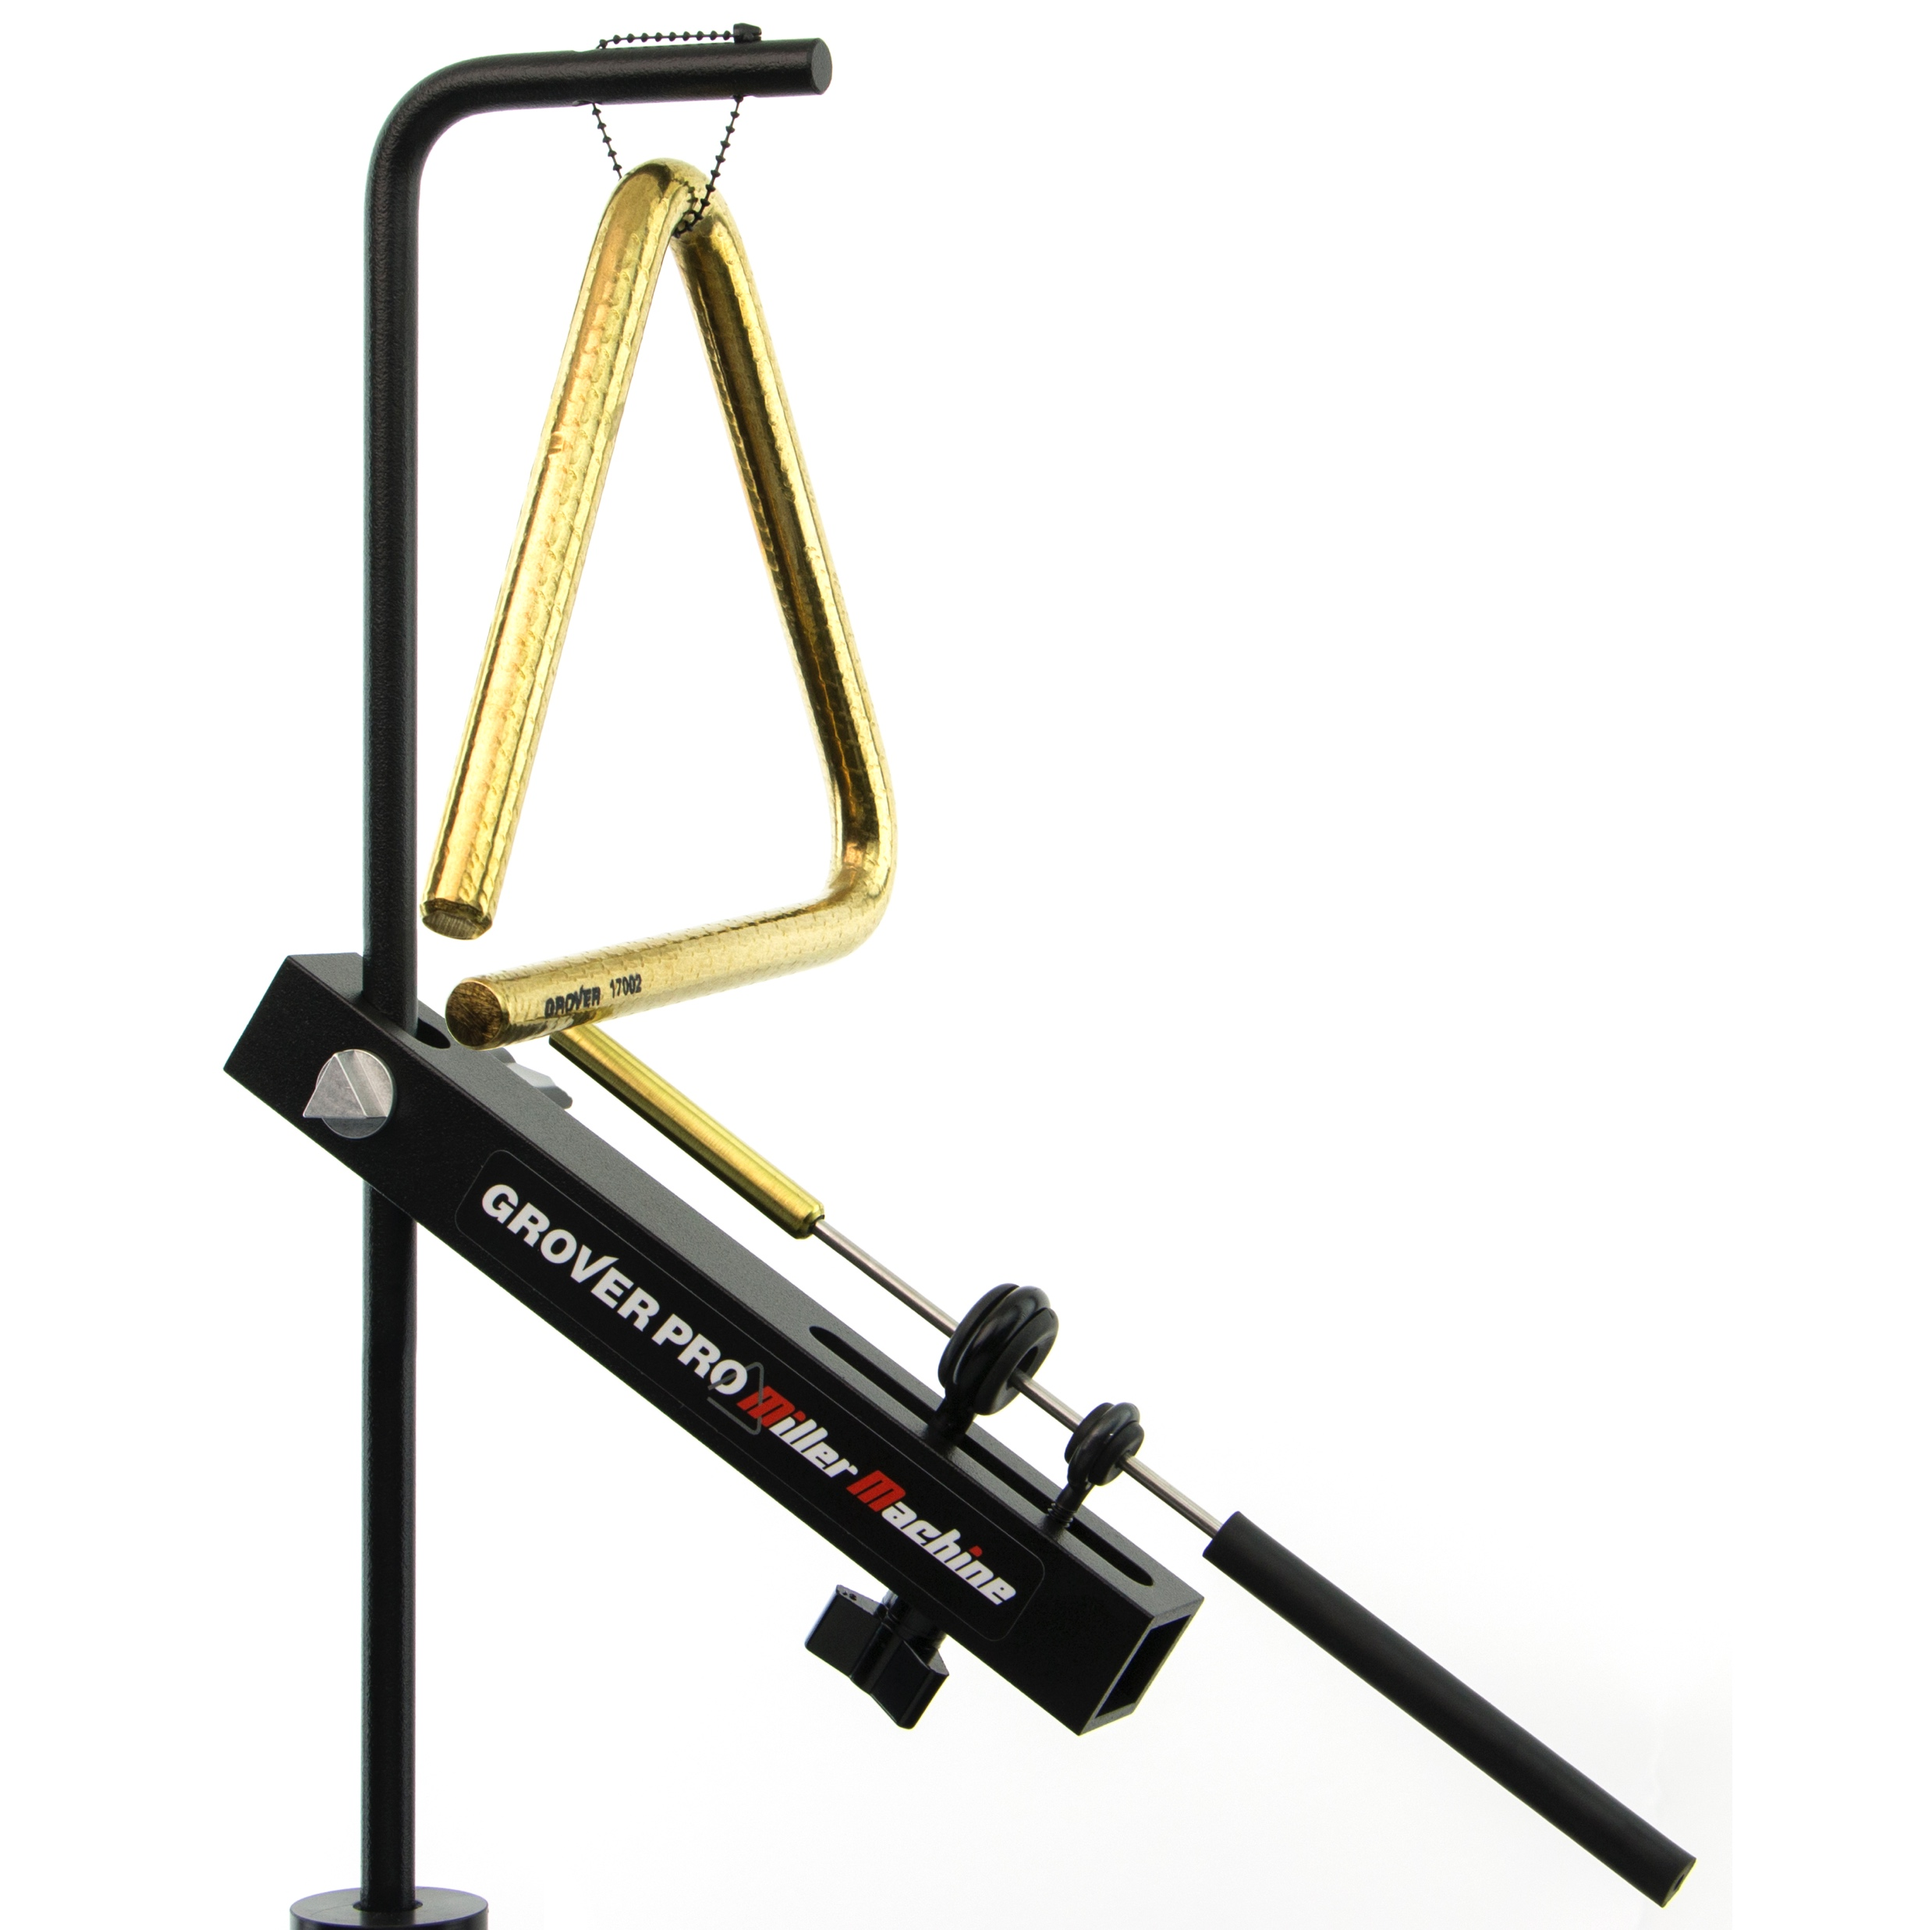
Miller Machine
The ultimate triangle triggering device!
This fully adjustable machine allows multi-percussionists to play a triangle with their hands or mallets.

Slide 12
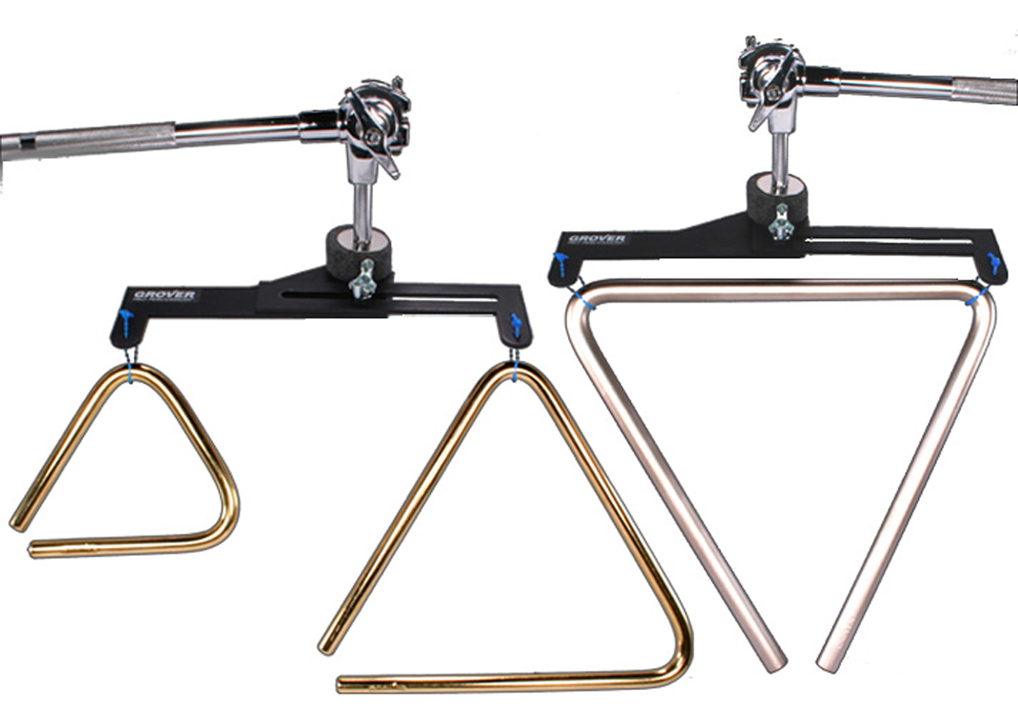
Dual Triangle Mount
Perfect for orchestras, pit percussionists, drum set players, or multi-percussion set-ups.
Mounts one or two triangles to a cymbal stand. An adjustable side arm extension enables suspension in a vertical or horizontal configuration. Our exclusive “nodal” system allows the triangle to resonate freely.

Slide 13
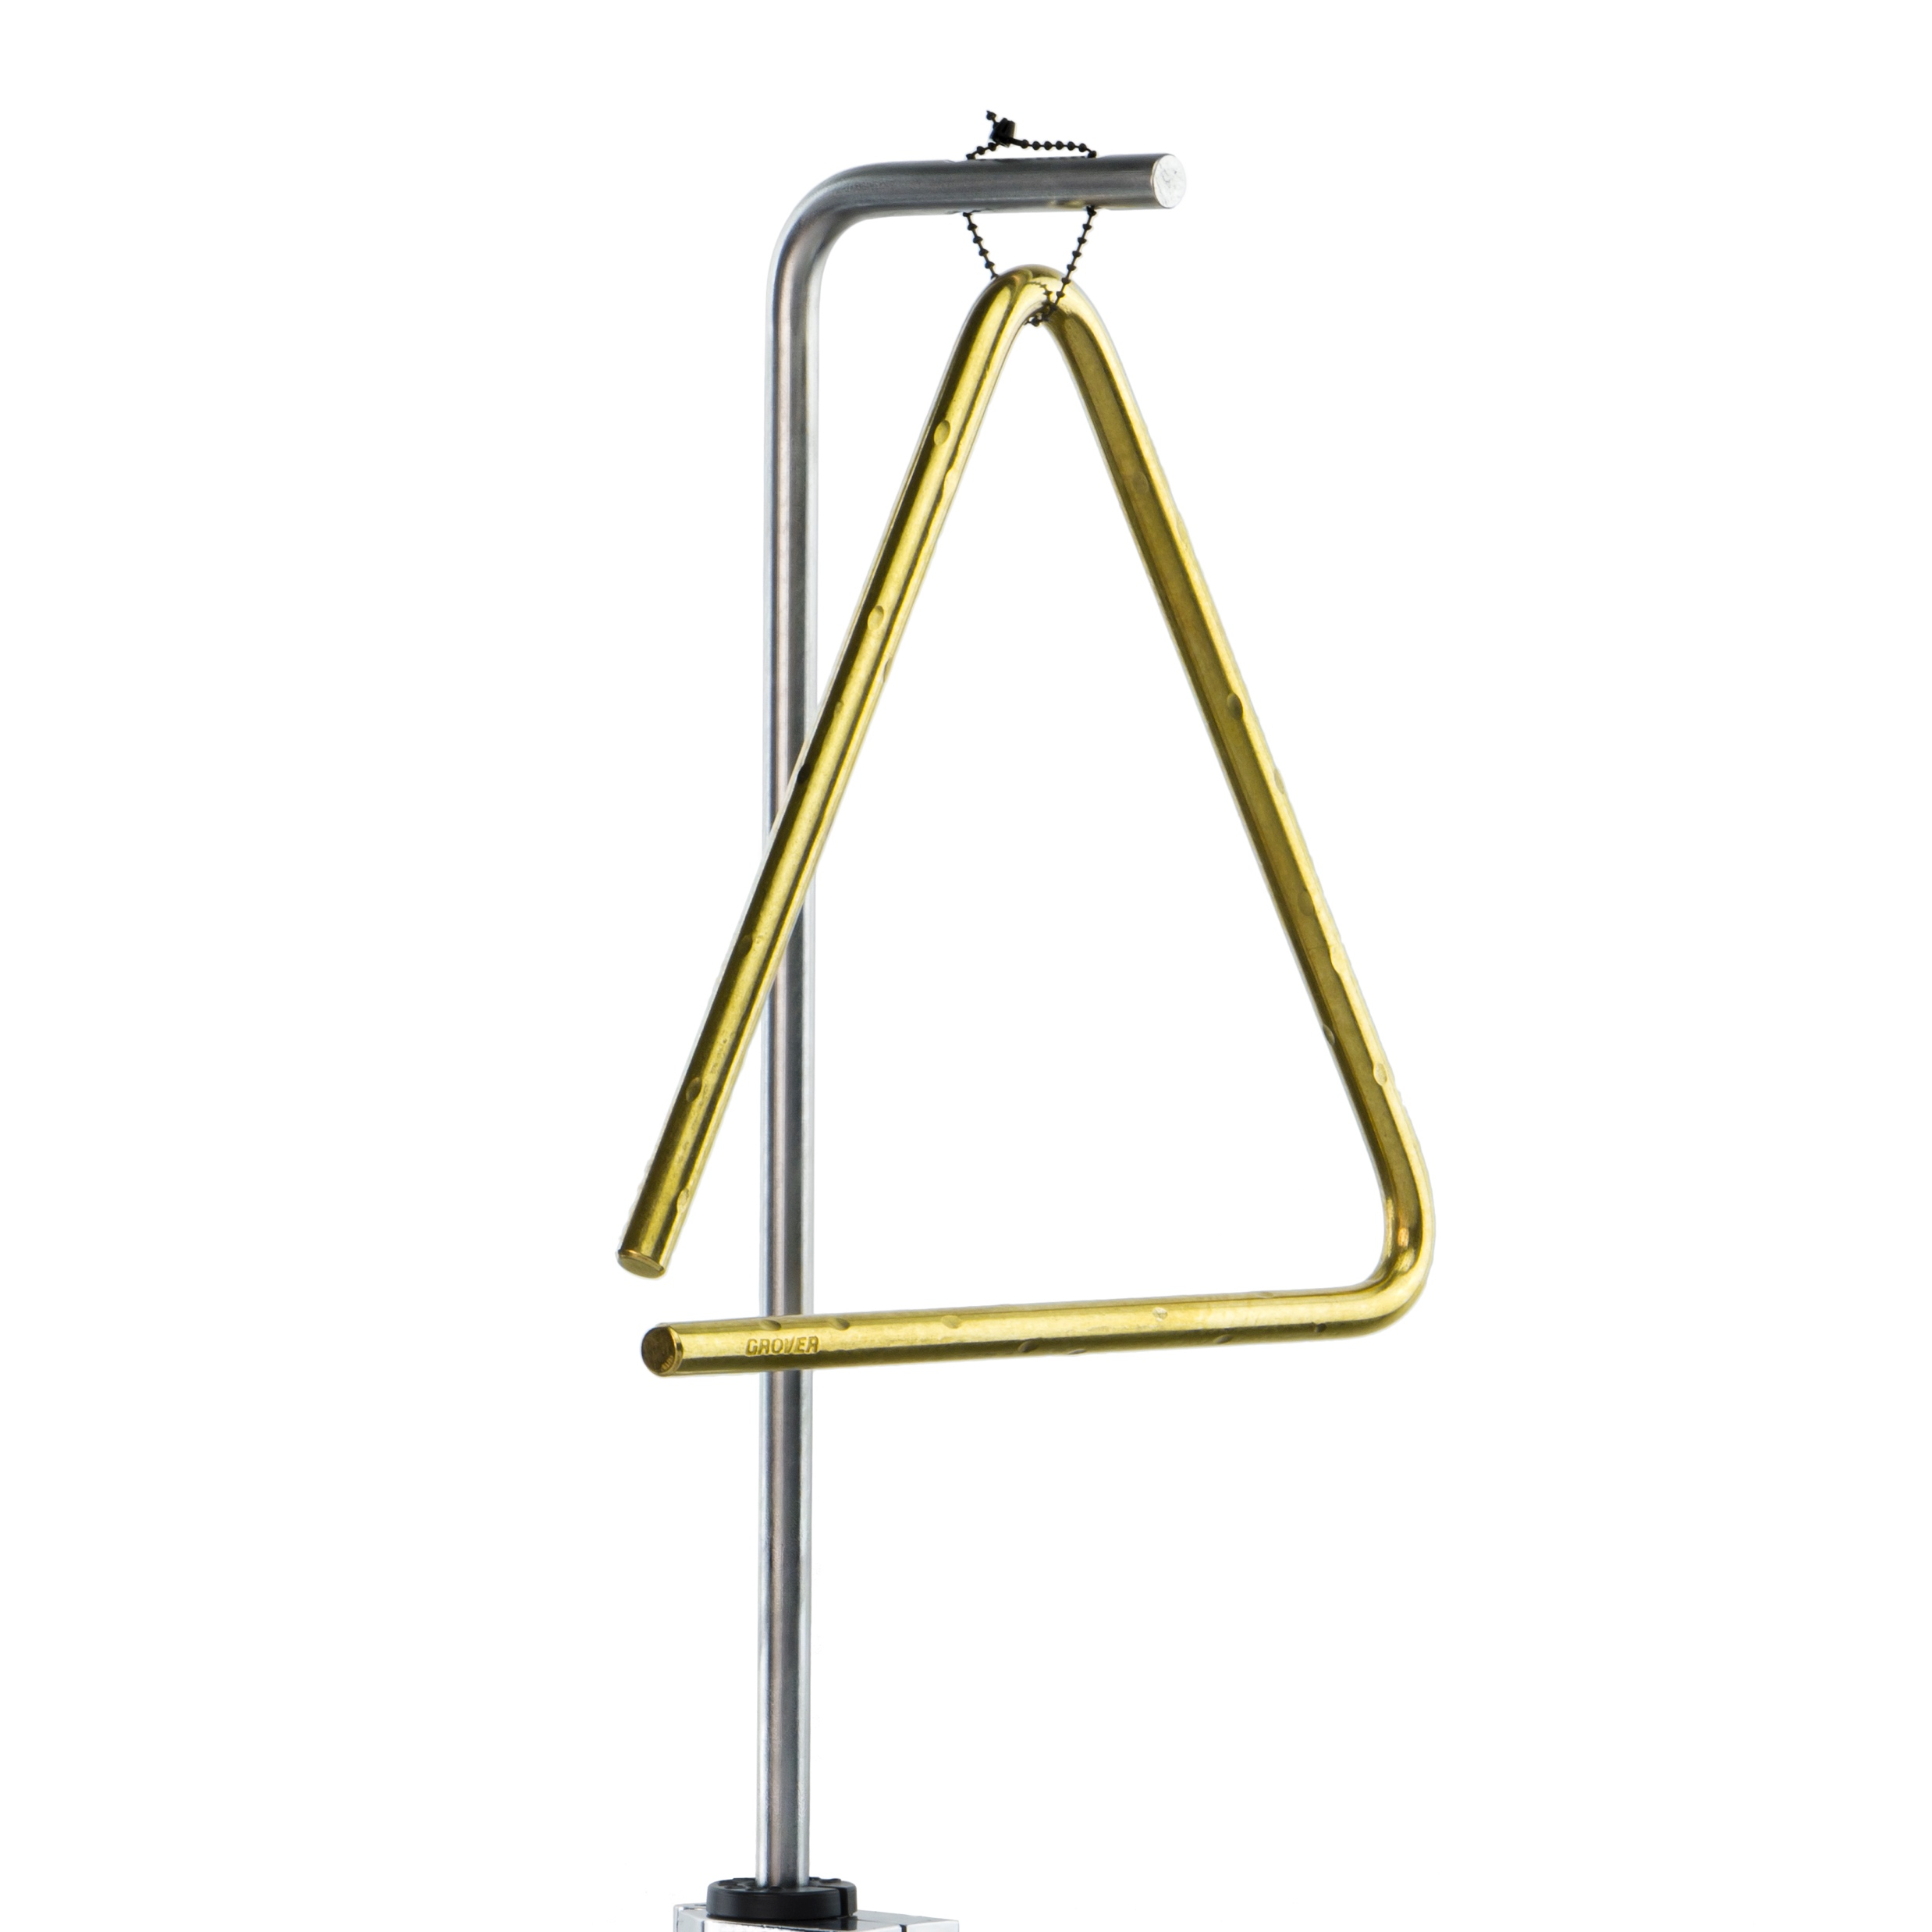
Triangle Arm
Suspend any triangle
The solid aluminum “L” arm fits any 3/8″ mounting bracket. Use it with our Multi-Stand Adapter for maximum flexibility in mounting.

Slide 14
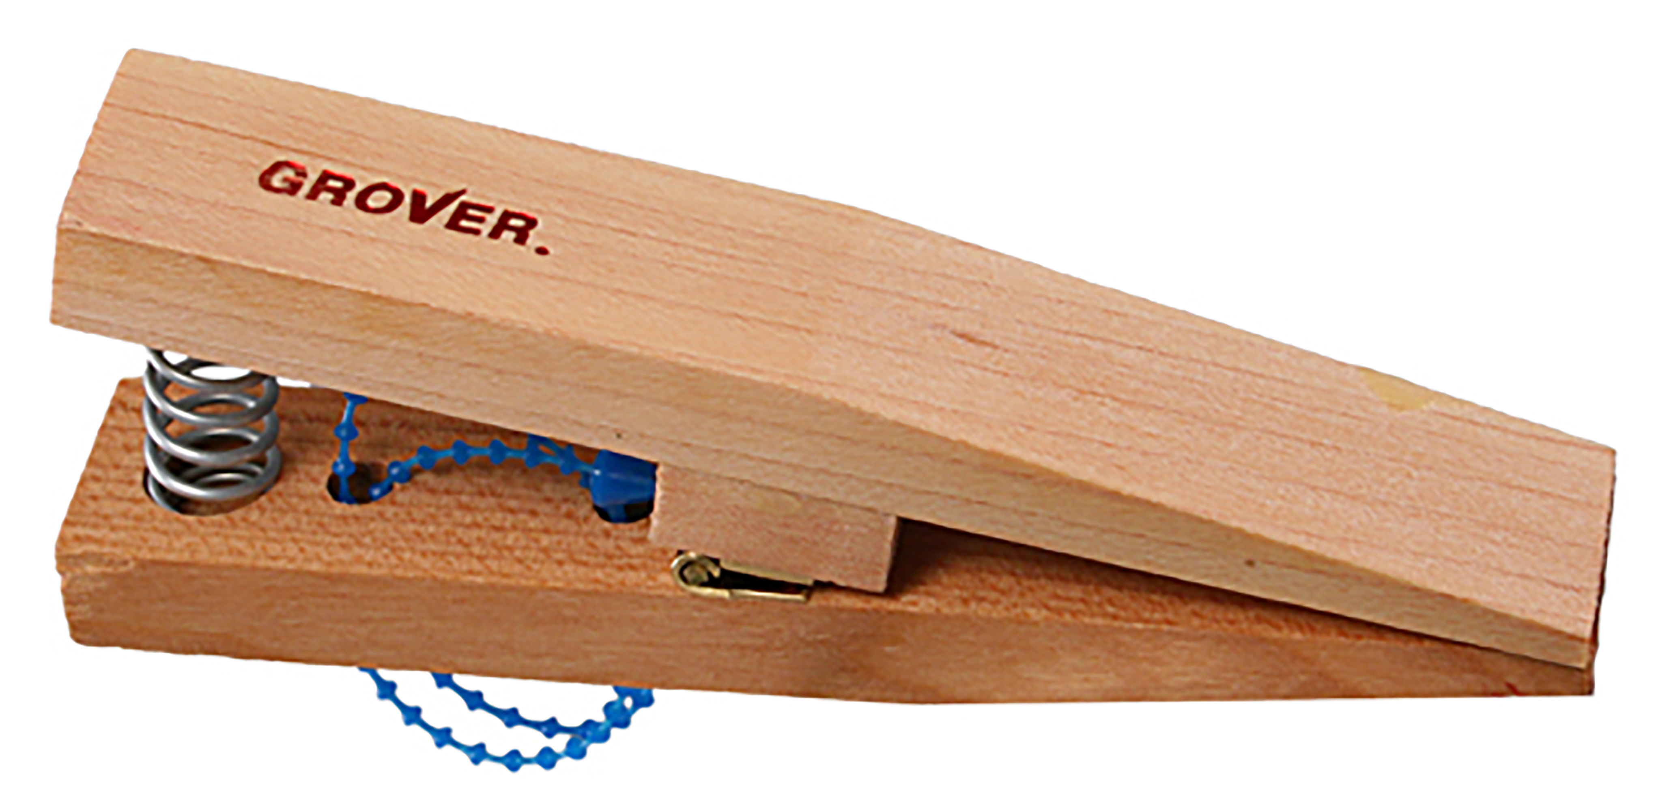
Pro Triangle Clip
Manufactured from New England hardwood for its strength and light weight.
The easy action spring allows the player to open the clip with one hand, so the triangle may be removed and clipped to a stand using only the holding hand. Our exclusive “nodal” suspension system allows maximum resonance.

Slide 15
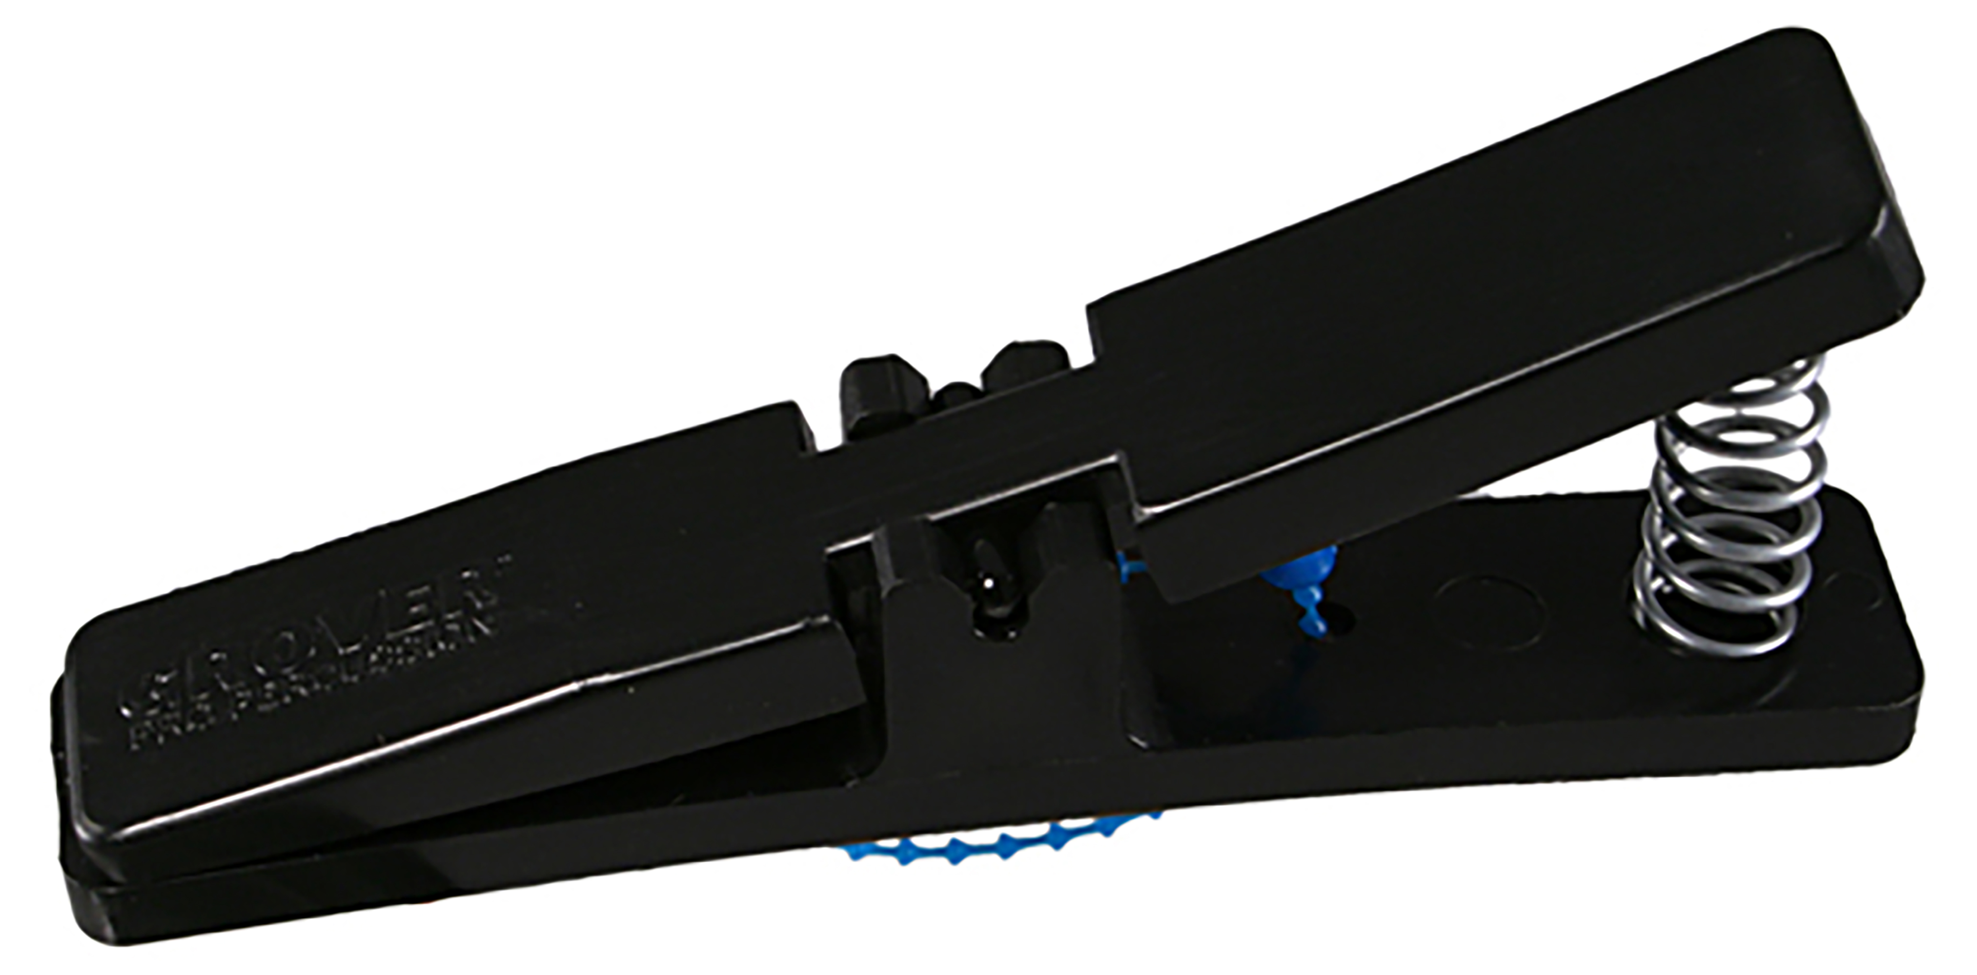
Sound Values™ Triangle Clip
An economical clip good for smaller triangles.
Molded from impact-resistant plastic and features a single nodal suspension cord. This economical clip is sturdy, durable and a great choice for schools and budget-minded players.

Slide 16
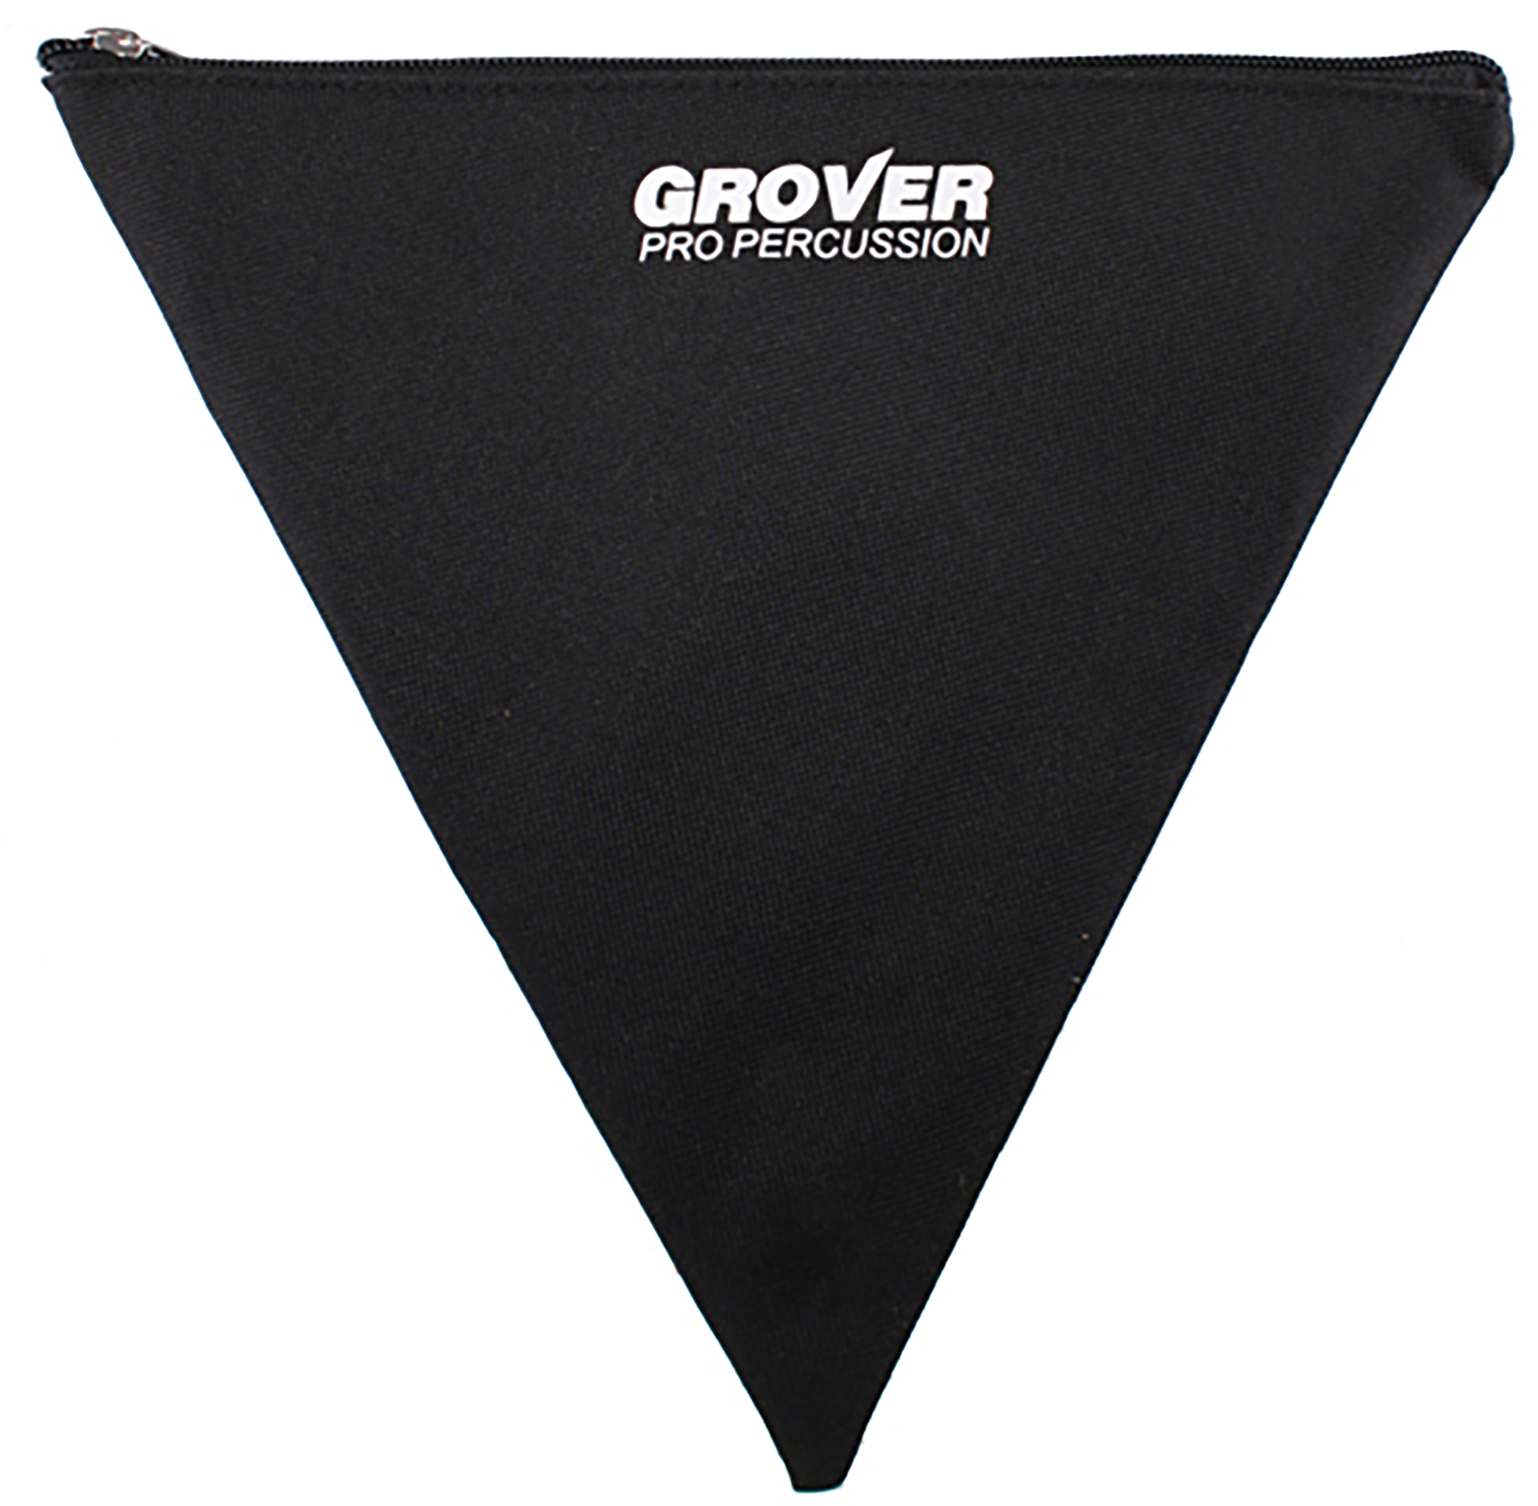
Triangle Case
Cordura® triangle bags come standard with all triangles, but are also available separately.
Protect your triangular investments with our zippered storage cases!

Slide 17
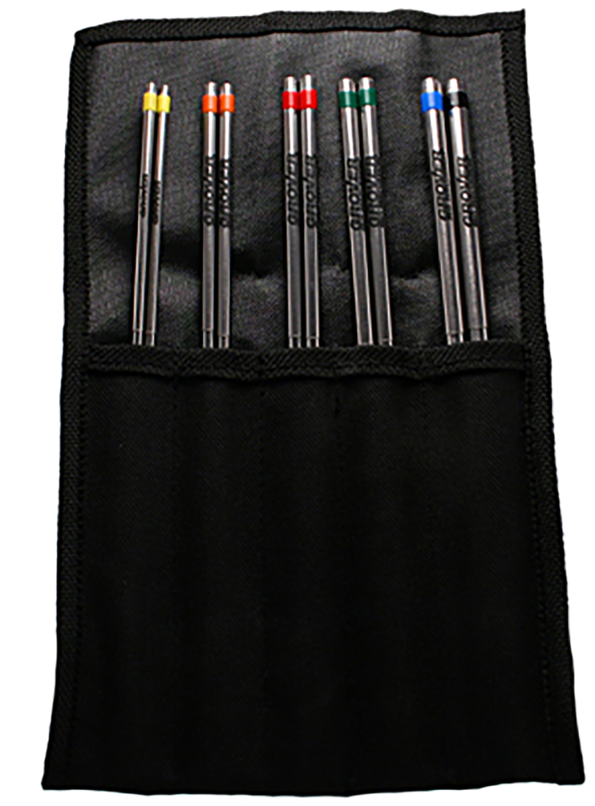
Triangle Beater Case
Our Cordura® triangle beater cases come standard with Alloy 303 and Tubular beaters, but are also available separately.
Our triangle beater case will easily hold five pairs of beaters. It neatly folds up using a Velcro closure. A great way to keep your beater collection organized!

Slide 18
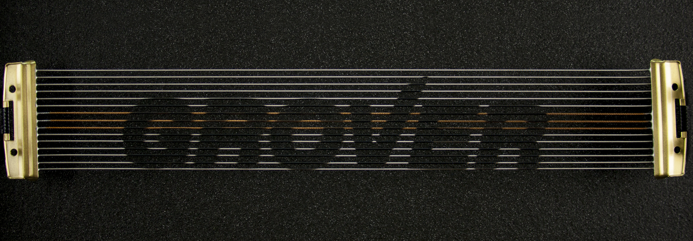
Snare Wires
Non-Spiral Snare Systems.
JD – Jazz Dark, Light gauge
JB – Jazz Bright, Light gauge
CD – Club Dark, Medium gauge
CB – Club Bright, Medium gauge
CC – Club Combo, Medium gauge
And 7 more types

Slide 19
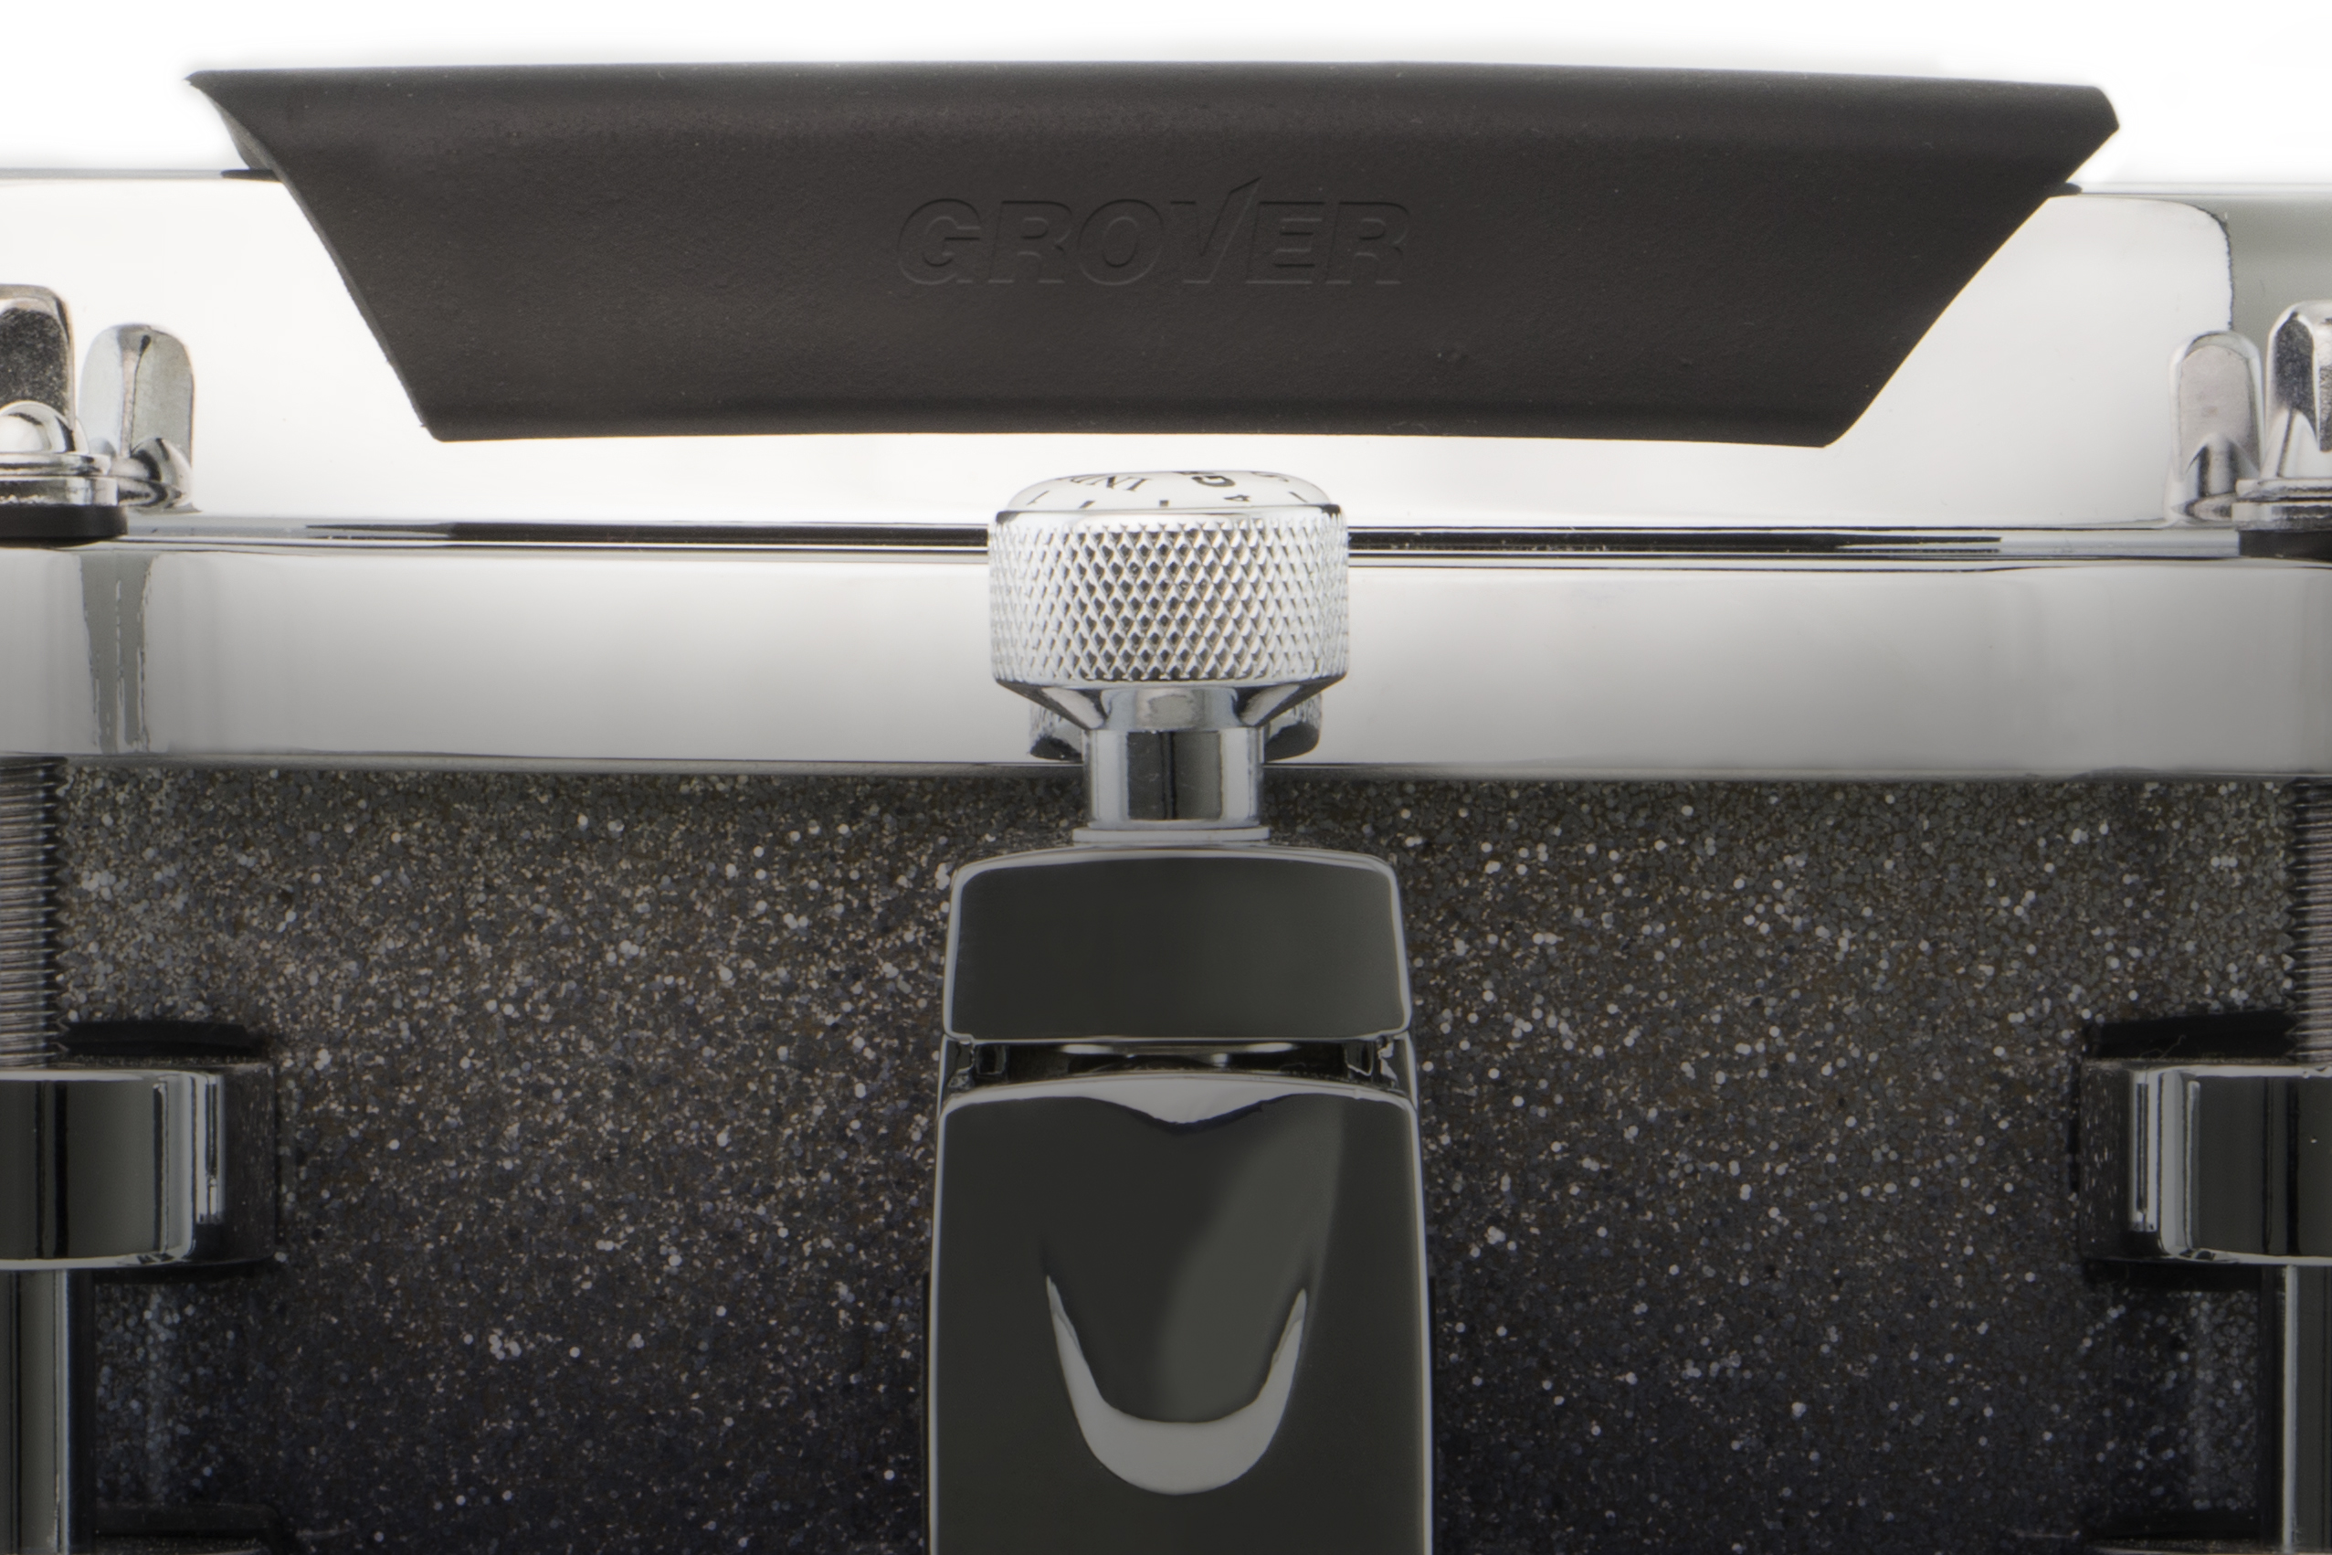
Rim Guard™
Protect against those pesky rim clicks!
Provides you with added security when playing quiet passages close to the rim. Plus, with the added convenience of instant removability, you can move the Rim Guard from one drum to another.

Slide 20
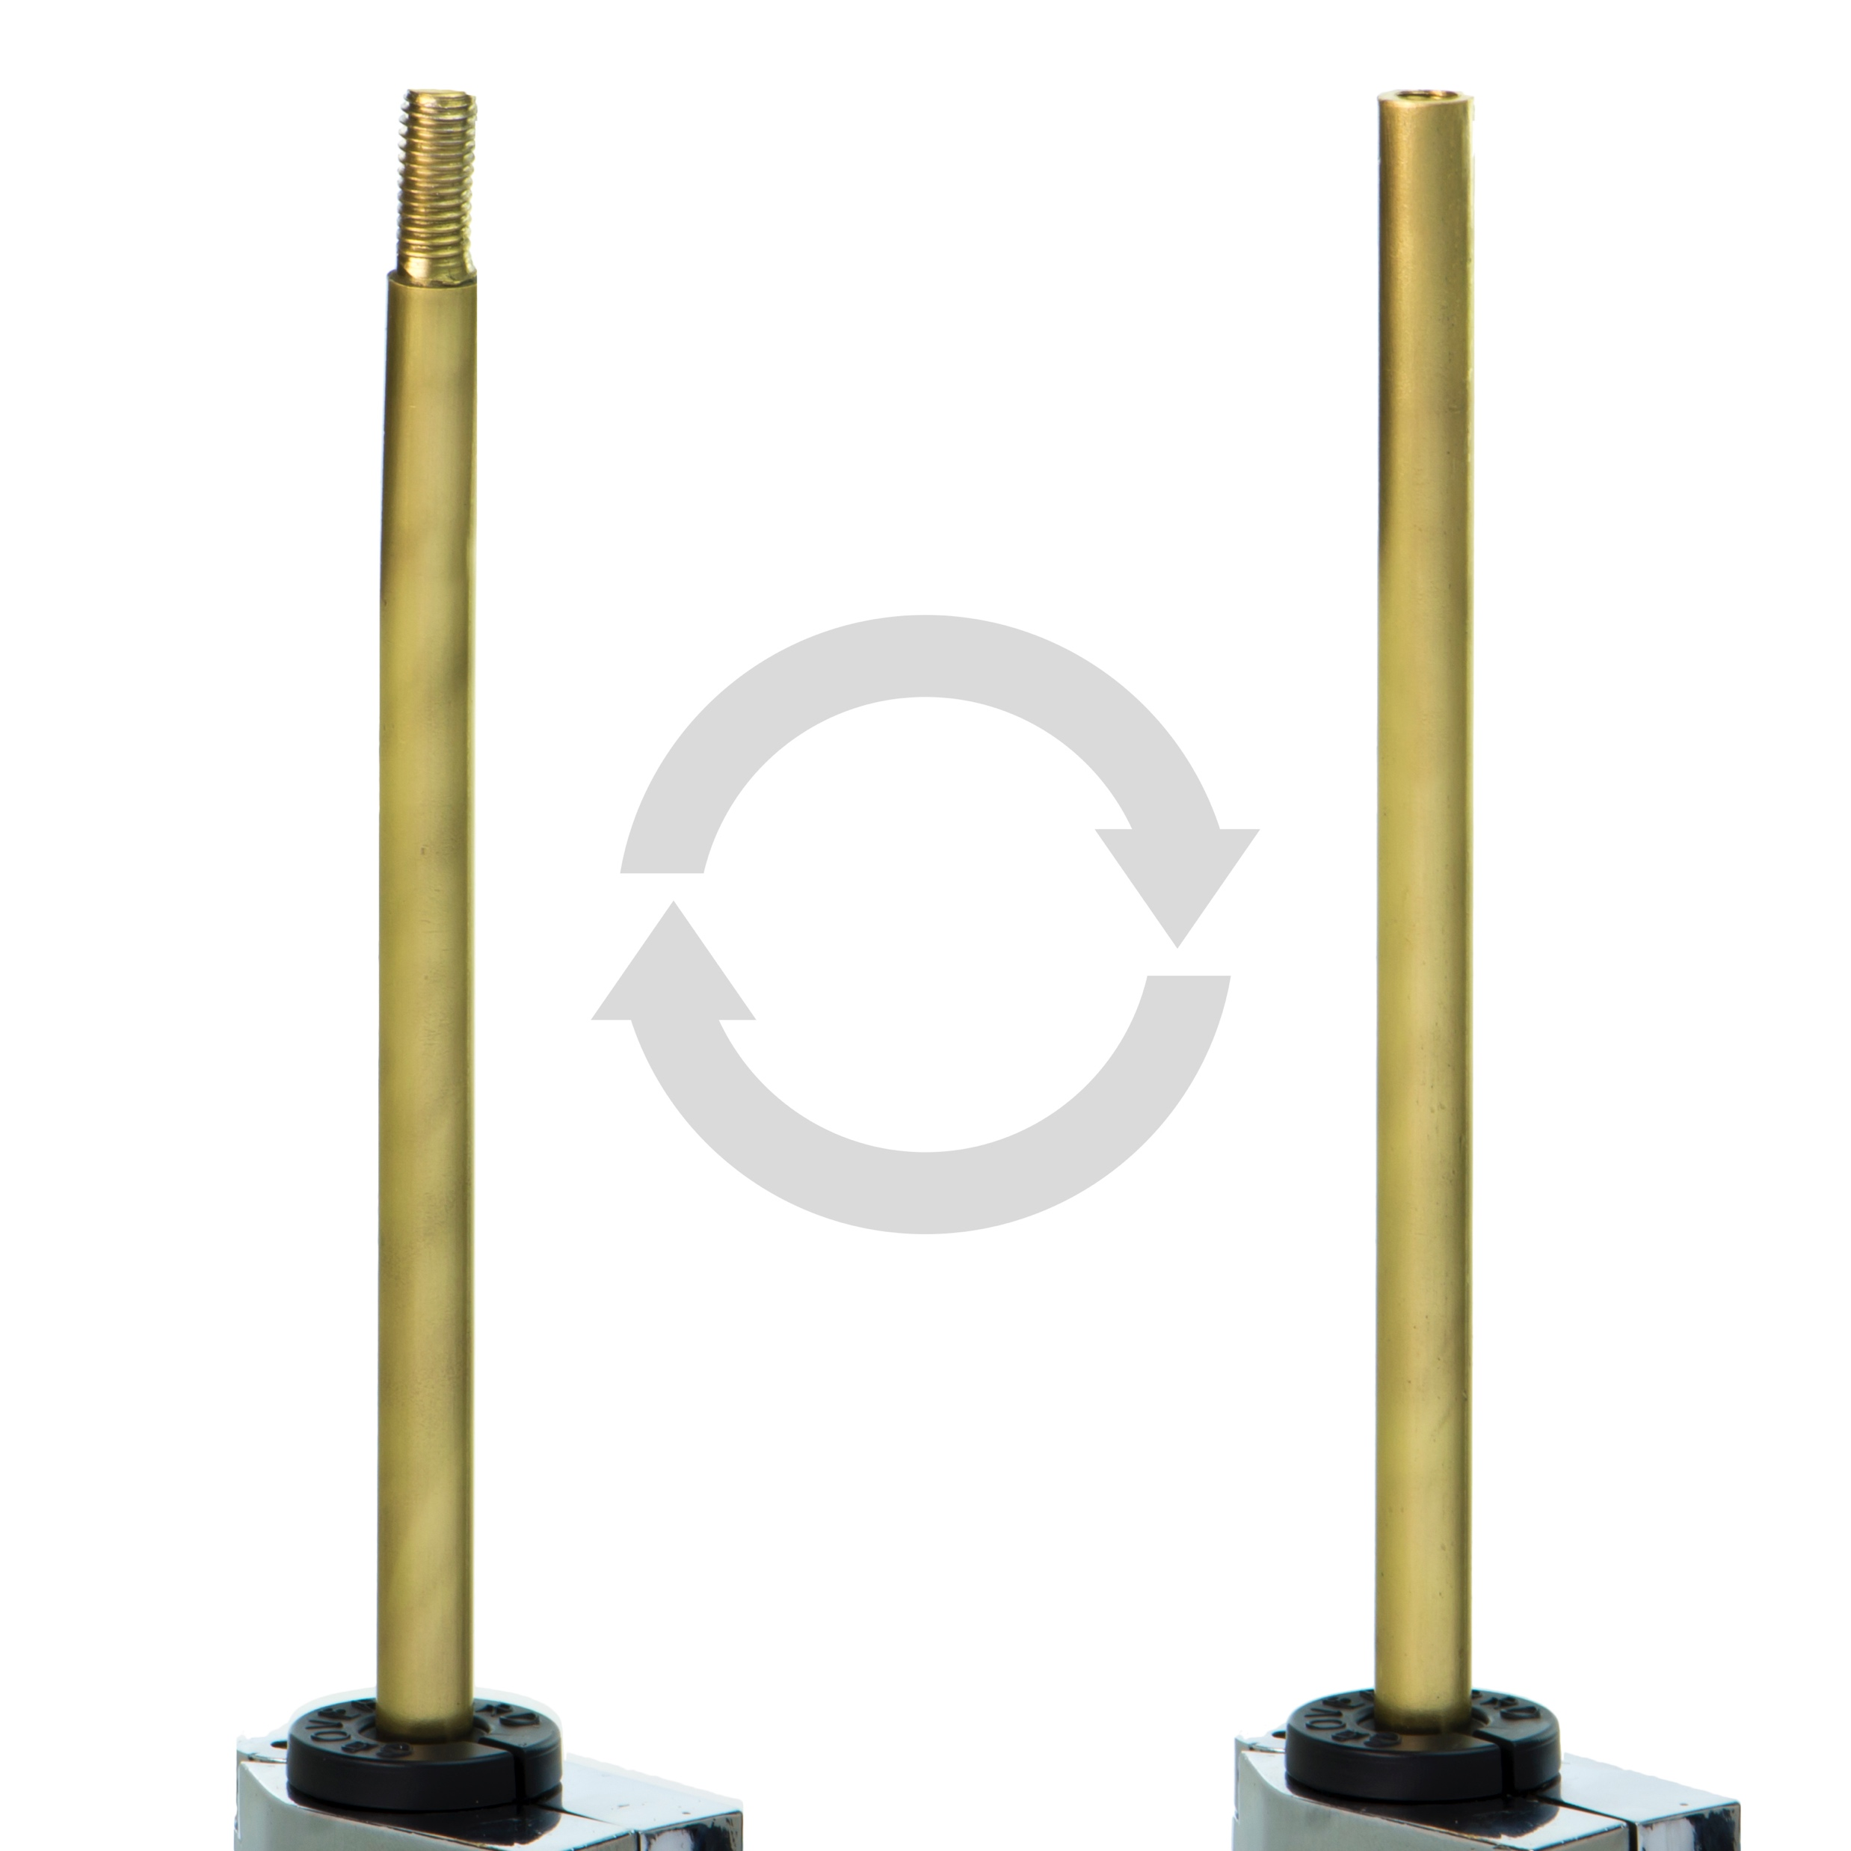
Accessory Mounting Post
Mount virtually any of our accessories!
Allows you to mount virtually any of our accessories on a standard 3/8″ rod bracket or on many types of stands, including our Suspended Cymbal Stand.

Slide 21
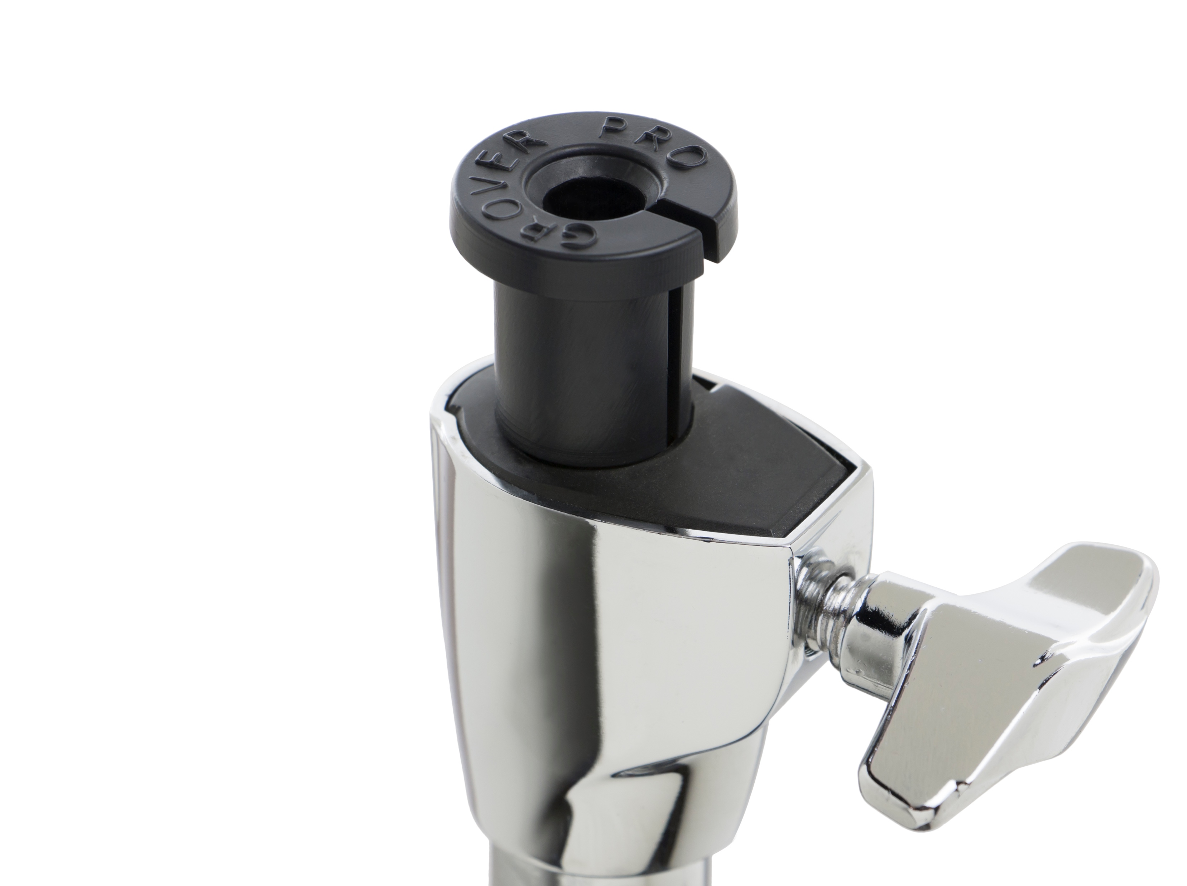
Multi-Stand Adapter
Mount any 3/8″ rod on virtually any cymbal stand!
Allows you to use our Suspended Cymbal Arm or Auxiliary Mounting Post on virtually any cymbal stand. Just plug the adapter into your stand, insert our arm or post, and off you go! It fits all standard 5/8″ and 3/4″ stands.

Slide 22
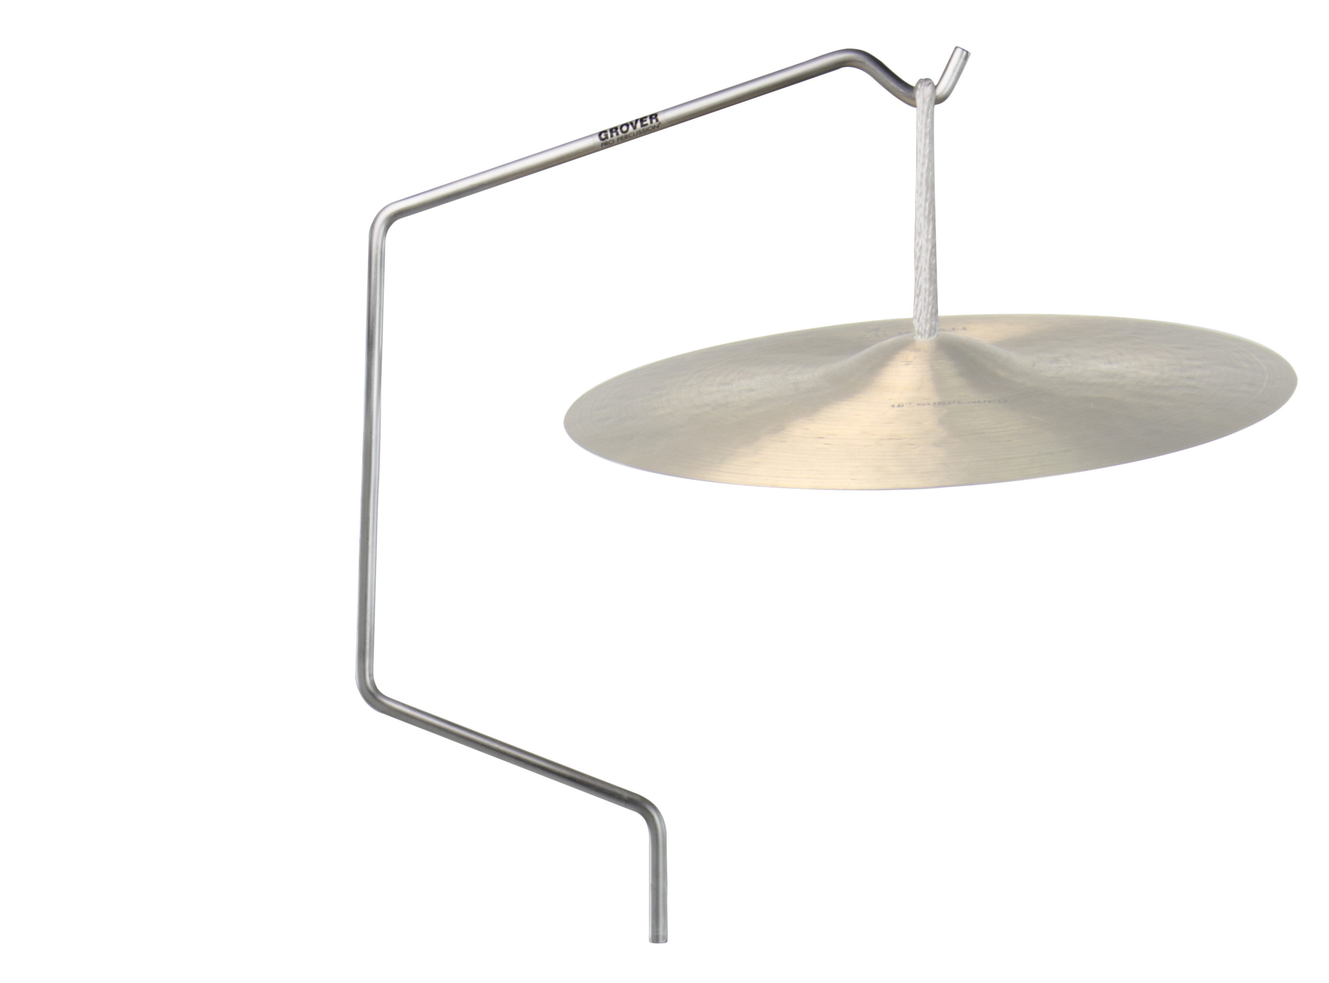
Suspended Cymbal Arm
Suspend cymbals up to 20″
Our solid aircraft aluminum cymbal arm is specially designed to hold suspended cymbals up to 20″ in diameter. Designed to allow the cymbal to vibrate completely, it also provides a generous work space for muffling.

Slide 23
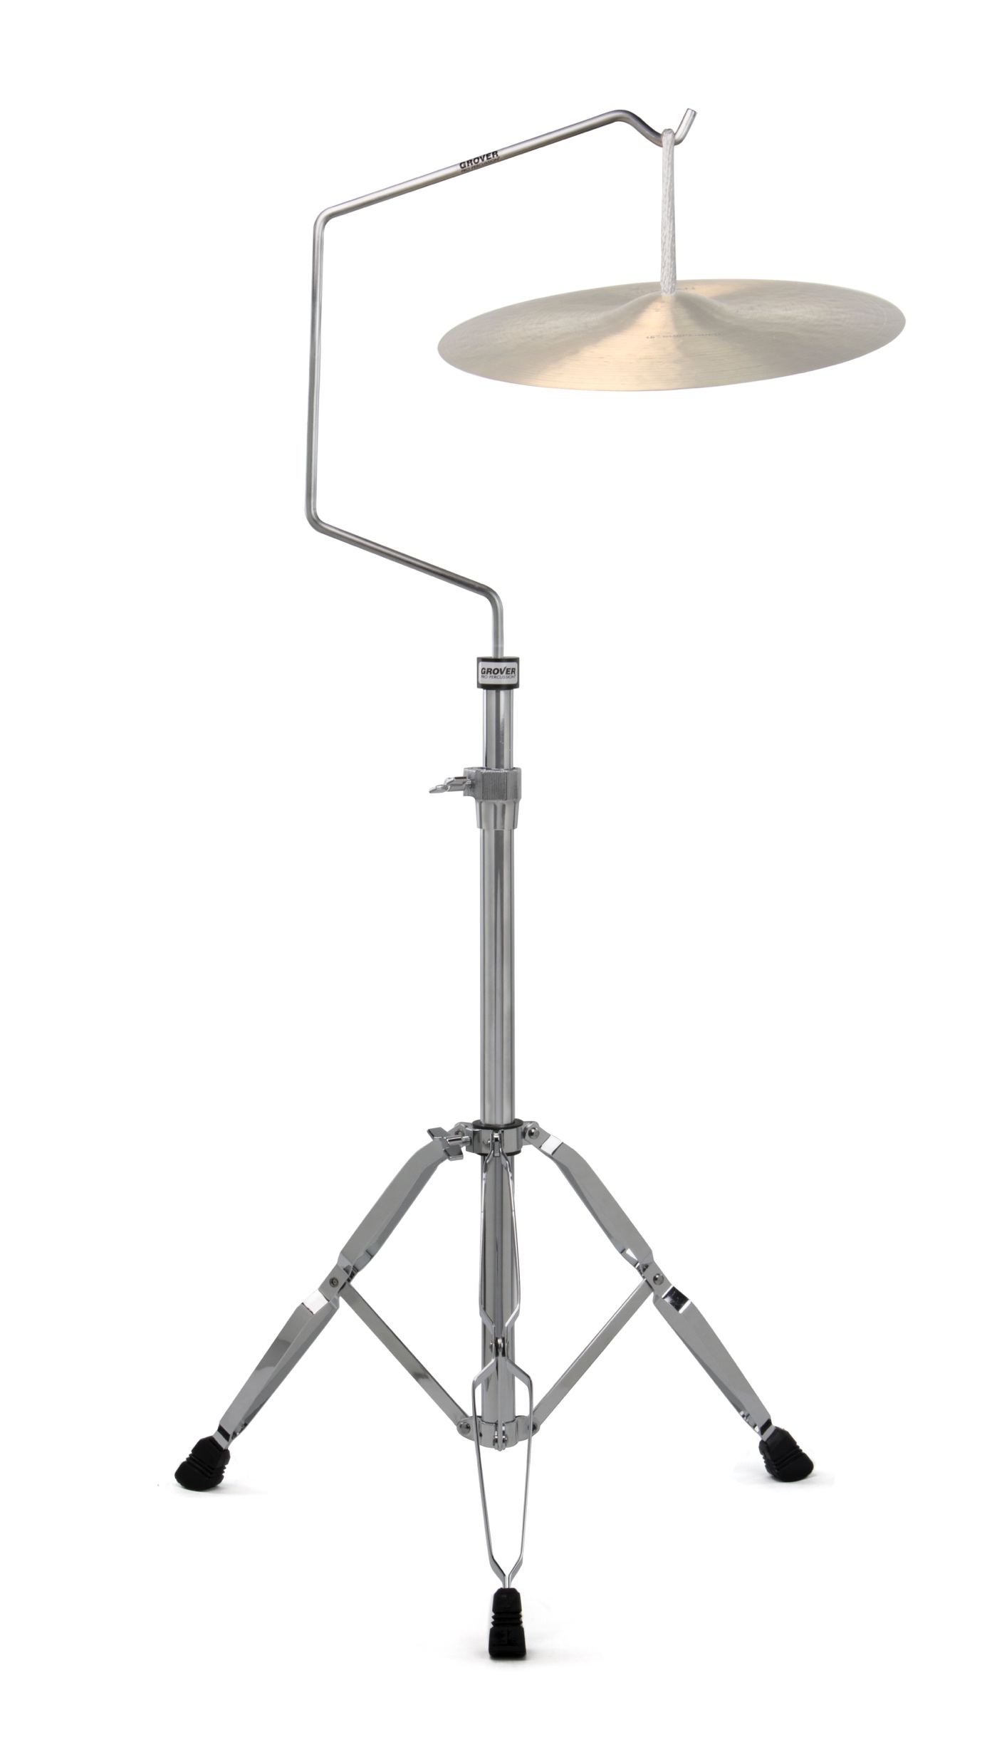
Suspended Cymbal Stand
Cymbal arm and stand package
Designed to allow cymbals to “breathe” while providing a stable, height-adjustable cymbal stand.

Slide 24
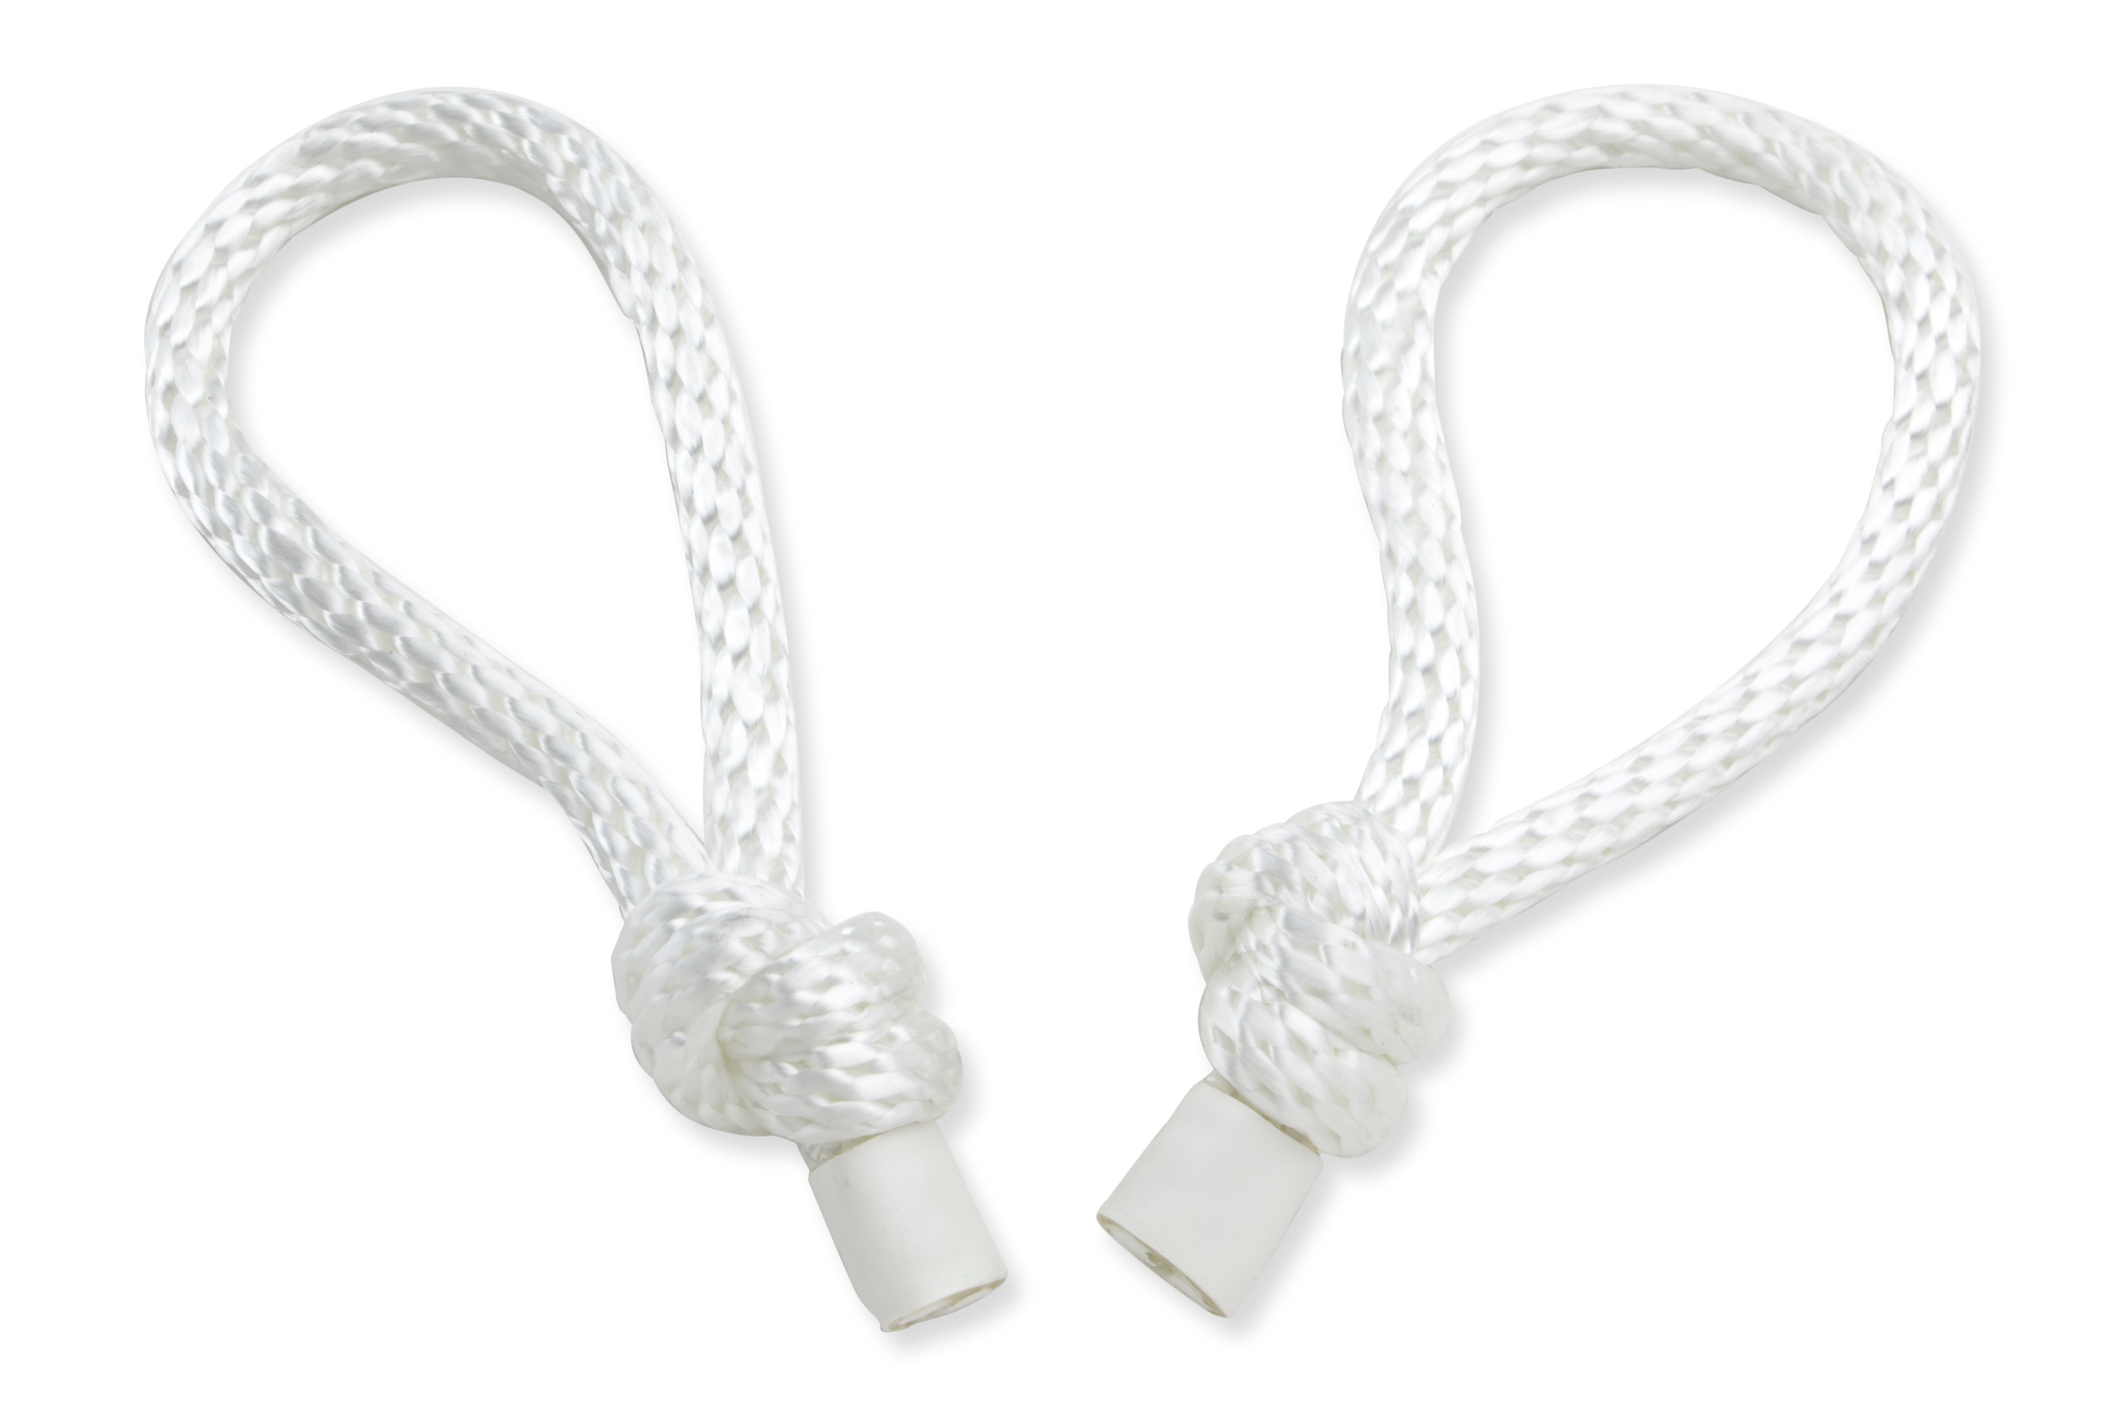
Suspended Cymbal Loops
Freely hang a suspended cymbal on a gooseneck stand
The braided nylon material is durable yet supple enough to allow a suspended cymbal to fully vibrate while being played. A large knot prevents the loop from slipping through the cymbal hole, while providing a support for the cymbal to rest on.

