Slide 1
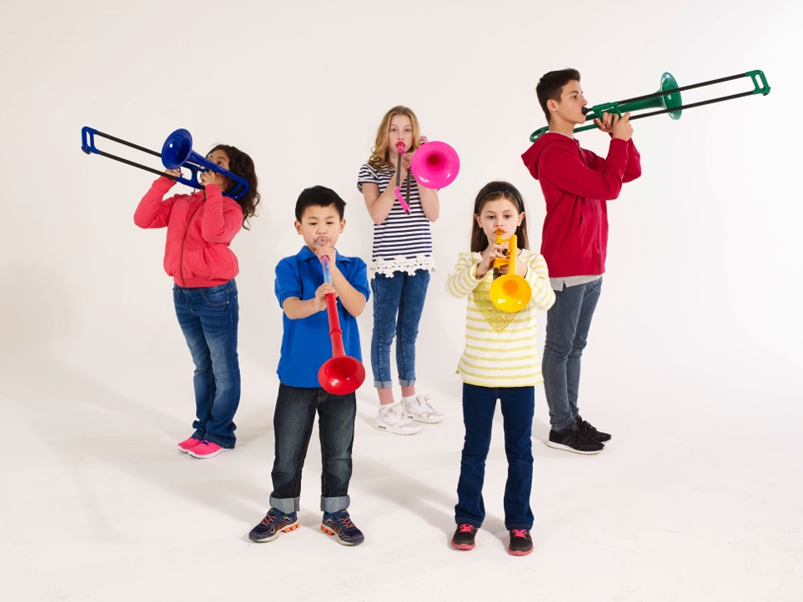
pBuzz l pBone l pTrumpet l just play!
Our Vision
the world’s greatest musicians of the future will start their musical journey with us

Slide 2
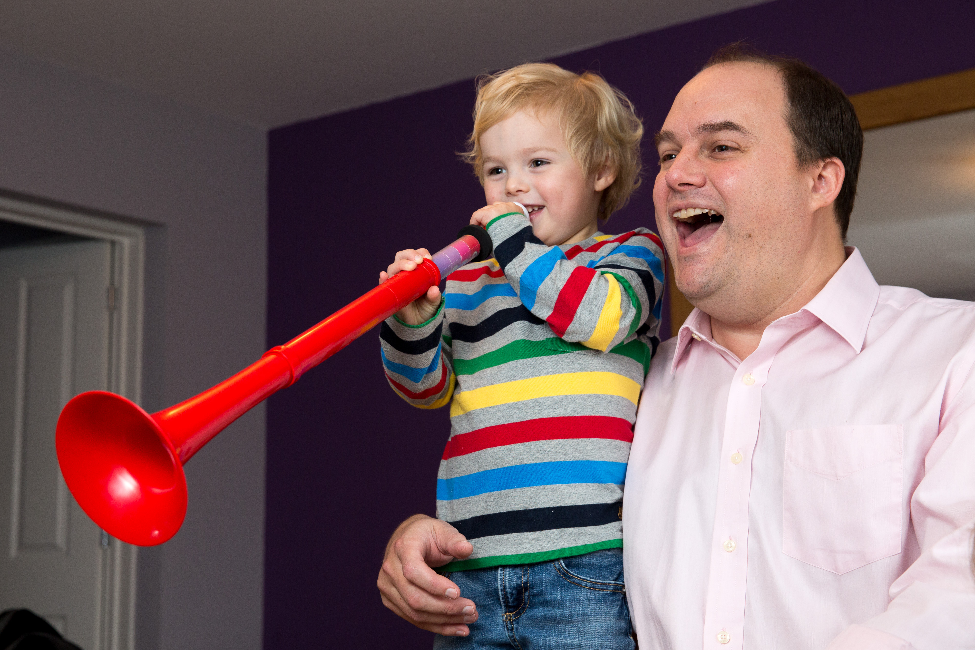
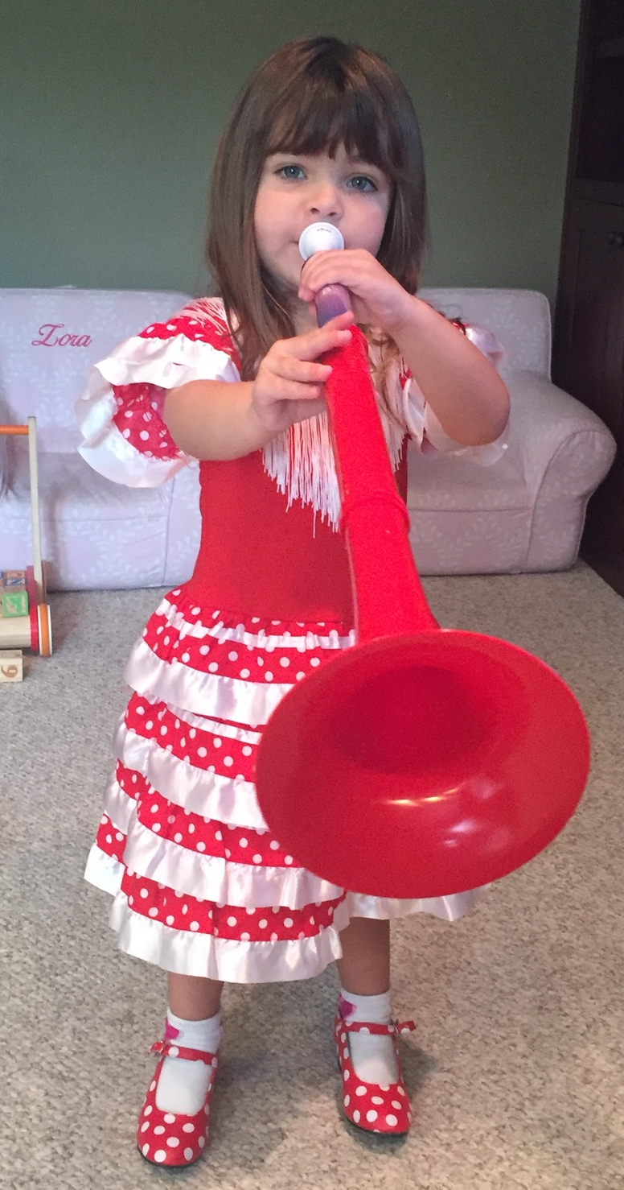


pBuzz -- igniting the growth for Brass Instruments
Framing the Opportunity
Conceived as instrument by Musicians
Endorsed by Educators
Embraced by Parents
Loved by Children

Slide 3
Executive Summary – pBuzz is
Point
By
Point
Complimentary for Band & Orchestra Dealers
Targeted at pre-Band offer for ages 3+
Gateway to build Trombone & Trumpet Players
Award-winning and best-selling products
Industry-leading community engagement and social reach
Designed, developed and manufactured in the UK

Slide 4
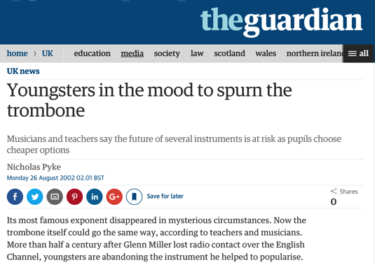
Why plastic instruments began?
Humble
Origins
Trombone officially an “endangered-species” (UK Government)
A generation of musicians was being lost
Plastic offered unique opportunities to make things easier
Notes:
National Foundation for Youth Music, funded by the UK Government, declared the trombone to be an “endangered species”

Slide 5
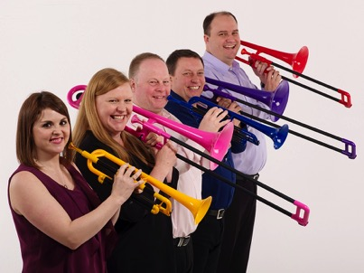
The musicians behind pBone & pTrumpet and now pBuzz
Core
Team
British musicians and parents passionate about music-making
pBone: Designed and developed in the UK from 2007-2010
pTrumpet: Designed and developed in the UK from 2012-2014
pBuzz: Designed, developed and manufactured in the UK 2016
Branislav Zivkovic joins as Chief Commercial Officer & President, North America in 2016

Slide 6
Why are we here?
Aspiration
Great Endorsement as Musical Instrument
Massive potential Toy Product
pBuzz offers unique experience & revenue stream for partners
Bridge and leverage local Elementary & Band Director Relationships
Case Studies, lessons plans and curriculums being developed across the globe by progressive, innovative educators.
Notes:
Bulk discount opportunities
Leads with teachers, school districts

Slide 7
What do we provide in return?
The Offer We Bring
A dedicated and committed team
High volume, high margin product
First-mover advantage on new product innovation
Industry leading quality and service for your customers
A pre Band complimentary instrument to grow the market
1.4m people engaged monthly on social media
Notes:
Bulk discount opportunities
Leads with teachers, school districts

Slide 8
Growing the market for incumbents
Pre Band
Base Growth
pBand ideal for pre-Band
Low cost
Lightweight
Robust
No maintenance
Easy Access
Fun
Band
6^{th+} Grade
pBone / pTrumpet 4th – 6th Grade (12.2m) $159
pBone mini 1st – 3rd Grade (12.3m) $129
pBuzz Pre – K (8.8m) $29
US School Population
Pre-6: 33m
School Brass Sales: 234k units p.a. = 0.8%
pBand: making music fun
Notes:
Bulk discount opportunities
Leads with teachers, school districts

Slide 9
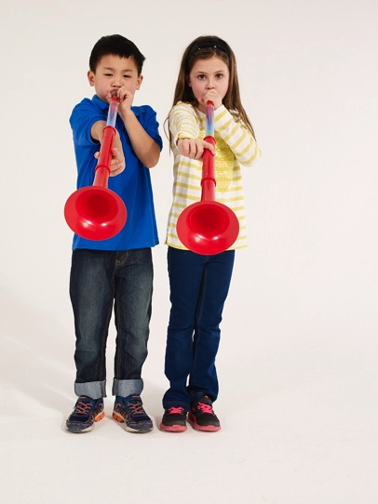
What customers asked for?
Hearing Market Needs
Musical Instrument for 3+ year olds
Discover the joy of music in seconds
Learn to Play in Minutes
Enjoy a lifetime of Music

Slide 10
What we wanted to solve?
White Space
Beginner instruments are often limited to recorder and harmonica, traditional and restrictive choices
Effortless creation of the first sound
Focus on buzzing
Ability to learn and play notes
Design suitable for young children
Increase the number of Musicians and potential of future Brass Players

Slide 11
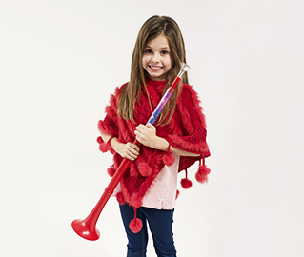
Here is what we gave them
A new Instrument
Accessible instrument
Very tough and robust
Rests effortlessly in your hand – large or small
Maintenance free
Clear hand positions
Patented technology delivers unbeatable sound quality
Industry leading product quality
Low cost
Colorful and fun!

Slide 12
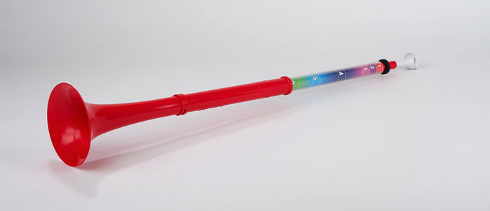
What is pBuzz? ➔ Easy & Fun way to learn Music
Easy
& Simple
A musical instrument:
Introduce buzzing to make a musical sound
Ability to play six notes
Slide the bell towards you to create a high note and away from you to create a low note

Slide 13

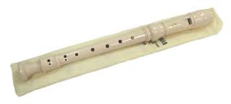
Compared to our competitors?
8:0
Score
1. pBuzz demonstrates the core musical fundamental learning of pitch and length
2. Authentic method of sound production
3. Recorder has complicated fingering to move by one whole tone
4. Unique offer – recorder is very staple and boring
5. Recorder is not engaging in a fun way, vuvuzela is not musical
6. pBuzz can be used in existing Orff lessons (unlike vuvuzela)
7. Little fingers can’t always work a recorder, or cover the finger holes
8. Support all types of learners
Vuvuzela
Plays only “one” “poor sound quality, no mouthpiece, lead pipe or bell flare -- not a specific length for a pitch
Recorder
Increased complexity More difficult to advance Boring limited discovery effect Is not authentic transition to flute/clarinet

Slide 14
pBuzz BREAKS category record: First 4 month in the UK 8,000 units sold, here is what we are learning…
Market
Survey
Key Data Point
Implication
68% purchases are as gifts for children
58% of sales were driven by social media
94% of pBuzz are used every week
81% of buyers would recommend pBuzz to a friend
Messaging needs to focus on parents and/or grand parents
Increase pBuzz awareness/ visibility with digital advertising campaign on social media
Product has longevity of appeal
Create referral opportunities and mechanisms

Slide 15
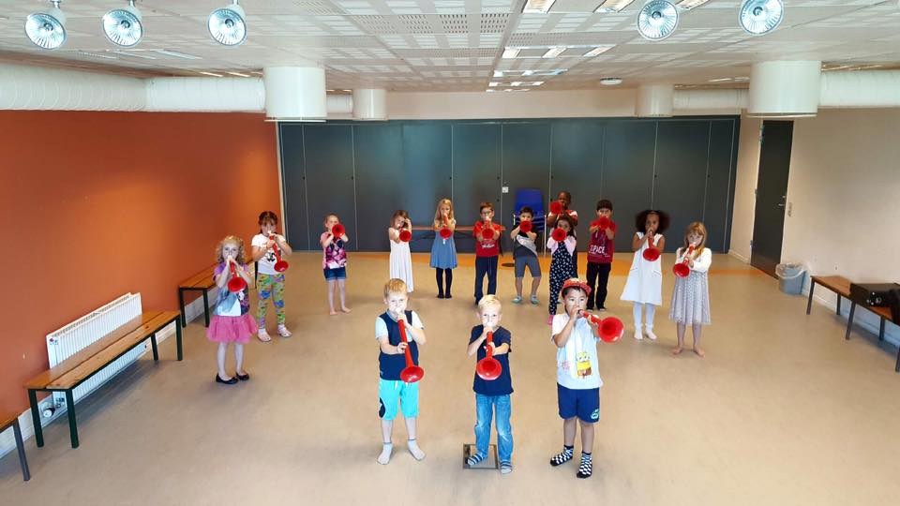
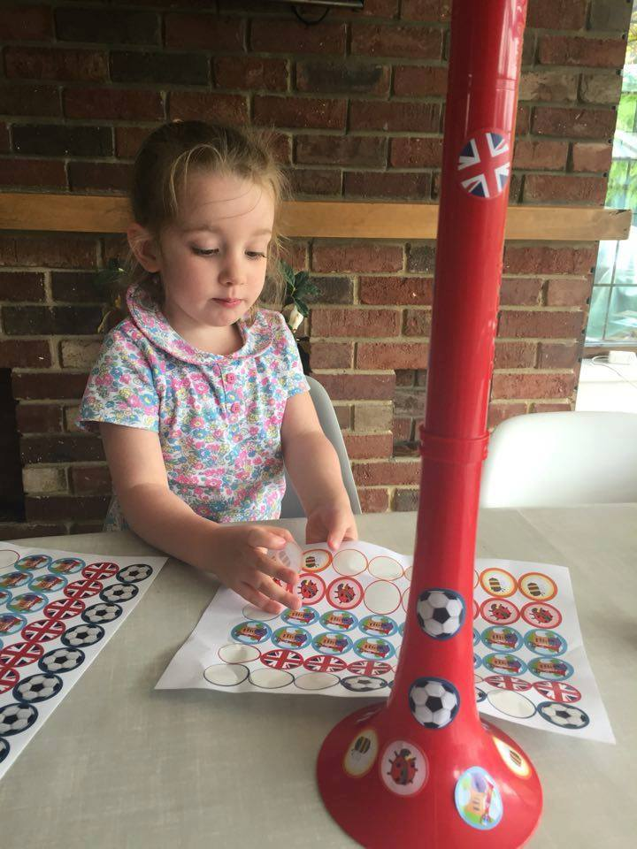
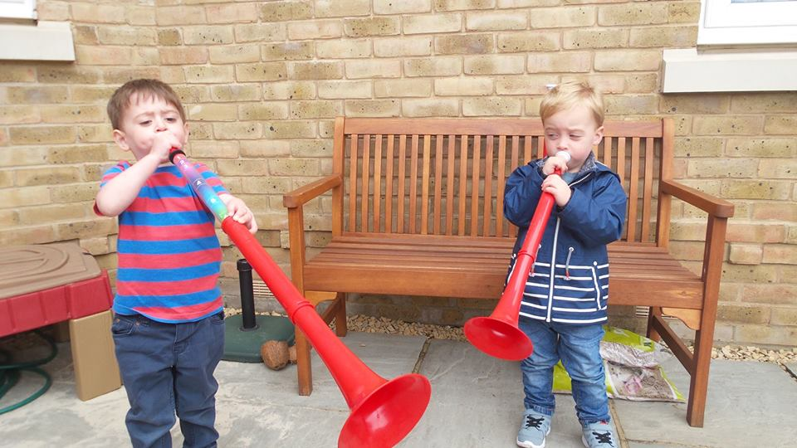
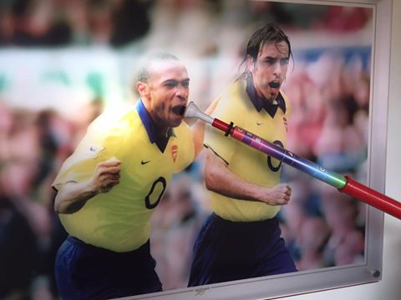
Understanding Motivation
Notes:
Bulk discount opportunities
Leads with teachers, school districts

Slide 16
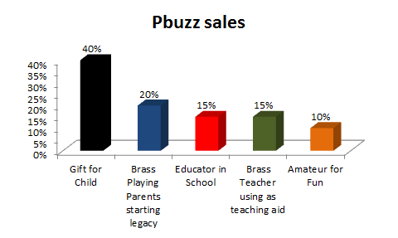
Who is buying ?
Understanding Motivation
Notes:
Bulk discount opportunities
Leads with teachers, school districts

Slide 17
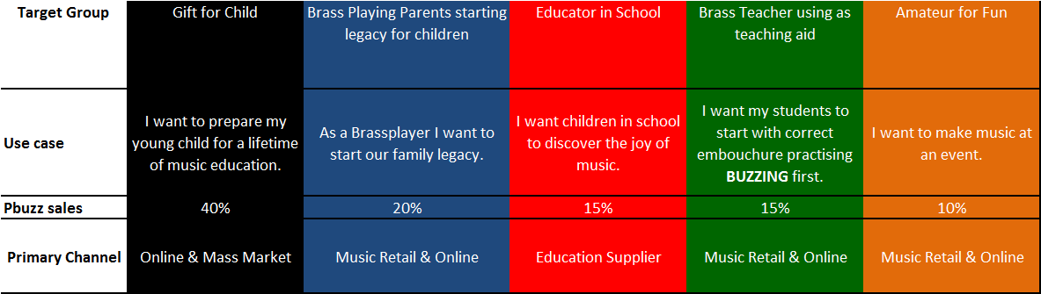
Surprise: pBuzz is used as teaching aid About 15% are Brass Teachers starting Students of 12 years of age with a pBuzz in 3 to 5 introductory embouchure lessons before moving on to a Brass instrument.
Analyzing Data
Target Groups and Channels
Notes:
Bulk discount opportunities
Leads with teachers, school districts

Slide 18
Favorite Quotes when asked: How would you describe pBuzz to a friend?
Top 3
Quotes
“A fun, great quality plastic instrument - ideal for introducing young children to a brass instrument in a bright and appealing way!”
“The perfect starter instrument for encouraging young musicians. A cross between a trumpet and a trombone, made of plastic (so lightweight) and simple to use”
“An easy way to start kids off playing brass instruments-- a rival for recorder as a beginning instrument!”

Slide 19
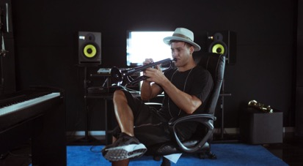
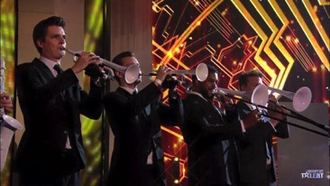
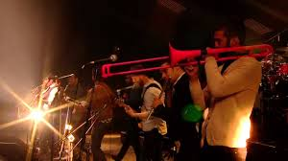
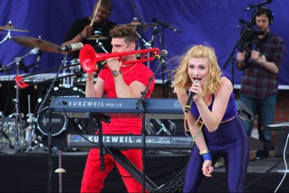
Mass Appeal
Scalable &
Expandable
Timmy Trumpet (DJ) – 757k FB likes, 200m YT views
Britains Got Talent Live Final – 9.7m viewers
Glastonbury 2013, Mumford & Sons
6.2m viewers
Karmin – 1.8m FB Likes, 1.5m YT Subscribers
Notes:
When we started in 2007, as teachers and players we were also our customers - evenso we spent a lot of time talking to friends and colleagues in the music world:
Instruments which are light and easy to hold but also robust – suitable for the classroom environment
A unique and distinctive design which is respective of the heritage of the instrument – don’t copy or replace brass
An affordable alternative that gives opportunity to those that can’t afford a (decent!) brass instrument
Something which is fun to play and can be multi-purpose

Slide 20
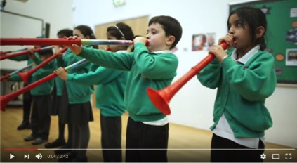

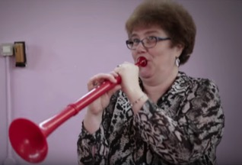
A picture paints a thousand words . . . .
Seeing is
Believing
. . . but a video paints a thousand pictures
What the Children say https://www.youtube.com/watch?v=8FCHUGzhZ6E
Children Funhttps://youtu.be/uyXlmvRP1p8
Educator / Influencer perspective
https://www.youtube.com/watch?v=yNzvlNkz2CM
Notes:
Bulk discount opportunities
Leads with teachers, school districts

Slide 21




Quality in Manufacture
Demanding
Excellence
Since 2011, we have exclusively used automotive suppliers certified to ISO9001 & TS-16949
pBuzz made in UK w automotive supplier- OPS Director monitored.
We have 1 full-time employee based in China focused solely on quality for pBone & pTrumpet.
Notes:
Bulk discount opportunities
Leads with teachers, school districts

Slide 22
Quality in Service
Customers
First
We replace and ship all warranty and non-warranty claims worldwide free of charge from Rhythm Band for the pBuzz USA and the UK for pinstruments.
We do not need to provide any spare parts or servicing support to dealers
Net Promoter Score (customer service) 89%
“Kate was very helpful is shipping out replacement part and keeping me updated along the way, top notch service”
Alain Bourgeois (Jul 2016)
"There was a special needs student this year with a degenerative muscular disease who couldn't hold his metal trumpet due to it's weight, so we were able to get him a 'P-Trumpet' which is a quality trumpet made from light plastic and now he is able to participate fully and loves music!” VH1 Save The Music Foundation (Jun 2016)
“Excellent customer service, efficient, professional & friendly. Top class!!!”
Gemma Proudfoot (Jul 2016)
Notes:
Bulk discount opportunities
Leads with teachers, school districts

Slide 23






Net Promoter Scores
Quantifiable
Measures
 | pBuzz | pBone | pTrumpet
NPS | +81% | +68% | +37%
Amazon.com | NA
Facebook Reach (Jul-16) | 567k

Slide 24
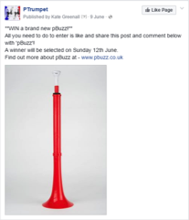

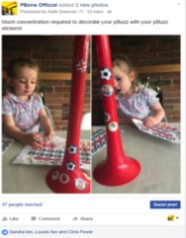
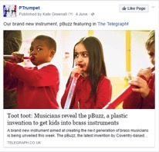
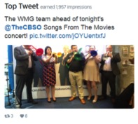
Consumer Reach & Engagement
Building a Community
Key Performance Indicators – June 2016
Social Reach: 144,373 Engagement: 1,454358

Slide 25


Earning our Unique Right to Win
Fit to Win
Passionate and dedicated team who listen, care and deliver
Award-winning, innovative and patent-protected instruments – that fully utilize the USPs of plastic to improve experiences for consumers and educators
Leading quality rates of any supplier to Conn-Selmer
Outstanding customer support based in the UK (NPS>89%)
Educational resources and inspirational content to our community of over 1.4m consumers and educators
Actively collaborate and support our dealers with campaigns
Notes:
We make great instruments – that utilize the benefits of plastic
We don’t copy brass – it is made in a completely different way
As teachers and players ourselves we understand the needs of customers
We offer the best quality rates of any supplier to Conn-Selmer
Our products just work out of the box
We won’t stop working until our customers are completely satisfied
We provide outstanding customer support based in the UK
Exclusively staffed by musicians who understand
80% of our customers would recommend our service to others (Amazon.com 64%, Netflix 54%, Apple 72%)
We offer educational resources and inspirational content to our community of over 80k people and growing daily
We support our brand with global marketing initiatives
We collaborate and support our dealers
we don’t compete with them

Slide 26
Potential Next Steps
Enhance
Category
Rhythm Band Instruments, LLC
www.rbidealer.net
Ashley Walsh
awalsh@rhythmband.com
PH: 800-424-4724 Ext. 119
PH: 817-335-2561 Ext. 119
Ext 119
Amanda Six
asix@rhythmband.com
PH: 800-424-4724 Ext. 108
PH: 817-335-2561 Ext. 108
FA: 800-784-9401
FA: 817-332-5654
Interest in product
Connect with Rhythm Band
Become Market introduction Partner
Develop & service local demand
pBuzz Partner Tool Kit
https://www.dropbox.com/work/pBuzz%20-%20Tool%20Kit

Slide 27
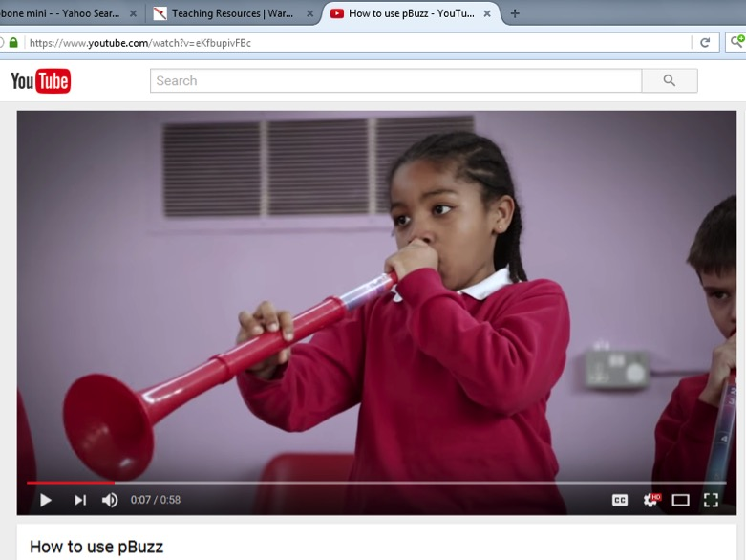
Why pBuzz?
Top
Choice
Unique gateway instrument
Relevant to parents
Endorsed by educators
pBuzz is maintenance free, easy to store and very robust
Outstanding quality
Children are enthused and engaged

Slide 28

pBuzz l pBone l pTrumpet l just play!
Appendix
Notes:
Instruments which are light and easy to hold but also robust – suitable for the classroom environment
A unique and distinctive design which is respective of the heritage of the instrument – don’t copy or replace brass
An affordable alternative that gives opportunity to those that can’t afford a (decent!) brass instrument
Something which is fun to play and can be multi-purpose

Slide 29
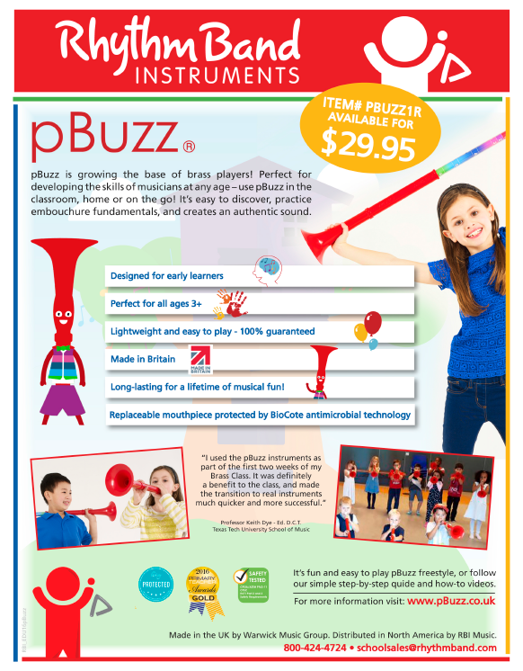
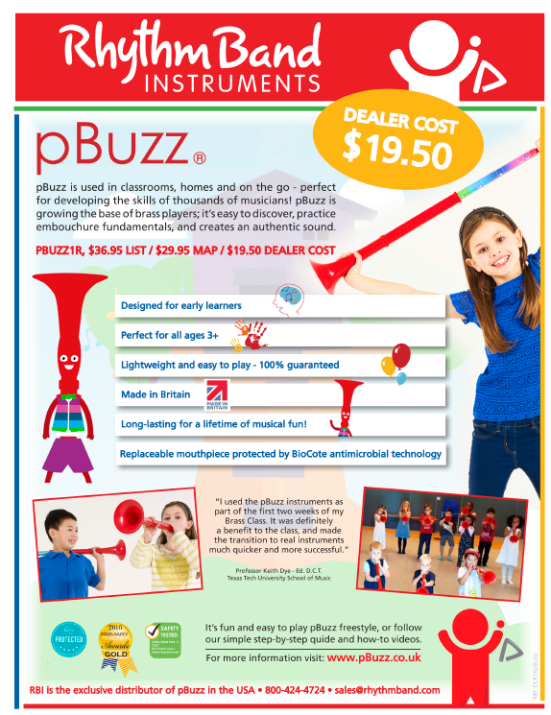
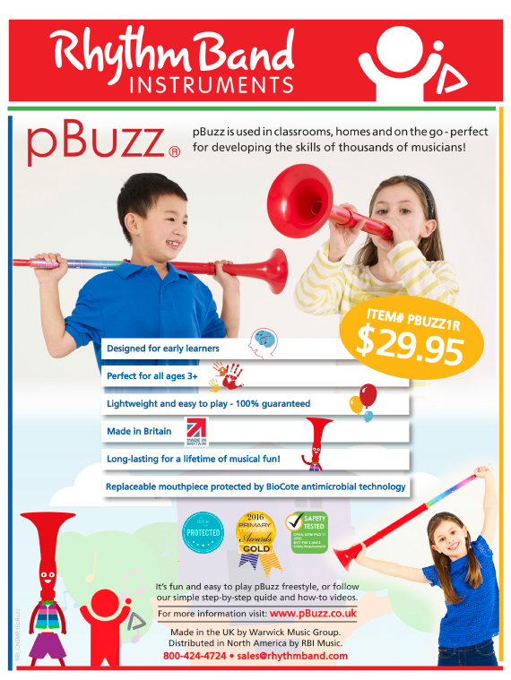
pBuzz – Helping you share the story
Prepared Awareness Builders
pBuzz The Easy And Fun Way To Learn Music
Educator
Channel Partner
Consumer

Slide 30


pBuzz – Available in the USA
Announcing
pBuzz The Easy And Fun Way To Learn Music

Slide 31

pBuzz – Available in the USA
Announcing
pBuzz The Easy And Fun Way To Learn Music
Your Logo here

Slide 32
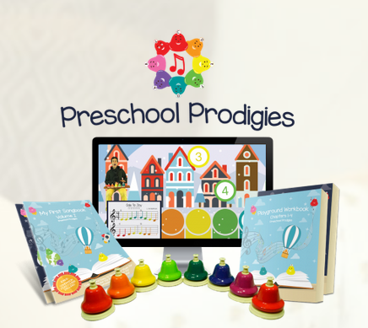
pBuzz – Available in the USA https://shop.preschoolprodigies.com/product/pbuzz/
Announcing
pBuzz The Easy And Fun Way To Learn Music

Slide 33


pBuzz – ORFF Schulwerk
Announcing
Please visit us at American Orff-Schulwerk Association – Rhythm Band & pBuzz Stand 321
This years Professional Development conference is held Nov. 2 to 5th in Atlantic City, NJ.
We are excited to announce that pBuzz, the award-winning pre-brass instrument for beginner musicians, has reached US shores, and will be available for trial at this years Professional Development Conference , Nov 2 to 5th proudly represented by Rhythm Band Instruments on Stand 321. Please look for Kendall Spooner !
pBuzz is the first instrument of its kind, the perfect first-time instrument made specifically for young children. pBuzz is manufactured in the UK where its successful launch resulted in record sales for a new instrument. It was awarded Gold in the Primary Teacher Awards 2016.
pBuzz will be distributed by Rhythm Band Instruments in North America
To find out more, check out pBuzz on our website and YouTube channel.

Slide 34
pBuzz - – Available in the USA
Announcing
pBuzz The Easy And Fun Way To Learn Music

Slide 35
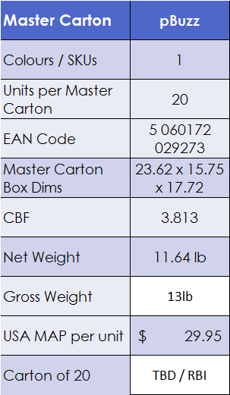
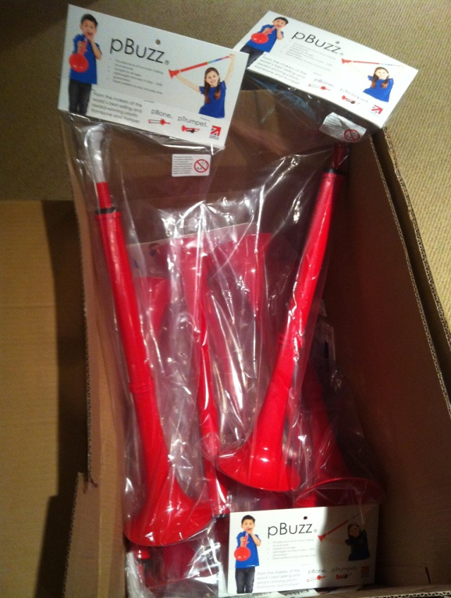

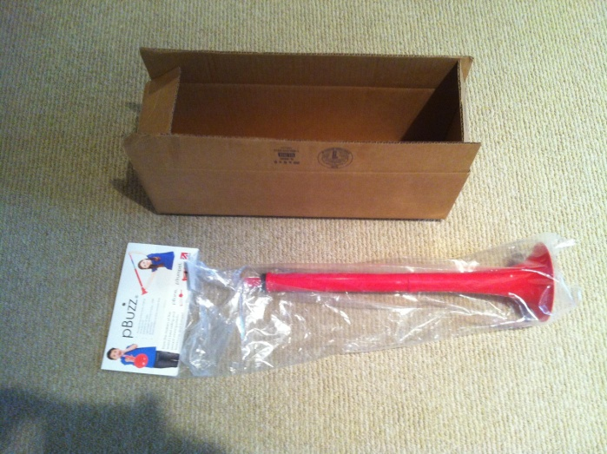
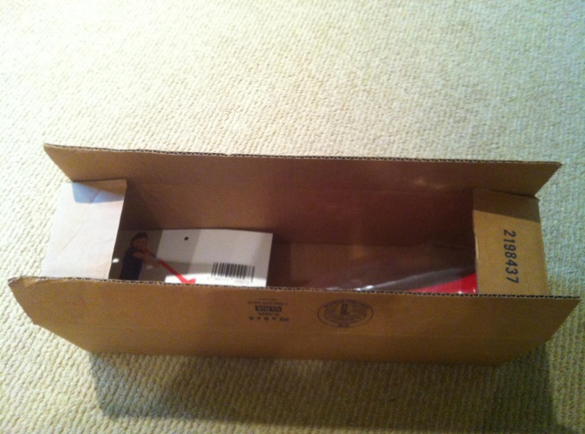
Product Specifications
Details
Dims & Weights

Slide 36
pBuzz campaigns
Grassroots
Momentum
General awareness
Mumsnet
Derek Klingenberg
Educational
Global classroom competition
Event-Mass oriented
“Birmingham Soccer team”
“Green Bay Packers”
“New Orleans Saints”
2017 Super Bowl ?
“Goal Russia 2018” !
Birthday & Gift Seasons:
Christmas
Halloween
My 3rd Birthday Present Campaign
Or My 4th or 5th…l

Slide 37
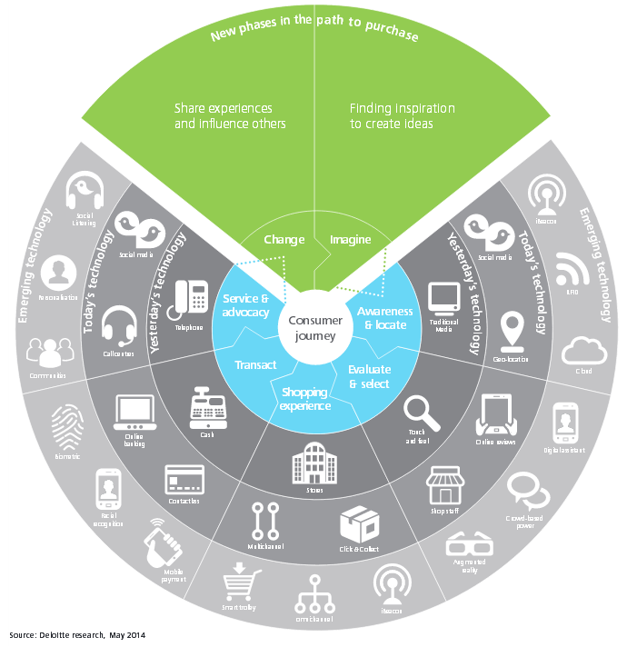
The Path to Purchase is changing
Impactful Trends

Slide 38
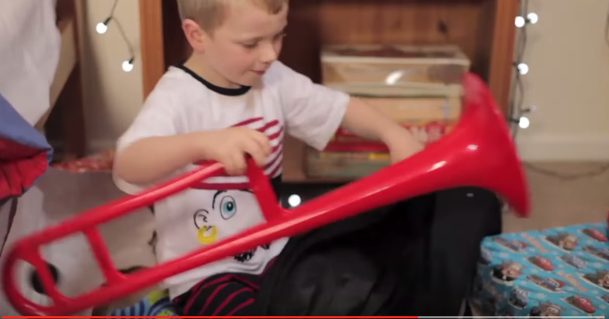
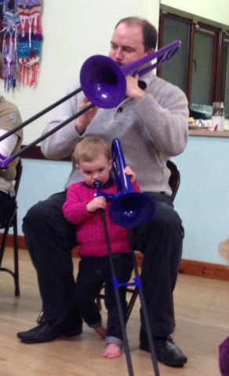

Emotional Connections Build lasting Memories
Communication Campaigns
#1
Give the Gift
of Music
#2
#3
How I started Trombone or Trumpet ?
Start your
own Legacy

Slide 39



Introducing a fun, new musical instrument
New
Audience &
Language
Designed for early Learners
Research shows youngsters who have exposure to musical
Instruments develop areas of the brain that relate social,
language and reasoning skills, as well as memory.
Source: http://www.nafme.org/20-important-benefits-of-music-in-our-schools/
Made in Britain
From the British makers of the award winning and best selling pBone, mini pBone, and ptrumpet, the brightly-coloured, lightweight pBuzz is a fun, easy introduction into brass playing.
Mini Musicians
The brightly colored pBuzz has been specially designed for mini musicians’ little hands – making it easy and fun to hit the right note every time.

Slide 40



Designed by Mums for Moms
Icons,
Tone &
Voice
Perfect for all ages (3+)
Perfect for all ages the light and smooth curved edged pBuzz makes a great first purchase for mini Musicians.
Long-lasting for lifetime of musical Fun
Mum and Dad will love our patented hard wearing design.
Hygienic Bio-cote mouthpiece
The pBuzz mouthpiece is made with BioCote, a market leading antimicrobial technology for ultimate protection against microbes, such as bacteria and mould.

Slide 41





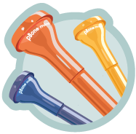
Graphic Representation
Conveying Messages
5 inch Bell
Light weight
Pitched between
pBone & ptrumpet
Easy to play slide
Hygienic Bio-cote
antimicrobial
mouthpiece
Durable

Slide 42
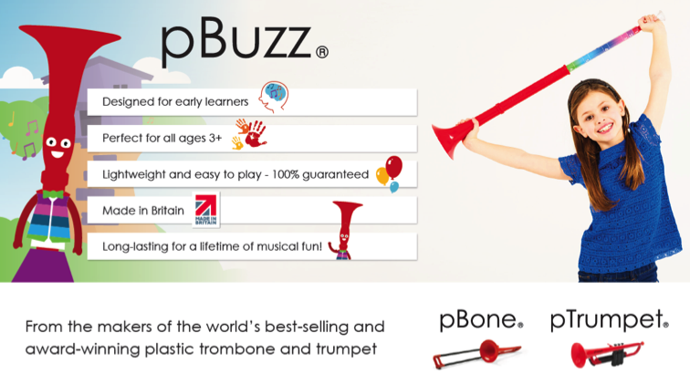
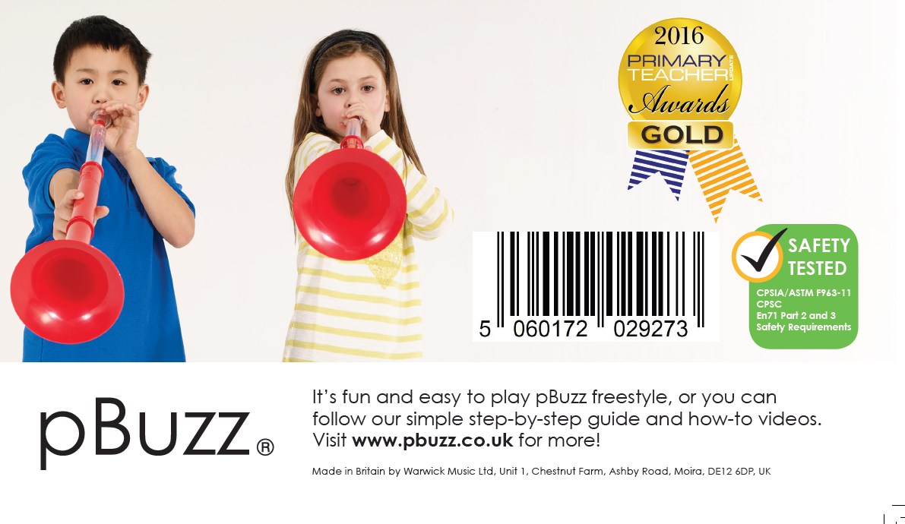
Product Cards
Unique Right to Win
Who am I?
What am I?
What can only I do for you?

Slide 43
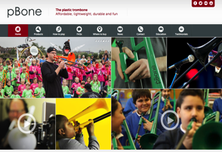
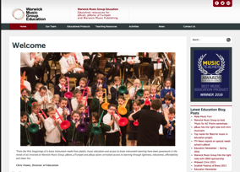
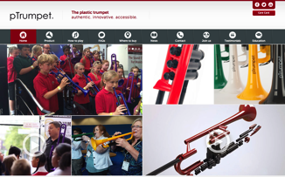
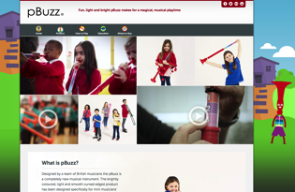
Websites
Digital
Presence
pbone.co.uk
education.warwickmusicgroup.com
ptrumpet.com
pbuzz.co.uk

Slide 44
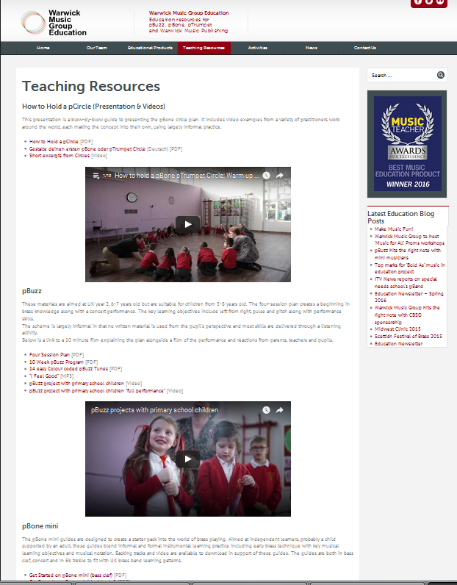
Supporting teachers with a dedicated education portal
Influencer
Backing
http://education.warwickmusicgroup.com/teaching-resources/
News, Education resources,
testimonials, endorsements
How to guide
Personalized expert support

Slide 45
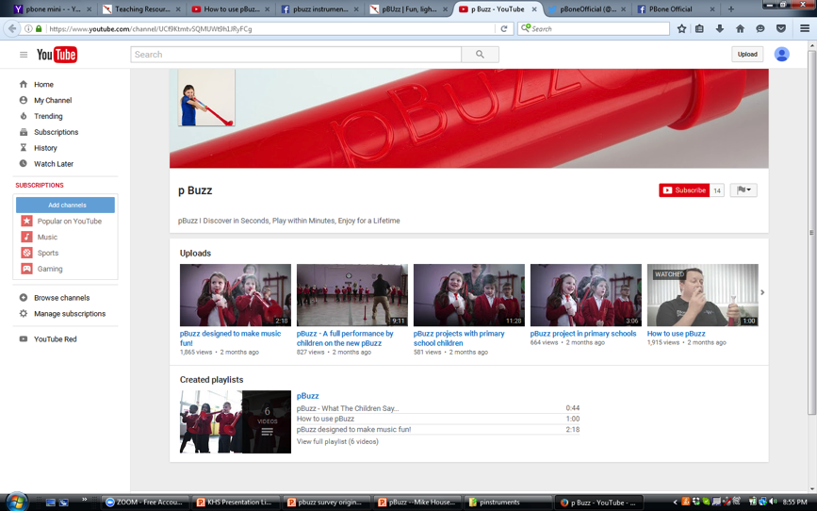
Please contact, engage and join the journey
Consumer
takeover
Web: http://www.pbuzz.co.uk
New FB: https://www.facebook.com/pBuzz-1725213057738246/about/
Facebook: https://www.facebook.com/thepTrumpet
Twitter: https://twitter.com/thepTrumpet

Slide 46







Music Industry Partners
Network

Slide 47


How would you describe pBuzz to a friend?
Some
Quotes
The perfect starter instrument for a encouraging young musicians. A cross between a trumpet and a trombone, made of plastic (so lightweight) and simple to use
A first step for someone who wants to play a brass instrument
A musical instrument that sounds good even though it's only the price of a toy
A fantastic introduction to brass playing with a limited range of notes in a very easy to play format. So easy to play and change the notes and very light for young children to hold
An introductory brass instrument for young children with features in common with a trombone. It has a mouthpiece the same size as a baritone horn/narrow bore trombone, has 8 notes available on a single harmonic and is fun to play

Slide 48

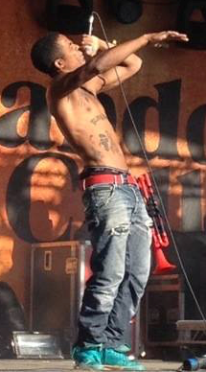
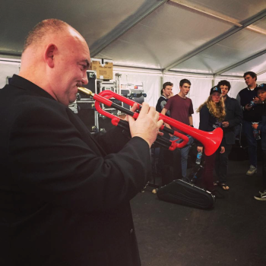
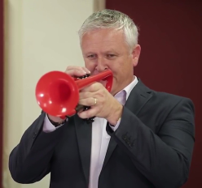
Used by professionals . . .
Legitimized
& Endorsed

Slide 49
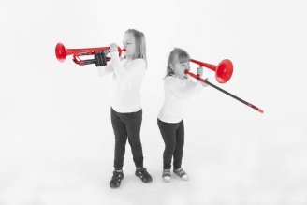


. . . and future professionals
Advancing
pre Band Base

Slide 50






Creating Life Changing Experiences
Origins of Expressions
Notes:
When we started in 2007, as teachers and players we were also our customers - evenso we spent a lot of time talking to friends and colleagues in the music world:
Instruments which are light and easy to hold but also robust – suitable for the classroom environment
A unique and distinctive design which is respective of the heritage of the instrument – don’t copy or replace brass
An affordable alternative that gives opportunity to those that can’t afford a (decent!) brass instrument
Something which is fun to play and can be multi-purpose

Slide 51




Nurturing the next generation
Caring
Journey
Notes:
When we started in 2007, as teachers and players we were also our customers - evenso we spent a lot of time talking to friends and colleagues in the music world:
Instruments which are light and easy to hold but also robust – suitable for the classroom environment
A unique and distinctive design which is respective of the heritage of the instrument – don’t copy or replace brass
An affordable alternative that gives opportunity to those that can’t afford a (decent!) brass instrument
Something which is fun to play and can be multi-purpose

Slide 52





Making Music Fun
Play &
Pleasure
Notes:
When we started in 2007, as teachers and players we were also our customers - evenso we spent a lot of time talking to friends and colleagues in the music world:
Instruments which are light and easy to hold but also robust – suitable for the classroom environment
A unique and distinctive design which is respective of the heritage of the instrument – don’t copy or replace brass
An affordable alternative that gives opportunity to those that can’t afford a (decent!) brass instrument
Something which is fun to play and can be multi-purpose

